Slide 1
Variability Modeling in Clafer Using SMT
Ed Zulkoski

Slide 2
Specification
Models
App__0
appCost__0 = 2.99
Phone__0
instApp__0 -> App__0
cost__0 = 52.98
App *
appCost : real
[appCost >= 0]
Phone 1
instApp -> App *
cost : real
[cost = 49.99 + sum(instApp.appCost)]
App__0
appCost__0 = 2.99
App__1
appCost__1 = 0.99
Phone__0
instApp__0 -> App__0
instApp__1 -> App__1
cost__0 = 53.97
…

Slide 3
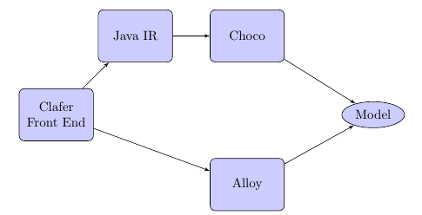
Clafer Architecture

Slide 4
Motivation
The expressive power of Clafer is limited by its backend solver.
Real Number Constraints
Percentages/Currency/Degrees/Ratios
String Constraints
Sanitizers/Program Constraints (PHP Scripts)
Unbounded Integers
Z3 is a well-established, fast SMT solver, capable of addressing these restrictions.
Notes:
ECos

Slide 5
Goal
Produce a full translation of Clafer to Z3, which addresses some restrictions imposed by other backends.

Slide 6
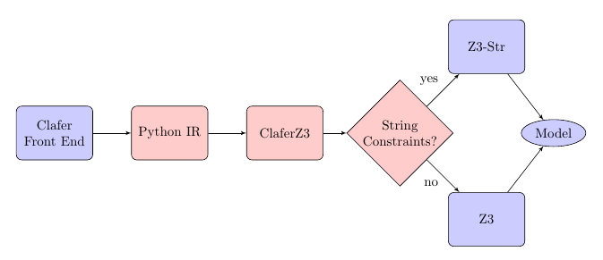
ClaferZ3 Architecture

Slide 7
Clafer Representation in Z3
A clafer is represented as a finite list of integers.
Constraints in the Clafer specification are translated to Z3 by constraining these variables.
Solutions from Z3 are mapped back to a Clafer model.

Slide 8
Conversion to Z3
Specification
Z3 Variables
App *
appCost : real
[appCost >= 0]
Phone 1
instApp -> App *
cost : real 1
[cost = 49.99 + sum(instApp.appCost)]
//int variables
[App__0, App__1]
[appCost__0, appCost__1]
//real variables
[appCost_ref_0, appCost_ref_1]
//int variables
[Phone__0]
[instApp__0, instApp__1]
[instApp_ref_0, instApp_ref_1]
[cost__0]
//real variables
[cost_ref_0]
Scope = 2

Slide 9
Mapping of Z3 Output to Clafer Model
Values of variables used to construct the hierarchy in the outputted model.
Specification
Z3 Output
App *
appCost : real
[appCost >= 0]
Phone 1
instApp -> App *
cost : real 1
[cost = 49.99 + sum(instApp.appCost)]
//int variables
[App__0 = 0, App__1 = 1]
[appCost__0 = 0, appCost__1 = 2]
//real variables
[appCost_ref_0 = 2.99, appCost_ref_1 = 0]
//int variables
[Phone__0 = 0]
[instApp__0 = 0, instApp__1 = 1]
[instApp_ref_0 = 0, instApp_ref_1 = 2]
[cost__0 = 0]
//real variables
[cost_ref_0 = 52.98]
Resulting Model
App__0
appCost__0 = 2.99
Phone__0
instApp__0 -> App__0
cost__0 = 52.98

Slide 10
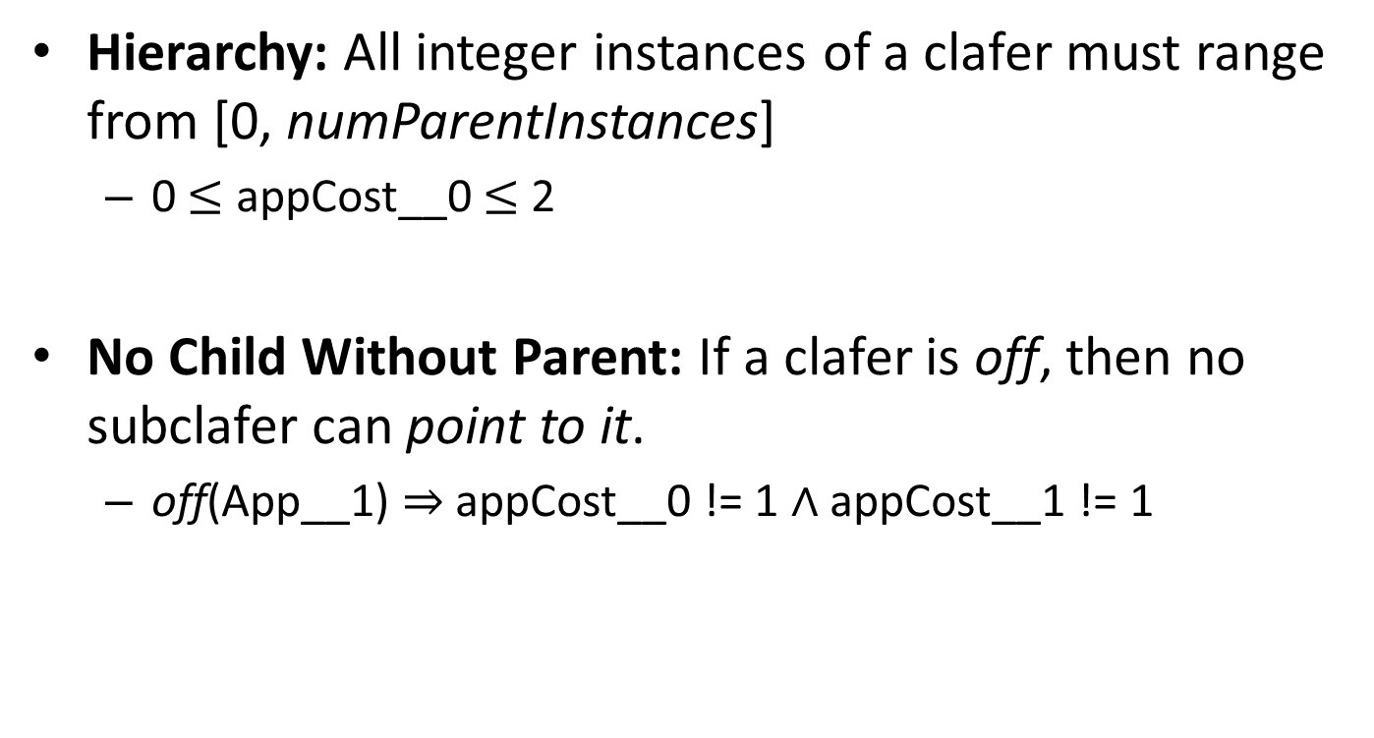
Example Constraints
Hierarchy: All integer instances of a clafer must range from [0, numParentInstances]
0 $≤$ appCost__0 $≤$ 2
No Child Without Parent: If a clafer is off, then no subclafer can point to it.
off(App__1) ⇒ appCost__0 != 1 ∧ appCost__1 != 1

Slide 11
Other Constraints
Arithmetic
Translates naturally
Set Constraints
Join, Union, Intersection, Cardinality, etc.
Quantified Expressions
ForAll, Exists, None, One, Some

Slide 12
String Constraints
Use Z3-Str: an extension of Z3 with support for substring, length, concat, etc. of strings.
Problem: Z3Py API does not support strings.
Need a basic purification of string expressions.

Slide 13
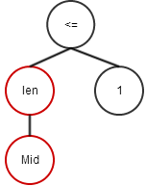
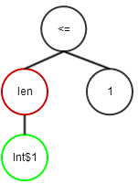
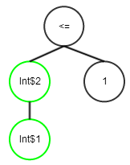
Converting to Z3-Str Format
Name
First : string
Last : string
Mid : string
[len(Mid) <= 1]
Full: string
[Full = First + Mid + Last]
Fresh Int Variables
Int$1 == Mid
Int$2 == len(Int$1)
----------------------------
Int$3 = Full
…
Int$8 = Int$6 + Int$7
(assert (<= (Length Mid) 1))

Slide 14
Evaluation
Evaluated various models from literature.
Audi Car Configurator from TVL-to-SMT paper.
PHP Script Example from Z3-Str Paper.
Clafer test-suite.
Low solving time for all models (< 0.5 sec)
Translation currently takes longer.

Slide 15
Future Work
Address scope restrictions (e.g. App *)
Utilize other constructs available in Z3 (functions, datatypes)
Evaluate larger models.
Investigate complexity of Clafer models.
What makes a Clafer specification hard?

Slide 16
Conclusions
Developed a full translation of Clafer to Z3.
Capable of handling new types of constraints:
Real Numbers
String Constraints
Unbounded Integers
Sufficiently expressive for many domains.

Slide 17
Converting to Z3-Str Format
(assert (<= (Length Mid) 1))
Fresh Int Variables
Int$1 == Mid
Int$2 == len(Int$1)

