Slide 1
Variability Modeling in Clafer Using SMT
Ed Zulkoski

Slide 2
Specification
Models
App__0
appCost__0 = 2.99
Phone__0
instApp__0 -> App__0
cost__0 = 52.98
App *
appCost -> real
[appCost >= 0]
Phone 1
instApp -> App *
cost : real
[cost = 49.99 + sum(instApp.appCost)]
App__0
appCost__0 = 2.99
App__1
appCost__1 = 0.99
Phone__0
instApp__0 -> App__0
instApp__1 -> App__1
cost__0 = 53.97
…

Slide 3
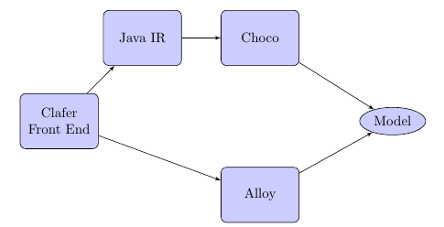
Clafer Architecture

Slide 4
Motivation
The expressive power of Clafer is limited by its backend solver.
Real Number Constraints
Percentages/Currency/Degrees/Ratios
String Constraints
Sanitizers/Program Constraints (PHP Scripts)
Unbounded Integers
Z3 is a well-established, fast SMT solver, capable of addressing these restrictions.
Notes:
ECos

Slide 5
Goal
Produce a full translation of Clafer to Z3, which addresses some restrictions imposed by other backends.

Slide 6
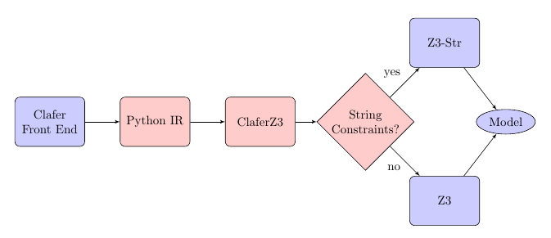
ClaferZ3 Architecture

Slide 7
Clafer Representation in Z3
A clafer is represented as a finite list of integer variables.
Each variable corresponds to a potential clafer instance in the model.
Constraints in the Clafer specification are translated to Z3 by constraining these variables.
Solutions from Z3 are mapped back to a Clafer model.

Slide 8
Conversion to Z3
Specification
Z3 Variables
App *
appCost -> real
[appCost >= 0]
Phone 1
instApp -> App *
cost : real 1
[cost = 49.99 + sum(instApp.appCost)]
//int variables
[App__0, App__1]
[appCost__0, appCost__1]
//real variables
[appCost_ref_0, appCost_ref_1]
//int variables
[Phone__0]
[instApp__0, instApp__1]
[instApp_ref_0, instApp_ref_1]
[cost__0]
//real variables
[cost_ref_0]
Scope = 2

Slide 9
Interpreting Z3 Output as a Clafer Model
Values of variables used to construct the hierarchy in the outputted model.
Specification
Z3 Output
App *
appCost -> real
[appCost >= 0]
Phone 1
instApp -> App *
cost : real 1
[cost = 49.99 + sum(instApp.appCost)]
Predefined ints: on, off
//int variables
[App__0 = on, App__1 = on]
[appCost__0 = 0, appCost__1 = 1]
//real variables
[appCost_ref_0 = 2.99, appCost_ref_1 =0.99]
//int variables
[Phone__0 = on]
[instApp__0 = 0, instApp__1 = off]
[instApp_ref_0 = 1, instApp_ref_1 = off]
[cost__0 = 0]
//real variables
[cost_ref_0 = 50.98]
Resulting Model
App__0
appCost__0 = 2.99
App__1
appCost__1 = 0.99
Phone__0
instApp__0 -> App__1
cost__0 = 50.98

Slide 10
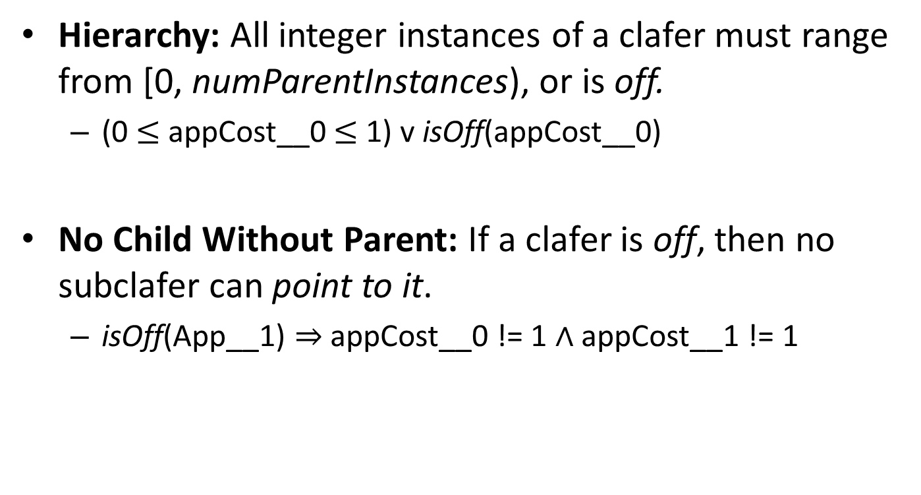
Example Constraints
Hierarchy: All integer instances of a clafer must range from [0, numParentInstances), or is off.
(0 $≤$ appCost__0 $≤$ 1) v isOff(appCost__0)
No Child Without Parent: If a clafer is off, then no subclafer can point to it.
isOff(App__1) ⇒ appCost__0 != 1 ∧ appCost__1 != 1

Slide 11
Constraints
Hierarchy – “No child can exist without its parent.”
Cardinality Constraints
Arithmetic
Translates naturally
Set Constraints
Join, Union, Intersection, Cardinality, etc.
Quantified Expressions
ForAll, Exists, None, One, Some

Slide 12
String Constraints
Use Z3-Str: an extension of Z3 with support for substring, length, concat, etc. of strings.
Problem: Z3Py API does not support strings.
Need a basic purification of string expressions.

Slide 13
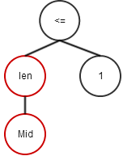
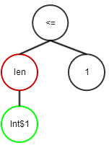
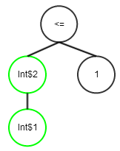
Converting to Z3-Str Format
Name
First : string
Last : string
Mid : string
[len(Mid) <= 1]
Fresh Int Variables
Int$1 == Mid
Int$2 == len(Int$1)
(assert (<= (Length Mid) 1))

Slide 14
Evaluation
Evaluated various models from literature.
Audi Car Configurator from TVL-to-SMT paper.
PHP Script Example from Z3-Str Paper.
Clafer test-suite.
Low solving time for all models (< 0.5 sec)
Translation currently takes longer.

Slide 15
Future Work
Address scope restrictions (e.g. App *)
Utilize other constructs available in Z3 (functions, datatypes)
Evaluate larger models.
Investigate complexity of Clafer models.
What makes a Clafer specification hard?

Slide 16
Conclusions
Developed a full translation of Clafer to Z3.
Capable of handling new types of constraints:
Real Numbers
String Constraints
Unbounded Integers
Sufficiently expressive for many domains.

Slide 17
Converting to Z3-Str Format
(assert (<= (Length Mid) 1))
Fresh Int Variables
Int$1 == Mid
Int$2 == len(Int$1)

