Slide 1
Menu Analysis
Angeles Ramirez
Ghassan Seba
Jonah Brennan

Slide 2
During the course of our research, we looked into Menu Design Shop’s (MDS) e-commerce platform, Shopify.com, analytics as well as information tracked through Google Analytics. We began to notice a specific pattern with regard to search queries. It seemed as though the vast majority of search queries Menu Design Shop appeared in, which resulted in a click to their website, were deliberate. What we mean by this is that the search queries entered indicated the searcher was aware of MDS specifically or were aware of a product/designer that was exclusive to MDS and is not sold elsewhere.
Notes:
Ghassan

Slide 3
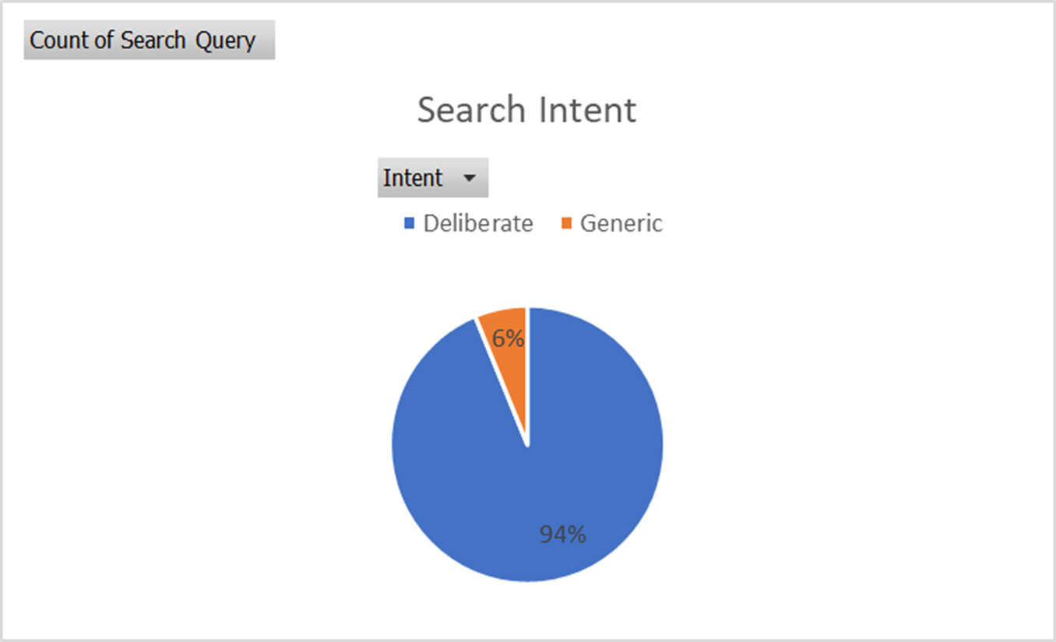
Proportion of search queries that were deliberate vs those that were more generic.
Notes:
Ghassan

Slide 4
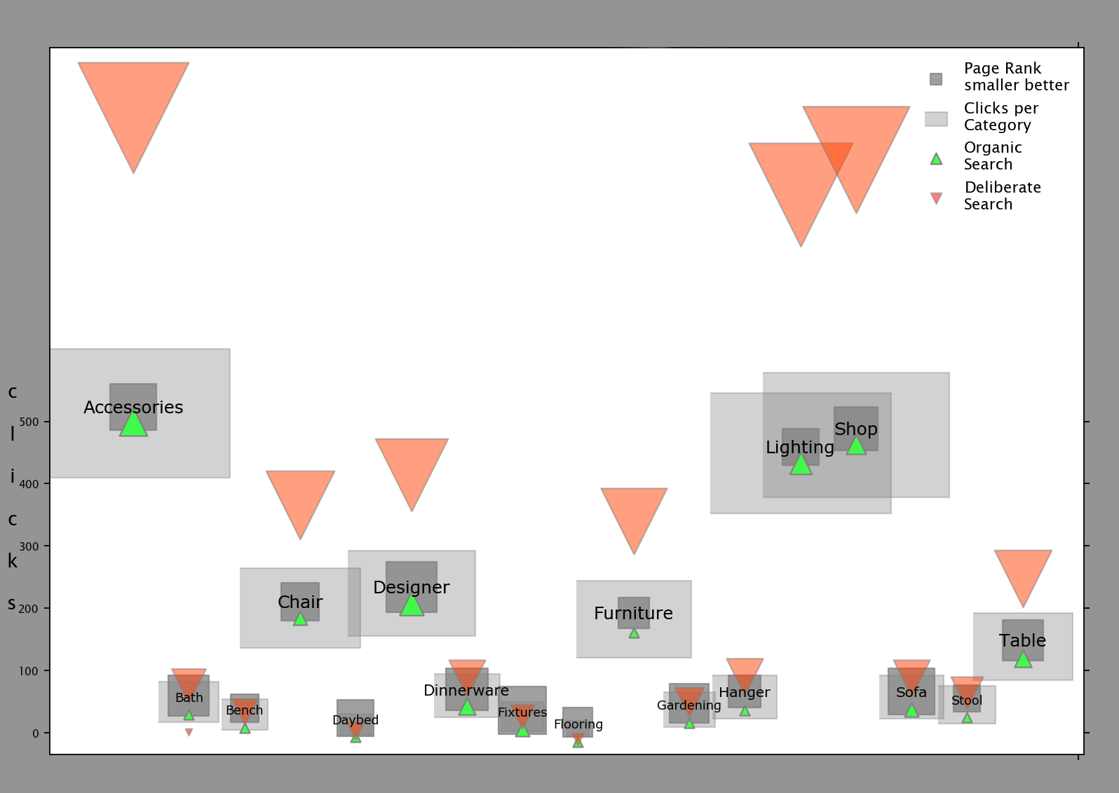
top searches by category
Notes:
Jonah

Slide 5
Hypothesis: If the majority of current search queries are completed by customers that are aware of Menu Design Shop and its product line, then new customers are not organically finding MSD through search engines. Null Hypothesis: If the majority of current search queries are not completed by customers that are aware of Menu Design Shop and its product line, then new customers are organically finding MSD through search engines. P-Value is 3.9855351096551076e-13
1. Market Segmentation: What is our demographic?
2. What variables/factors are associated with e-commerce conversions?
3. What proportion of traffic that comes from organic searches are from users that already know the brand and what proportion comes from generic searches?
Notes:
Ghassan
Briefly describe why we asked these questions, and explain how we decided on our hypothesis.
Q1: We wanted to get more details on who is visiting MDS, who visits the site and leaves (bounce rate), and who actually makes a purchase
Q2: E-commerce conversion occurs when someone goes from being a visitor to a customer, so we wanted to if there were any trends between how visitors got to MDS and if they actually made a purchase.
Q3: After looking at the search queries visitors made prior to reaching MDS, in Google Analytics, we noticed that the majority were related to MDS one way or another. So, we decided to dig deeper and look into what visitors were searching for. We also wanted to see if SEO contributed to organic traffic.
Side Note:
MDS changed their e-commerce platform to Shopify about 2 months ago, so visitors are landing on redirected pages to the new store, so we wanted to see if that has had an impact on the bounce rate, pages per session, and actual e-commerce conversions.

Slide 6
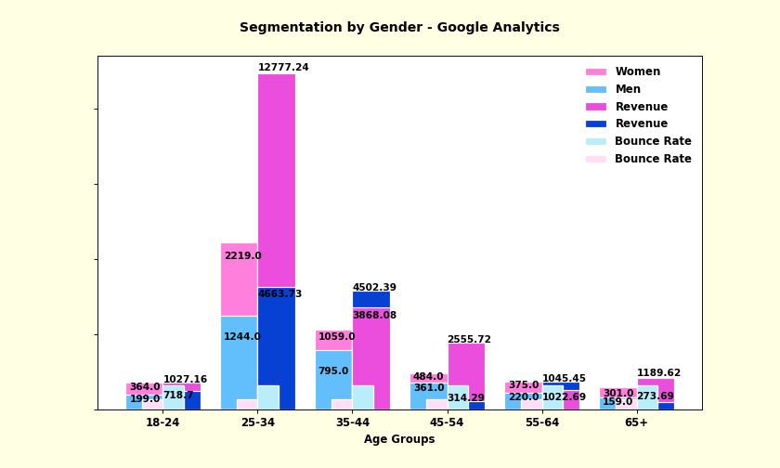

Slide 7
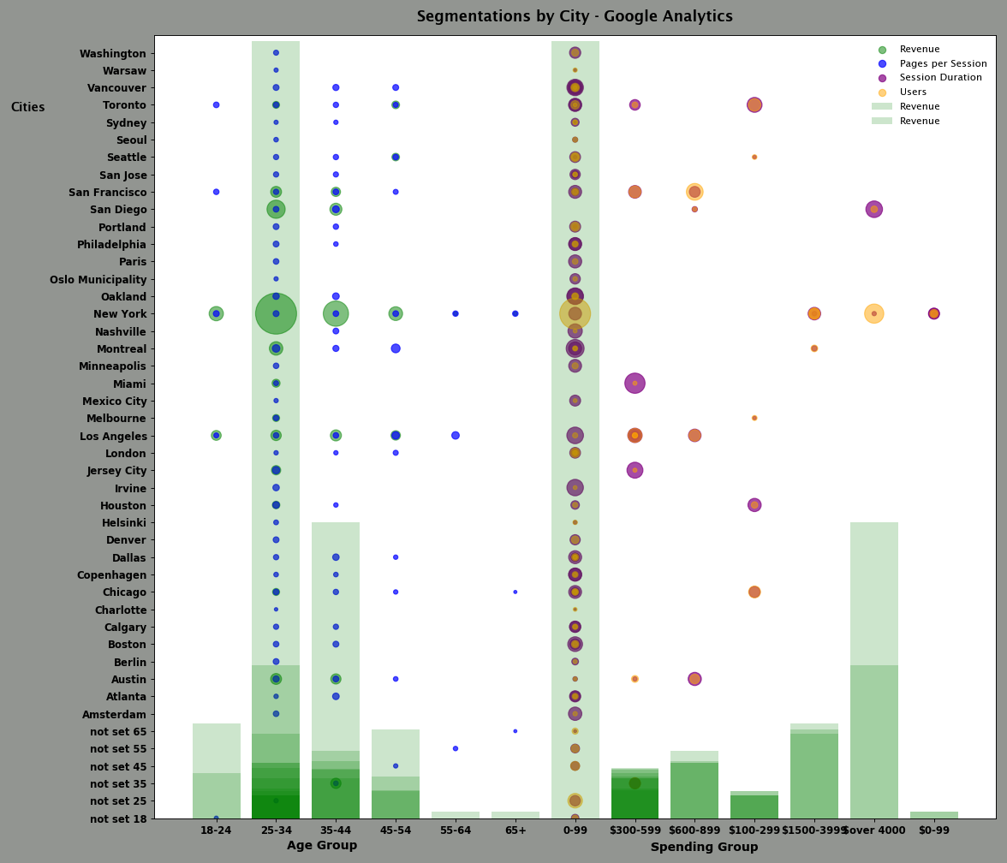

Slide 8
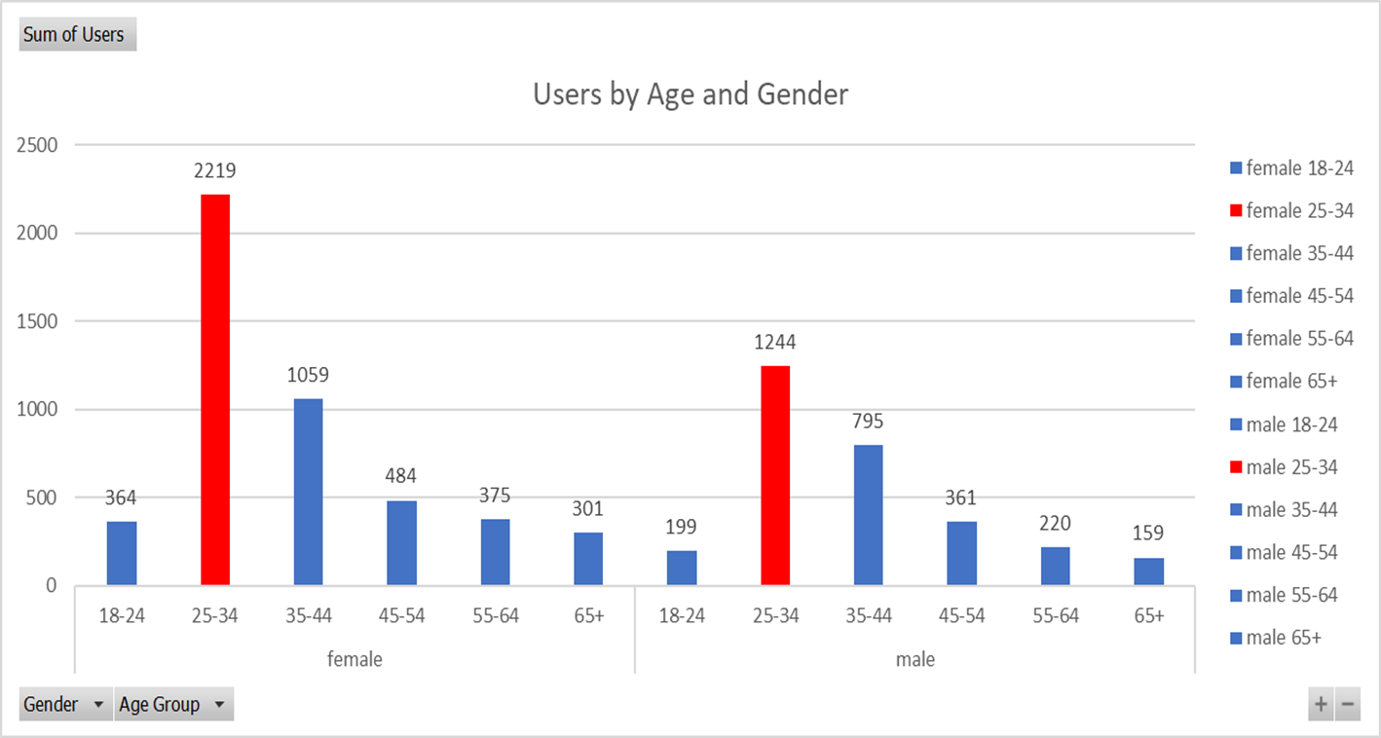
Market Segmentation: What is our demographic?
Notes:
Ghassan
Users by Age/Gender – (Users who have initiated at least one session during the date range. Learn more about how Analytics calculates the number of users) - Looking at this graph we see that with both males and females, the largest number of users fall in the 25-34 age group

Slide 9
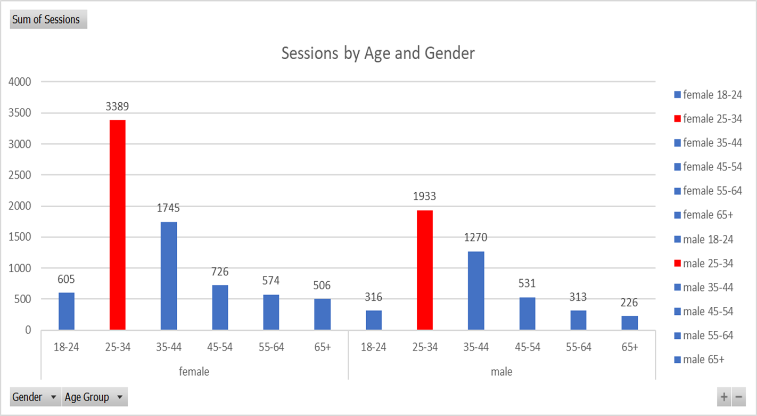
Market Segmentation: What is our demographic?
Notes:
Ghassan
Sessions by Age/Gender Total number of Sessions within the date range. A session is the period time a user is actively engaged with your website, app, etc. All usage data (Screen Views, Events, Ecommerce, etc.) is associated with a session) - Looking at this graph we see that with both males and females, the largest number of sessions also fall in the 25-34 age group.aphs

Slide 10
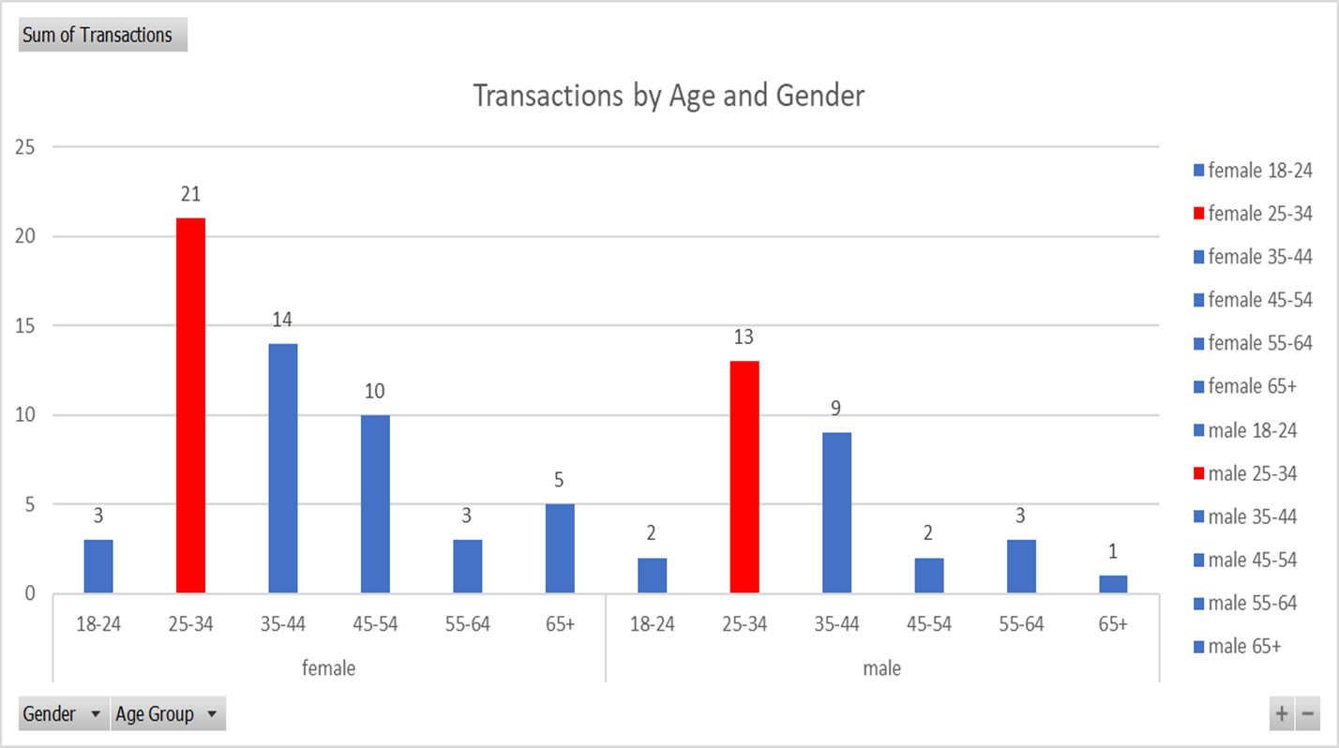
Market Segmentation: What is our demographic?
Notes:
Ghassan
Transactions by Age/Gender – (Transactions is the total number of completed purchases on your site) - Looking at this chart we see again that the largest number of transactions are conducted by the 25-34 age groups with both males and females

Slide 11
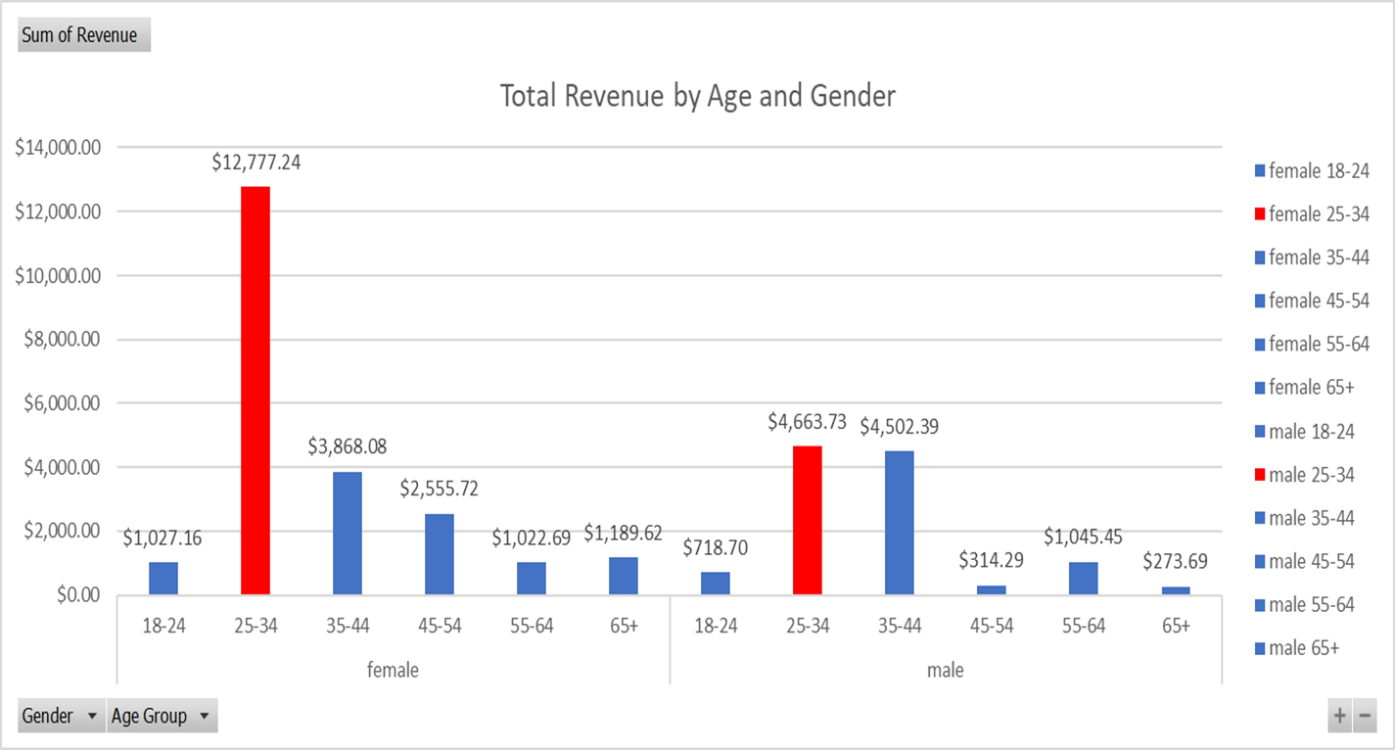
Market Segmentation: What is our demographic?
Notes:
Ghassan
Revenue by Age/Gender – (The total revenue from web ecommerce or in-app transactions. Depending on your implementation, this can include tax and shipping) - Looking at this chart we see yet again that the majority of Revenues are generated by the 25-34 age groups with both males and females, with females being the vast majority

Slide 12
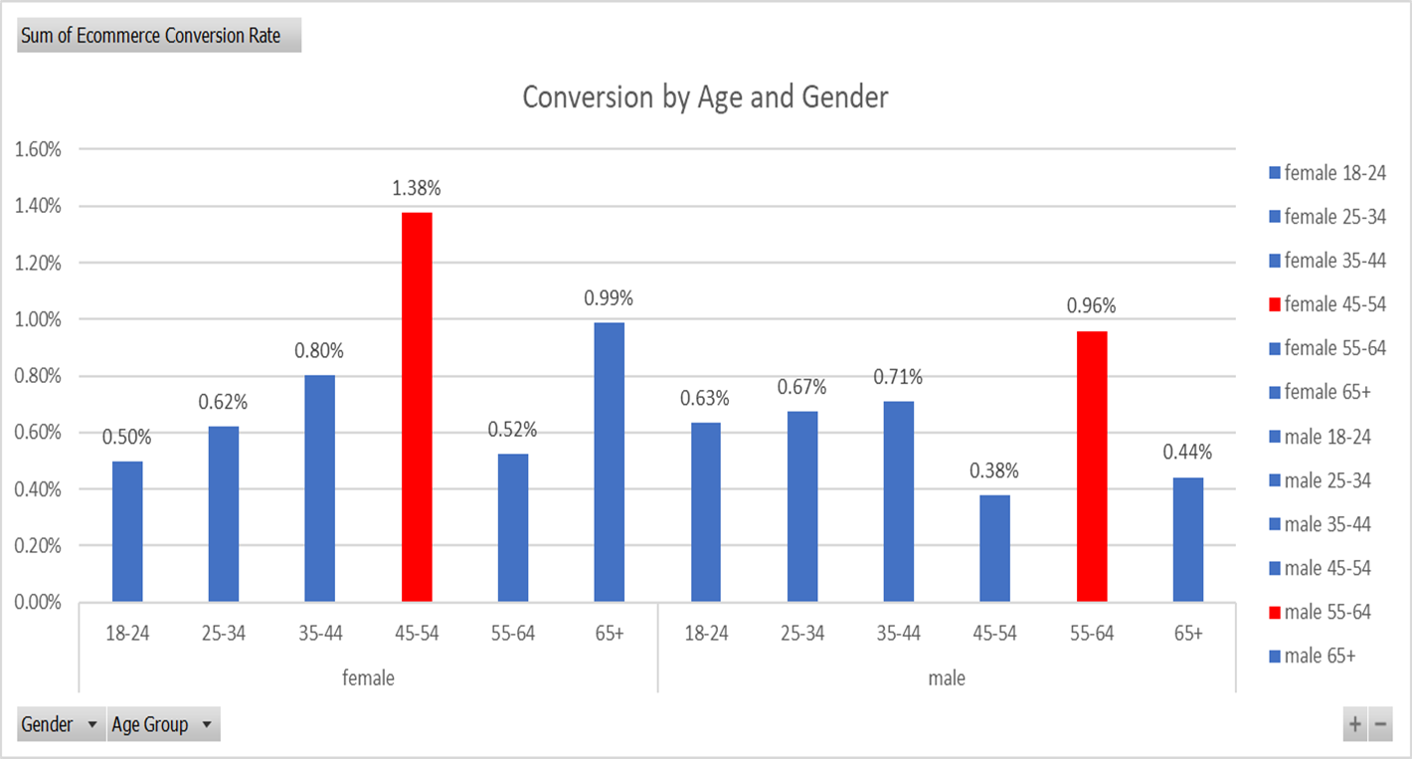
Market Segmentation: What is our demographic?
Notes:
Ghassan
**We start to see something different in the next 4 charts**
- Conversions by Age/Gender – (The percentage of sessions that resulted in an e-commerce transaction) – This chart shows us the highest conversion rates among the female 45-54 age group and the male 55-64 age group. Perhaps this is an untapped market that should be addressed to increase current revenues?

Slide 13
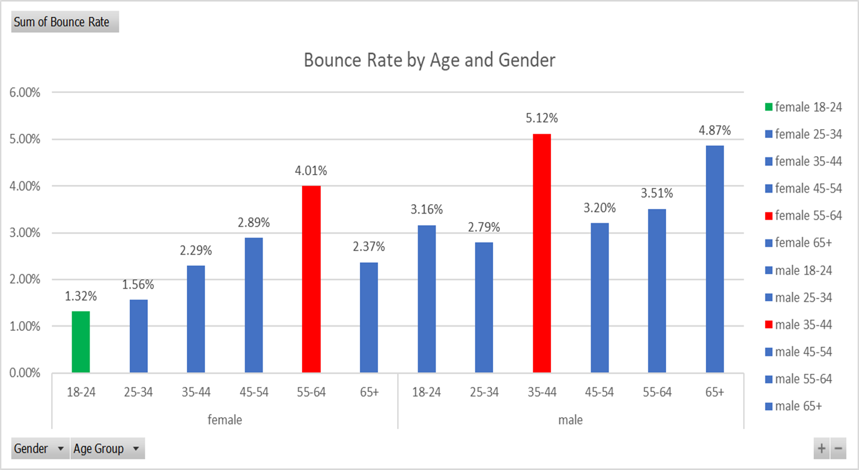
Market Segmentation: What is our demographic?
Notes:
Ghassan
Bounce Rate by Age/Gender – (The percentage of single-page sessions in which there was no interaction with the page. A bounced session has a duration of 0 seconds) – Not surprisingly we see our lowest bounce rates, with males, in the 25-34 y/o age group. What is surprising however, is that the lowest bounce rate with females falls in the 18-24 y/o age group, with the female 25-34 y/o age group of coming in second.

Slide 14
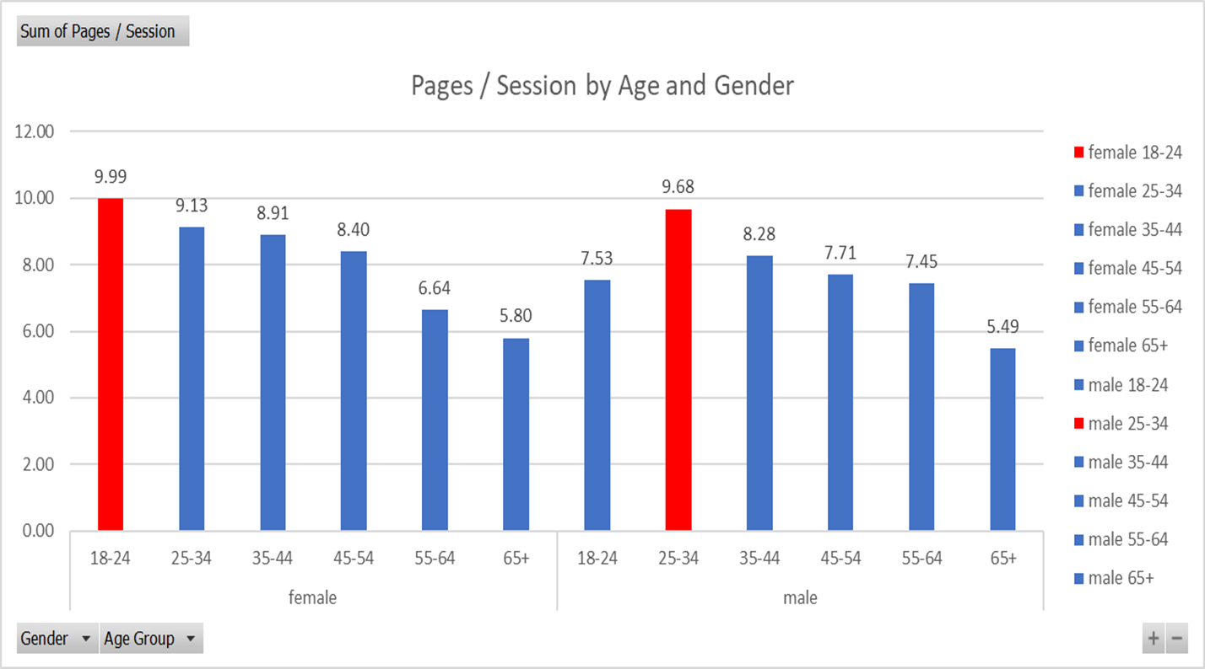
Market Segmentation: What is our demographic?
Notes:
Ghassan
Pages/Session by Age/Gender – (Pages/Session (Average Page Depth) is the average number of pages viewed during a session. Repeated views of a single page are counted) – In this chart we see again that the leading age group is the 18-24 y/o females.

Slide 15
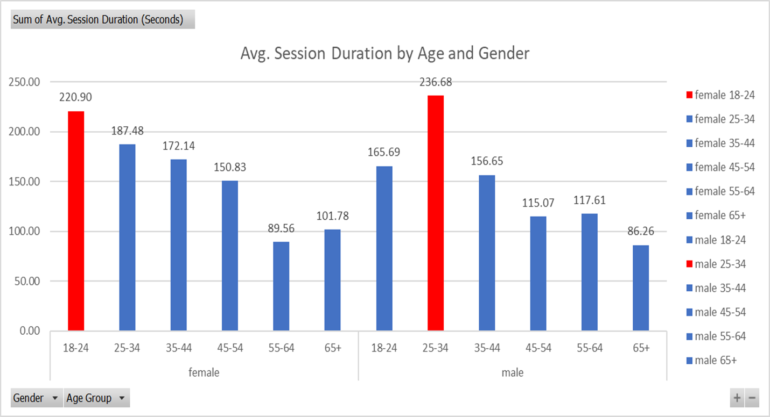
Market Segmentation: What is our demographic?
Notes:
Avg Session Duration by Age/Gender – (The average length of a Session. Numbers are in Seconds) – In this chart we see that although the group that spends the most amount of time on the site males between the age of 25-34, but it is our second-place demographic, 18-24 y/o females, that seems significant. Although the number of users in this demographic is small, if we look at percentage of sessions that result in a transaction, we see that the difference is negligible (females 25-34: 0.95% & females 18-24: 0.82%)
-Take-Aways:
- 25-34 year-olds lead in the number of Users visiting the site, Sessions initiated, Transactions conducted, and Revenue generated. This tells us that our current business is comprised of actions taken by this demographic.
-As far as gender demographics are concerned females lead males in Number of Users (4,802- 2,978), Revenues ($22,440.51- $11,518.25), Conversion rate (0.80%-0.63%), and Transactions (56-30). Females also lead in Avg Session Duration (2.6 Minutes vs 2.4 Minutes), Number of Sessions (7,545 - 4,589). In fact, the only category males lead is Bounce rate (3.78% - 2.41%)
-Potential Target groups appear to be 18-24 year-old females as the statistics we reviewed earlier indicate an interest in Menu Design Shop’s product offerings.

Slide 16
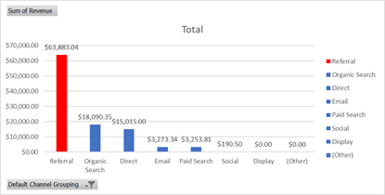
What variables/factors are associated with e-commerce conversions?
Notes:
Ghassan
E-commerce Conversion Channels – These are the paths that lead to an eCommerce Conversion (sale). In the case of Menu Design Shop the category labeled “Referral” came in first with $63,883.04 in sales

Slide 17
What variables/factors are associated with e-commerce conversions?
Notes:
Angeles
Referrals are traffic that occur when a user finds MDS through a site other than a major search engine
ex: blogs, “top ten” lists
Organic Searches refer to searches linking through search engines
Direct: Any traffic where the referrer or source is unknown
Email: Traffic from email marketing that has been properly tagged with an email parameter
Ex: newsletters
Paid Search: Traffic from search engine results that is the result of paid advertising via Google AdWords or another paid search platform
Social: Traffic from a social network, such as Facebook, LinkedIn, Twitter, or Instagram
Display: This traffic found your site by clicking on an ad that you ran on another website. Banner ads on blogs and image ads on news sites are some common generators of display traffic

Slide 18
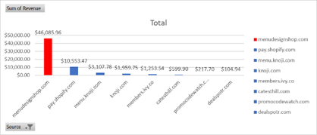
What variables/factors are associated with e-commerce conversions?
Notes:
Angeles
Referral Channels
We looked more into what the referrals were coming from and these were the results.
Turns out that those referrals were coming from the old website (mds.com)
Pay.shopify.com is a built-in Shopify payment method like PayPal or Venmo
knoji.com is a review website like Yelp, where members can leave reviews, and ask or answer questions about the company
Members.ivy.co - Ivy is a cloud-based business management tool built for interior designers
Catesthill.com: blog run by an interior designer and stylist
Promocodewatch,com – discount code site like slickdeals.com or wikibuy that has lists of promo codes people have reported onto the site
Dealspotr.com is the same as Promocodewatch.com

Slide 19
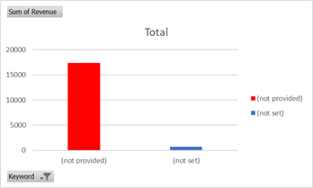
What variables/factors are associated with e-commerce conversions?
Notes:
Angeles
Organic Search “As we saw earlier… Organic isn’t as organic as it seems…”
“Not provided” and “not represent” visits” are from direct links that are not from search engines, social media, or any kind of referrals. They are most likely bookmarked links.

Slide 20
Hypothesis: If the majority of current search queries are completed by customers that are aware of Menu Design Shop and its product line, then new customers are not organically finding MSD through search engines.
Notes:
Angeles
Organic Search “As we saw earlier… Organic isn’t as organic as it seems…”
What we learned from where these traffic sources are coming from is that they let us know of where we can improve and where we can start growing
Going back to the hypothesis:
Lets us know that the majority of “references”, that may look like other sites linking to MDS, are actually links from the old store redirecting customers to the new domain
It also revealed that there is a review site, Knoji, that can help bring in more visitors, which can lead to more e-commerce conversions by MDS taking action and answering questions on the review site or reflecting on reviews customers may leave
Now that we know WHERE visitors are coming from, we wanted to see if these visitors are returning customers or new customers.

Slide 21
Comparison of new visitors and the benchmark of new visitors
Notes:
Angeles
Here we can see the comparison between the amount of new visitors that have visited MDS and Google Analytic’s benchmark of the amount of new visitors that have visited similar companies like MDS. The benchmark is based on the type of company MDS is and the size of the company.
This is important because we can see how the company compares to the rest of the market and now that we have a visual of that, we can take a step back and see that a good chunk (12,505) are from organic searches.
This tells us that 51.3% of new visitors are coming from search engines, which means that:
They are finding MENU through generic searches
They somehow have learned about MENU through word of mouth, showrooms hosted by MENU, seeing our products in physical stores, or other forms of marketing that are not taking place online.

Slide 22
Did you find what you expected to find? If not, why not? What inferences or general conclusions can you draw from your analysis?
Notes:
Our Hypothesis was not false, but at the same time we made discoveries that we didn’t think of until we actually looked at the data such as:
Low bounce rates within certain age groups
High conversion rates in other age groups
Where traffic is actually coming from
A large number (51.3%) of new visitors have heard of MENU and deliberately searched for MDS

Slide 23
* Discuss any difficulties that arose, and how you dealt with them
* Discuss any additional questions that came up, but which you didn't have time to answer: What would you research next, if you had two more weeks?

