Slide 1
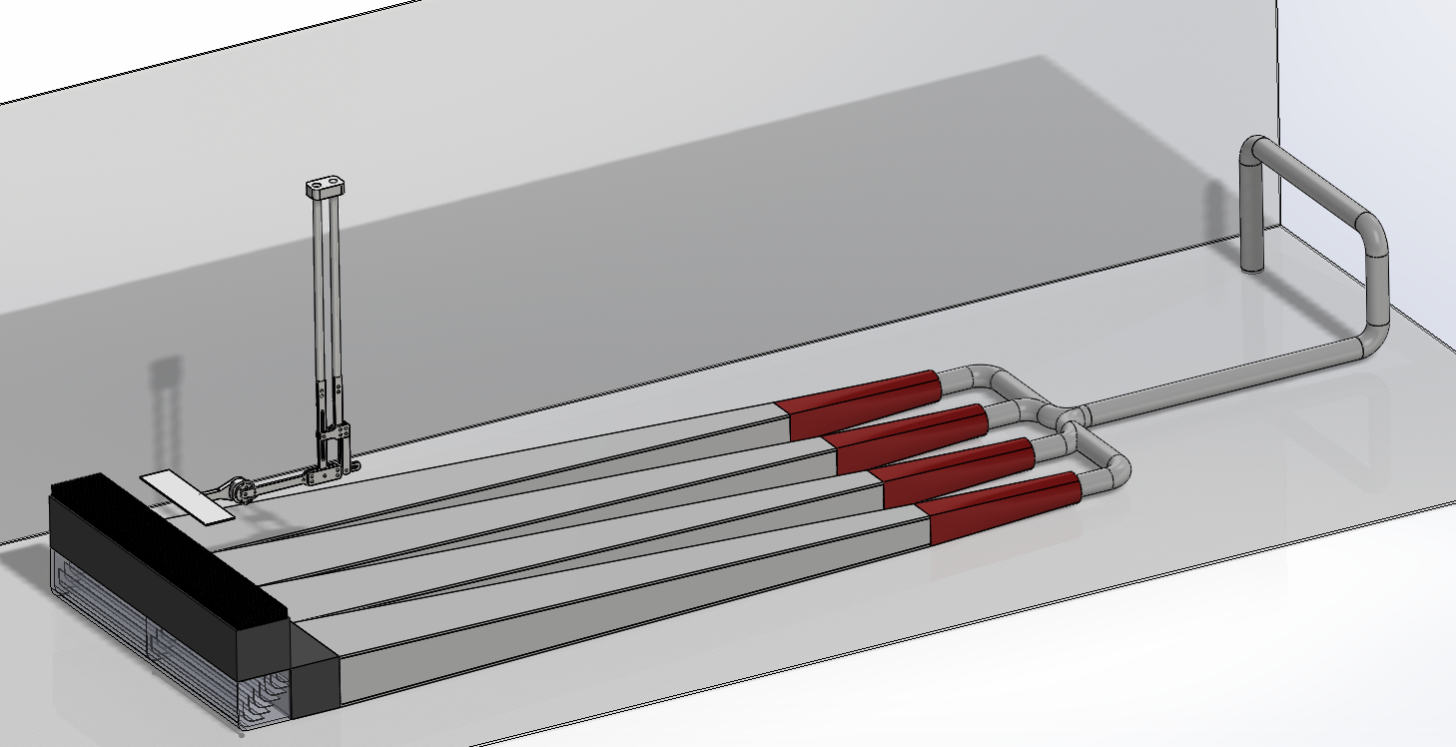
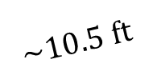
Wing motion
$$\sim 10.5 ft$$
Diffuser-pipe adapter
Pump discharge
Honey comb
PVC piping
Mixing chamber
Diffuser section
Turning manifold

