Slide 1
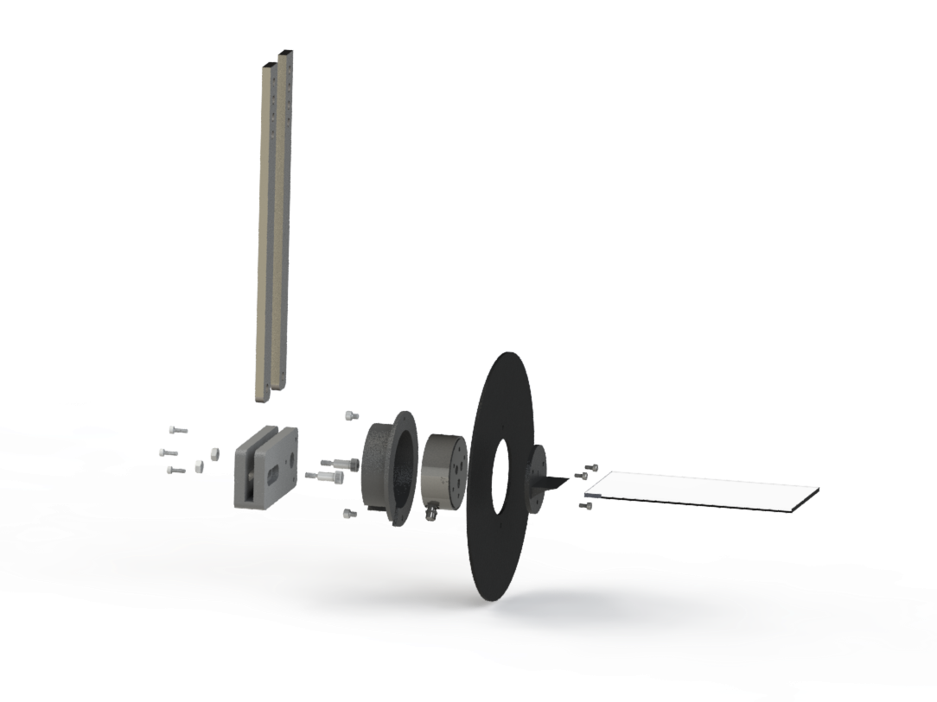
Sensor housing
Force sensor
Splitter-plate
Sensor-wing mount
Horizontal slider
Glass wing
Shoulder screws

