Slide 1

Version 2.0

Slide 2
Features
The Wow Factor…
Categorization of the tourist sites as:
• Heritage tourism sites
• Eco-tourism sites
• Pilgrimage tourism sites
• Wildlife tourism sites
• Adventure tourism sites
• Medical tourism sites

Slide 3
Features
Booking services for airways, buses and railways by rendering links that redirect to the respective ticket booking websites recognized by the Ministry of Tourism.
For emergency – nearby Police Station ,ATM,Hospitals,Gas Stations.
Tour Guides and Tour Operators for assisting the tourists
Location or Route map to visit the particular tourist place .

Slide 4
Features
An ENTIRE section on Cuisine !
Notification of Upcoming Events
Support across all platforms

Slide 5
Features
Contact information for each site
A section on How to get around while visiting the place
Ratings and Timing information
Separate Interface for Ministry of Tourism to manipulate the data in the Tourism site database.

Slide 6
Tour Planner
We have developed a daily tour planner for the tourists.
What does it do?
It suggests the nearby tourists spots based on the tourist's interest dynamically

Slide 7
Statistical Analysis
What do we provide for the government ?
We provide a Statistical report of how many tourists visited a particular place during a particular time .
This will help in providing better facilities like transport,accomadations etc for that place.

Slide 8
Technology Stack

Slide 9
Application-User Interaction
Front-end –User Interface (UI)
Phone Gap
APIs for interaction
Tableau
Mongo DB
Android SDK
Java SDK
CSS3 | HTML5 | jQuery Mobile jQuery

Slide 10
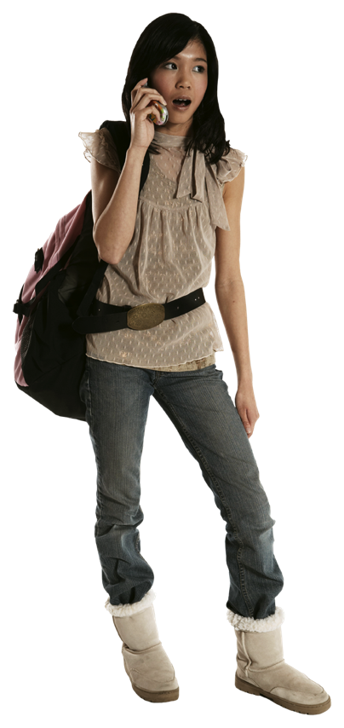
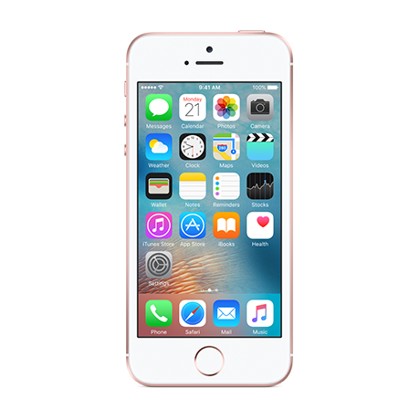
Opens App
Use Case Diagram
Displays Menu
Upcoming
Planner
Cuisine
Explore
Booking
Chooses to Explore
Searches for site
Displays site specifications
Contact Info
Language Assist
Site
Description
Getting around
Entry Fee

Slide 11
Our ui Designs

Slide 12
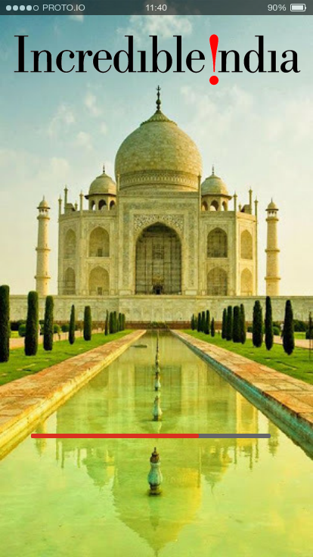
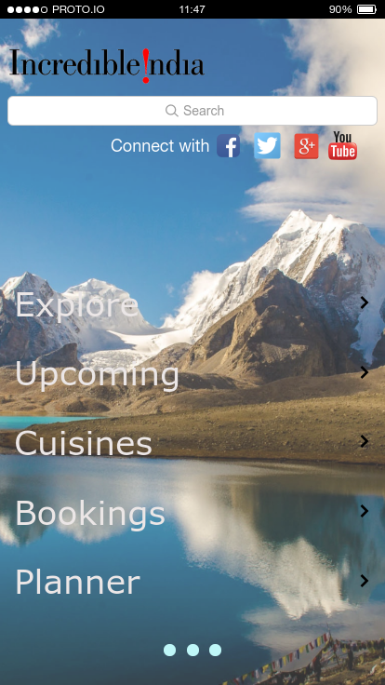

Slide 13
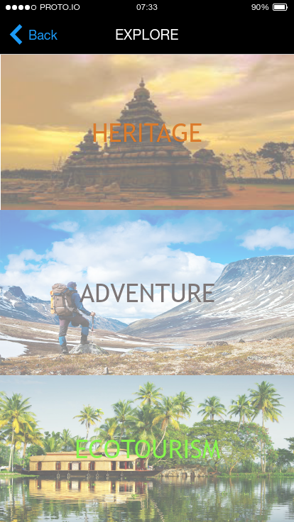
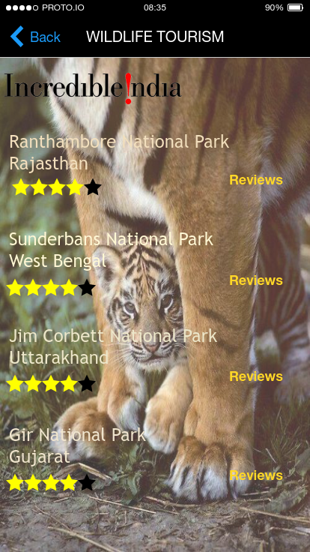

Slide 14
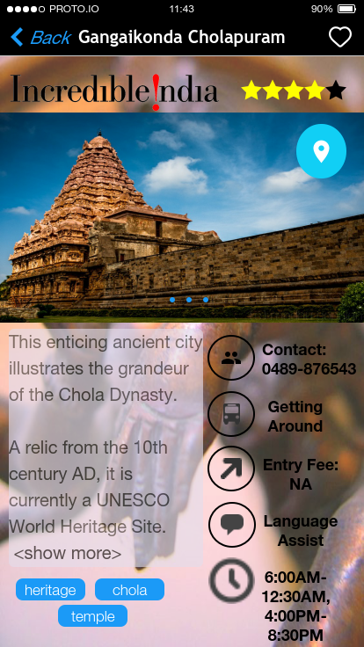
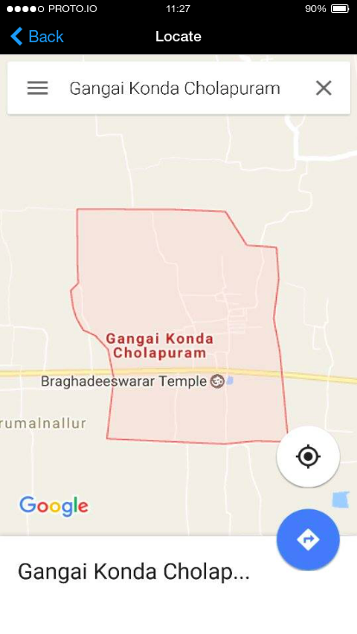

Slide 15
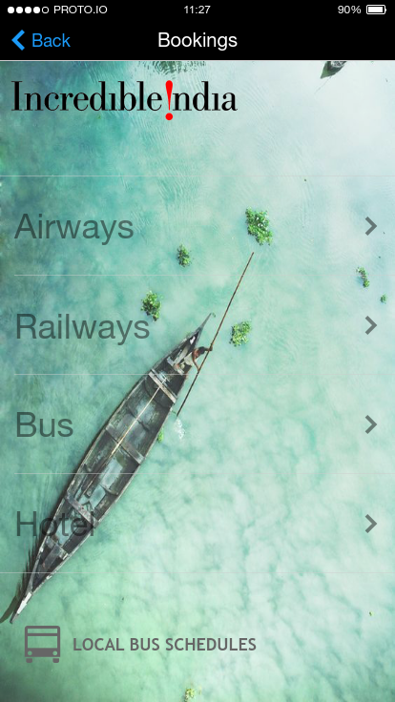

Slide 16
The Future as we see it
Weather Alert for the tourists to prevent them from getting into any danger.
Language Translation to help tourist.
Applying Machine Learning Algorithms to analyse the reviews and to give suggestions.

Slide 17
Thank You

