Slide 1
Monotonicity on Identification with
Neural Nets
Guillermo Sentoni
+54 114 379 7483
 gsentoni@uade.edu.ar
CAC-2002 - Seattle, Washington. September 22nd-26th 2002.

Slide 2
Summary
Introduction and Goals
Problem Definition
Modeling Framework
Polymerization Reactor Application
Conclusions and Future Work

Slide 3
Introduction and Goals
Introduction
We will deal with nonlinear function approximation / system identification from input/output data samples for control.
When learned from examples, some functions may show oscillatory behavior around a trend (the underlying function being estimated).
Some nonlinear models are made of linear ones, nonlinearly combined as in Gain Schedule schemes. They require monotonicity.
Goals
  To focus on modeling issues (monotonicity) related to nonlinear inferential sensing using Single Hidden Layer Perceptron.

Slide 4
Problem Definition
Gain Scheduling Scheme
Output_{ss}
Model 3
Model 2
Model 1
Input_{ss}

Slide 5





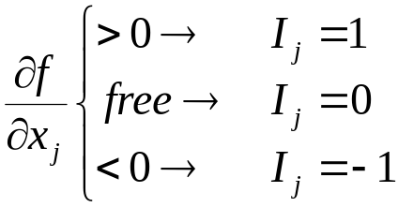
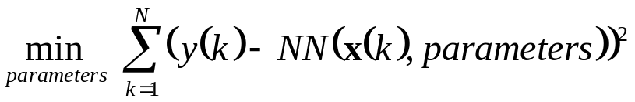
Problem Definition
Function Approximation
N measured data pairs, , where is the input, and is the output.
A Neural Network that approximates the input-output relationship .
A set of indexes I_{j} , j:1,…,D, that define the monotonicity of f:
A minimization procedure subject to monotonicity constraints

Slide 6




Modeling Framework
Model Structure
We have A Single Hidden Layer Perceptron with:
D inputs.
H hidden neurons.
For i=1,…,H
~
y (k)
1
c
0
c
H
c
1
c
2
. . .
η₁(k)
η₂(k)
η_{H} (k)
ξ₁(k)
ξ₂(k)
ξ_{H} (k)
w
H0
w
w
H1
10
w
22
w
H2
w
w
21
w
w
HN
1
11
12
x₁(k)
x₂(k)
x_{D}(k)

Slide 7
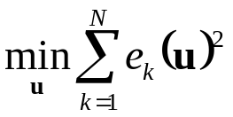
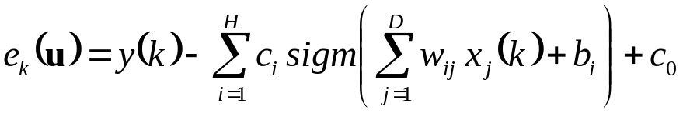





Problem Definition
Proposed Solution
Let us define the vector of parameters u
Then we pose the following minimization problem
subject to

Slide 8

Polymerization Reactor
Co-monomer C4
Monomer C2
Hydrogen H2
Polymer Removal
P, T, L
Condenser
Reactor

Slide 9
Values for the Example
Ri: melt index is the objective to be modeled.
All the input variables were scaled between –1 and 1.
The NN chosen has: 11 inputs, 3 hidden Neurons, 1 Output.
The indexes I_{j} are:
H2_Ratio: 1 C4_Ratio: 0
C_C2: 1 F_C2: 1
C_C4: 0 F_C4: 1
C_H2: 0 F_H2: 1
Temp: 1 Press: -1
Level: 1

Slide 10
Melt Index Approximation
Approximation and Real Values
2
1.5
1
0.5
0
0
20
40
60
80
100
samples
Approximation Error
0.06
0.02
0
-0.04
0
20
40
60
80
100
samples

Slide 11
Input Variables held at -.5
1
0.25
Gain1
0.5
Gain0
0.2
0
-1
-0.5
0
0.5
1
0.15
-1
-0.5
0
0.5
1
0.25
0.2
Gain1
0.2
Gain1
0.19
0.15
-1
-0.5
0
0.5
1
0.18
-1
-0.5
0
0.5
1
0.25
0.2
Gain0
0.2
Gain1
0.19
0.15
-1
-0.5
0
0.5
1
0.18
-1
-0.5
0
0.5
1
0.25
Gain0
0.2
Gain1
0.19
0.15
-1
-0.5
0
0.5
1
-1
-0.5
0
0.5
1
0.2
0.2
Gain1
0.19
Gain-1
0.19
0.18
-1
-0.5
0
0.5
1
0.18
-1
-0.5
0
0.5
1
0.2
2
Gain1
0.19
1
0.18
-1
-0.5
0
0.5
1
0
0
20
40
60
80
100
120

Slide 12
Input Variables held at 0
2
0.4
Gain1
1
Gain0
0.3
0
-1
-0.5
0
0.5
1
0.2
-1
-0.5
0
0.5
1
0.35
0.35
Gain1
0.3
Gain1
0.3
0.25
-1
-0.5
0
0.5
1
0.25
-1
-0.5
0
0.5
1
0.32
0.35
Gain0
0.3
Gain1
0.3
0.28
-1
-0.5
0
0.5
1
0.25
-1
-0.5
0
0.5
1
1
Gain0
0.5
Gain1
0.305
0
-1
-0.5
0
0.5
1
-1
-0.5
0
0.5
1
0.32
0.32
Gain1
Gain-1
0.3
0.3
-1
-0.5
0
0.5
1
0.28
-1
-0.5
0
0.5
1
0.35
2
Gain1
0.3
1
0.25
-1
-0.5
0
0.5
1
0
0
20
40
60
80
100
120

Slide 13
Input Variables held at .5
2
1.5
Gain1
1
Gain0
1
0
-1
-0.5
0
0.5
1
0.5
-1
-0.5
0
0.5
1
1.5
Gain1
1
Gain1
1
-1
-0.5
0
0.5
1
0.5
-1
-0.5
0
0.5
1
1.2
1.5
Gain0
1.1
Gain1
1
1
-1
-0.5
0
0.5
1
0.5
-1
-0.5
0
0.5
1
2
1.045
Gain0
1
Gain1
0
-1
-0.5
0
0.5
1
-1
-0.5
0
0.5
1
Gain1
1.05
Gain-1
1.05
1.5
-1
-0.5
0
0.5
1
2
-1
-0.5
0
0.5
1
Gain1
1
1
0.5
-1
-0.5
0
0.5
1
0
0
20
40
60
80
100
120

Slide 14
Conclusions
We have presented a general framework for system identification having monotonicity.
We presented the proposed scheme in the approximation of a polymerization reactor.
The results showed that it is feasible and simple to get monotonic aproximator using this approach.

