Slide 1
Temperature/Humidity Sensor - si70210
Gino Seridon

Slide 2
Proposal
Sensor: si7021 Temperature and Humidity Sensor for the LumiMonitor
Database will store the temperature and humidity readings at regular intervals
User can read this data from the mobile device
With baby surveillance in mind, the sensor is used to monitor the temperature and humidity of the baby room to ensure that the room is comfortable for infants

Slide 3
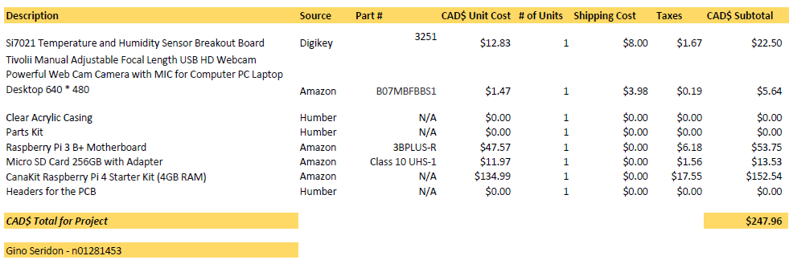
Budget
Total: $247.96CAD; Initially $81.89CAD

Slide 4
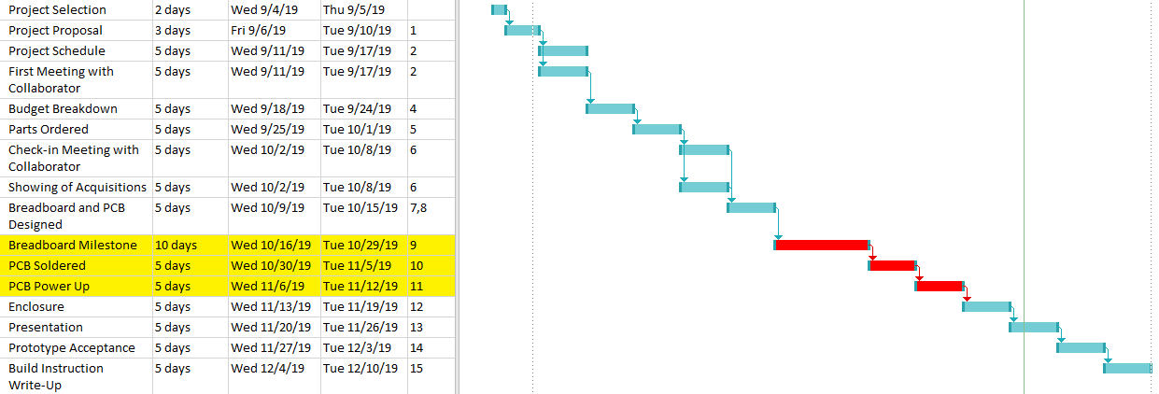
Problems with the Pi and PCB caused 3 weeks of problems
Previous pi malfunction; purchasing a new RP caused delays
Soldering the PCB incorrectly caused issues when testing

Slide 5
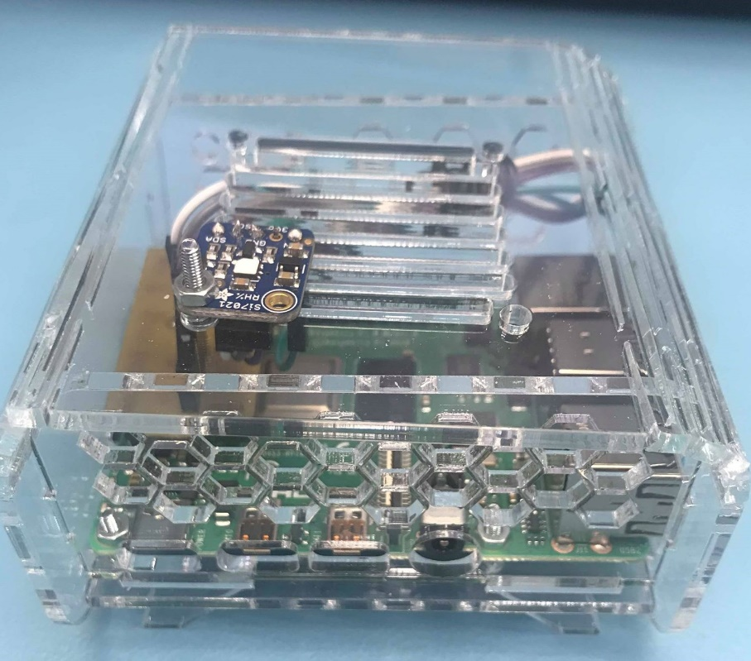
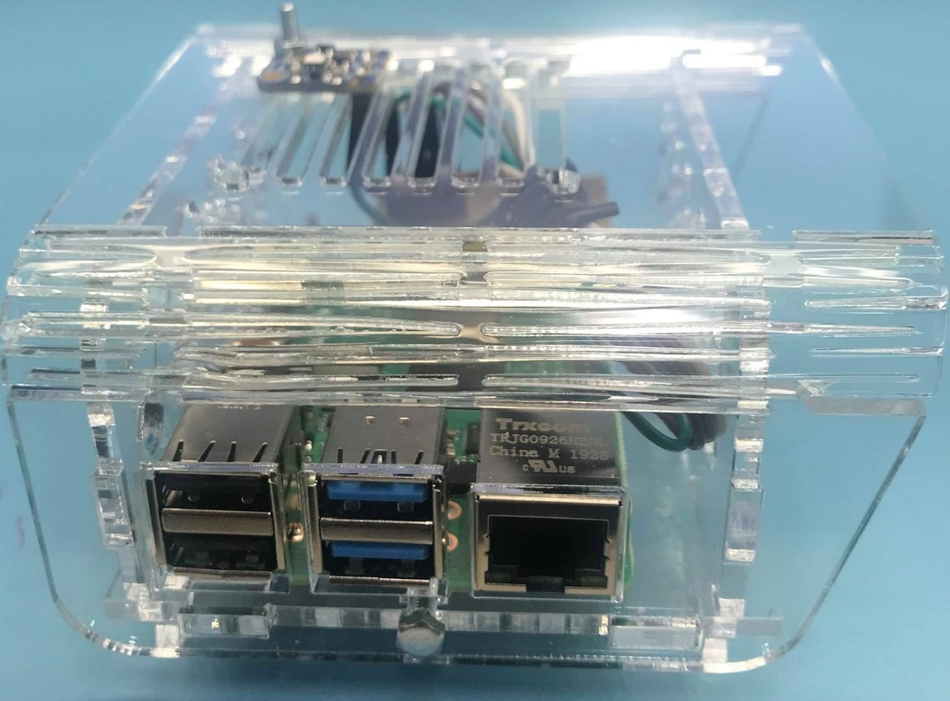
Sensor’s Enclosure

Slide 6
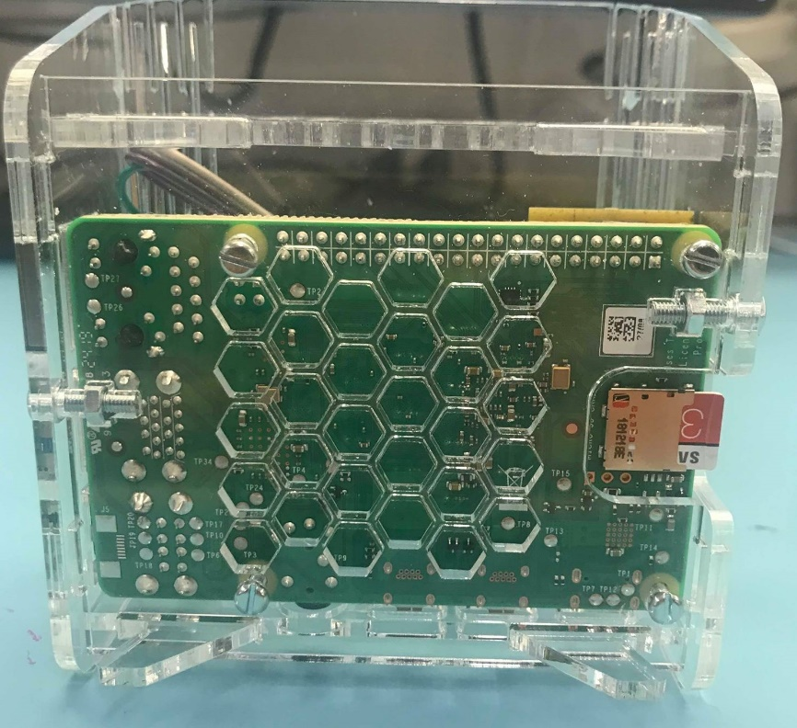
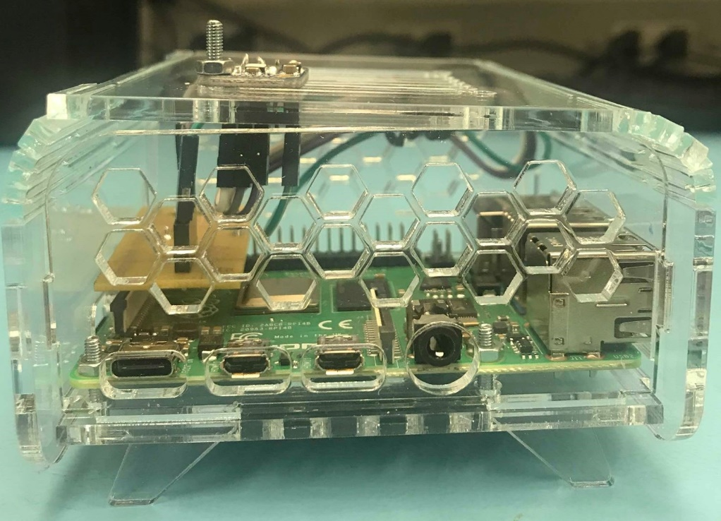
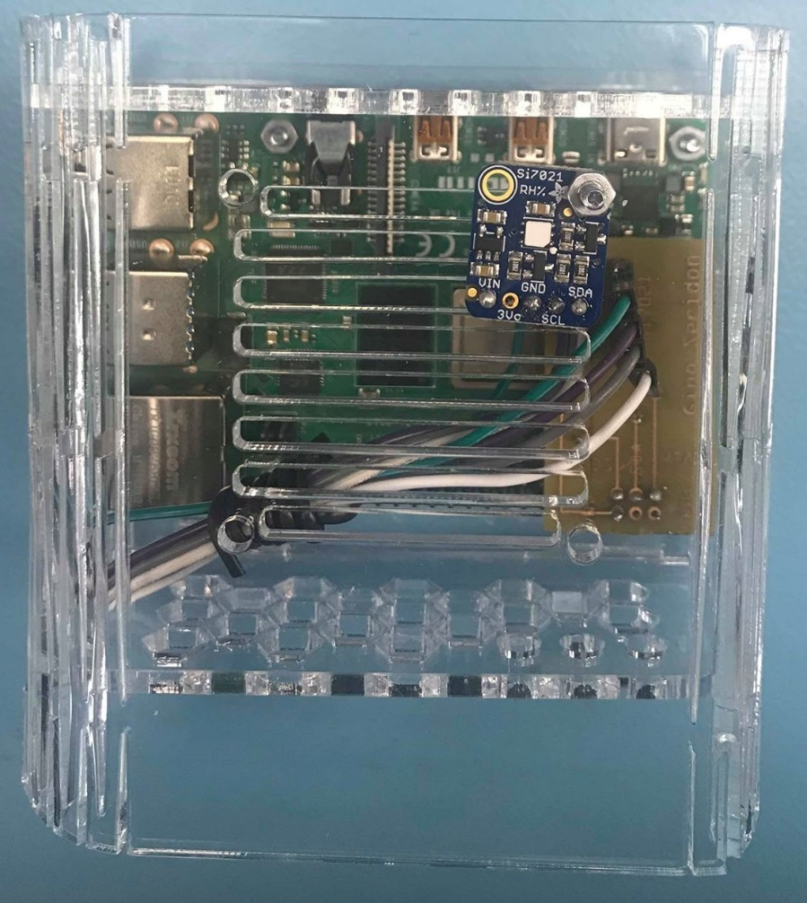

Slide 7
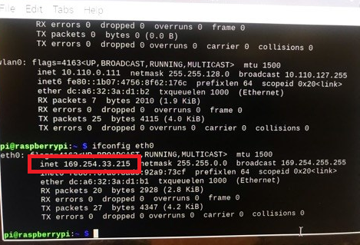
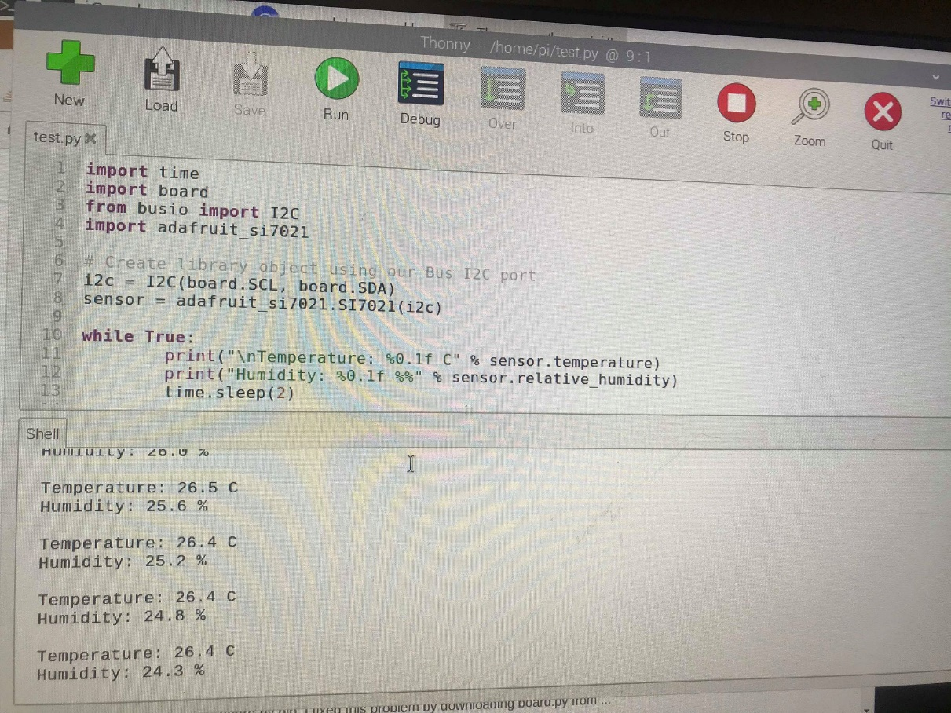
Pi’s Address &Functionality
Pi Address: 169.254.33.215

Slide 8
Knowledge
Electric Circuits – TECH101
Basic knowledge of circuits (for PCB connections)
Measuring voltage
Technical C – CENG153
Introduction to the raspberry pi and its functionalities
Understanding how to navigate through a raspberry pi

Slide 9
Embedded Systems – CENG252
More experience with the raspberry pi
Introduction to version control, used for tracking changes during software development
Software Engineering – CENG216
Design with a purpose and made up of components that work well together
Planning with a budget in mind
Use of a Gantt Chart to create a schedule for the project
Ensuring that the project can be easily implemented along with other software

Slide 10
Thank you!

