Slide 1
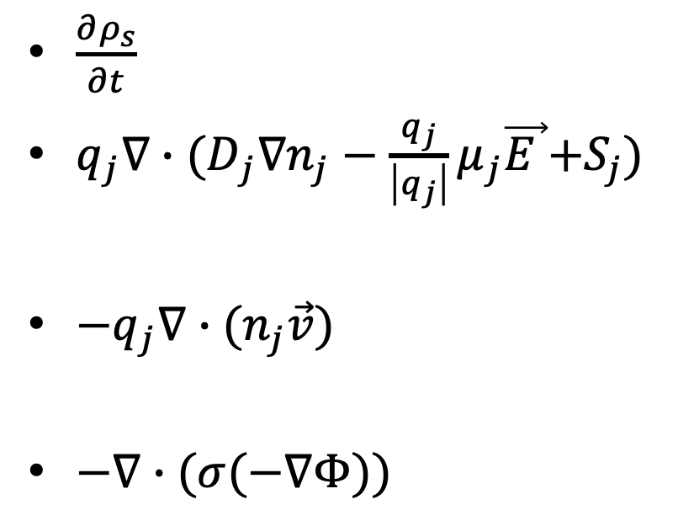
$\frac{∂ρ_{s}}{∂t}$
$q_{j}∇∙{(D}_{j}∇n_{j}−\frac{q_{j}}{\left|q_{j}\right|}μ_{j}\vec{E }{+S}_{j})$
$−q_{j}∇∙(n_{j}\vec{v})$
$−∇∙(σ(−∇Φ))$
Zapdos Time Integrates
ADSurfaceCharge captures this
Missing but can be added easily
Captured in PotentialSurfaceCharge

