Slide 1

PAnDA
Packet Analysis Diagram Automator
Notes:
PAndA is a system that automatically translates PCAPs into deterministic verified sequence diagrams

Slide 2



The Necessity
Reproducibility
Bridging the gap between visual summaries and network evidence, there is a need for a deterministic traceback mechanism.
Visualization is Powerful
Visuals increase recall from 10% to 65% (Jasina et al., 2025)
Documentation Tax
As data grows in complexity, the ability to match the “story” to the detailed PCAPs becomes exponentially hard
Notes:
Let’s talk about the need for this system
Humans are visual creatures. Research shows that adding a visual component to data increases recall
from 10% to 65%. To truly understand a difficult information, especially complex attack scenarios, a diagram is almost always mandatory.
Another problem that network analysis faces today is Reproducibility raw PCAP files are essentially black boxes.
When a security researcher documents a new attack scenario, they hand over a massive files. For another tester or researcher, trying to reverse-engineer and reproduce that exact attack from the crude packets is incredibly difficult. There is a heavy 'documentation tax’- extracting theoretical story of the attack from from large, noisy pcap files is complex, and prone to error

Slide 3
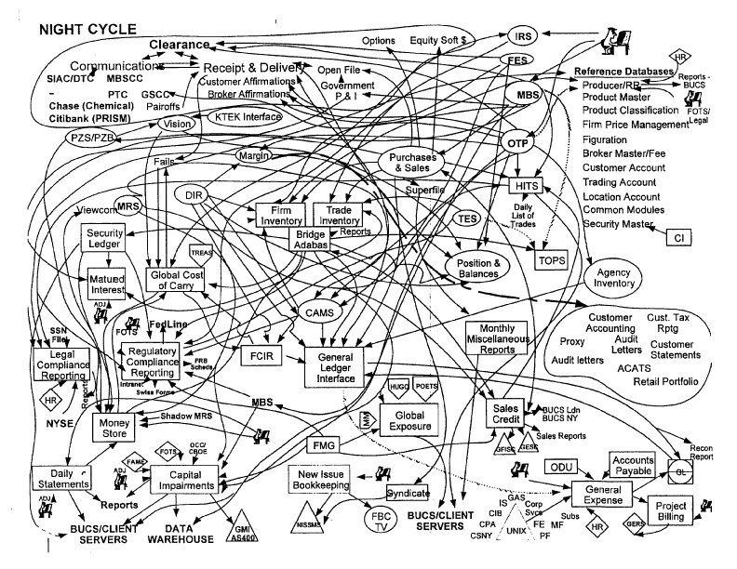
The Goals
Visual: Transform raw data that includes PCAPs/texts into instant, high-fidelity visual narratives using LLMs
Forensic: Provide a deterministic tool that allows reviewers to traceback data shown in diagrams to the original PCAPs
Notes:
Nodes = attacker states, capabilities, or goals
Edges = exploit steps or transitions
- יוצר דיאגרמות
הכלי המוצע מריץ פונקציית מיפוי דטרמיניסטית בשם Traceback Function
פונקציה זו משייכת לכל שלב לוגי מופשט בנרטיב של חבילות מידע מדויקות מתוך קובץ
מיפוי זה מבטיח כי כל טענה סמנטית בנרטיב ניתנת לאימות מלא (Fully Verifiable) מול הראיות הדיגיטליות הגולמיות."

Slide 4
System Abstract
Visual: Receives PCAP files and/or a textual details of network scenarios and generates LLM sequence diagrams.
Forensic: The system then validates the accuracy of the narrative against the PCAP using Validation and Evaluation layers.
Notes:
"That is an excellent point. Visualization and forensic verification are two separate challenges. But in real-world network analysis, they suffer from the exact same bottleneck: the gap between the qualitative story and the quantitative data."
"PAndA doesn’t just build a pretty diagram; it builds a deterministic bridge between these two problems. Here is how they connect:"

Slide 5
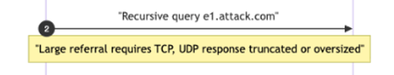
Grounding to Evidence
Textual Narrative
Ground Truth Artifacts
Event: UDP DNS referral response
Size: 1532 bytes
Evidence: packets #417- #421
Time: 2.18 - 2.24 s
Final series of abstract logical steps describing the scenario
Final series of packets
Create a DETERMINISTIC Traceback Function that maps Narrative steps to the corresponding groups of Ground Truth packets
Notes:
פחות מידע אבסטרקטי ויותר הכוונה מדויקת לפרמטרים בטקסט/PCAP
traceability

Slide 6
Grounding to Evidence - Determinism from Statistical Models
False Positives (Hallucinations) - LLM maps logical steps to incorrect packets, entities, or packets with wrong data
False Negatives (Droppings) - LLM omits important packets, entities
Challenge: how can we create a deterministic mapping function using statistical models?
Notes:
פחות מידע אבסטרקטי ויותר הכוונה מדויקת לפרמטרים בטקסט/PCAP
Traceability
FNs
The Risk: Critical attack events hidden or ignored within the filtered packet stream
FPs
The Risk: AI generating imaginary sequence steps or tying correct traffic to non-existent malicious action

Slide 7
The Requirements
Integrity& Uniformity
syntactically correct diagrams, with
consistent visual language across multiple figures
Evidence Grounding: Pointing every diagram message to a specific PCAP metadata
Semantic Precision:
All terms and variables need to be defined within the diagram

Slide 8

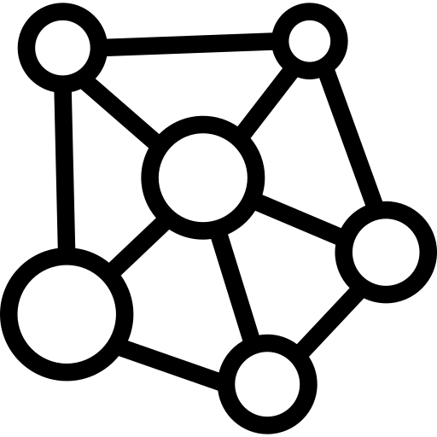

Existing Methods
Visualization of Network Traffic
Wireshark flow diagram
Attack Trees and Attack Graphs
MulVal, Mul
LLM + Diagram Generation
Eraser.com,
Selector.ai
Github CoPilot
Notes:
Visualize networks, attacks and protocols
Nodes = attacker states, capabilities, or goals
Edges = exploit steps or transitions
Wireshark Flow Graph
Not diagrams but:
Mostly for troubleshooting
Shows connections between hosts and packet details
Filters all connections by different options

Slide 9
Generalization Constraints
Contextual Granularity: Different research articles require different “lenses.”
Structural Uniformity: Maintaining a consistent style while adapting to the unique conventions of varying protocols
Notes:
An article on protocol vulnerabilities mayrequire deep variable inspection, while a paper on networktopology requires high-level traffic summaries.
The noise of one article is important in another

Slide 10
Pipeline Architecture
Narrative
Preprocessing
Generator
Analysis
Validator
Analysis
PCAP
Ground-Truth Diagram
Rendering
Evaluator
Output Diagram
Evaluation Score
Notes:
Preprocessing and parsing

Slide 11
Preprocessing
Window Constraints: LLM have memory limits, and PCAP Files can contain tens of thousands of packets!
Fighting against noise: Many packets are repeating, not meaningful for the scenario description and load the system for no reason.

Slide 12
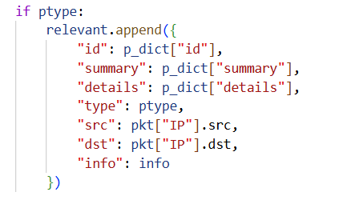
Preprocessing – Algorithmic Filtering
Noise Removal:
Remove Packets that have no IP layer (2nd layer, ARP)
Remove ICMP layers
Fingerprint:
TCP: Flags + Dport
UDP: Dport
DNS: Domain name
Pattern Finding:
Pick at most sampling_limit packets with the same fingerprint
Output a filtered packet dictionary

Slide 13
Generator LLM Analysis
Avoiding Randomness
Fixing seeds and parameters to guarantee deterministic, reproducible execution.
Extracting Narrative Breaking down network events into expected logical phases and identifying relevant network entities.
Creating a syntactically correct D2 diagram
turns simple code into clean diagrams and support images and animations.
Packet-Level Grounding Linking logical steps directly to physical packets.
Notes:
D2: Declarative Diagramming
A modern language that turns text to diagrams

Slide 14
Validator
D2 Syntax Validation
Algorithmic check to ensure the generated output is syntactically valid and error-free before rendering.
Using second agent to verify generator AI instructions
Utilizing a second, zero-temperature LLM reviewer to cross-examine the generator instructions
Cross-Matching
Splitting steps into structured sets (Source, Destination, Protocol) and matching them against packets to flag FPs and FN
Notes:
פחות מידע אבסטרקטי ויותר הכוונה מדויקת לפרמטרים בטקסט/PCAP
Traceability
מודלי שפה גדולים (LLMs) הם אלופים בהבנת טקסט, אבל הם גרועים מאוד בחישובים מדויקים, ספירה, ואימות של נתונים בינאריים רחבים.
קוד Python דטרמיניסטי (כמו סקריפט שמפנח פקטות) הוא מצוין בלבחון מספרים וביטים, אבל הוא עיוור לחלוטין להקשר סמנטי ומטרות על.

Slide 15

Validator – Handling FPs and FNs
Droppings (FNs)
Hallucinations (FPs)
Scan the filtered packets and
checking for ignored packets
with critical keywords
(Protocol-Based Filter)
For each logical step, go through the list of packets matched by the AI and check for the correction of entities and attached packets
DNS Amplification Attack, packet #3 includes the word ANY but the generator skipped it
Packet #594 doesn’t exist, #345 doesn’t match step 3
Notes:
פחות מידע אבסטרקטי ויותר הכוונה מדויקת לפרמטרים בטקסט/PCAP
Traceability
ANY: במתקפות DNS Amplification, התוקף כמעט תמיד ישלח בקשה מסוג ANY (כלומר, "תחזיר לי את כל המידע שיש לך על הדומיין הזה"). זה נעשה כדי שנפח התשובה מהשרת יהיה גדול ככל האפשר. אם יש פקטות עם המחרוזת ANY בשדה ה-Query שנשארו בחוץ – המערכת תדע שהן קריטיות.

Slide 16
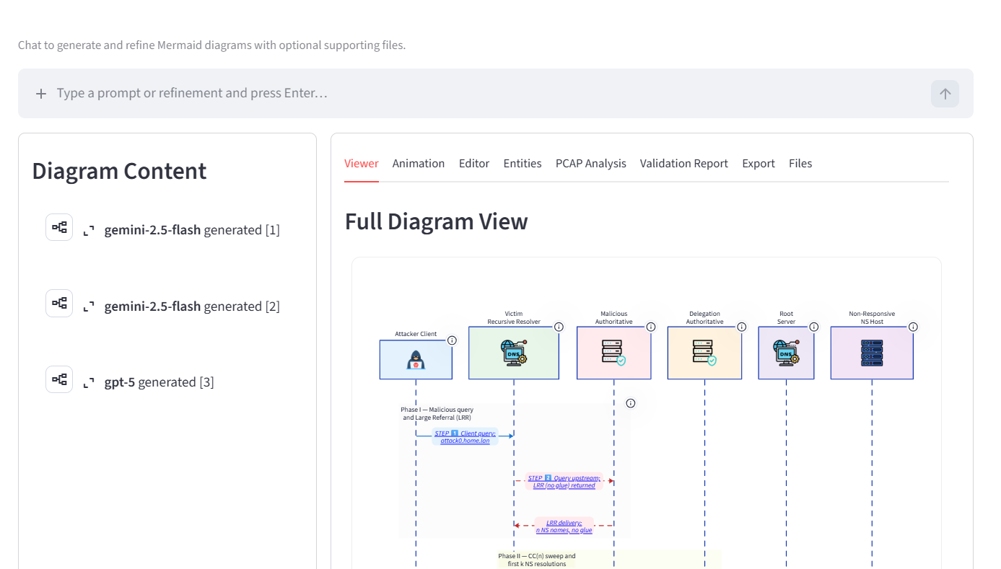
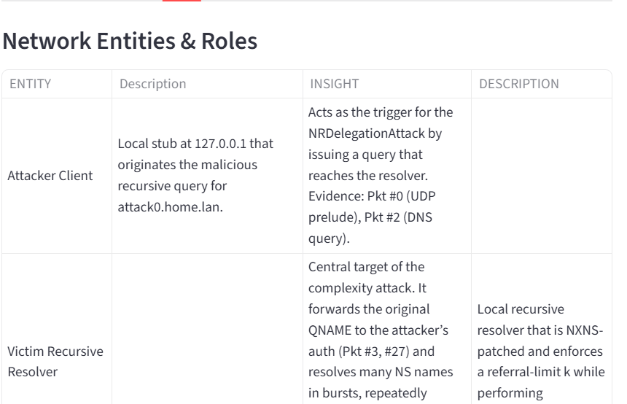
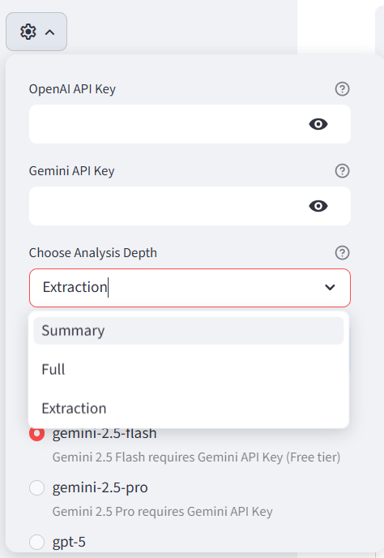
Rendering
Notes:
פחות מידע אבסטרקטי ויותר הכוונה מדויקת לפרמטרים בטקסט/PCAP
traceability

Slide 17
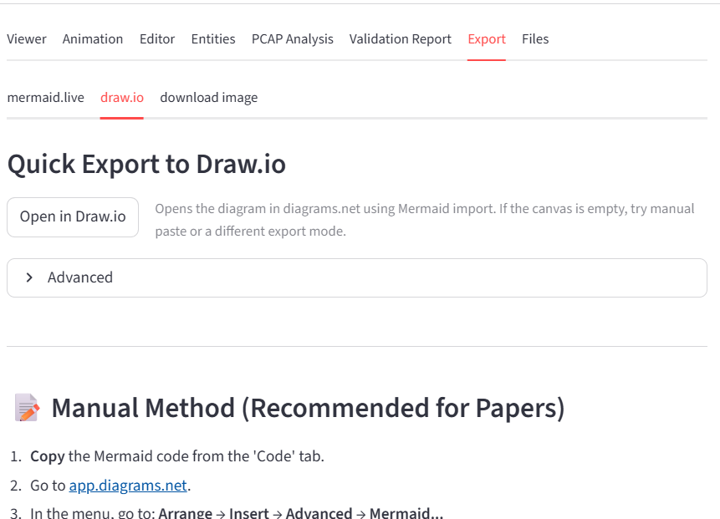
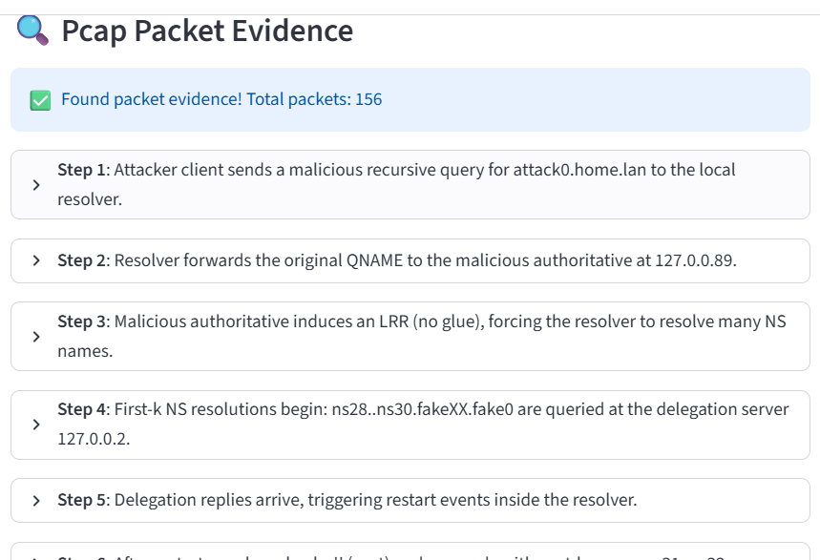
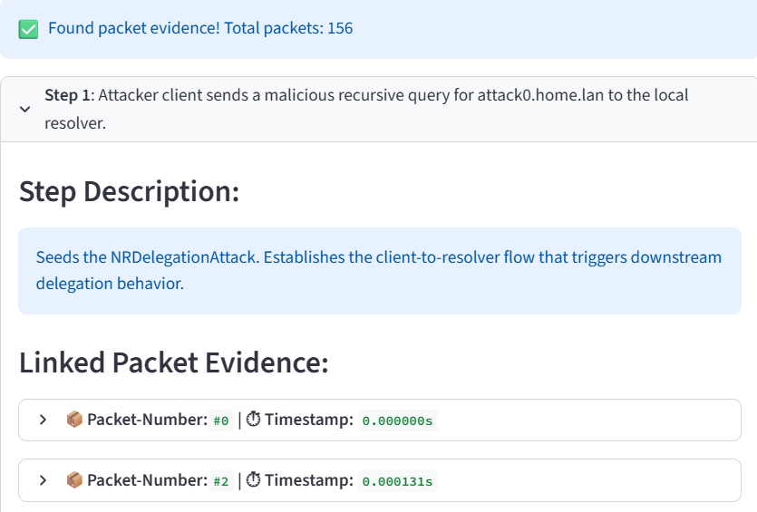
Rendering
Notes:
פחות מידע אבסטרקטי ויותר הכוונה מדויקת לפרמטרים בטקסט/PCAP
traceability

Slide 18
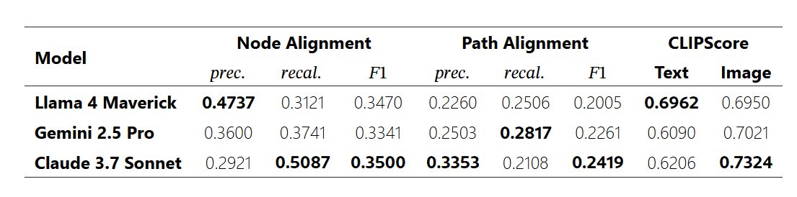
Evaluator:
DiagramEval (Liang & You, 2025) Score:
Compare AI output diagram to manual ground-truth diagram
Node Alignment
Node Precision: Don’t make up actors
Recall: Don’t forget about actors
F1 Score combines the two
Path Alignment
Path Precision: are there made up arrows? Are all arrows going to the correct directions?
Recall: Did you skip critical steps in the attack?
F1 Score combines the two
Notes:
פחות מידע אבסטרקטי ויותר הכוונה מדויקת לפרמטרים בטקסט/PCAP
Traceability
לתת מדדים כלשהם בין דיאגרמות אולי דלתא כלשהי
Our metrics quantify the node and path (multi-hop edges) alignment between generated and ground-truth diagrams using precision, recall, and F1 scores.

Slide 19


Evaluator: Future Extension
Quantitative Evaluation DiagramEval score
Precision, Recall, F1-score
Researcher Review
Creating manual metrics and a poll for researchers to rank diagrams quality
Verifiability of diagrams
Qualitative
Satisfying Density Ratio (Packets/Node)
Clarity
Precision = $\frac{8}{10}$
Ground Truth
12 protocol events
Diagram shows 10
Recall = $\frac{8}{12}$
8 are correct
F1 ≈ 0.73
Notes:
DiagramEval: Evaluating LLM-Generated Diagrams via Graphs
Syntax Correctness: Use a "Mermaid Linter" or the Mermaid CLI to automatically check if the generated code is valid. A failed render is a 0% score for that run.
Precision/Recall: Are all the essential packets from the Pcap represented in the diagram?
F1-Score: Does the sequence of "who talked to whom" match the actual protocol flow?
Syntax Correctness: Use a "Mermaid Linter" or the Mermaid CLI to automatically check if the generated code is valid. A failed render is a 0% score for that run.
Precision = 8/10 Of the events the diagram shows, how many are correct?
Recall = 8/12 Of the events that actually happened, how many did the diagram capture?

Slide 20


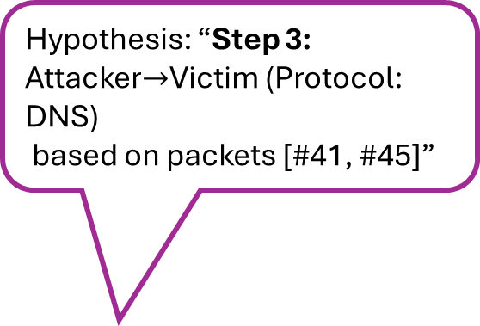
Hypothesis: “Step 3: Attacker$→$Victim (Protocol: DNS)
based on packets [#41, #45]”
Do these packets exist?
Is the metadata correct? (DNS? Attacker to victim?)
Evaluating Diagram precision and alignment + manual score
Hallucination (FP)
Generator
Validator
Evaluator
Dropping (FN)
Notes:
Validator check of existing or non existing packets can be done algorithmically

Slide 21



Grounding to Evidence – The Path to Reproducibility
Notes:
https://secartifacts.github.io/usenixsec2025/badges

Slide 22
The Path to Reproducibility
REPRODUCED
”To earn this badge, the AEC must judge that they can use the submitted artifacts to obtain the main results presented in the paper.”
Notes:
Available
To earn this badge, the AEC must judge that the artifacts described in the “Open-Science section” of the paper have been made available for retrieval, permanently and publicly
Functional
To earn this badge, the AEC must judge that the artifacts conform to the expectations set by the paper in terms of functionality, usability, and relevance.

Slide 23
Why is PAnDA meaningful?
Visual Mapping: Automates the creation of clear, intuitive sequence diagrams.
Ground Truth Verification: Proves the narrative's correctness against actual network data.
Objective Benchmarking: Provides a reproducible score to evaluate discrepancies between the narrative and crude data.
Notes:
התוכנה שלך מייצרת את ה"מפה" (הדיאגרמה): היא מתרגמת את הררי המידע הגולמי לסיפור ברור ואינטואיטיבי בתוך שניות.
התוכנה שלך מוכיחה שהסיפור אמיתי (Grounded): היא נותנת לבודק את שכבת ה-Traceback הלחיצה. הבודק יכול להקליק על השלב של "הזרקת הקוד הזדוני" ולראות מיד בעיניים את הפקטות המדויקות שמוכיחות שזה קרה, בלי לחפש ב-Wireshark.
התוכנה שלך נותנת ציון אובייקטיבי (Results Reproduced): באמצעות ה-Score Test והמדדים, היא אומרת לבודק בצורה מדעית: "קובץ ה-PCAP הזה מכיל בדיוק את הישויות והשלבים שהחוקר טען במאמר, בציון דיוק של 98%".

Slide 24
Proof of Concept - Implementation Plan
Scenario Compilation: Collecting 10 diverse attack PCAPs and building expert manual ground-truth reference diagrams.
Paper Replication: Incorporating 2 real-world case studies from published cyber security literature.
Metric Benchmarking: Mathematically auditing the Validator/Evaluator scores against manual expert verification
Notes:
שתי דוגמאות משני מאמרים
מהפיקאפ הוא מייצר תמונה ותיאור, והיא קרובה למציאות - גם ניקוד של evaluator וגם בעין
אין פולס נגטיב ואין פולס פוזיטיב- דוגמה אחת
בדיקה ידנית ועם אבליואטור – 10 דוגמאות שונות

Slide 25
Future Suggestions
Improve Filtering algorithm to include various end cases
Improve Validator algorithm to include various end cases
Improving Correction feedback loop
Include manual evaluation criteria
Improving rendering and animation
Notes:
שליטה ברמת ההפשטה

Slide 26
Thank You!

