Slide 1
Project

Slide 2
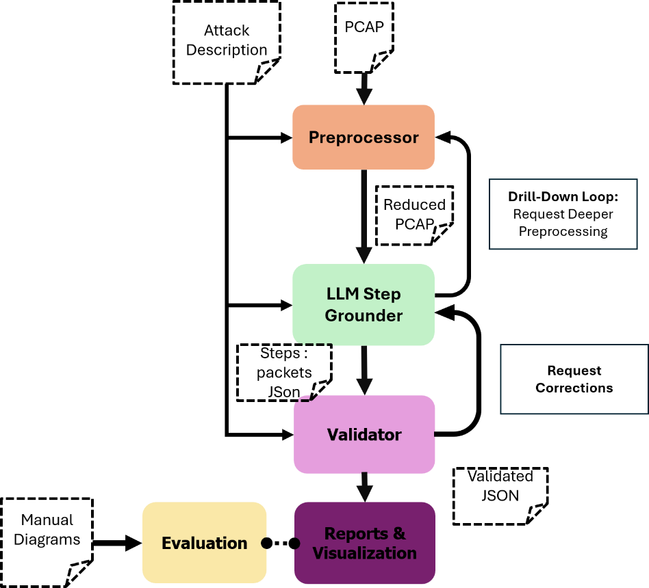
Project

Slide 3
Preprocessor
Botminer

Slide 4
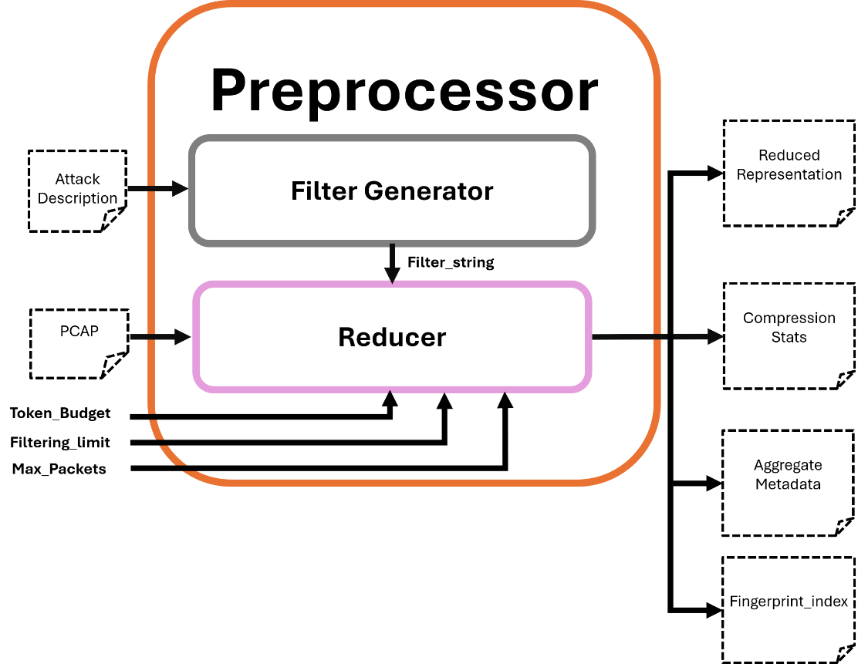
Budget Status

Slide 5
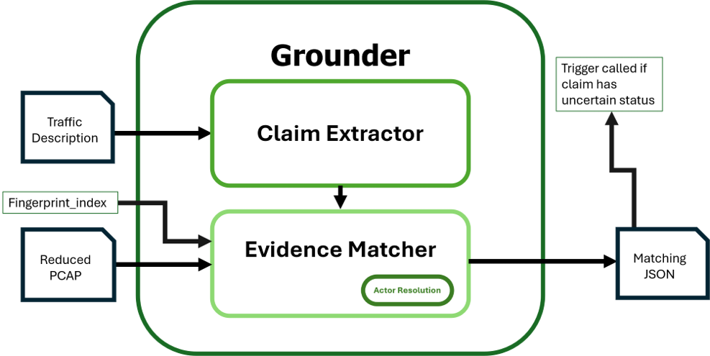
Ips Summary
Anomalies
Step Resolution

Slide 6
