Slide 1
Attack
Description
PCAP
Preprocessor
Reduced PCAP
Drill-Down Loop:
Request Deeper Preprocessing
LLM Step Grounder
Steps : packets
JSon
Request Corrections
Validator
Validated
JSON
Manual Diagrams
Evaluation
Reports & Visualization

Slide 2
Preprocessor
Reduced Representation
Filter Generator
Attack
Description
Filter_string
Reducer
Compression Stats
PCAP
Token_Budget
Filtering_limit
Aggregate Metadata
Max_Packets
Fingerprint_index

Slide 3
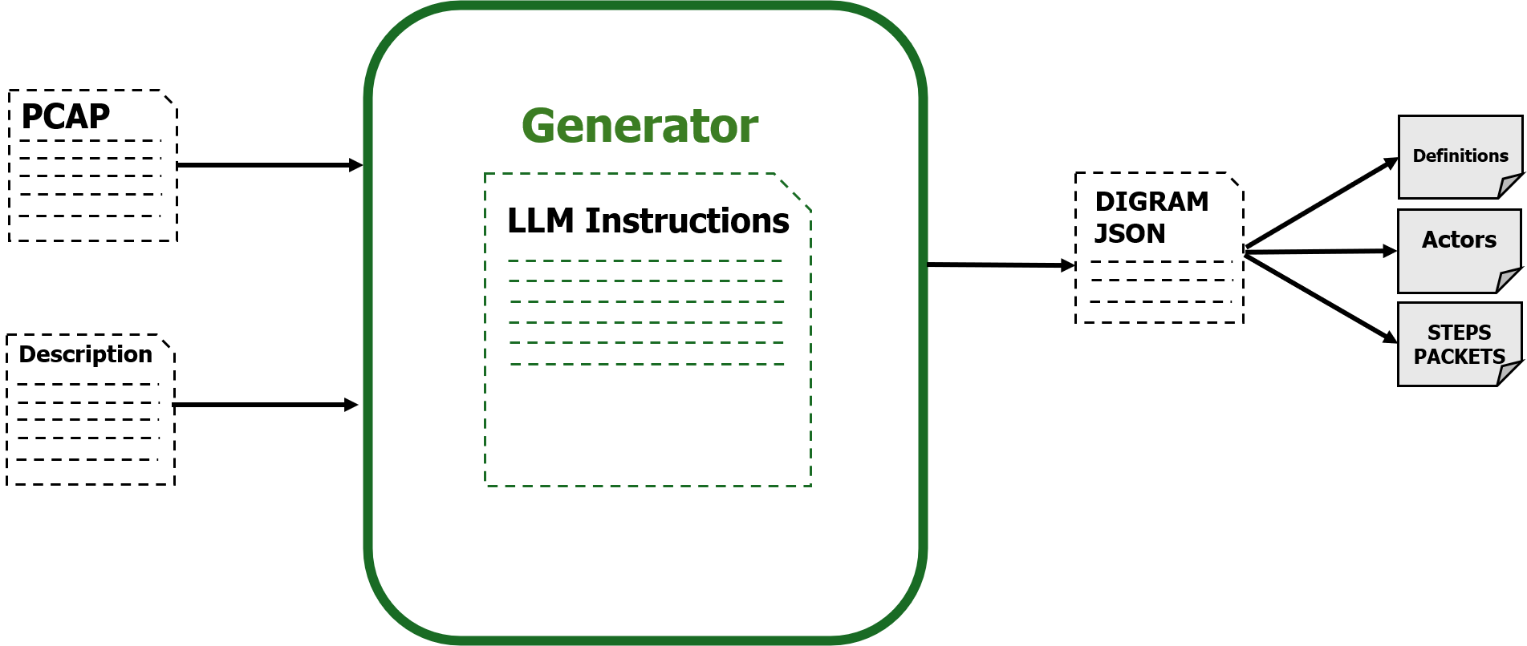
Grounder
Attack
Description
Step_Definer
Phases_Steps_dictionary
Reduced
PCAP
Step_to_evidence
Encoded JSON
Encode Dependencies

Slide 4
Grounder
Attack
Description
Step_Definer
Phases_Steps_dictionary
Reduced
PCAP
Step_to_evidence
Encoded JSON
Encode Dependencies

Slide 5
Validator
Attack
Description
Extraction Checker
Ex_FN_Flags
Ex_FP_Flags
Validator assessment
Claims:
groundings
Linkage Checker
MA_FN_Flags
MA_FP_Flags
Reduced
PCAP

Slide 6









