Slide 1
Spring Batch
Parameswari Ettiappan

Slide 2
Batch Processing
Batch processing is the execution of a series of programs ("jobs") on a computer without manual intervention.
Jobs are set up so they can be run to completion without human interaction.
All input parameters are predefined through scripts, command-line arguments, control files, or job control language.
This is in contrast to "online" or interactive programs which prompt the user for such input.
A program takes a set of data files as input, processes the data, and produces a set of output data files.
- From Wikipedia

Slide 3
What Is a Batch Job?
A batch job is a computer program or set of programs processed in batch mode.
This means that a sequence of commands to be executed by the operating system is listed in a file (often called a batch file, command file, or shell script) and submitted for execution as a single unit.

Slide 4
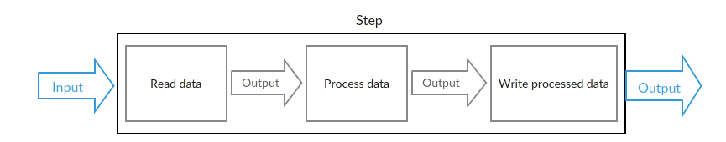
What Is a Batch Job?

Slide 5
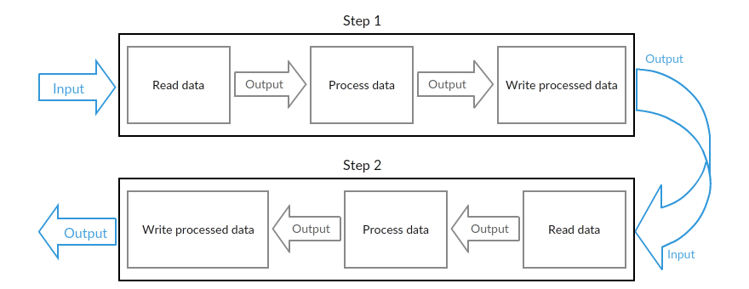
What Is a Batch Job?

Slide 6

Batch vs Real-time
Per sec, minutes, hours, days, weeks, months, etc.
Sometimes “job net” or “job stream” reconfiguration required
JBatch (JSR 352)
EJB
POJO
etc.
Long Running (minutes - hours)
Batch
Immediately
Short Running (nanosecond - second)
Fixed at deploy
JSF
EJB
etc.
Real-time

Slide 7
Batch vs Real-time Details
 | Trigger | UI support | Availability | Input data | Transaction time | Transaction cycle
Batch | Scheduler | Optional | Normal | Small - Large | Minutes, hours, days, weeks… | Bulk (chunk) operation
Real-time | On demand | Sometimes UI needed | High | Small | ns, ms, s | Per item

Slide 8
Batch app categories
File driven
Database driven
Message driven
Records or values are retrieved from files
Rows or values are retrieved from file
Messages are retrieved from a message queue
Combination

Slide 9
Batch Procedure
Job A
Job B
Job C
Input A
Input B
Input C
Stream
Process A
Process B
Process C
Card
/Step
…
Output A
Output B
Output C
“Job Net” or “Job Stream”,
comes from JCL era. (JCL itself doesn’t provide it)

Slide 10
Simple” History of Batch Processing in Enterprise
1950
1960
1970
1980
1990
2000
2010
Mainframe COBOL
Java
C
J2EE
Java EE
FORTLAN
JCL
JSR 352
UNIX Sh
Bash
Hadoop
PL/I
CP/M Sub
MS-DOS Bat
Win NT Bat
Power Shell
BASIC
VB
C#

Slide 11
Usage Scenarios
A typical batch program generally reads a large number of records from a database, file, or queue, processes the data in some fashion, and then writes back data in a modified form.
Spring Batch automates this basic batch iteration, providing the capability to process similar transactions as a set, typically in an offline environment without any user interaction.
Batch jobs are part of most IT projects and Spring Batch is the only open source framework that provides a robust, enterprise-scale solution.

Slide 12
Business Scenarios
• Commit batch process periodically
• Concurrent batch processing: parallel processing of a job
• Staged, enterprise message-driven processing
• Massively parallel batch processing
• Manual or scheduled restart after failure
• Sequential processing of dependent steps (with extensions to workflow-driven batches)
• Partial processing: skip records (e.g. on rollback)
• Whole-batch transaction: for cases with a small batch size or existing stored procedures/scripts

Slide 13
How Can Spring Batch Help Us?
Non-trivial batch jobs, which don’t use any framework or library, suffer from these problems:
The code that implements the batch job is a mess. Because it has only one huge step, no one cannot really understand how the batch job works.
The batch job is slow because it does everything inside a HUGE transaction.
The batch job doesn’t have a real error handling. If an error occur during a batch job, the job simply fails. However, if we are lucky, the batch job might write an error message to a log file.
The batch job doesn’t report its final state. In other words, there is no easy way to figure out if the batch job was finished successfully.

Slide 14
How Can Spring Batch Help Us?
It helps us to structure our code in a clean way by providing the infrastructure that is used to implement, configure, and run batch jobs.
It uses so called chunk oriented processing where items are processed one by one and the transaction is committed when the chunk size is met.
In other words, it provides us an easy way to manage the size of our transactions.
It provides proper error handling. For example, we can skip items if an exception is thrown and configure retry logic that is used to determine whether our batch job should retry the failed operation.
We can also configure the logic that is used to decide whether or not our transaction is rolled back.

Slide 15
How Can Spring Batch Help Us?
It writes comprehensive log in the used database. This log contains the metadata of each job execution and step execution, and we can use it for troubleshooting purposes. We can access this information by using a database client or a graphical admin user interface.
Batch developers use the Spring programming model: concentrate on business logic; let the framework take care of infrastructure.
Clear separation of concerns between the infrastructure, the batch execution environment, and the batch application.

Slide 16
How Can Spring Batch Help Us?
Provide common, core execution services as interfaces that all projects can implement.
Provide simple and default implementations of the core execution interfaces that can be used ‘out of the box’.
Easy to configure, customize, and extend services, by leveraging the spring framework in all layers.
All existing core services should be easy to replace or extend, without any impact to the infrastructure layer.
Provide a simple deployment model, with the architecture JARs completely separate from the application, built using Maven.

Slide 17
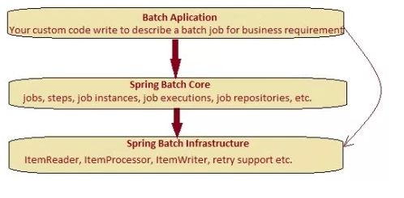
Spring Batch Architecture

Slide 18
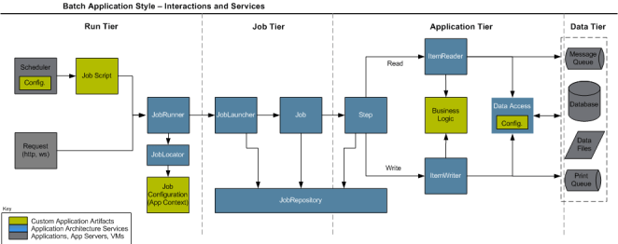
Spring Batch Launch Environment

Slide 19
The Anatomy of a Spring Batch Job
Spring Batch job consists of the following components:
The Job represents the Spring Batch job. Each job can have one or more steps.
The Step represents an independent logical task (i.e. import information from an input file). Each step belongs to one job.
The ItemReader reads the input data and provides the found items one by one. An ItemReaderbelongs to one step and each step must have only one ItemReader.
The ItemProcessor transforms items into a form that is understood by the ItemWriter one item at a time. An ItemProcessor belongs to one step and each step can have one ItemProcessor.
The ItemWriter writes an information of an item to the output one item at a time. An ItemWriterbelongs to one step and a step must have only one ItemWriter

Slide 20
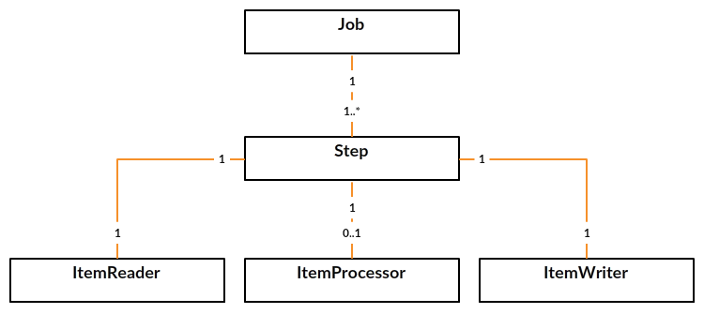
The Anatomy of a Spring Batch Job

Slide 21
Examining Jobs and Steps

Slide 22
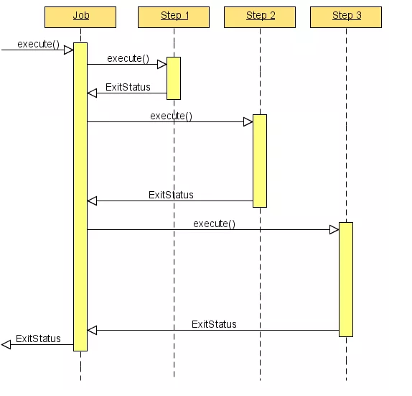
Examining Jobs and Steps

Slide 23
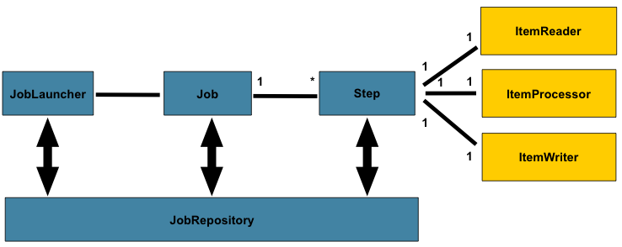
Batch Stereotypes

Slide 24
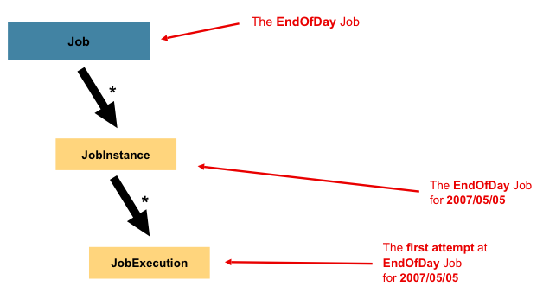
Job

Slide 25
Job
In Spring Batch, a Job is simply a container for Steps.
It combines multiple steps that belong logically together in a flow and allows for configuration of properties global to all steps, such as restartability.
The job configuration contains:
The simple name of the job
Definition and ordering of Steps
Whether or not the job is restartable

Slide 26
Job
<job id="footballJob">
<step id="playerload" next="gameLoad"/>
<step id="gameLoad" next="playerSummarization"/>
<step id="playerSummarization"/>
</job>

Slide 27
JobInstance
A JobInstance refers to the concept of a logical job run.
Let's consider a batch job that should be run once at the end of the day, such as the 'EndOfDay' job from the diagram above.
There is one 'EndOfDay' Job, but each individual run of the Job must be tracked separately.
In the case of this job, there will be one logical Job Instance per day.\
For example, there will be a January 1st run, and a January 2nd run. If the January 1st run fails the first time and is run again the next day, it is still the January 1st run.

Slide 28
Job Instance
Each Job Instance can have multiple executions and only one Job Instance corresponding to a particular Job and identifying Job Parameters can be running at a given time.
The definition of a JobInstance has absolutely no bearing on the data the will be loaded.
It is entirely up to the ItemReader implementation used to determine how data will be loaded.
Job Instance = Job + identifying Job Parameters.

Slide 29
JobParameters
Job Parameters is a set of parameters used to start a batch job.
They can be used for identification or even as reference data during the run:

Slide 30
Job Execution
A Job Execution refers to the technical concept of a single attempt to run a Job.
An execution may end in failure or success, but the Job Instance corresponding to a given execution will not be considered complete unless the execution completes successfully.

Slide 31
Job, Job Instance and Job Execution
A Job defines what a job is and how it is to be executed, and Job Instance is a purely organizational object to group executions together, primarily to enable correct restart semantics.
A Job Execution, however, is the primary storage mechanism for what actually happened during a run, and as such contains many more properties that must be controlled and persisted:

Slide 32
Job Execution Properties

Slide 33
Job Execution Properties

Slide 34
Step
A Step is a domain object that encapsulates an independent, sequential phase of a batch job.
Therefore, every Job is composed entirely of one or more steps.
A Step contains all of the information necessary to define and control the actual batch processing.
This is a necessarily vague description because the contents of any given Step are at the discretion of the developer writing a Job.
A Step can be as simple or complex as the developer desires.

Slide 35
Step
A simple Step might load data from a file into the database, requiring little or no code.
A more complex Step may have complicated business rules that are applied as part of the processing.
As with Job, a Step has an individual Step Execution that corresponds with a unique Job Execution:

Slide 36
Step

Slide 37
Step Execution
A Step Execution represents a single attempt to execute a Step.
A new Step Execution will be created each time a Step is run, similar to Job Execution.
However, if a step fails to execute because the step before it fails, there will be no execution persisted for it.
A Step Execution will only be created when its Step is actually started.

Slide 38
Step Execution
Step executions are represented by objects of the Step Execution class.
Each execution contains a reference to its corresponding step and Job Execution, and transaction related data such as commit and rollback count and start and end times.
Additionally, each step execution will contain an Execution Context, which contains any data a developer needs persisted across batch runs, such as statistics or state information needed to restart.

Slide 39
Step Execution Properties

Slide 40
Step Execution Properties

Slide 41
Execution Context
An Execution Context represents a collection of key/value pairs that are persisted and controlled
by the framework in order to allow developers a place to store persistent state that is scoped to
a StepExecution or JobExecution.
For those familiar with Quartz, it is very similar to JobDataMap.
The best usage example is to facilitate restart. Using flat file input as an example, while processing individual lines, the framework periodically persists the Execution Context at commit points.
This allows the Item Reader to store its state in case a fatal error occurs during the run, or even if the power goes out.

Slide 42
Tasklet(Single or Granular Task)

Slide 43
Tasklet vs Chunk
Parameter | Tasklet | Chunk
When to use | Suppose the job to be run a single granular task then Tasklet processing is used. | Suppose the job to be run is complex and involves executing of tasks involving reads, processing and writes the we use chunk oriented processing

Slide 44
Tasklet vs Chunk
How it works | No aggregation, just the task gets executed. | It involves reading an input, processing it based on the business logic and then aggregating it till the commit-interval is reached and finally writing out the chunk of data output to a file or database table.
Usage | Its not used commonly. | Its the most common way of executing a Step.

Slide 45
Tasklet vs Chunk
Use Case | Usually Used in scenarios invloving a single task like deleting a resource or executing a query . | Usually used in scenarios where multiple aggregated steps need to be run like copying, processing and transferring of data .

Slide 46
Tasklet vs Chunk
Example | <job id="taskletJob"> <step id="callingStoredProc"> <tasklet ref="callProc"/> </step> </job> Spring Batch Tasklet Example | <job id="sampleJob" job-repository="jobRepository"> <step id="step1"> <tasklet transaction-manager="transactionManager"> <chunk reader="itemReader" writer="itemWriter" commit-interval="10"/> </tasklet> </step> </job> Spring Batch Chunk Processing Example

Slide 47
Job Repository
Job Repository is the persistence mechanism.
It provides CRUD operations for Job Launcher, Job, and Step implementations.
When a Job is first launched, a Job Execution is obtained from the repository, and during the course of execution Step Execution and Job Execution implementations are persisted by passing them to the repository

Slide 48
Job Launcher
JobLauncher represents a simple interface for launching a Job with a given set of Job Parameters:
public interface JobLauncher {
public JobExecution run(Job job, JobParameters jobParameters)
throws JobExecutionAlreadyRunningException, JobRestartException;
}

Slide 49
Item Reader
Item Reader is an abstraction that represents the retrieval of input for a Step, one item at a time.
When the Item Reader has exhausted the items it can provide, it will indicate this by returning null.

Slide 50
Item Reader
Reader | Purpose
FlatFIleItemReader | To read data from flat files.
StaxEventItemReader | To read data from XML files.
StoredProcedureItemReader | To read data from the stored procedures of a database.
JDBCPagingItemReader | To read data from relational databases database.
MongoItemReader | To read data from MongoDB.
Neo4jItemReader | To read data from Neo4jItemReader.

Slide 51
Item Writer
Item Writer is an abstraction that represents the output of a Step, one batch or chunk of items at a time.
Generally, an item writer has no knowledge of the input it will receive next, only the item that
was passed in its current invocation.

Slide 52
Item Writer
Writer | Purpose
FlatFIleItemWriter | To write data into flat files.
StaxEventItemWriter | To write data into XML files.
StoredProcedureItemWriter | To write data into the stored procedures of a database.
JDBCPagingItemWriter | To write data into relational databases database.
MongoItemWriter | To write data into MongoDB.
Neo4jItemWriter | To write data into Neo4j.

Slide 53
Item Processor
Item Processor is an abstraction that represents the business processing of an item.
While the Item Reader reads one item, and the Item Writer writes them, the Item Processor provides access to transform or apply other business processing.
If, while processing the item, it is determined that the item is not valid, returning null indicates that the item should not be written out.

Slide 54
Configuring and Running a Job

Slide 55
Configuring a Job(Default Job Repository)
<job id="footballJob">
<step id="playerload" parent="s1" next="gameLoad"/>
<step id="gameLoad" parent="s2" next="playerSummarization"/>
<step id="playerSummarization" parent="s3"/>
</job>
repository with an id of 'jobRepository', which is a sensible default

Slide 56
Configuring a Job (Explicit Job Repository)
<job id="footballJob" job-repository="specialRepository">
<step id="playerload" parent="s1" next="gameLoad"/>
<step id="gameLoad" parent="s3" next="playerSummarization"/>
<step id="playerSummarization" parent="s3"/>
</job>

Slide 57
Restartability
One key issue when executing a batch job concerns the behavior of a Job when it is restarted.
The launching of a Job is considered to be a 'restart' if a JobExecution already exists for the particular JobInstance.
Ideally, all jobs should be able to start up where they left off, but there are scenarios where this is not possible.
It is entirely up to the developer to ensure that a new Job Instance is created in this scenario.
However, Spring Batch does provide some help.
If a Job should never be restarted, but should always be run as part of a new JobInstance, then the restartable property may be set to 'false':
<job id="footballJob" restartable="false">
...
</job>

Slide 58
Restartability
To phrase it another way, setting restartable to false means "this Job does not support being started again".
Restarting a Job that is not restartable will cause a JobRestartException to be thrown:
Job job = new SimpleJob();
job.setRestartable(false);
JobParameters jobParameters = new JobParameters();
JobExecution firstExecution = jobRepository.createJobExecution(job, jobParameters);
jobRepository.saveOrUpdate(firstExecution);
try {
jobRepository.createJobExecution(job, jobParameters);
fail();
}
catch (JobRestartException e) {
// expected
}

Slide 59
Intercepting Job Execution
During the course of the execution of a Job, it may be useful to be notified of various events in its lifecycle so that custom code may be executed.
The Simple Job allows for this by calling a Job Listener at the appropriate time:
public interface JobExecutionListener {
void beforeJob(JobExecution jobExecution);
void afterJob(JobExecution jobExecution);
}
<job id="footballJob">
<step id="playerload" parent="s1" next="gameLoad"/>
<step id="gameLoad" parent="s2" next="playerSummarization"/>
<step id="playerSummarization" parent="s3"/>
<listeners>
<listener ref="sampleListener"/>
</listeners>
</job>

Slide 60
Intercepting Job Execution
It should be noted that after Job will be called regardless of the success or failure of the Job.
If success or failure needs to be determined it can be obtained from the Job Execution:
public void afterJob(JobExecution jobExecution){
if( jobExecution.getStatus() == BatchStatus.COMPLETED ){
//job success
}
else if(jobExecution.getStatus() == BatchStatus.FAILED){
//job failure
}
}

Slide 61
Inheriting from a Parent Job
If a group of Jobs share similar, but not identical, configurations, then it may be helpful to define a "parent" Job from which the concrete Jobs may inherit properties.
Similar to class inheritance in Java, the "child" Job will combine its elements and attributes with the parent's.
In the following example, "baseJob" is an abstract Job definition that defines only a list of listeners.
The Job "job1" is a concrete definition that inherits the list of listeners from "baseJob" and merges it with its own list of listeners to produce a Job with two listeners and one Step, "step1".

Slide 62
Inheriting from a Parent Job
<job id="baseJob" abstract="true">
<listeners>
<listener ref="listenerOne"/>
<listeners>
</job>
<job id="job1" parent="baseJob">
<step id="step1" parent="standaloneStep"/>
<listeners merge="true">
<listener ref="listenerTwo"/>
<listeners>
</job>

Slide 63
Configuring a Job Repository
Job Repository is used for basic CRUD operations of the various
persisted domain objects within Spring Batch, such as Job Execution and Step Execution.
It is required by many of the major framework features, such as the Job Launcher, Job, and Step.
<job-repository id="jobRepository"
data-source="dataSource"
transaction-manager="transactionManager"
isolation-level-for-create="SERIALIZABLE"
table-prefix="BATCH_"
max-varchar-length="1000"/>
The max-varcharlength
defaults to 2500, which is the length of the long VARCHAR columns in the sample schema scripts
used to store things like exit code descriptions.

Slide 64
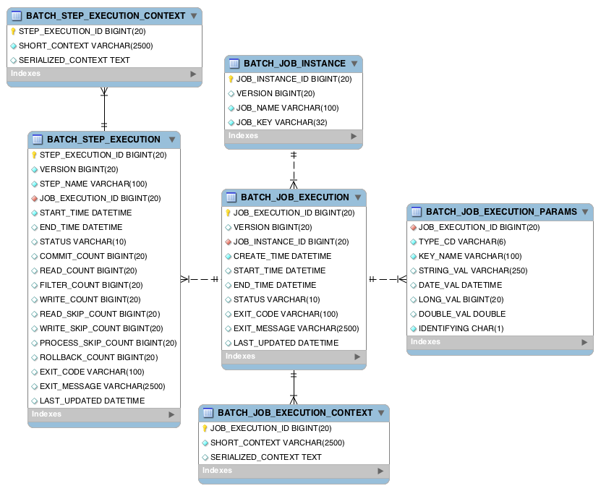
Meta Data

Slide 65
Configuring a Job Launcher
<bean id="jobLauncher"
class="org.springframework.batch.core.launch.support.SimpleJobLauncher">
<property name="jobRepository" ref="jobRepository" />
</bean>
(or)
<bean id="jobLauncher"
class="org.springframework.batch.core.launch.support.SimpleJobLauncher">
<property name="jobRepository" ref="jobRepository" />
<property name="taskExecutor">
<bean class="org.springframework.core.task.SimpleAsyncTaskExecutor" />
</property>
</bean>

Slide 66
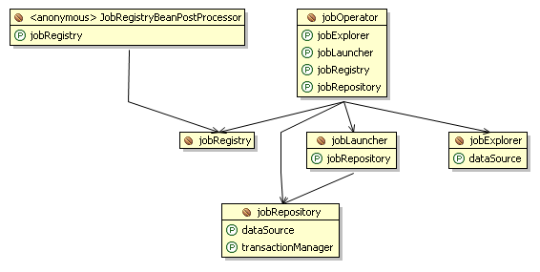
Job Launcher

Slide 67
Job Operator
The JobRepository provides CRUD operations on the meta-data.
The JobExplorer provides read-only operations on the meta-data.
However, those operations are most useful when used together to perform common monitoring tasks such as stopping, restarting, or summarizing a Job, as is commonly done by batch operators. Spring
Spring Batch provides for these types of operations via the JobOperator interface:

Slide 69
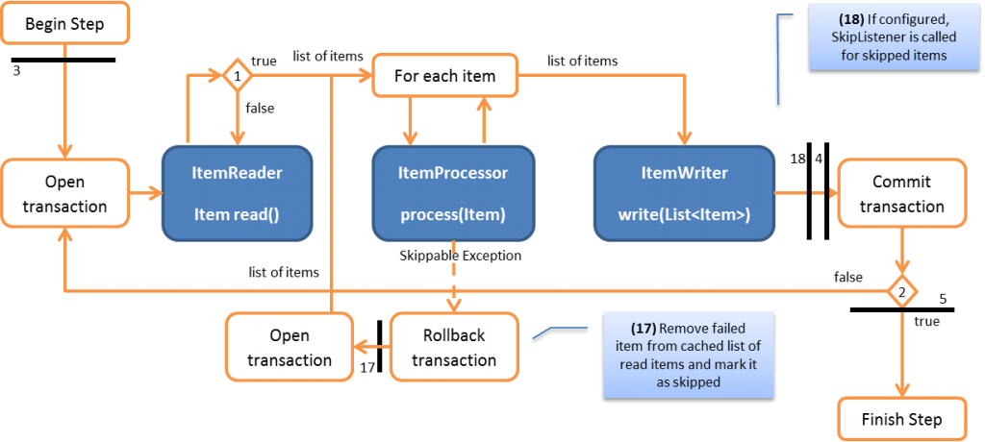
Skip

Slide 70
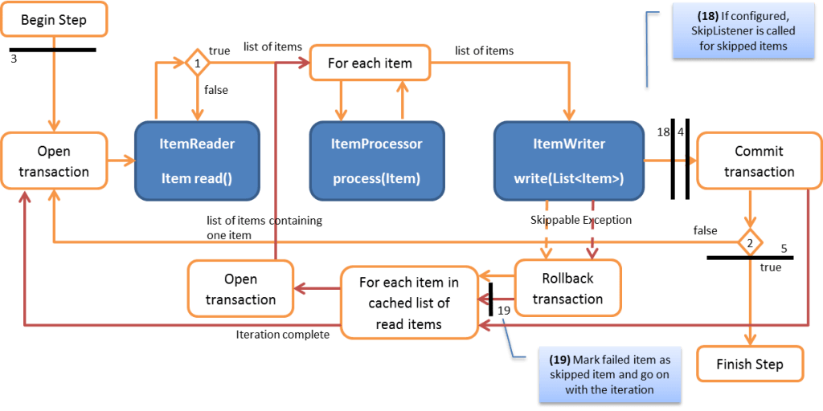
Skip

Slide 71
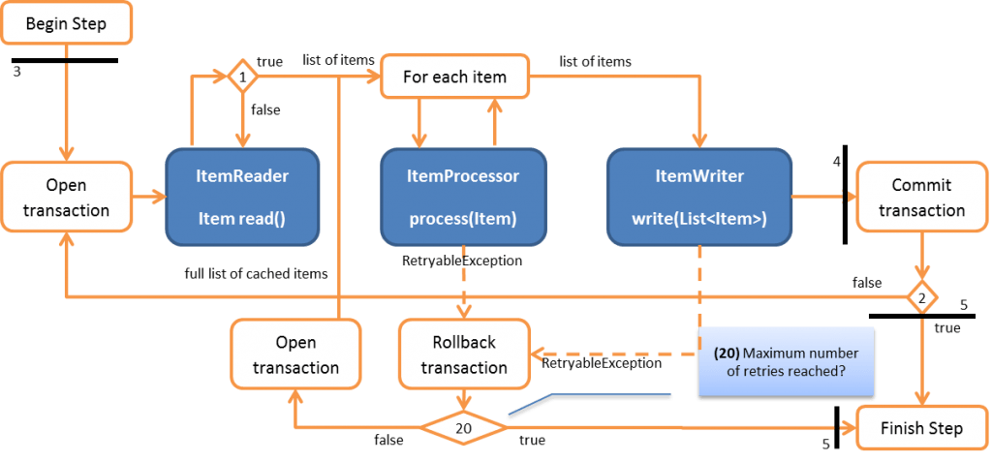
Retry

Slide 72
Configuring a Step

Slide 73
Chunk Oriented Processing
Spring Batch uses a 'Chunk Oriented' processing style within its most common implementation.
Chunk oriented processing refers to reading the data one at a time, and creating 'chunks' that will be written out, within a transaction boundary.
One item is read in from an ItemReader, handed to an ItemProcessor, and aggregated.
Once the number of items read equals the commit interval, the entire chunk is written out via the ItemWriter, and then the transaction is committed.

Slide 74
Chunk Oriented Processing

Slide 75
Chunk Oriented Processing
List items = new Arraylist();
for(int i = 0; i < commitInterval; i++){
Object item = itemReader.read()
Object processedItem = itemProcessor.process(item);
items.add(processedItem);
}
itemWriter.write(items);
<job id="sampleJob" job-repository="jobRepository">
<step id="step1">
<tasklet transaction-manager="transactionManager">
<chunk reader="itemReader" writer="itemWriter" commit-interval="10"/>
</tasklet>
</step>
</job>

Slide 76
Configuring a Step
<job id="sampleJob" job-repository="jobRepository">
<step id="step1">
<tasklet transaction-manager="transactionManager">
<chunk reader="itemReader" writer="itemWriter" commit-interval="10“/>
</tasklet>
</step>
</job>

Slide 77
Inheriting from a Parent Step
<step id="parentStep">
<tasklet allow-start-if-complete="true">
<chunk reader="itemReader" writer="itemWriter" commit-interval="10"/>
</tasklet>
<step id="concreteStep1" parent="parentStep">
<tasklet start-limit="5">
<chunk processor="itemProcessor" commit-interval="5"/>
</tasklet>
</step>

Slide 78
Abstract Step
<step abstract="true" id="abstractParentStep">
<tasklet>
<chunk commit-interval="10"/>
</tasklet>
</step>
<step id="concreteStep2" parent="abstractParentStep">
<tasklet>
<chunk reader="itemReader" writer="itemWriter"/>
</tasklet>
</step>

Slide 79
The Commit Interval
<job id="sampleJob">
<step id="step1">
<tasklet>
<chunk reader="itemReader" writer="itemWriter" commit-interval="10"/>
</tasklet>
</step>
</job>

Slide 80
Configuring a Step for Restart
<step id="step1">
<tasklet start-limit="1">
<chunk reader="itemReader" writer="itemWriter" commit-interval="10"/>
</tasklet>
</step>
The simple step above can be run only once. Attempting to run it again will cause an exception to be thrown. It should be noted that the default value for the start-limit is Integer.MAX_VALUE.

Slide 81
Restarting a completed step
<step id="step1">
<tasklet allow-start-if-complete="true">
<chunk reader="itemReader" writer="itemWriter" commit-interval="10"/>
</tasklet>
</step>

Slide 82
Configuring Skip Logic
<step id="step1">
<tasklet>
<chunk commit-interval="10" reader="flatFileItemReader" skip-limit="10" writer="itemWriter">
<skippable-exception-classes>
<include class="org.springframework.batch.item.file.FlatFileParseException"/>
</skippable-exception-classes>
</chunk>
</tasklet>
</step>

Slide 83
Configuring Skip Logic
<step id="step1">
<tasklet>
<chunk commit-interval="10" reader="flatFileItemReader" skip-limit="10" writer="itemWriter">
<skippable-exception-classes>
<include class="java.lang.Exception"/>
<exclude class="java.io.FileNotFoundException"/>
</skippable-exception-classes>
</chunk>
</tasklet>
</step>

Slide 84
Configuring Retry Logic
<step id="step1">
<tasklet>
<chunk commit-interval="2" reader="itemReader" retry-limit="3" writer="itemWriter">
<retryable-exception-classes>
<include class="org.springframework.dao.DeadlockLoserDataAccessException"/>
</retryable-exception-classes>
</chunk>
</tasklet>
</step>

Slide 85
Controlling Rollback
<step id="step1">
<tasklet>
<chunk commit-interval="2" reader="itemReader" writer="itemWriter">
<no-rollback-exception-classes>
<include class="org.springframework.batch.item.validator.ValidationException"/>
</no-rollback-exception-classes>
</chunk></tasklet>
</step>

Slide 86
Transaction Attributes
<tasklet>
<chunk reader="itemReader" writer="itemWriter" commit-interval="2"/>
<transaction-attributes isolation="DEFAULT"
propagation="REQUIRED"
timeout="30"/>
</tasklet>

Slide 87
Registering ItemStreams with the Step
<step id="step1">
<tasklet>
<chunk commit-interval="2" reader="itemReader" writer="compositeWriter">
<streams>
<stream ref="fileItemWriter1"/>
<stream ref="fileItemWriter2"/>
</streams>
</chunk>
</tasklet>
</step>
<beans:bean class="org.springframework.batch.item.support.CompositeItemWriter" id="compositeWriter">
<beans:property name="delegates">
<beans:list>
<beans:ref bean="fileItemWriter1" />
<beans:ref bean="fileItemWriter2" />
</beans:list>
</beans:property>
</beans:bean>

Slide 88
LineMapper
public interface LineMapper<T> {
T mapLine(String line, int lineNumber) throws Exception;
}
Line Mapper gets a raw line

Slide 89
LineTokenizer
An abstraction for turning a line of input into a line into a FieldSet is necessary because there can be many formats of flat file data that need to be converted to a FieldSet.
In Spring Batch, this interface is the LineTokenizer:
public interface LineTokenizer {
FieldSet tokenize(String line);
}
This FieldSet can then be passed to a FieldSetMapper.

Slide 90
Line Tokenizers
DelmitedLineTokenizer - Used for files where fields in a record are separated by a delimiter. The most common delimiter is a comma, but pipes or semicolons are often used as well.
FixedLengthTokenizer -sed for files where fields in a record are each a 'fixed width'. The width of each field must be defined for each record type.
PatternMatchingCompositeLineTokenizer - Determines which among a list of LineTokenizers should be used on a particular line by checking against a pattern.

Slide 91
FieldSetMapper
This FieldSet can then be passed to a FieldSetMapper.
Spring Batch contains the following LineTokenizer implementations:
The FieldSetMapper interface defines a single method, mapFieldSet, which takes a FieldSet object and maps its contents to an object.
This object may be a custom DTO, a domain object, or a simple array, depending on the needs of the job.
The FieldSetMapper is used in conjunction with the LineTokenizer to translate a line of data from a resource into an object of the desired type:

Slide 92
LineAggregator
Line Aggregator interface is necessary to take an item and turn it into a String.
File writing must have a way to aggregate multiple fields into a single string for writing to a file.
In Spring Batch this is the LineAggregator:
public interface LineAggregator<T> {
public String aggregate(T item);
}

Slide 93
LineAggregator
The Line Aggregator is the opposite of a Line Tokenizer.
Line Tokenizer takes a String and returns a Field Set, whereas Line Aggregator takes an item and returns a String.

Slide 94
PassThroughLineAggregator
The most basic implementation of the LineAggregator interface is the PassThroughLineAggregator.
It simply assumes that the object is already a string, or that its string representation is acceptable for writing:
public class PassThroughLineAggregator<T> implements LineAggregator<T> {
public String aggregate(T item) {
return item.toString();
}
}

Slide 95
Express Spring Integration
Understanding Channels

Slide 96
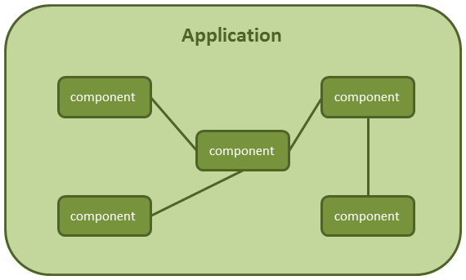
Spring Integration

Slide 97
Spring Integration
It allows communication between components within your application, based on in-memory messaging.
This allows these application components to be loosely coupled with each other, sharing data through message channels.
It allows communication with external systems.
You just need to send the information; Spring Integration will handle sending it to the specified external system and bring back a response if necessary.
Spring Integration will handle incoming calls from the external system to your application.

Slide 98
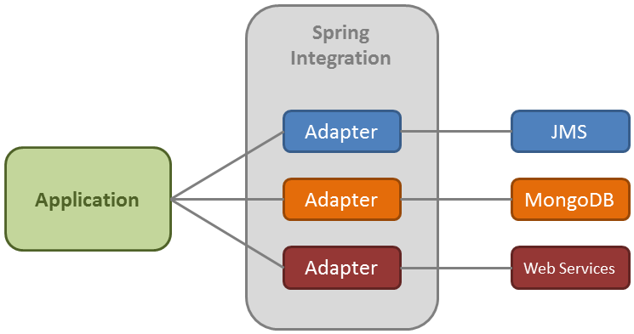
Spring Integration

Slide 99
Spring Integration
Spring Integration targets the best practices of the Spring framework like programming with interfaces or composition over inheritance technique.
Its main benefits are:
Loose coupling among components.
Event oriented architecture.
The integration logic (handled by the framework) is separated from the business logic.

Slide 100
Core concepts of Spring Integration messaging system
The basic concepts of a message-driven architecture are: message, message channel and message endpoint.
The API is pretty simple:
A message is sent to an endpoint
Endpoints are connected among them through MessageChannels
An endpoint can receive messages from a MessageChannel

Slide 101
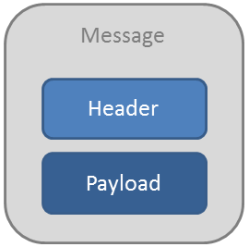
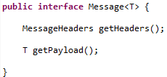
Message

Slide 102
Header
Header: Contains meta-information about the message.
Once the message has been created, you cannot modify it.
You can add your own headers in the form of key-value pair, but they are mainly used to pass transport information.
For example, if you want to send an e-mail, it will contain headers like to, subject, from…

Slide 103
Payload
This is just a normal Java class that will contain the information you want to share.
It can be any Java type.
Message<String> message = MessageBuilder
.withPayload("my message payload")
.setHeader("key1", "value1")
.setHeader("key2", "value2")
.build();

Slide 104
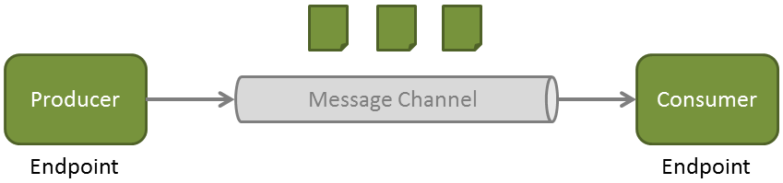
Message Channel
A message channel is a pipe that connects endpoints, and where messages travel through.
Producers send messages to a channel and consumers receive them from a channel.
With this mechanism, you don’t need any kind of broker.
A message channel can also be used as an interception point or for message monitoring.

Slide 105
Spring Integration
The main components
Pipe
Producer
(Sender)
Consumer
(Receiver)
Message

Slide 106
Spring Integration Applications
Pipe
Producer
(Sender)
Consumer
(Receiver)
Pipe
Pipe
Pipe
Producer
(Sender)
Consumer
(Receiver) -/Producer (Sender)
Consumer
(Receiver) -/Producer (Sender)
Consumer
(Receiver)
filter
transform
Message

Slide 107
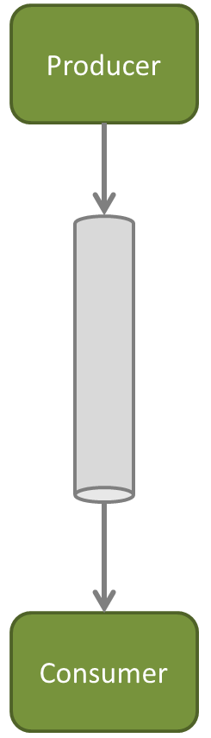
Point-to-point

Slide 108
Message Channels
Two general classifications of message channels
Pollable Channel
Subscribable Channel

Slide 109
Pollable Channels
May buffer its messages
Requires a queue to hold the messages
The queue has a designated capacity
Waits for the consumer to get the messages
Consumers actively poll to receive messages
Typically a point-to-point channel
Only one receiver of a message in the channel
Usually used for sending information or “document” messages between endpoints

Slide 110
Subscribable
Allows multiple subscribers (or consumers) to register for its messages.
Messages are delivered to all registered subscribers on message arrival
It has to manage a list or registry of subscribers.
Doesn’t buffer its messages
Usually used for “event” messages
Notifying the subscribers that something happened and to take appropriate action.

Slide 111
Direct Channel
DirectChannel: Implements SubscribableChannel.
The message is sent to the subscriber through the same receiver’s thread.
This communication is synchronous and the producer block until a response is received.
How it works:The producer sends the message to the channel.
The channel sends the message to its subscriber (passive subscriber).

Slide 112
QueueChannel
Implements PollableChannel. T
There’s one endpoint connected to the channel, no subscribers.
This communication is asynchronous; the receiver will retrieve the message through a different thread.
How it works:The producer sends the message to the channel.
The channel queues the message.
The consumer actively retrieves the message (active receiver).

Slide 113
ExecutorChannel
Implements SubscribableChannel.
Sending is delegated to a TaskExecutor.
This means that the send() method will not block.

Slide 114
Priority Channel
Implements PollableChannel.
Similar to the QueueChannel but messages are ordered by priority instead of FIFO.

Slide 115
Rendezvous Channel
Implements PollableChannel.
Similar to the Queue Channel but with zero capacity.
The producer will block until the receiver invokes its receive() method.

Slide 116
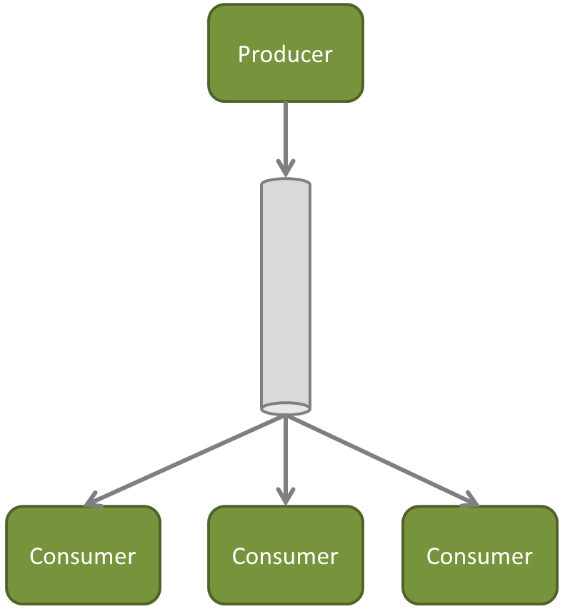
Publish-subscribe
The channel can have several endpoints subscribed to it. Thus, the message will be handled by different receivers.

Slide 117
Publish Subscribe Channel
Implements SubscribableChannel.
Subscribed receivers can be invoked consecutively through the producer’s thread.
If we specify a TaskExecutor, receivers will be invoked in parallel through different threads.

Slide 118
Temporary channels
This is a special type of channel which is created automatically by endpoints that have no output channel explicitly defined.
The channel created is a point-to-point anonymous channel.
You can see it defined in the message header under the name reply Channel.
These types of channels are automatically deleted once the response is sent.
It is recommended that you don’t explicitly define an output channel if you don’t need it.
The framework will handle it for you.

Slide 119
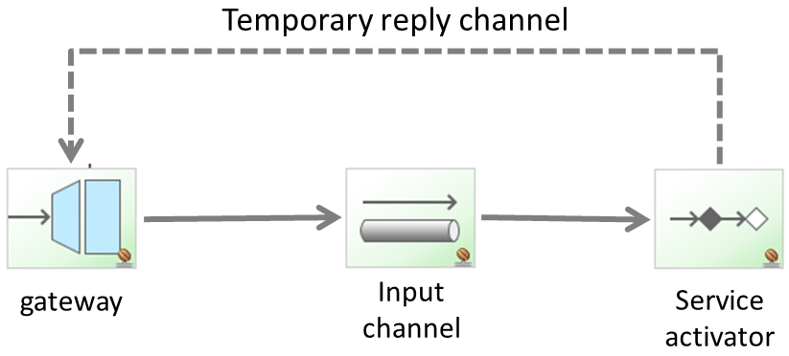
Temporary channels

Slide 120
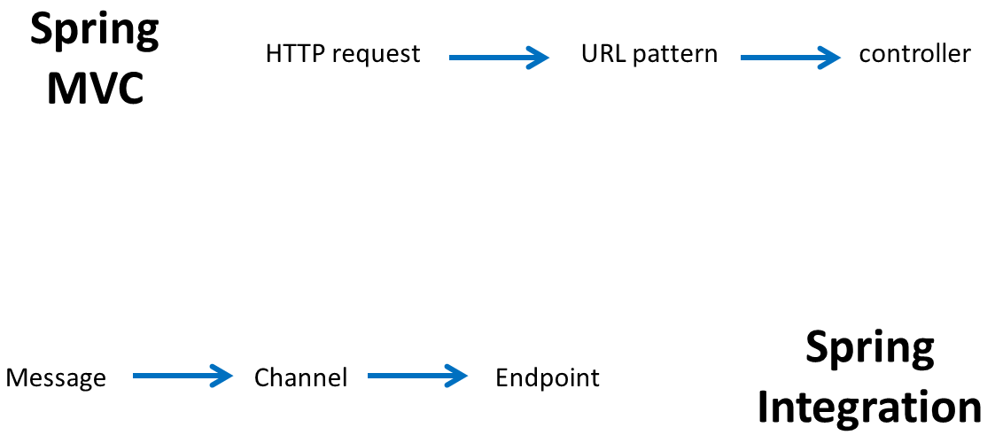
Message EndPoints

Slide 121
Message Endpoints
Channel adapter: Connects the application to an external system (unidirectional).
Gateway: Connects the application to an external system (bidirectional).
Service Activator: Can invoke an operation on a service object.
Transformer: Converts the content of a message.
Filter: Determines if a message can continue its way to the output channel.
Router: Decides to which channel the message will be sent.
Splitter: Splits the message in several parts.
Aggregator: Combines several messages into a single one.

Slide 122
Channel Adapters
The channel adapter is the endpoint that allows your application to connect with external systems.
Provided types like connecting to JMS queues, MongoDB databases, RMI, web services, etc.
There are four types of adapters:
Inbound channel adapter: Unidirectional. It receives a message from an external system. It then enters to our messaging system through a message channel, where we will handle it.
Outbound channel adapter: Unidirectional. Our message system creates a message and sends it to an external system.
Inbound gateway: Bidirectional. A message enters into the application and expects a response. The response will be sent back to the external system.
Outbound gateway: Bidirectional. The application creates a message and sends it to the external system. The gateway will then wait for a response.

Slide 123
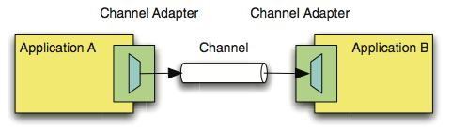
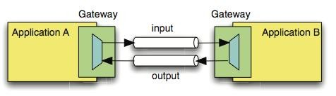

Slide 124



Inbound
Outbound
Service Aggregator

Slide 125
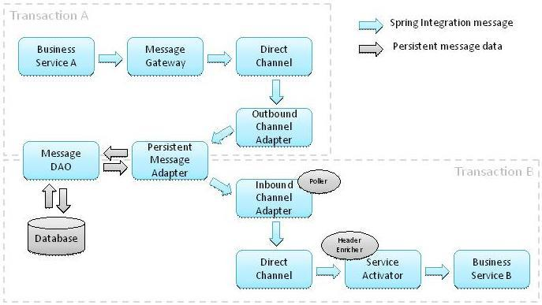

Slide 126
Scaling and Parallel Processing
Many batch processing problems can be solved with single threaded, single process jobs.
It is always a good idea to properly check if that meets your needs before thinking about more complex implementations.
Measure the performance of a realistic job and see if the simplest implementation meets your needs first:
you can read and write a file of several hundred megabytes in well under a minute, even with standard hardware.

Slide 127
Scaling and Parallel Processing
When you are ready to start implementing a job with some parallel processing, Spring Batch offers a range of options.
At a high level there are two modes of parallel processing: single process, multi-threaded; and multi-process.
These break down into categories as well, as follows:
Multi-threaded Step (single process)
Parallel Steps (single process)
Remote Chunking of Step (multi process)
Partitioning a Step (single or multi process)

Slide 128
Multi-threaded Step
The simplest way to start parallel processing is to add a TaskExecutor to your Step configuration, e.g. as an attribute of the tasklet:
<step id="loading">
<tasklet task-executor="taskExecutor">...</tasklet>
</step>
taskExecutor is a reference to another bean definition, implementing the TaskExecutor interface.

Slide 129
Multi-threaded Step
The result of the above configuration will be that the Step executes by reading, processing and writing each chunk of items (each commit interval) in a separate thread of execution.
Note that this means there is no fixed order for the items to be processed, and a chunk might contain items that are non-consecutive compared to the single-threaded case. .
In addition to any limits placed by the task executor (e.g. if it is backed by a thread pool), there is a throttle limit in the tasklet configuration which defaults to 4.
You may need to increase this to ensure that a thread pool is fully utilised,
<step id="loading"> <tasklet
task-executor="taskExecutor"
throttle-limit="20">...</tasklet>
</step>

Slide 130
Multi-threaded Step
Note also that there may be limits placed on concurrency by any pooled resources used in your step, such as a DataSource.
Be sure to make the pool in those resources at least as large as the desired number of concurrent threads in the step.

Slide 131
Multi-threaded Step
There are some practical limitations of using multi-threaded Steps for some common Batch use cases.
Many participants in a Step (e.g. readers and writers) are stateful, and if the state is not segregated by thread, then those components are not usable in a multi-threaded Step.
In particular most of the off-the-shelf readers and writers from Spring Batch are not designed for multi-threaded use.
It is, however, possible to work with stateless or thread safe readers and writers.
Process Indicator is to keep track of items that have been processed in a database input table.

Slide 132
Parallel Steps
As long as the application logic that needs to be parallelized can be split into distinct responsibilities, and assigned to individual steps then it can be parallelized in a single process.
Parallel Step execution is easy to configure and use, for example, to execute steps (step1,step2) in parallel with step3, you could configure a flow like this:

Slide 133
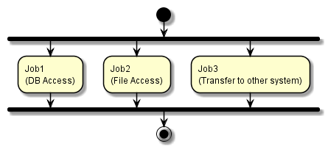
Parallel jobs

Slide 134
Parallel Steps
<job id="job1">
<split id="split1" task-executor="taskExecutor" next="step4">
<flow>
<step id="step1" parent="s1" next="step2"/>
<step id="step2" parent="s2"/>
</flow>

Slide 135
Parallel Steps
<flow>
<step id="step3" parent="s3"/>
</flow>
</split>
<step id="step4" parent="s4"/>
</job>
<beans:bean id="taskExecutor" class="org.spr...SimpleAsyncTaskExecutor"/>

Slide 136
Parallel Steps
The configurable "task-executor" attribute is used to specify which TaskExecutor implementation should be used to execute the individual flows.
The default is SyncTaskExecutor, but an asynchronous TaskExecutor is required to run the steps in parallel.
Note that the job will ensure that every flow in the split completes before aggregating the exit statuses and transitioning.

Slide 137
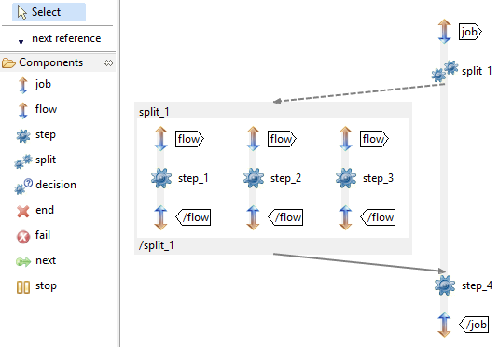
Parallel Steps

Slide 138
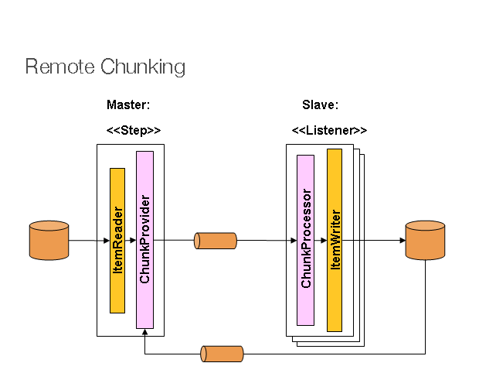
Remote Chunking
In Remote Chunking the Step processing is split across multiple processes, communicating with each other through some middleware.

Slide 139
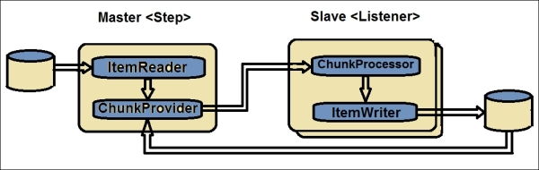
Remote Chunking

Slide 140
http://www.ontheserverside.com/blog/2014/07/23/horizontal-and-vertical-scaling-strategies-for-batch-applications

