Slide 1
DBMS COURSE PROJECT · FINAL PRESENTATION
Student and College
Management System
Campus Ledger
Golamari Shashanth Reddy
Hansini Baggu
Kandibanda Balaji
25WU0101041
25WU0101045
25WU0101057
Problem → ER & schema → MySQL & queries → working UI
Notes:
We are presenting Campus Ledger, a Student and College Management System. Our ten-minute sequence follows the assessment brief: problem, ER design and schema, live MySQL commands, then the UI demonstration.
Project evidence: README.md; final-presentation brief pages 1–2

Slide 2
1 MINUTE · PROBLEM
Problem, objectives and users
Problem
Admissions, teaching, examinations and accounts maintain related student records. Separate registers repeat data and slow reconciliation.
Objective
One connected database for admission, registration, attendance, grades, bills, payments and reports.
Users
Admin • Faculty • Examinations • Accounts • Student • Head of department
Campus Ledger | DBMS final presentation
02
Notes:
The problem is disconnected college records. The first-version scope is the full academic and fee workflow for a student. Six roles see the records and actions relevant to them. Hostel, library and payroll are outside this version.
Project evidence: README.md; complete project report sections 2–3

Slide 3
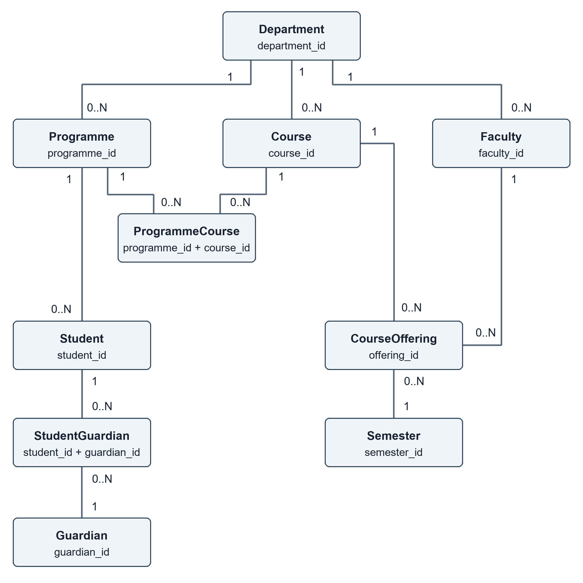
2 MINUTES · ER AND SCHEMA
ER model: academic structure
Core entities
Department • Programme
Course • Faculty • Semester
Student • Guardian
Course Offering • Registration
Keys and relationships
Each entity has a primary key. Foreign keys connect the child to exactly one parent; a parent can have zero or many children.
Campus Ledger | DBMS final presentation
03
Notes:
This diagram covers the academic master data. A department may offer many programmes and courses. Every programme belongs to one department. A course offering is one course in one semester, taught by one faculty member. Student and Guardian are many-to-many through StudentGuardian. The image files supplied with the repository also show attendance, exams, grades and fees.
Project evidence: ER_Diagram_1.png to ER_Diagram_4.png; sql/01_schema.sql

Slide 4
2 MINUTES · ER AND SCHEMA
Relationships, cardinality and participation
Relationship
Cardinality
Child participation
Department → Programme
1 to 0..N
Programme requires one department
Student → Registration
1 to 0..N
Registration requires one student
Offering → Registration
1 to 0..N
Registration requires one offering
Registration → Attendance
1 to 0..N
Attendance requires a registration
Fee Bill → Payment
1 to 0..N
Payment requires one bill
Bridge tables resolve many-to-many links: StudentGuardian, ProgrammeCourse and Registration.
Campus Ledger | DBMS final presentation
04
Notes:
The parent side may have no children, which is why the minimum is zero. A child row has a required foreign key to exactly one parent. The bridge tables resolve many-to-many relationships. These relationships are enforced through primary keys, foreign keys and unique constraints.
Project evidence: sql/01_schema.sql; ER_Diagram_2.png to ER_Diagram_4.png

Slide 5
2 MINUTES · ER AND SCHEMA
Relational schema and Third Normal Form
Representative keys
Student(student_id PK, programme_id FK, registration_no UNIQUE)
CourseOffering(offering_id PK, course_id FK, semester_id FK, faculty_id FK)
Registration(registration_id PK, student_id FK, offering_id FK)
Attendance(registration_id + session_id composite PK)
FeeBill(bill_id PK, student_id FK, semester_id FK)
Payment(payment_id PK, bill_id FK)
Why 3NF?
Each table stores one subject. Repeating values become separate rows; balances and attendance percentages are derived through views.
Campus Ledger | DBMS final presentation
05
Notes:
The schema has 21 base tables. Course facts stay in Course, while semester, section, capacity and teacher stay in CourseOffering. A student stores programme_id, and department is reached through Programme, avoiding a transitive dependency. Payment and attendance are separate rows; balances and percentages are calculated rather than copied.
Project evidence: sql/01_schema.sql; docs/REVIEW_2_EVIDENCE.md

Slide 6
2 MINUTES · DATABASE AND QUERIES
MySQL creation, constraints and sample rows
Live file: DBMS_Course_Project_All_Commands.sql
CREATE DATABASE college_pbl_presentation;
CREATE TABLE registration (
registration_id INT AUTO_INCREMENT PRIMARY KEY,
student_id INT NOT NULL, offering_id INT NOT NULL,
UNIQUE (student_id, offering_id),
FOREIGN KEY (student_id) REFERENCES student(student_id),
FOREIGN KEY (offering_id) REFERENCES course_offering(offering_id)
);
Verified on MySQL 8
21 base tables
4 reporting views
11+ rows in every table
45 passing tests
Real run output is included as SQL_Execution_Output.txt.
Campus Ledger | DBMS final presentation
06
Notes:
Run the combined SQL file in a fresh MySQL database. It creates the database, tables, stored procedures, views, sample rows and SELECT queries. The shortened snippet shows the keys; the complete script has all fields and constraints. The count verification returns at least eleven rows in every one of the 21 base tables.
Project evidence: DBMS_Course_Project_All_Commands.sql; SQL_Execution_Output.txt; test-results-final.xml

Slide 7
2 MINUTES · DATABASE AND QUERIES
SELECT joins and aggregate outputs
Join
Student → Registration → CourseOffering → Course → Semester
Example: 2026CS001, Aarav Sharma, CS301, section A, 2026–27 Odd
Aggregate: active students by section
CS301 A 9
CS301 B 0
CS302 A 9
CS303 A 0
EC301 A 3
COUNT + LEFT JOIN includes sections with zero registrations.
Full queries and actual outputs are included in the repository.
Campus Ledger | DBMS final presentation
07
Notes:
We can run both SELECT examples live. The first follows a student across registration, course offering, course and semester. The aggregate query groups active registrations by section and uses a left join so empty sections appear with zero. The values shown here came from the executed MySQL script, not invented output.
Project evidence: Live_Demo_Queries.sql; SQL_Execution_Output.txt

Slide 8
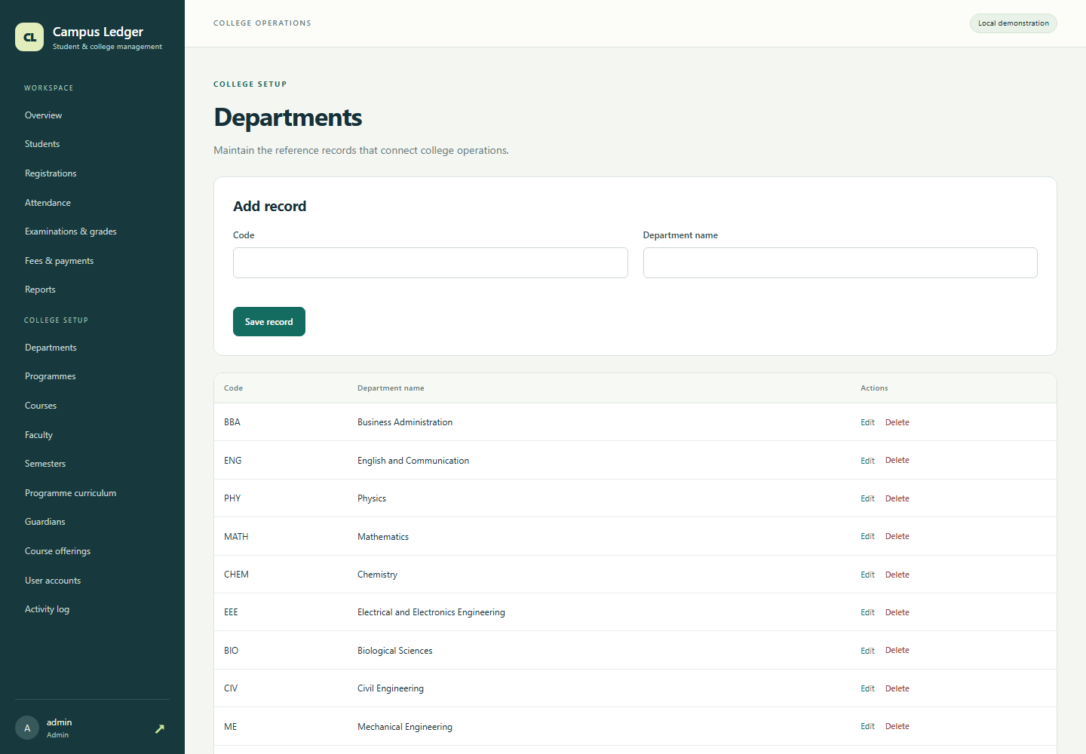
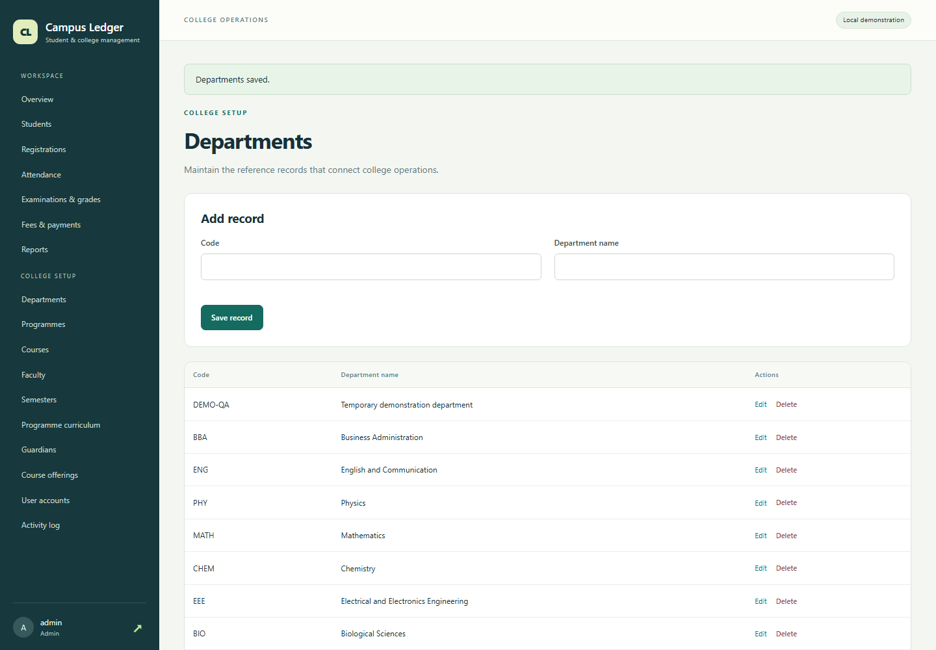
3 MINUTES · UI DEMO
Working UI: view and insert
Before: eleven departments
After UI insert: twelve departments
POST create → INSERT INTO department → SELECT confirms DEMO-QA
Campus Ledger | DBMS final presentation
08
Notes:
First show the list with eleven departments and the blank add form. Enter the temporary DEMO-QA department and save. The UI shows it at the top, and a SELECT confirms the new row in the same MySQL database. The count changes from eleven to twelve. The full screenshots are in Presentation/screenshots.
Project evidence: screenshots/13-department-before-insert.png; screenshots/14-department-after-insert-before-delete.png; CRUD_Database_Evidence.txt

Slide 9
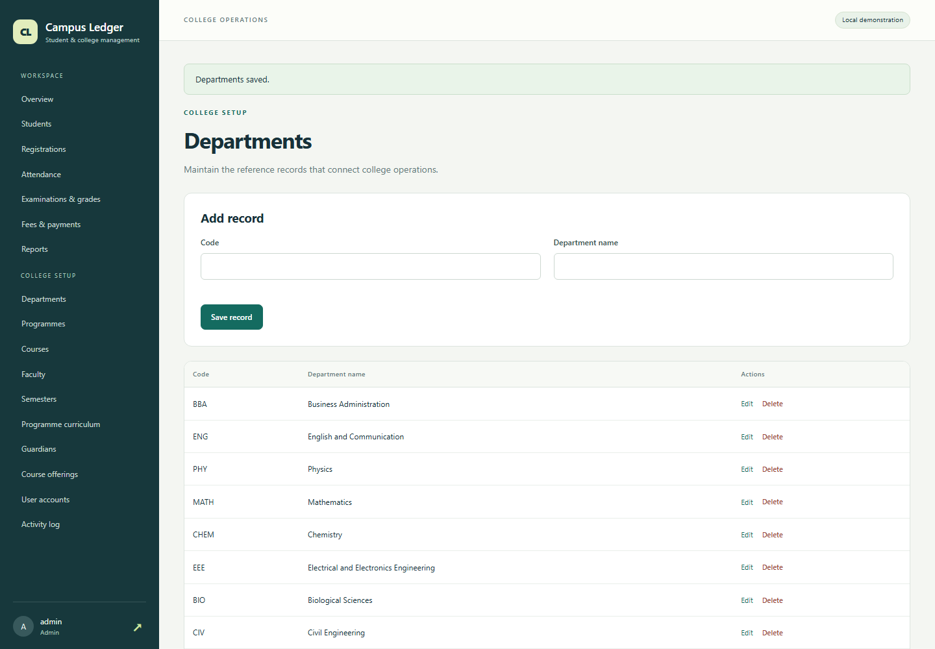
3 MINUTES · UI DEMO
Working UI: delete and database reflection
Before delete: DEMO-QA is present
After delete: DEMO-QA is absent
POST delete → DELETE FROM department → SELECT returns zero rows
Campus Ledger | DBMS final presentation
09
Notes:
Delete only the temporary DEMO-QA record, which has no child records. The UI list returns to eleven rows. A SELECT for DEMO-QA returns zero rows. The audit screen records both the create and delete actions. We then briefly show the student, attendance, examination, fees and report screens.
Project evidence: screenshots/14-department-after-insert-before-delete.png; screenshots/15-department-after-delete.png; CRUD_Database_Evidence.txt

Slide 10
2 MINUTES · QUESTIONS
Results, limits and questions
Verified result
45 tests passed · 0 failures · 0 errors
What the solution supports
Admissions, section registration, attendance, exam results, grades, fee collection and six CSV reports.
Scope of this prototype
Synthetic records. The 75% attendance threshold and grade scale are demo rules. The app runs locally.
Campus Ledger | DBMS final presentation
10
Notes:
Any team member can answer questions about the model, SQL and UI. Registration and payment procedures use row locks to prevent taking the last seat twice or overpaying a bill. The test suite was rerun against an isolated MySQL test database and passed all 45 tests. The 75 percent threshold and grade scale are demonstration assumptions, not a university policy.
Project evidence: docs/test-results-final.xml; README.md; DEMONSTRATION_GUIDE.md

