Slide 1
Satellite Flyover
Of Monsters and Men
May 2020
Anitha Venkatesan, Michael Nguyen, Gene Shaver, Tim Tanner

Slide 2
Agenda
Summary
Concept
Process and Application
Demo
Backlog
Links

Slide 3
Elevator Pitch
Our application will pique your curiosity. Who knew there was so much flying overhead?
Ever wonder what’s flying above you this very second? We have the tool that can help!
This app will provide you the names of specific satellites… what the satellites are doing… the angle to look for them from your global location… even what they look like.
It assess weather conditions to determine the visual viability of a search.
This application is everything you need to learn what’s orbiting above you now and everyday.

Slide 4
Concept
"Space or Satellite Enthusiast“ I spend time outdoors looking into the sky and wonder “what was that bright light?” Or wonder “can I see a satellite tonight?” Or just curious as to “what’s flying above right now?”
I want to determine which satellites are passing by;
I want to choose my current location or that of another city;
I want to save my most recent searches;
I want to filter by the type satellite;
I want to know if weather conditions are favorable for a view
I can satisfy my need for and curiosity about what orbiting over us
“As a”
“I Want”
“so that”

Slide 5
Process and Technology
User
Story
Application Sketch
APIs & CSS Selection
Determine
MVP
Build and Test
Iterations
The team started with a user story and initial UI sketch. The specific design minimum viable product changed in iterations over time.
Technology
HTML / CSS
Materialize
JavaScript
jQuery
JSON/AJAX
Local Storage
“3” Total APIs
Open Weather
N2YO.com (2 APIs)

Slide 6
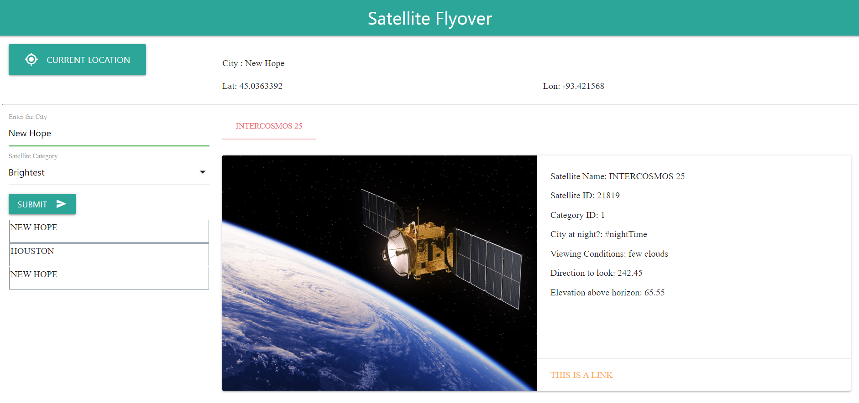
Demo

Slide 7
Backlog: What’s Next?
New Features
Save the category with the city in local storage
Change the image when category is selected
More satellite information
Additional search criteria
Projected arrival time i.e., when will satellite be in view?
Improved UX
Use a drop down box for search history
Satellite-specific images

Slide 8
Links
REPOSITORY: https://github.com/ttanner44/OfMonstersAndMen
APPLICATION LINK: https://ttanner44.github.io/OfMonstersAndMen/

