Slide 1


Slide 2
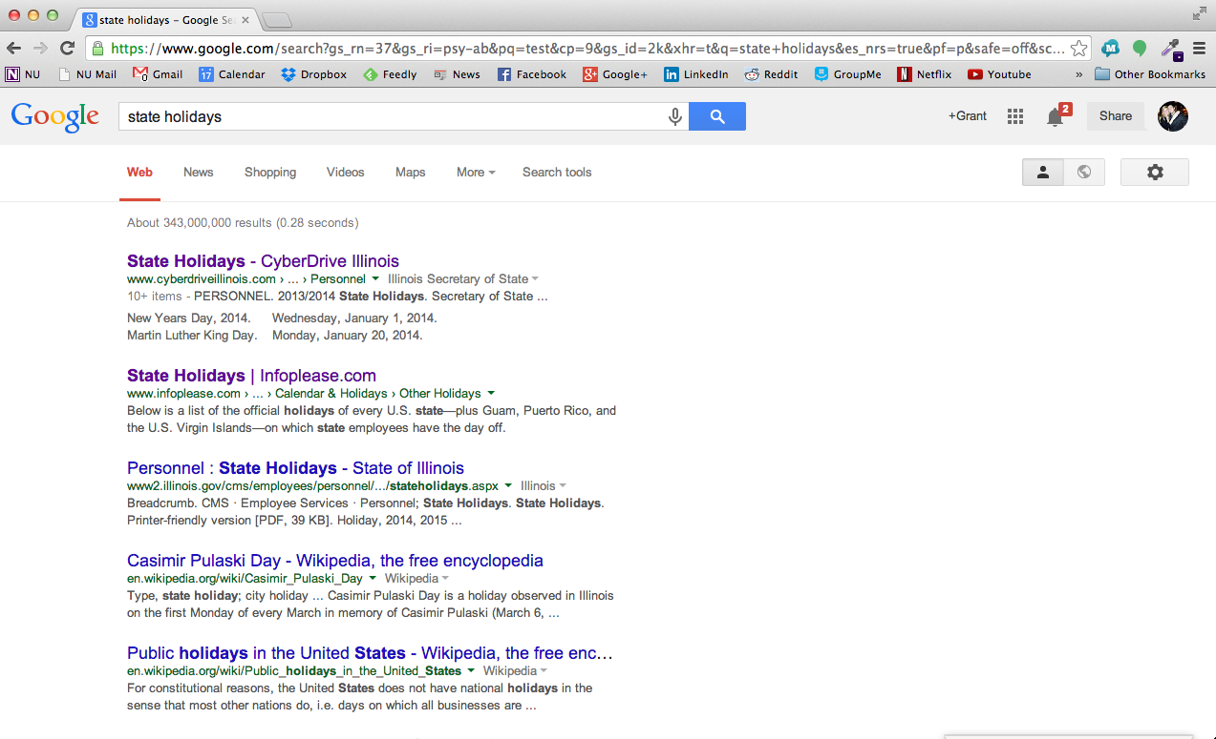

Slide 3
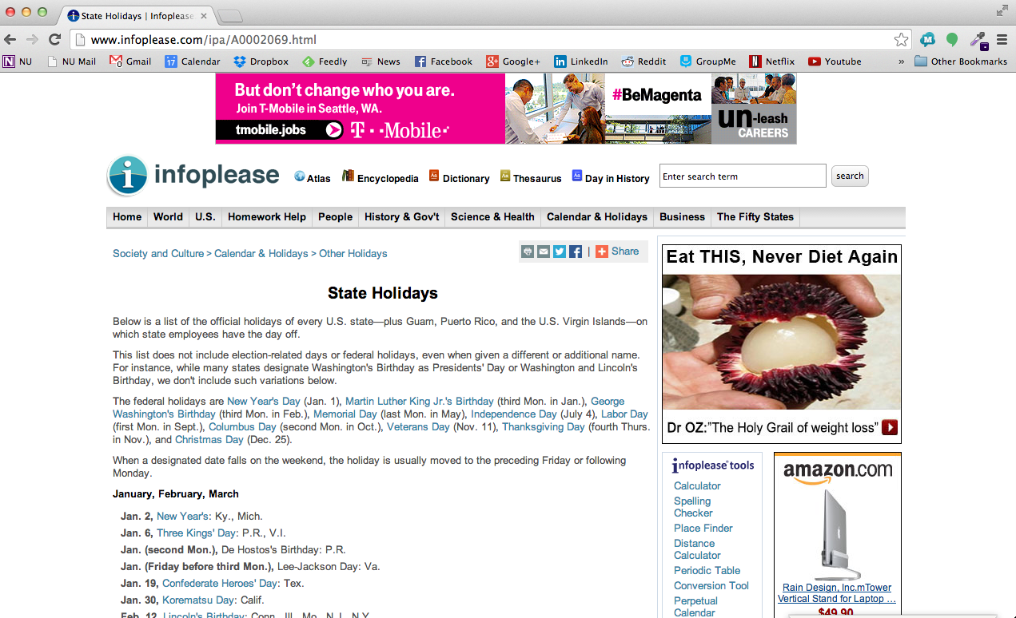

Slide 4
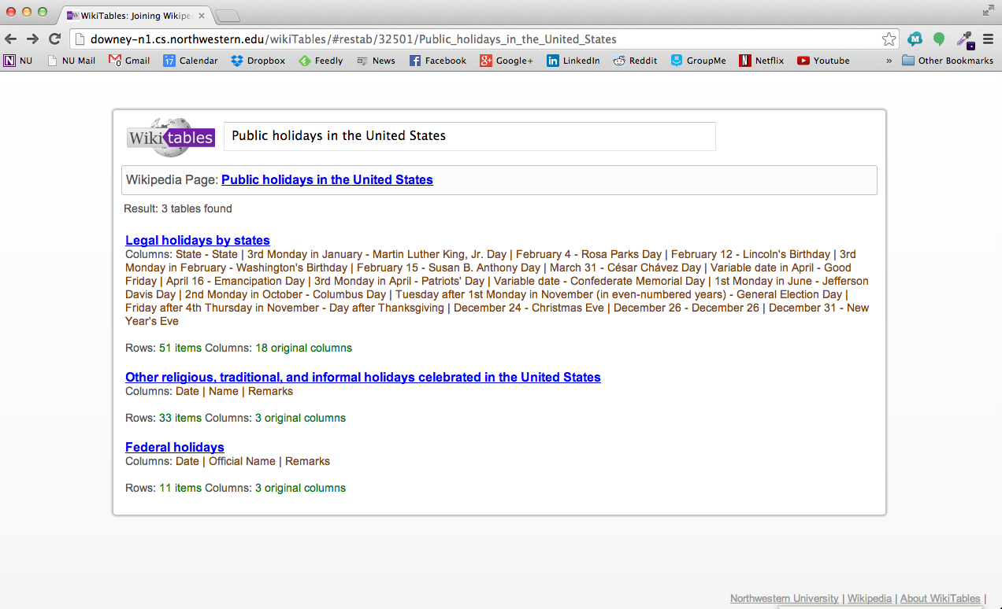

Slide 5
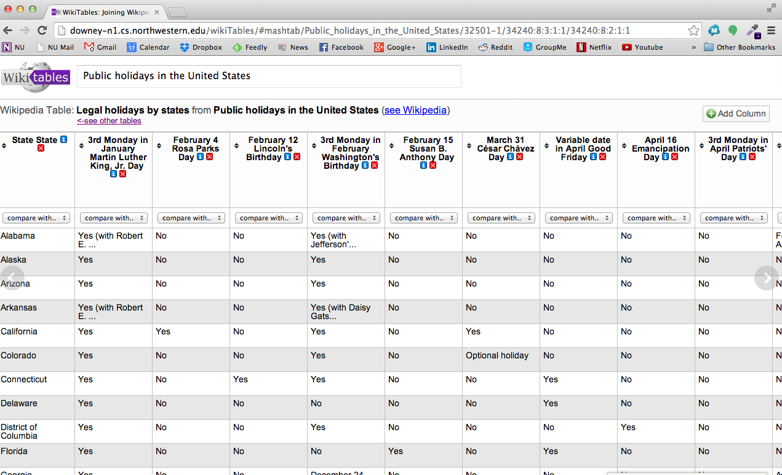

Slide 6
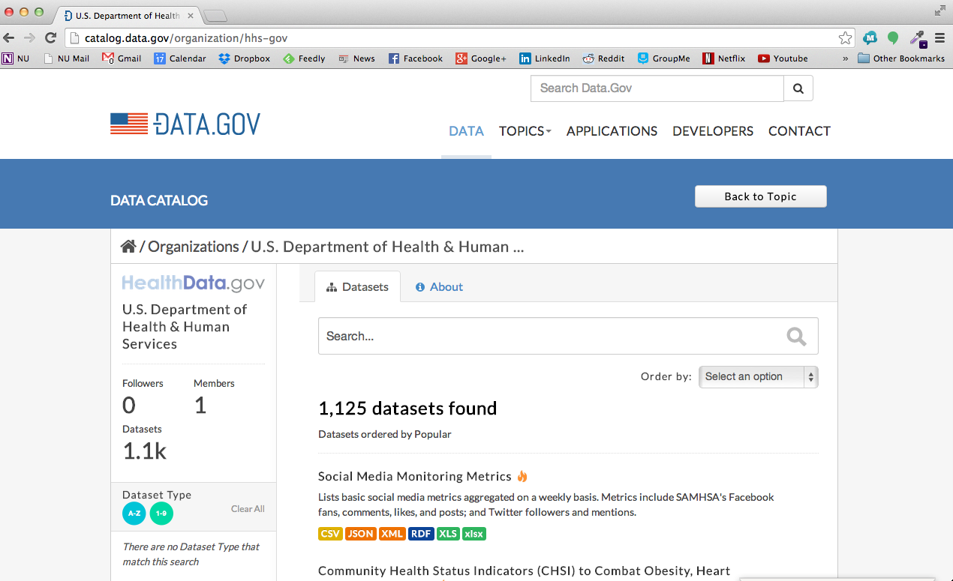

Slide 7
life expectancy race
family healthcare cost
smoking
state healthcare cost
hiv cases
health professional shortage
physician bonuses
nursing home costs
births in illinois
cancer cases america
infant death causes
als cases
common stds america
hypertension
birth weight
healthcare by state
vaccination
gender
obesity
heart attack
underweight
hospital cost
drug license
health insurance
child care
diet
prescription drugs
disability
medical equipment
nutrition
hospital deficiencies
hospitals by state
immunizations
patient happiness
pneumonia
dialysis cost
hospital locations
radiation
substance abuse
birth defects
behavioral health

Slide 8
Labeler Demo

Slide 9
1 qid:1 0:NaN 1:NaN 2:0.0 3:0.0 4:3 # 'als cases' agency-for-healthcare-research-and-quality-national-measures.csv
1 qid:1 0:NaN 1:NaN 2:0.0 3:0.0 4:3 # 'als cases' agency-for-healthcare-research-and-quality-national-measures.csv
1 qid:1 0:NaN 1:NaN 2:0.0 3:0.0 4:4 # 'als cases' casper-aspen-contacts.csv
1 qid:1 0:0.0 1:NaN 2:0.0 3:0.0 4:45 # 'als cases' complete-qip-data-payment-year-2013.csv
1 qid:1 0:NaN 1:NaN 2:0.0 3:0.0 4:24 # 'als cases' dialysis-facility-compare-national-averages.csv
1 qid:1 0:NaN 1:NaN 2:0.0 3:0.0 4:24 # 'als cases' dialysis-facility-compare-state-averages.csv
1 qid:1 0:NaN 1:NaN 2:0.0 3:0.0 4:5 # 'als cases' emergency-department-care-measures-national.csv
1 qid:1 0:NaN 1:NaN 2:0.0 3:0.0 4:10 # 'als cases' environmental-radiation-surveillance-ginna-station-readings-beginning-2009.csv
1 qid:1 0:NaN 1:NaN 2:0.0 3:0.0 4:10 # 'als cases' environmental-radiation-surveillance-ginna-station-readings-beginning-2009.csv
1 qid:1 0:NaN 1:NaN 2:0.0 3:0.0 4:10 # 'als cases' environmental-radiation-surveillance-indian-point-readings-beginning-2009.csv
1 qid:1 0:8.062454389688334E-6 1:8.062454389688334E-6 2:1.3605220050829102E-6 3:0.0 4:10 # 'als cases' genealogical-research-death-index-beginning-1957.csv
1 qid:1 0:NaN 1:NaN 2:0.0 3:0.0 4:11 # 'als cases' home-health-care-hhcahps-state-data.csv
1 qid:1 0:NaN 1:NaN 2:0.0 3:0.0 4:2 # 'als cases' home-health-care-measure-date-range.csv
1 qid:1 0:NaN 1:2.826065534929896E-4 2:5.2136284247021716E-5 3:0.0 4:4 # 'als cases' hospital-medicare-volume-measures-state-average.csv

Slide 10
Query: “als cases”
agency for healthcare research and quality national measures
agency for healthcare research and quality national measures
casper aspen contacts, complete qip data payment year 2013
dialysis facility compare national averages
dialysis facility compare state averages
emergency department care measures national
environmental radiation surveillance ginna station readings beginning 2009
environmental radiation surveillance ginna station readings beginning 2009
environmental radiation surveillance indian point readings beginning 2009
hospital medicare volume measures state average
home health care hhcahps state data
home health care measure date range
genealogical research death index beginning 1957
hospital value based purchasing hvbp heart failure scores
hospital value based purchasing hvbp heart failure scores
medicare spending per patient state
nursing home weekly bed census last submission
prevalence of behavioral health conditions in past year among adults aged 1864 years with,
templates

Slide 11
