Slide 1
Random Forest Modeling of Peak Snow Water Equivalent (SWE) in Water Year 2010 for the Conterminous U.S.
Griffin Shelor

Slide 2
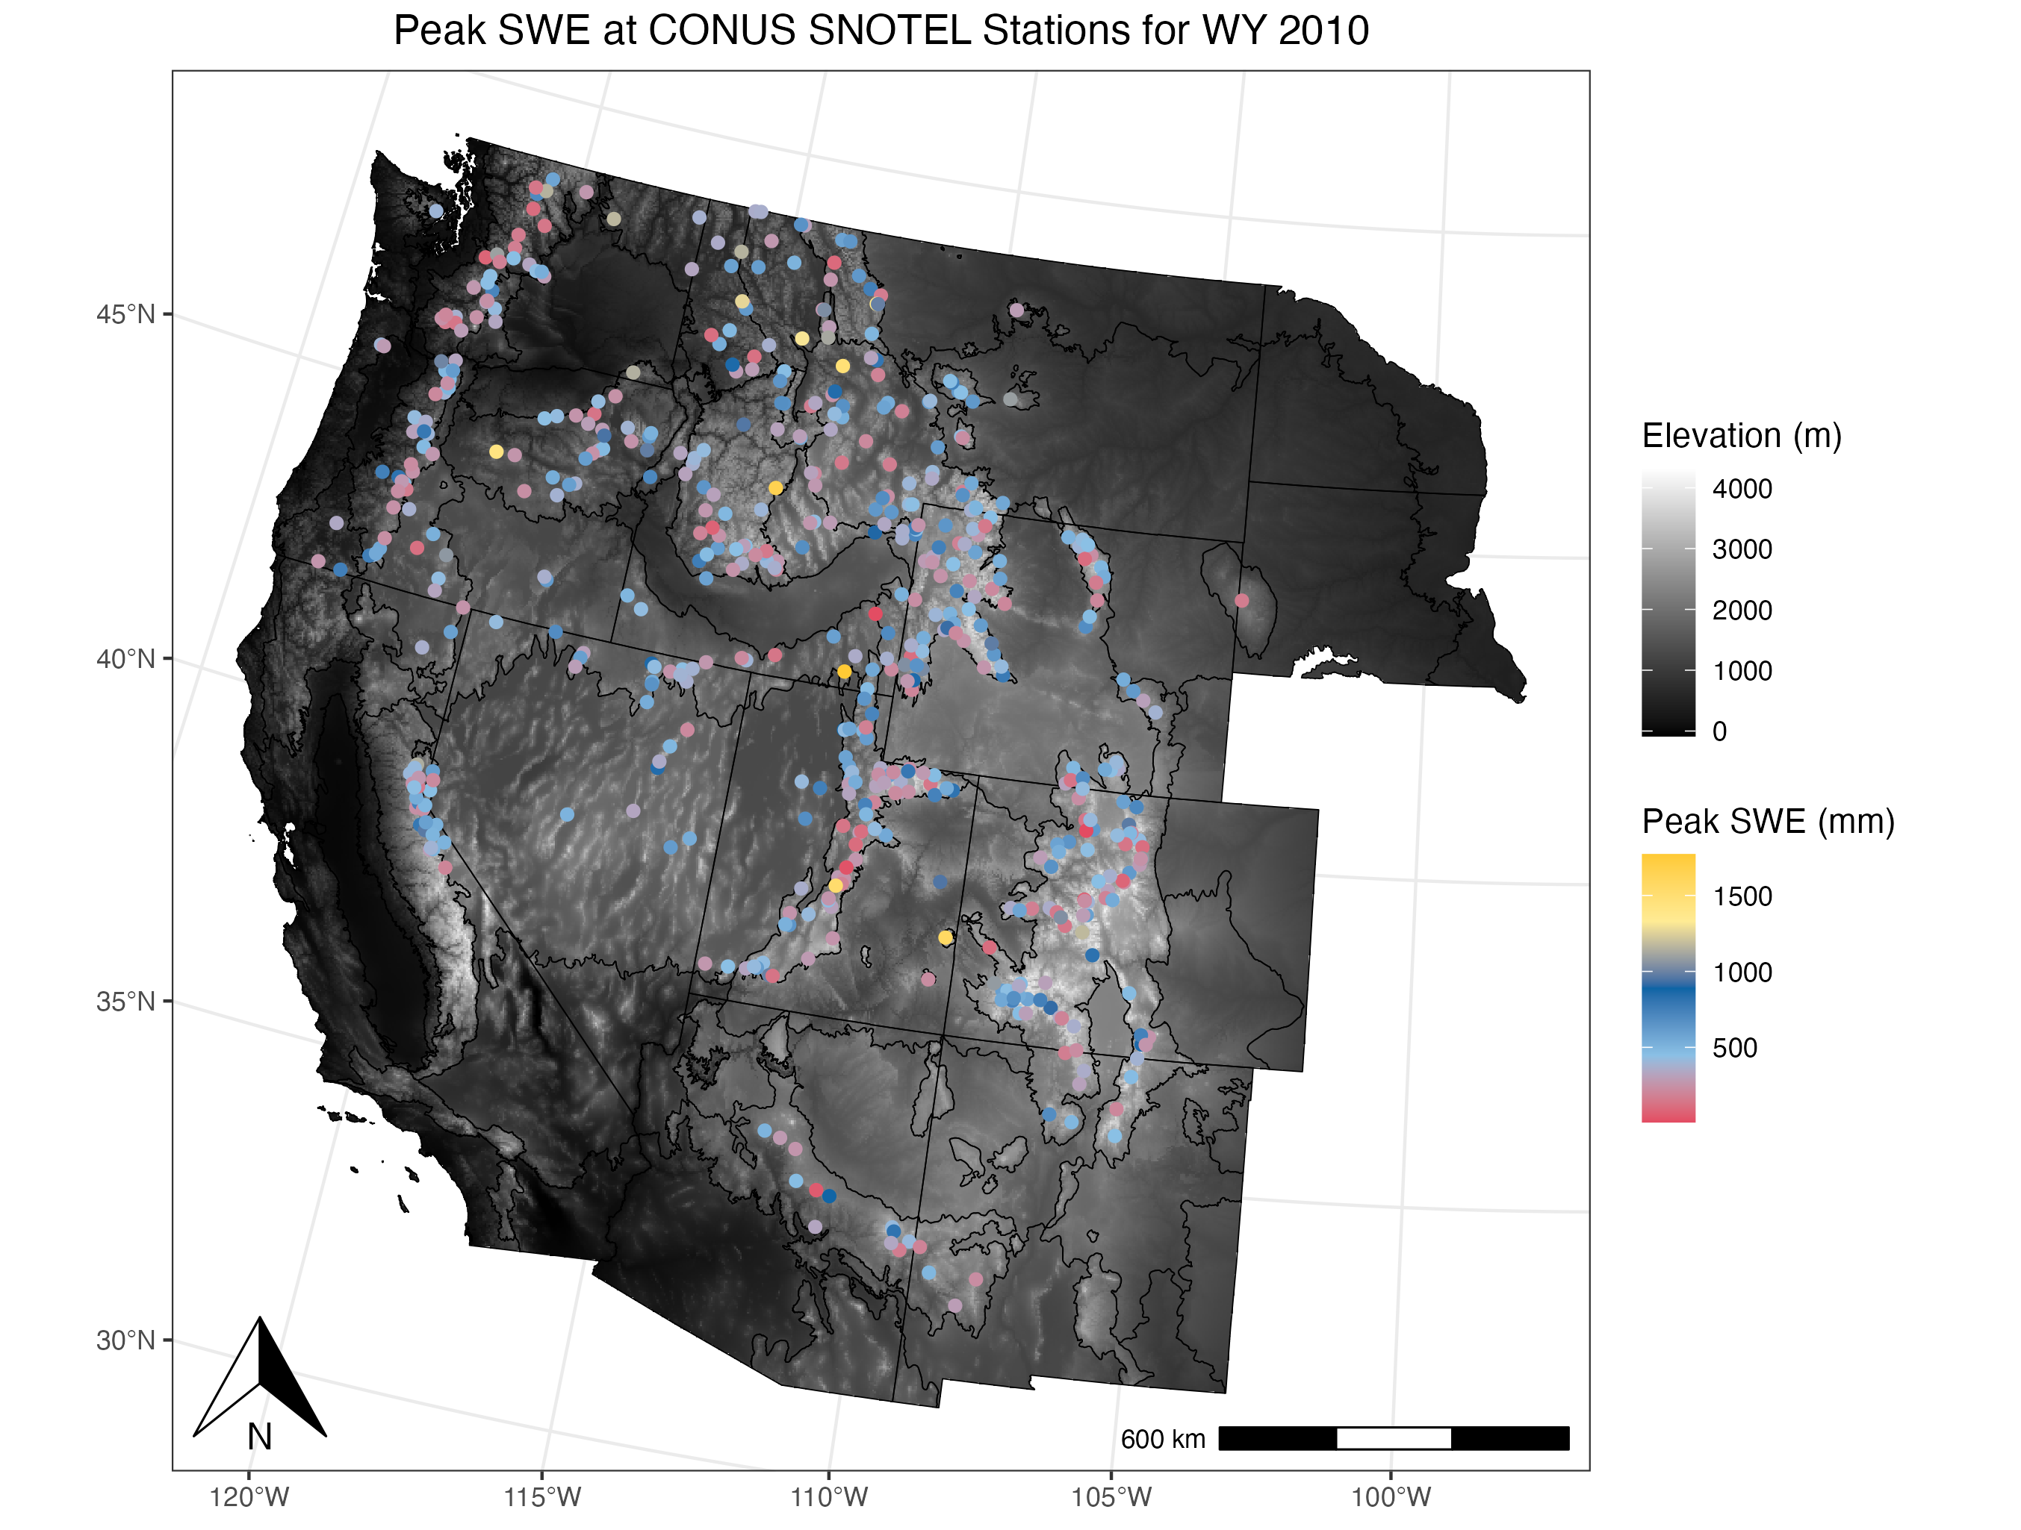
Why does this matter?
Importance of Water to Western U.S.
Large percentage of precipitation in the western US falls as snow

Slide 3
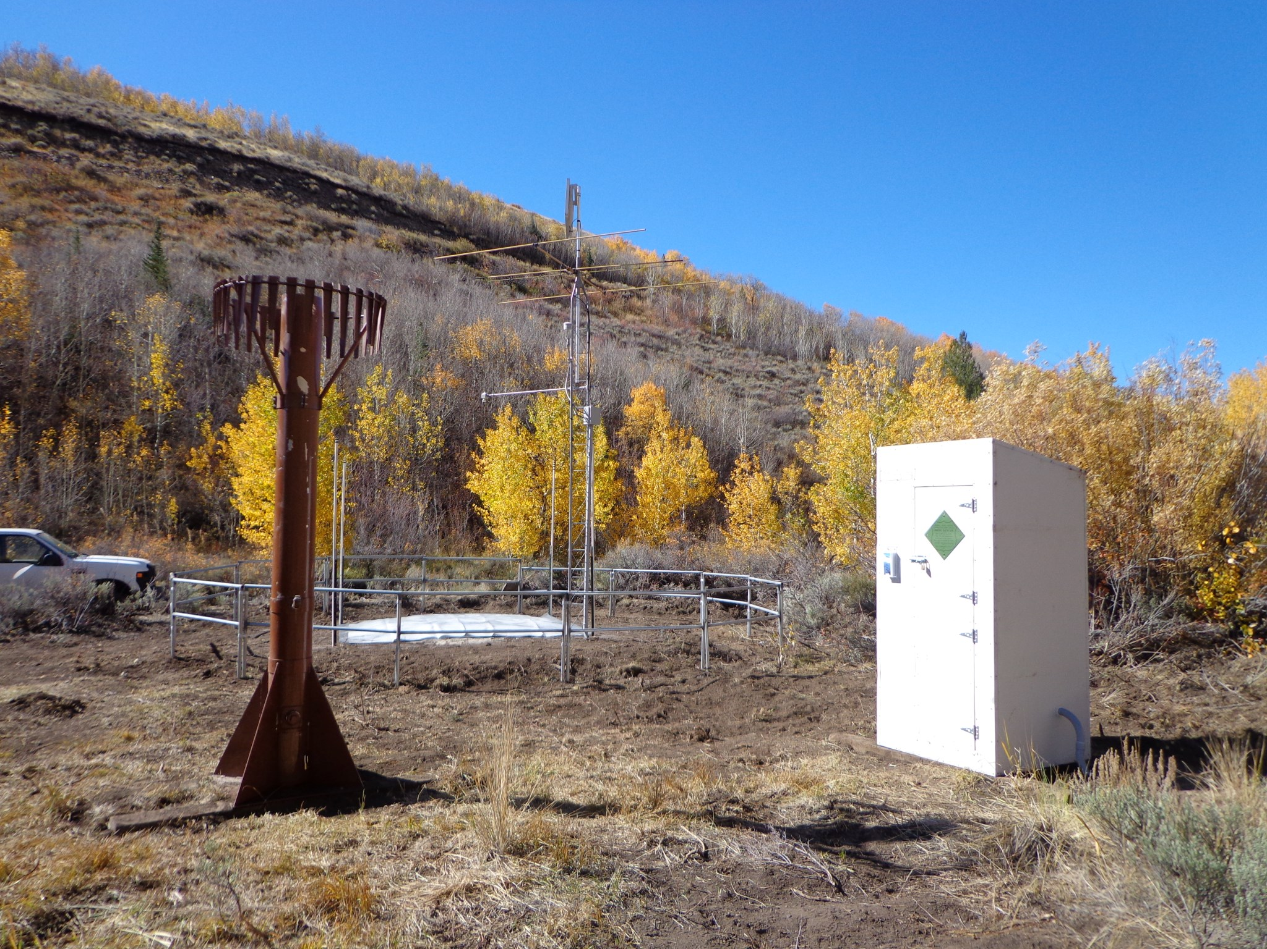
Preparing Data for Analysis and Modeling
Datasets Used
SNOTEL
USDA NRCS
SWE
Daymet
Climate
Cooling Degree Month (CDM)
Taken from Sturm and Liston (2011)
SRTM
Elevation, slope, aspect
Resampling

Slide 4
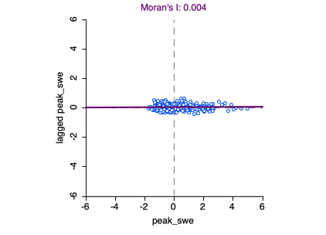
Evaluating Spatial Autocorrelation
Global Moran’s I and Local Moran’s I tests
Pseudo p-value of ~ 0.22
LISA tests revealed approximately 45-80 significant points
All Covariates displayed global spatial autocorrelation (p-value < 0.05, 999 permutations)

Slide 5
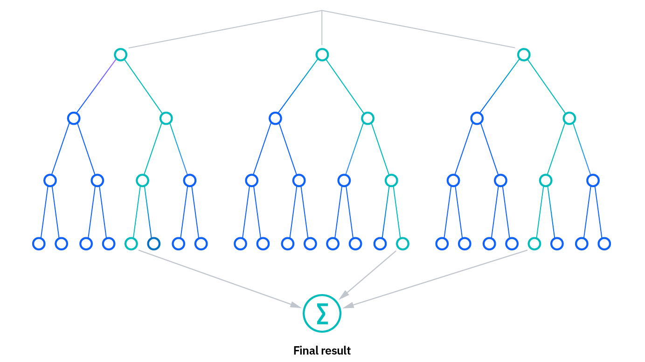
Random Forest
Machine learning method (Breiman 2001)
Decision tree-based
Averages decisions/values across multiple trees to create more robust prediction
Less overfitting
Regression and Classification
2 Main Parameters:
Number of Trees
Number of features evaluated at each split

Slide 6
Results
For all models
Mean or Summed covariates are averaged or summed from October 2009 – May 2010
Covariates determined using RMSE on test split (25%) of dataset
Final combination applied to both Peak SWE and Log of Peak SWE
Number of trees: 2000
Number of features tested at each node split: 2
Log model predicts lower max SWE values, underestimates higher SWE values, inflating RMSE
 | Covariates | Target Variable | RMSE on Test Data
Model 1 | Mean Temp Summed CDM values, Summed Precip CDM Values, Mean Solar Radiation, Mean Min Temp, Mean Max Temp, Elevation, Slope | Peak SWE | 262.518
Model 2 | Same as Model 1 | Log of Peak SWE | 272.0743

Slide 7
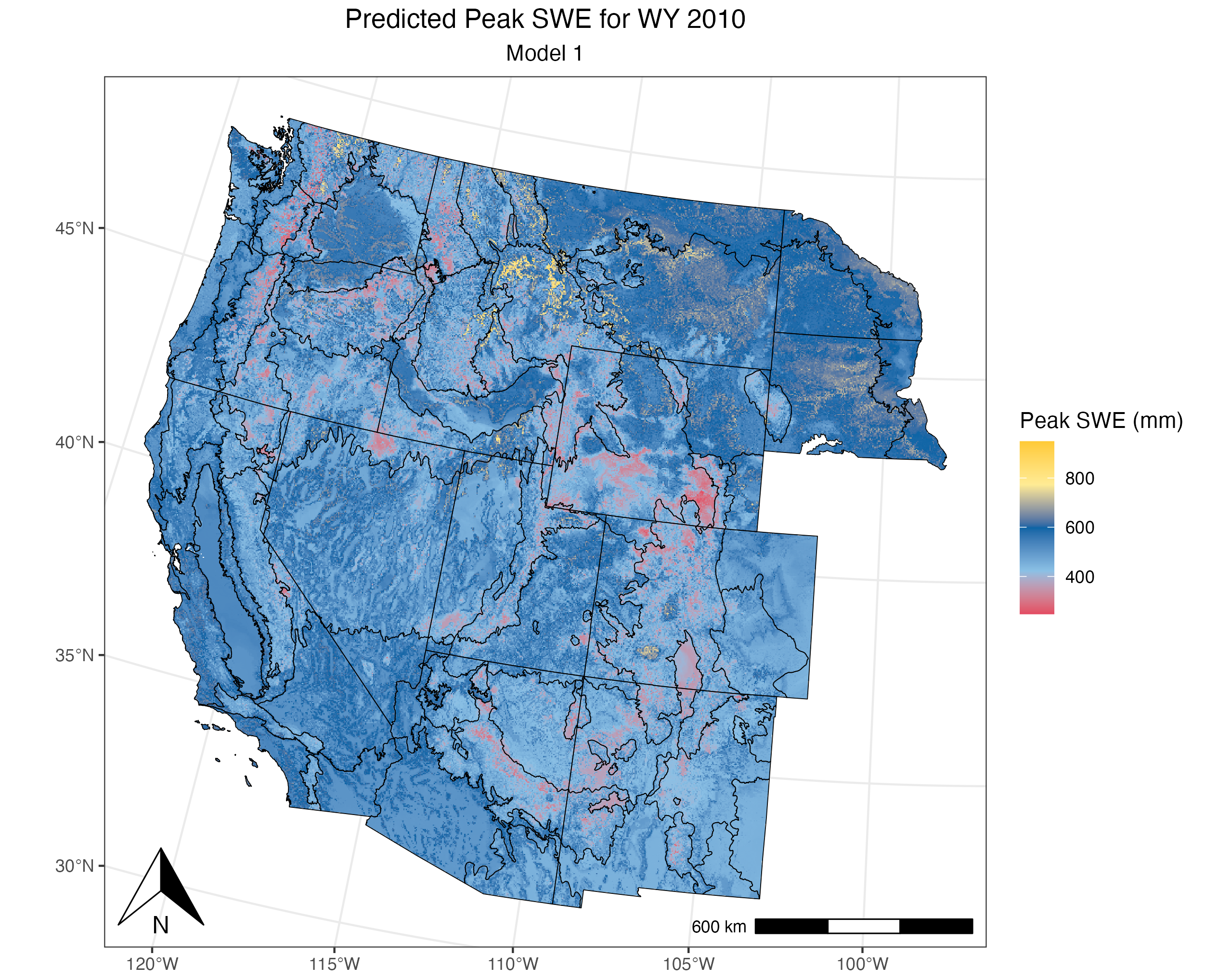
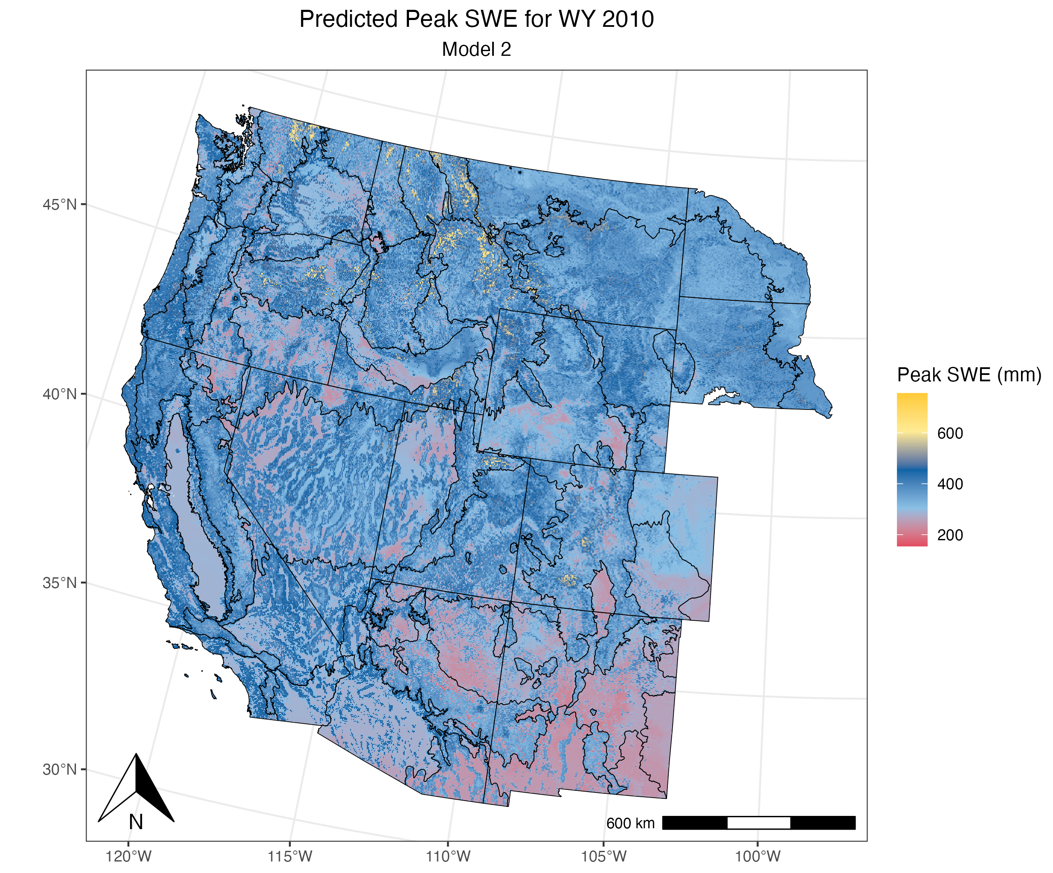
Results Maps

Slide 8
Factors to Consider for Future Work
Adding background “zero-value” points
Trimming AOI
Alternative Modeling Methodologies
Scaling variables instead of using “raw” values

Slide 9
References
Breiman, L. (2001). Random forests. Machine learning, 45, 5-32.
Elder, K., Dozier, J., & Michaelsen, J. (1991). Snow accumulation and distribution in an Alpine Watershed. Water Resources Research, 27(7), 1541–1552. https://doi.org/10.1029/91WR00506
Farr, T.G., Rosen, P.A., Caro, E., Crippen, R., Duren, R., Hensley, S., Kobrick, M., Paller, M., Rodriguez, E., Roth, L., Seal, D., Shaffer, S., Shimada, J., Umland, J., Werner, M., Oskin, M., Burbank, D., and Alsdorf, D.E., (2007). The shuttle radar topography mission: Reviews of Geophysics, v. 45, no. 2, RG2004, at https://doi.org/10.1029/2005RG000183.
Fierz, C., Armstrong, R.L., Durand, Y., Etchevers, P., Greene, E., McClung, D.M., Nishimura, K., Satyawali, P.K. and Sokratov, S.A. 2009. The International Classification for Seasonal Snow on the Ground. IHP-VII Technical Documents in Hydrology N°83, IACS Contribution N°1, UNESCO-IHP, Paris.
Hale, K. E., Jennings, K. S., Musselman, K. N., Livneh, B., & Molotch, N. P. (2023). Recent decreases in snow water storage in western North America. Communications Earth & Environment, 4(1), 170. https://doi.org/10.1038/s43247-023-00751-3
Hufkens, K. (2022). snotelr: a toolbox to facilitate easy SNOTEL data exploration and downloads in R. Zenodo. https://doi.org/10.5281/zenodo.7012728.
Molotch, N. P., & Bales, R. C. (2006). SNOTEL representativeness in the Rio Grande headwaters on the basis of physiographics and remotely sensed snow cover persistence. Hydrological Processes, 20(4), 723–739. https://doi.org/10.1002/hyp.6128
Musselman, K. N., Molotch, N. P., & Margulis, S. A. (2017). Snowmelt response to simulated warming across a large elevation gradient, southern Sierra Nevada, California. The Cryosphere, 11(6), 2847–2866. https://doi.org/10.5194/tc-11-2847-2017
Qin, Y., Abatzoglou, J. T., Siebert, S., Huning, L. S., AghaKouchak, A., Mankin, J. S., Hong, C., Tong, D., Davis, S. J., & Mueller, N. D. (2020). Agricultural risks from changing snowmelt. Nature Climate Change, 10(5), 459–465. https://doi.org/10.1038/s41558-020-0746-8
Siirila-Woodburn, E. R., Rhoades, A. M., Hatchett, B. J., Huning, L. S., Szinai, J., Tague, C., Nico, P. S., Feldman, D. R., Jones, A. D., Collins, W. D., & Kaatz, L. (2021). A low-to-no snow future and its impacts on water resources in the western United States. Nature Reviews Earth & Environment, 2(11), 800–819. https://doi.org/10.1038/s43017-021-00219-y
Sturm, M., & Liston, G. E. (2021). Revisiting the Global Seasonal Snow Classification: An Updated Dataset for Earth System Applications. Journal of Hydrometeorology. https://doi.org/10.1175/JHM-D-21-0070.1
Thornton, M.M., R. Shrestha, Y. Wei, P.E. Thornton, S-C. Kao, and B.E. Wilson. (2022). Daymet: Daily Surface Weather Data on a 1-km Grid for North America, Version 4 R1. ORNL DAAC, Oak Ridge, Tennessee, USA. https://doi.org/10.3334/ORNLDAAC/2129
Fleming, S. W., Zukiewicz, L., Strobel, M. L., Hofman, H., & Goodbody, A. G. (2023). SNOTEL, the Soil Climate Analysis Network, and water supply forecasting at the Natural Resources Conservation Service: Past, present, and future. JAWRA Journal of the American Water Resources Association, 59(4), 585–599. https://doi.org/10.1111/1752-1688.13104

