Slide 1
Forecasting Snow Water Equivalent (SWE) at Three SNOTEL Stations in Alaska from September 2021 - May 2022 using Random Forest
Griffin Shelor
Notes:
Hello. I am Griffin Shelor and I will be discussing Forecasting Snow Water Equivalent at 3 SNOTEL stations in Alaska using Random Forest

Slide 2
Datasets Used
SNOTEL
Long-running network of snow-sampling stations throughout western U.S. which report Snow Water Equivalent (SWE) as well as other climate variables
Daymet
Gridded dataset providing weather and climate variables at daily, monthly, and annual intervals
1 km x 1 km
1980-present
Notes:
So I relied on 2 datasets for this project, SNOTEL for my snow water equivalent and cumulative precipitation data to train and evaluate my forecast and Daymet to provide additional covariates such as daily temperature and precipitation values.

Slide 3
Why Study SWE
Snowpack is crucial to water availability in the western US
Uncertainty about snowpack
Climate
Sampling sites are currently located in relatively convenient places
Predicting SWE out-of-sample remains challenging
Identify the most important predictor of SWE
Notes:
Snowpack is a vital source of water in the western united states. Much of the precipitation in this region of the country does not fall as rain but rather as snow during the winter and at high elevations during fall and spring. However, given the progression of climate change, there is significant uncertainty surrounding snowpack as a resource and what will happen to the snowpack as climate change continues. Also, many SNOTEL sites are located in places which are relatively convenient to access for scientists and not necessarily in places with rugged terrain or at higher elevations closer to actual mountain peaks where it is suspected that more snow falls. Given this, it would be extremely useful if we could reliably predict SWE values out-of-sample and especially at locations where there is not a SNOTEL site and identify the primary factor in SWE values across the western US. This project serves as a useful stepping stone towards that ultimate goal.

Slide 4
Random Forest Workflow
Split off data to be forecasted after models are evaluated on test data
Extract covariates
0.75 train/test split
Fit model
Predict on test dataset
Create forecast with model
Adjust hyperparameters
Evaluate forecasts
Notes:
Random forest is a decision tree based method where a decision tree is built, and then at each node in the tree, a random subset of predictor variables is selected and used to split the node. This helps to make each tree in the random forest unique and prevent overfitting. The best prediction is identified at each tree and averaged across the whole set of trees.

Slide 5
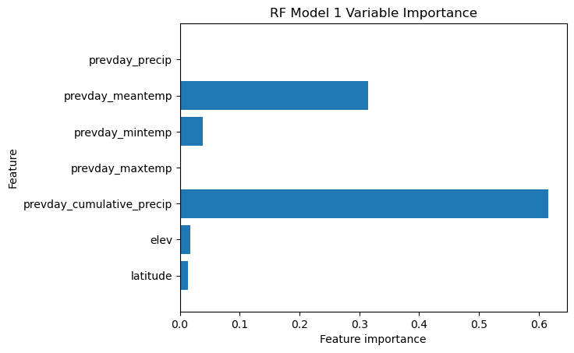
Random Forest Model #1
Max depth = 3, # of trees = 10,000
Variables used
Latitude, elevation, daily precipitation, cumulative precipitation, daily max temp, daily min temp, daily mean temp
R2 score: 0.41
Test data RMSE: 92.22
Forecast RMSE: 81.54

Slide 6
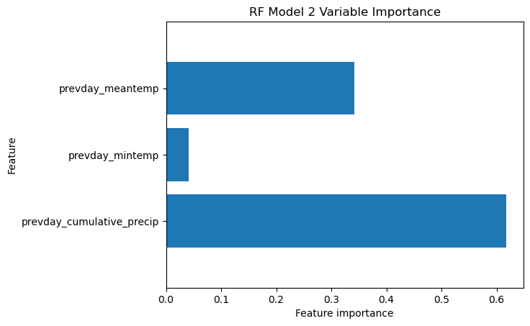
Random Forest Model #2
Same hyperparameters as model 1
Covariates:
Cumulative precipitation, mean temp, min temp
R2 score: 0.40
Test data RMSE: 92.80
Forecast RMSE: 81.14

Slide 7
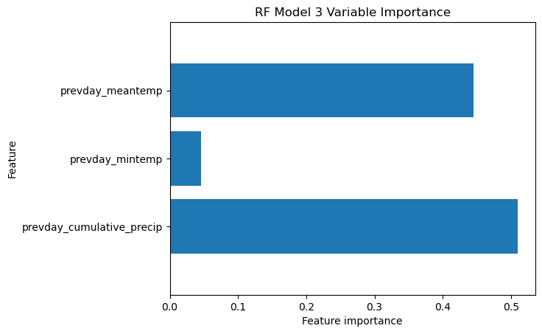
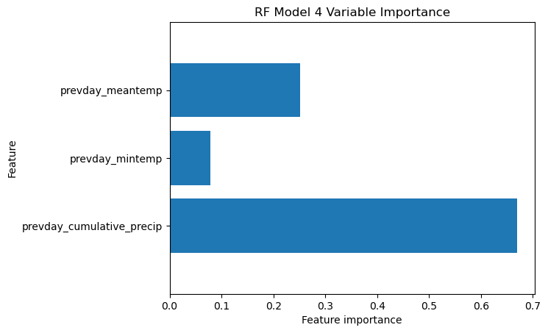
Adjusting hyper parameters on 2 more models
Used same covariates as Model 2
Model 3
Decreased max depth to 2, # trees to 5000
R2 score: 0.3
Forecast RMSE: 71.87
Model 4
Increased max depth to 5, # trees to 25000
R2 score: 0.53
Forecast RMSE: 37.62
Notes:
Given that Model 2 performed *slightly* better on the forecasted dataset, I took the same training/testing splits for that model and adjusted the hyper parameters to see if I could improve my forecast. While decreasing the hyperparameters led to lower R2, forecast RMSE was still improved, though not nearly to the degree that it was improved in Model 4 with much greater hyperparameters, which saw improvement in both metrics. This indicates the robustness of the random forest method.

Slide 8
Lessons Learned
Random forests generally resistant to overfitting
More trees probably = better model
Cumulative precip consistently most important
Importance of temperature predictors

Slide 9
Future Work
Train model to include more sites
Computationally intensive
Look at variable importance in different years
Make model spatial
Predict SWE away from SNOTEL sites
Evaluate on other sampling campaigns/networks

Slide 10
References
Hufkens, K. (2022). snotelr: a toolbox to facilitate easy SNOTEL data exploration and downloads in R. Zenodo. https://doi.org/10.5281/zenodo.7012728.
Thornton, M.M., R. Shrestha, Y. Wei, P.E. Thornton, and S-C. Kao. 2022. Daymet: Daily Surface Weather Data on a 1-km Grid for North America, Version 4 R1. ORNL DAAC, Oak Ridge, Tennessee, USA. https://doi.org/10.3334/ORNLDAAC/2129
Musselman, K. N., Molotch, N. P., & Margulis, S. A. (2017). Snowmelt response to simulated warming across a large elevation gradient, southern Sierra Nevada, California. The Cryosphere, 11(6), 2847–2866. https://doi.org/10.5194/tc-11-2847-2017
Hale, K. E., Jennings, K. S., Musselman, K. N., Livneh, B., & Molotch, N. P. (2023). Recent decreases in snow water storage in western North America. Communications Earth & Environment, 4(1), 170. https://doi.org/10.1038/s43247-023-00751-3
Qin, Y., Abatzoglou, J. T., Siebert, S., Huning, L. S., AghaKouchak, A., Mankin, J. S., Hong, C., Tong, D., Davis, S. J., & Mueller, N. D. (2020). Agricultural risks from changing snowmelt. Nature Climate Change, 10(5), 459–465. https://doi.org/10.1038/s41558-020-0746-8
Siirila-Woodburn, E. R., Rhoades, A. M., Hatchett, B. J., Huning, L. S., Szinai, J., Tague, C., Nico, P. S., Feldman, D. R., Jones, A. D., Collins, W. D., & Kaatz, L. (2021). A low-to-no snow future and its impacts on water resources in the western United States. Nature Reviews Earth & Environment, 2(11), 800–819. https://doi.org/10.1038/s43017-021-00219-y

