Slide 1

Forecasting Snow Water Equivalent (SWE) Using 3 Sites in Alaska as a Case Study
Griffin Shelor

Slide 2
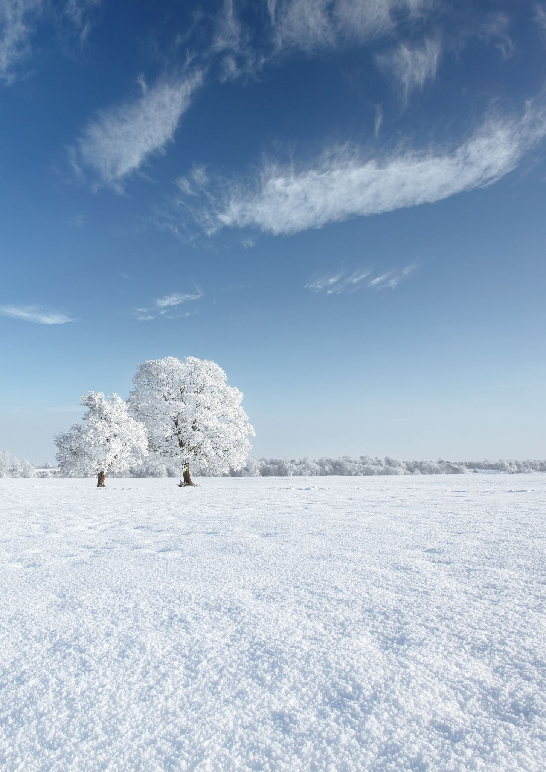
Why SWE, and Why Forecast It
Snow is critical to the west
Agriculture, Ranching
Snow is difficult/costly to sample
Uncertainty around snowpack conditions

Slide 3
Model Development
Gathering Data
Drop NAs
Pull climate data to replace oddities in SNOTEL data
Correlation with SWE
Model building
Deterministic linear functions
AR1 vs Not AR1
Random Forest
Variable importance
Correlation
Stan
Lognormal distribution
Normal distribution

Slide 4
Random Forest Model Evaluation
High volatility without autoregressive term
Missing data
Generally captures trend
Does not adjust to large swings

Slide 5
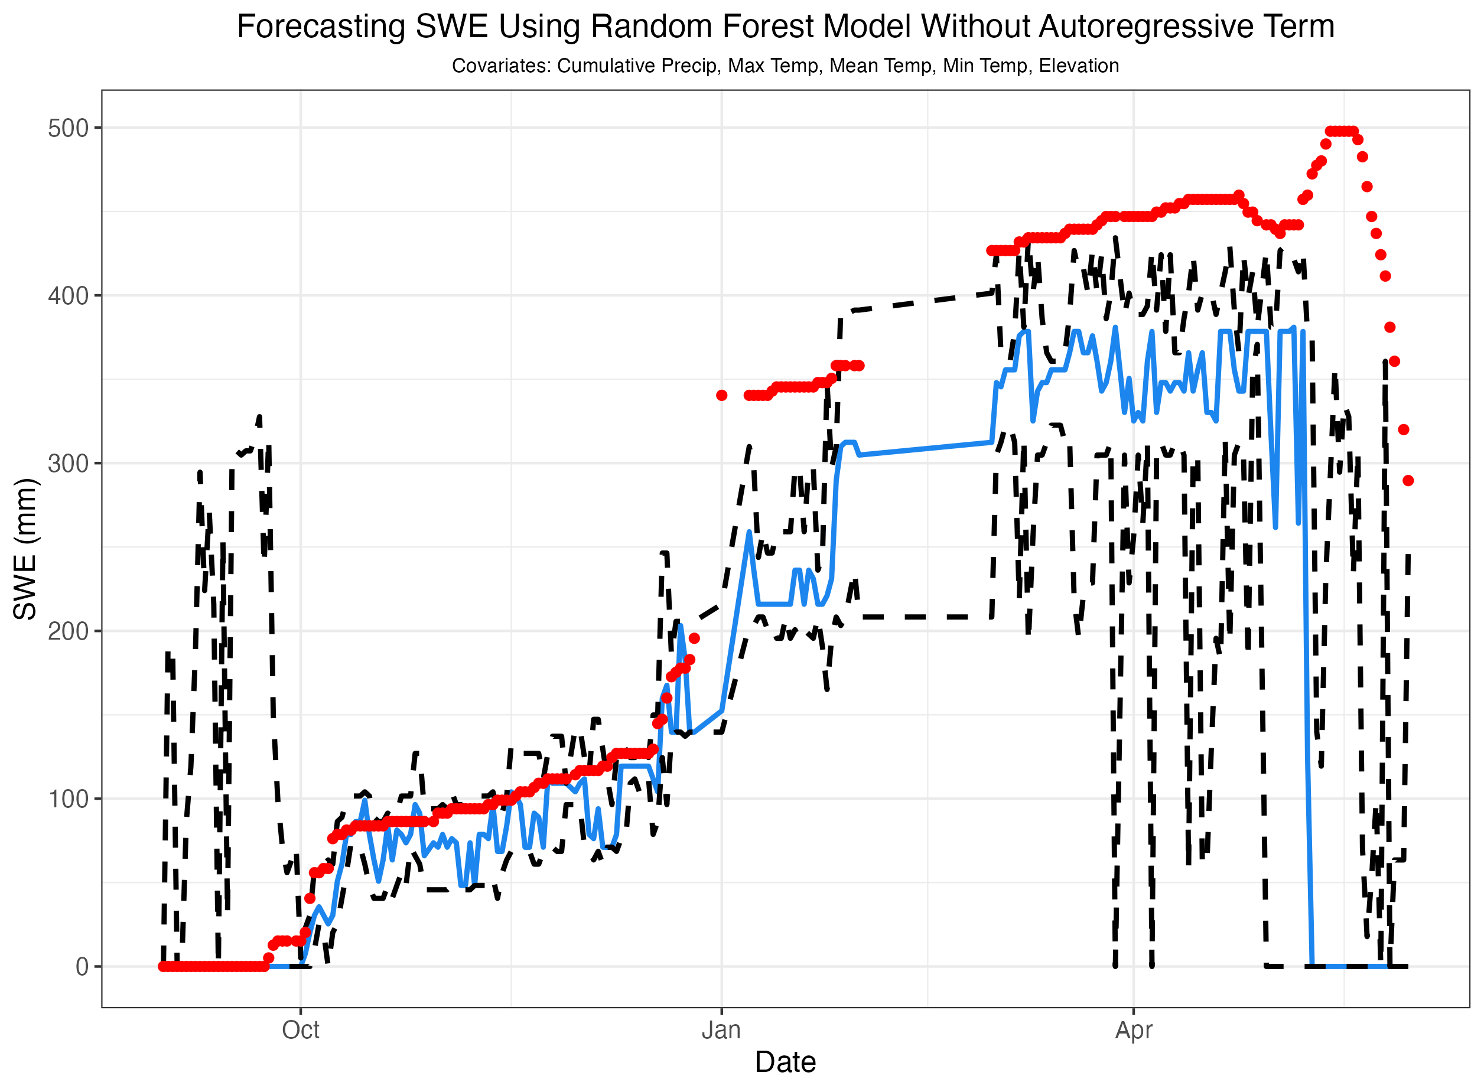
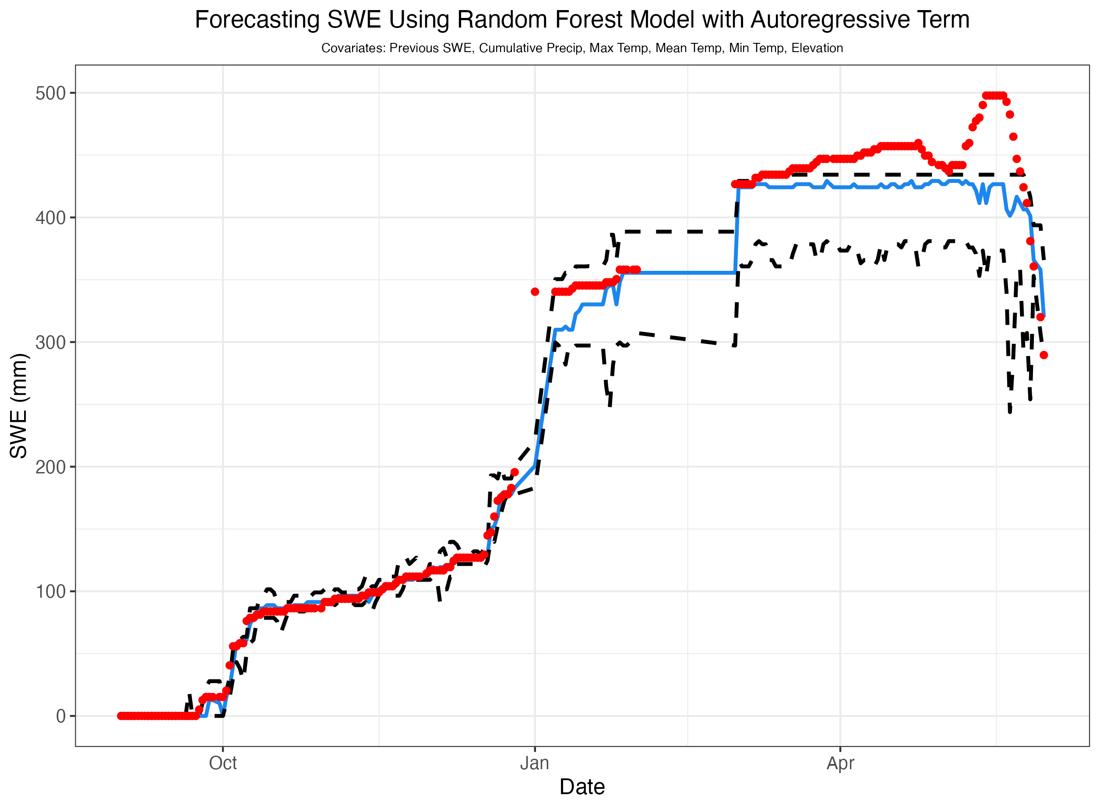
Random Forest Forecasts

Slide 6
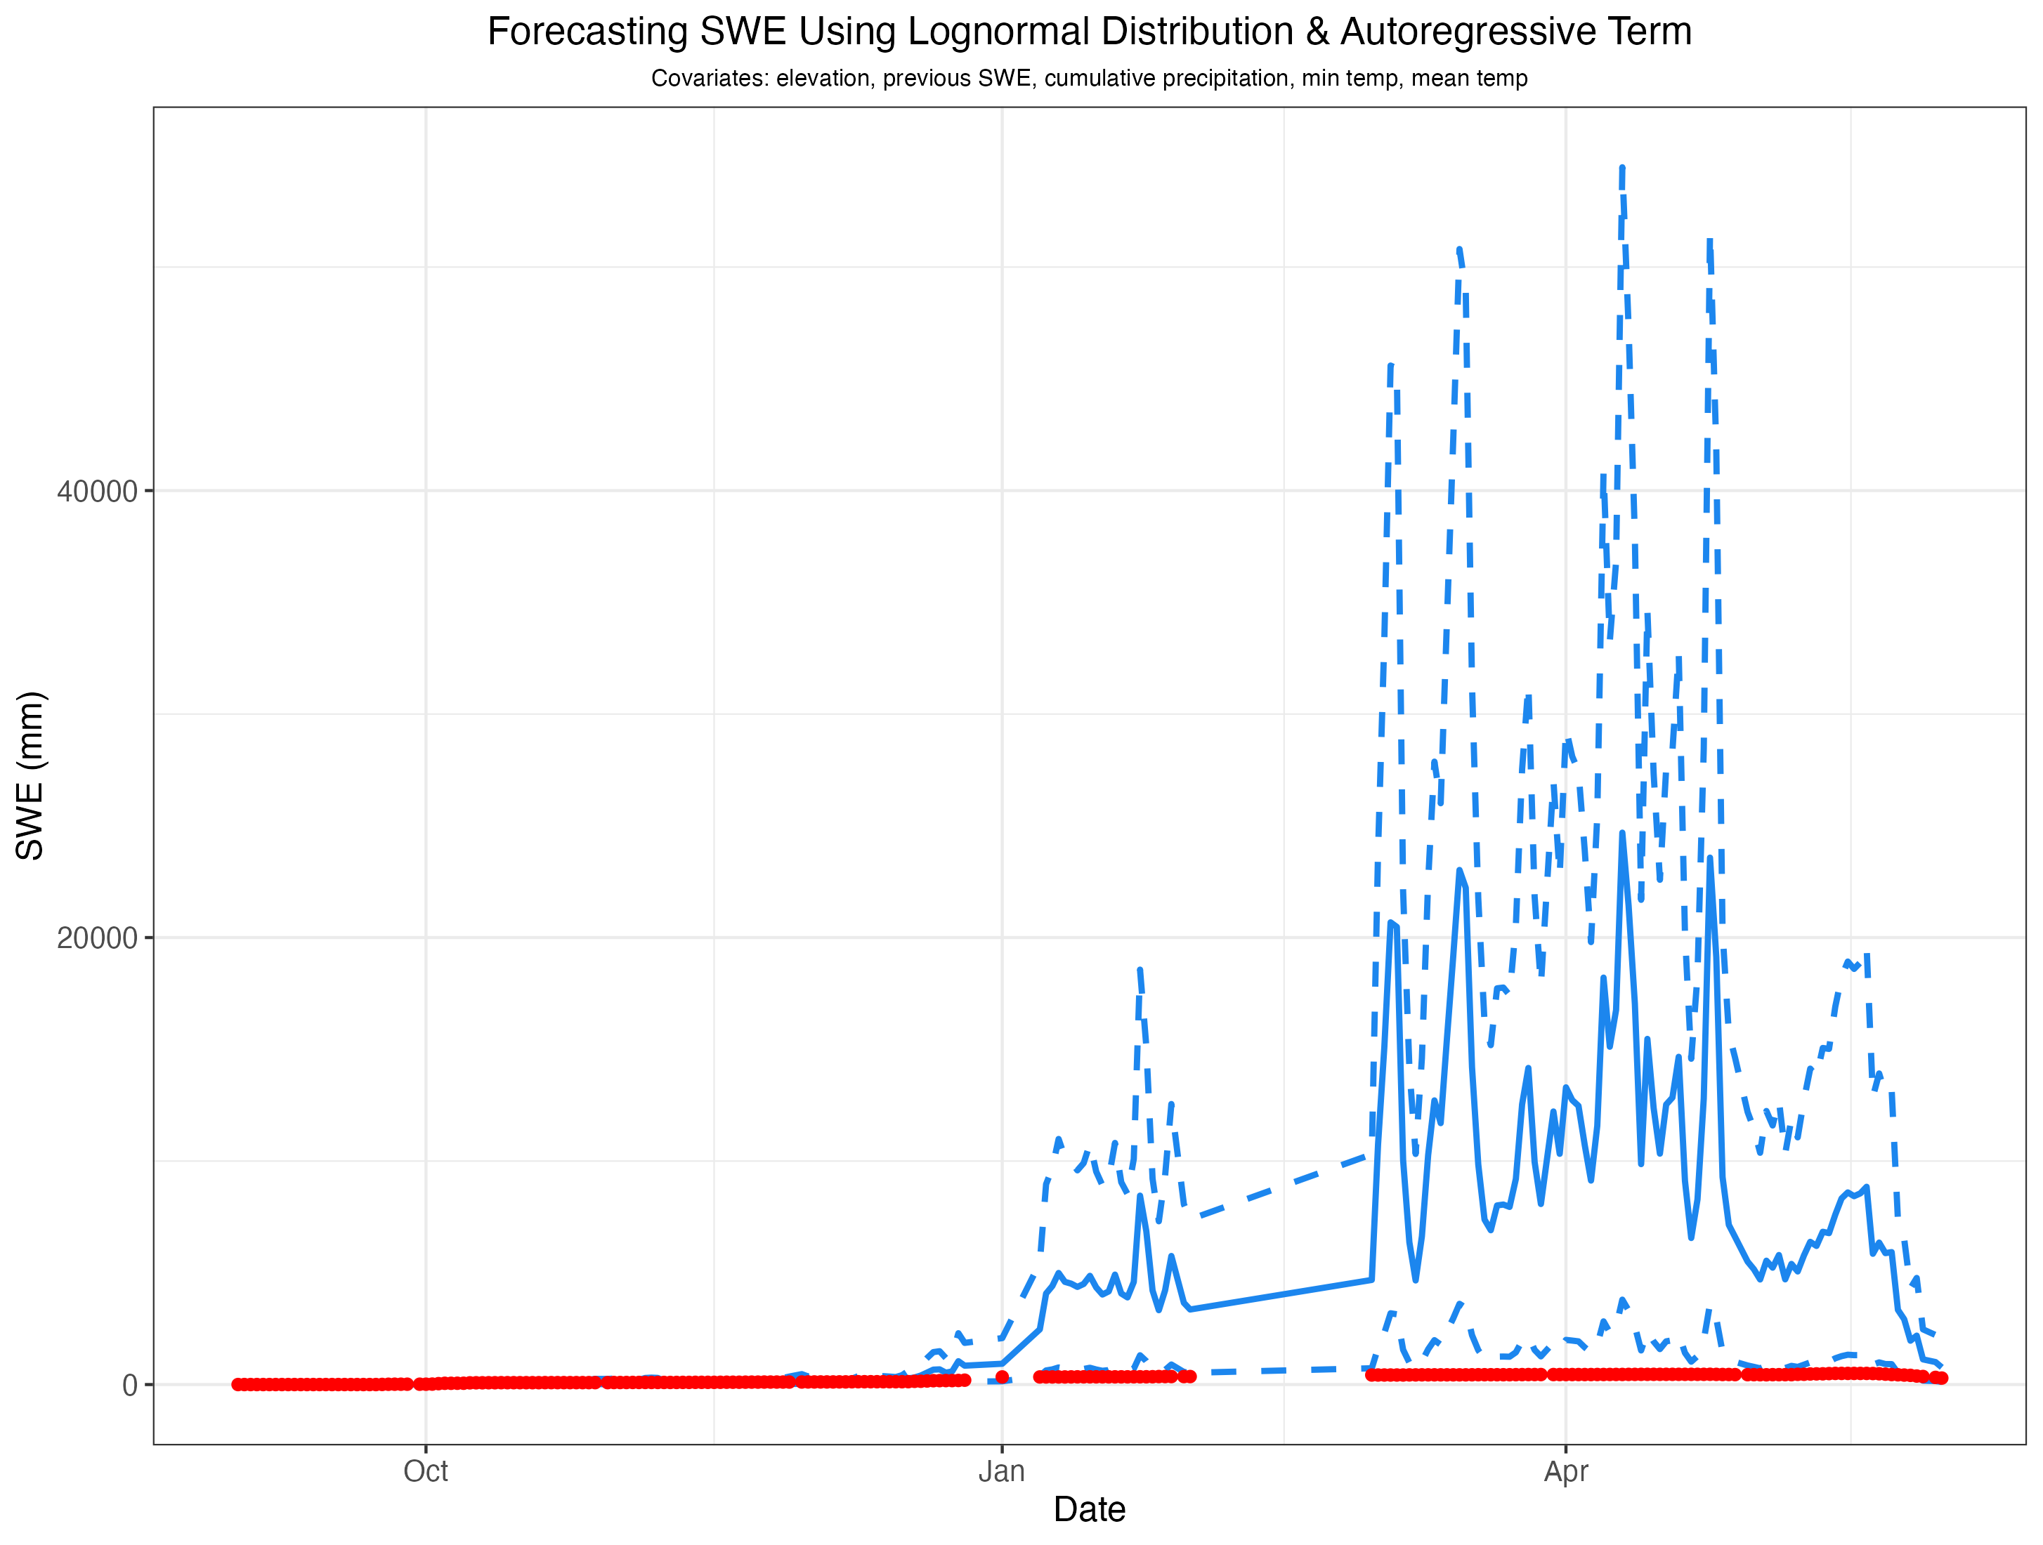
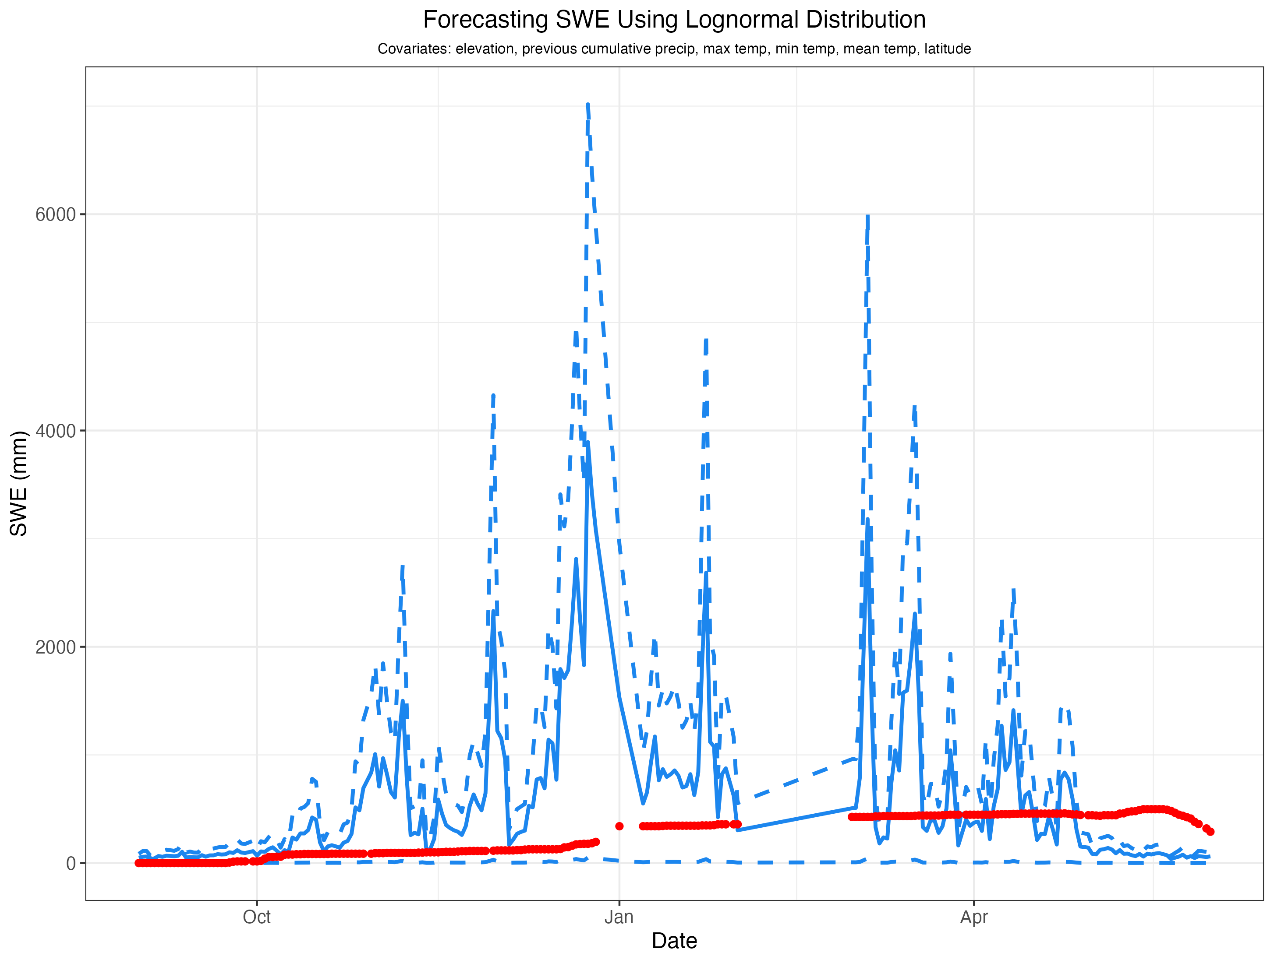
Lognormal Distribution Forecasts
Significant issues estimating upper bound
Missing data
Uncertainty grows when conditions change rapidly

Slide 7
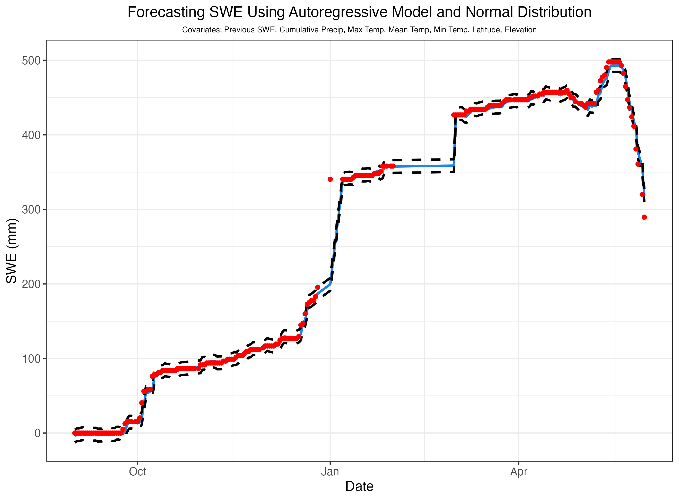
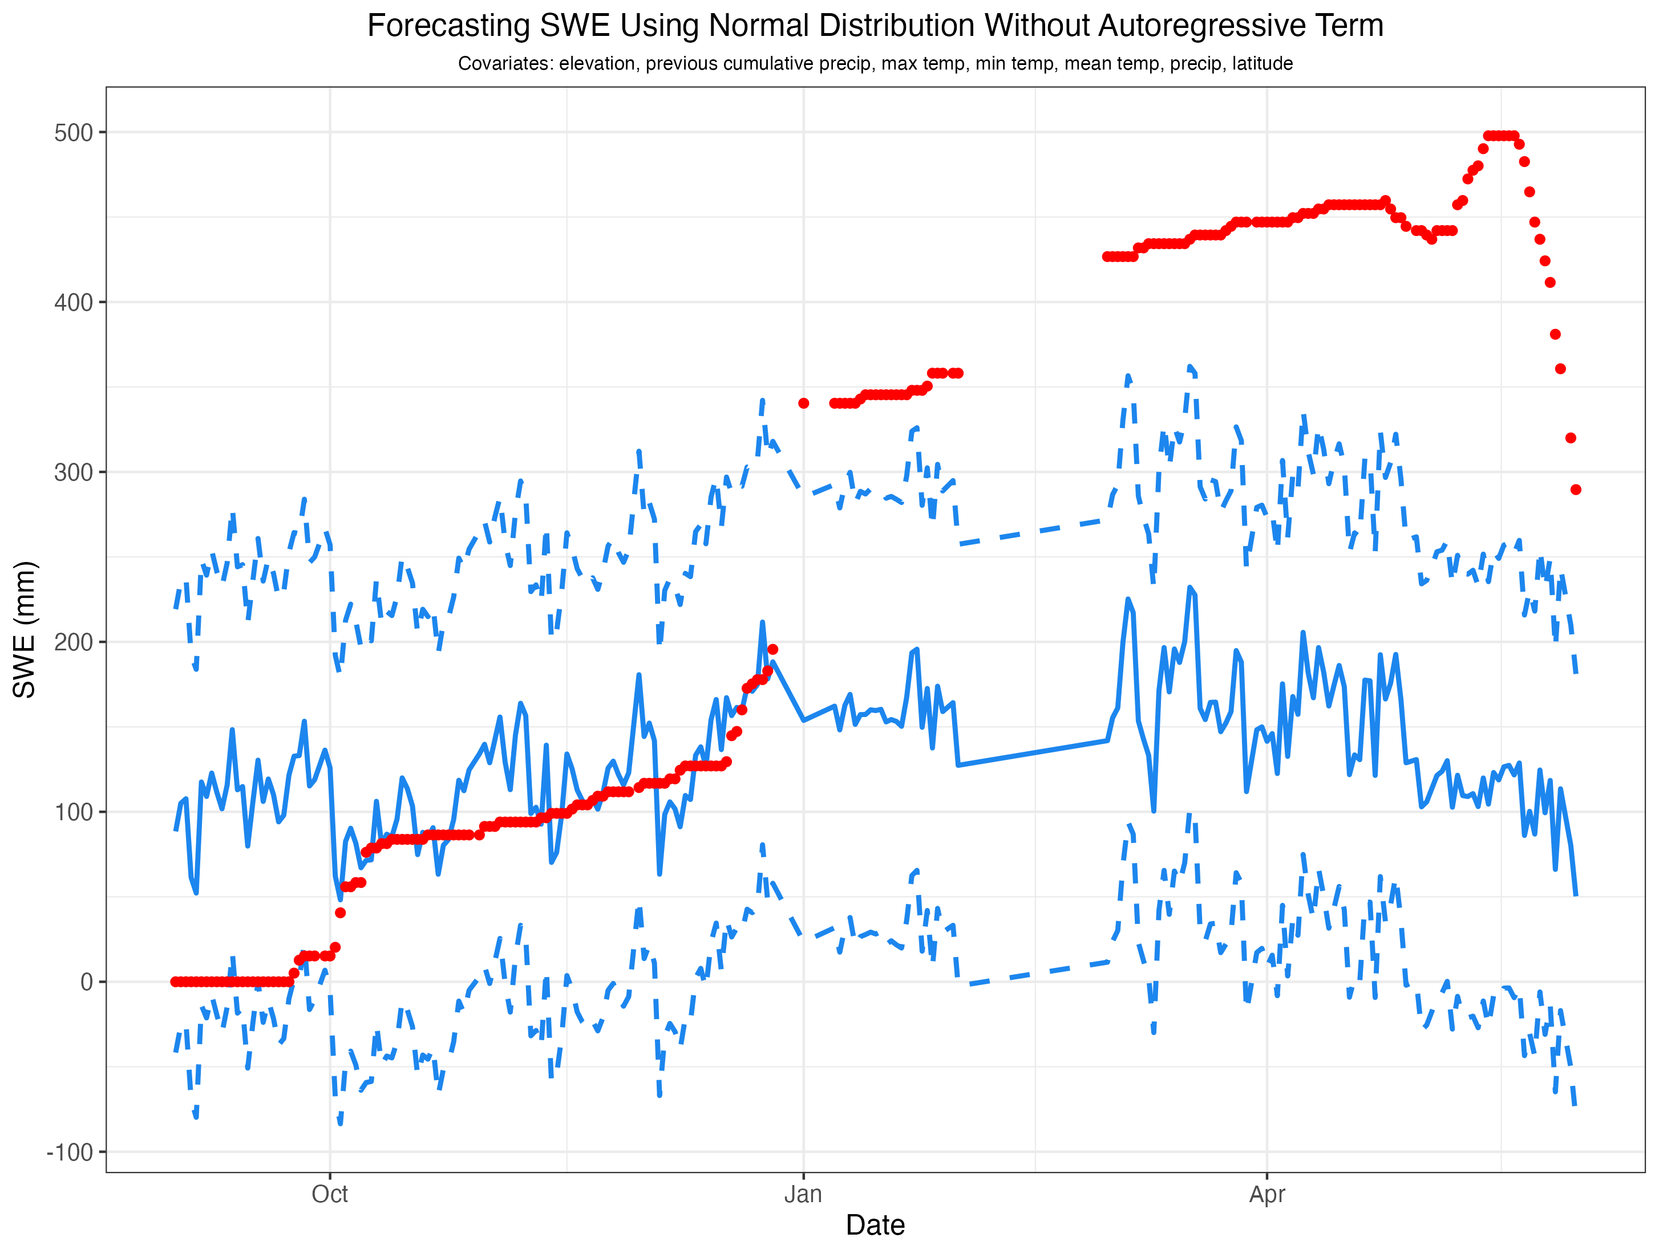
Normal Distribution Forecasts
Poorly handled missing data without AR term
Lower bound goes below 0

Slide 8
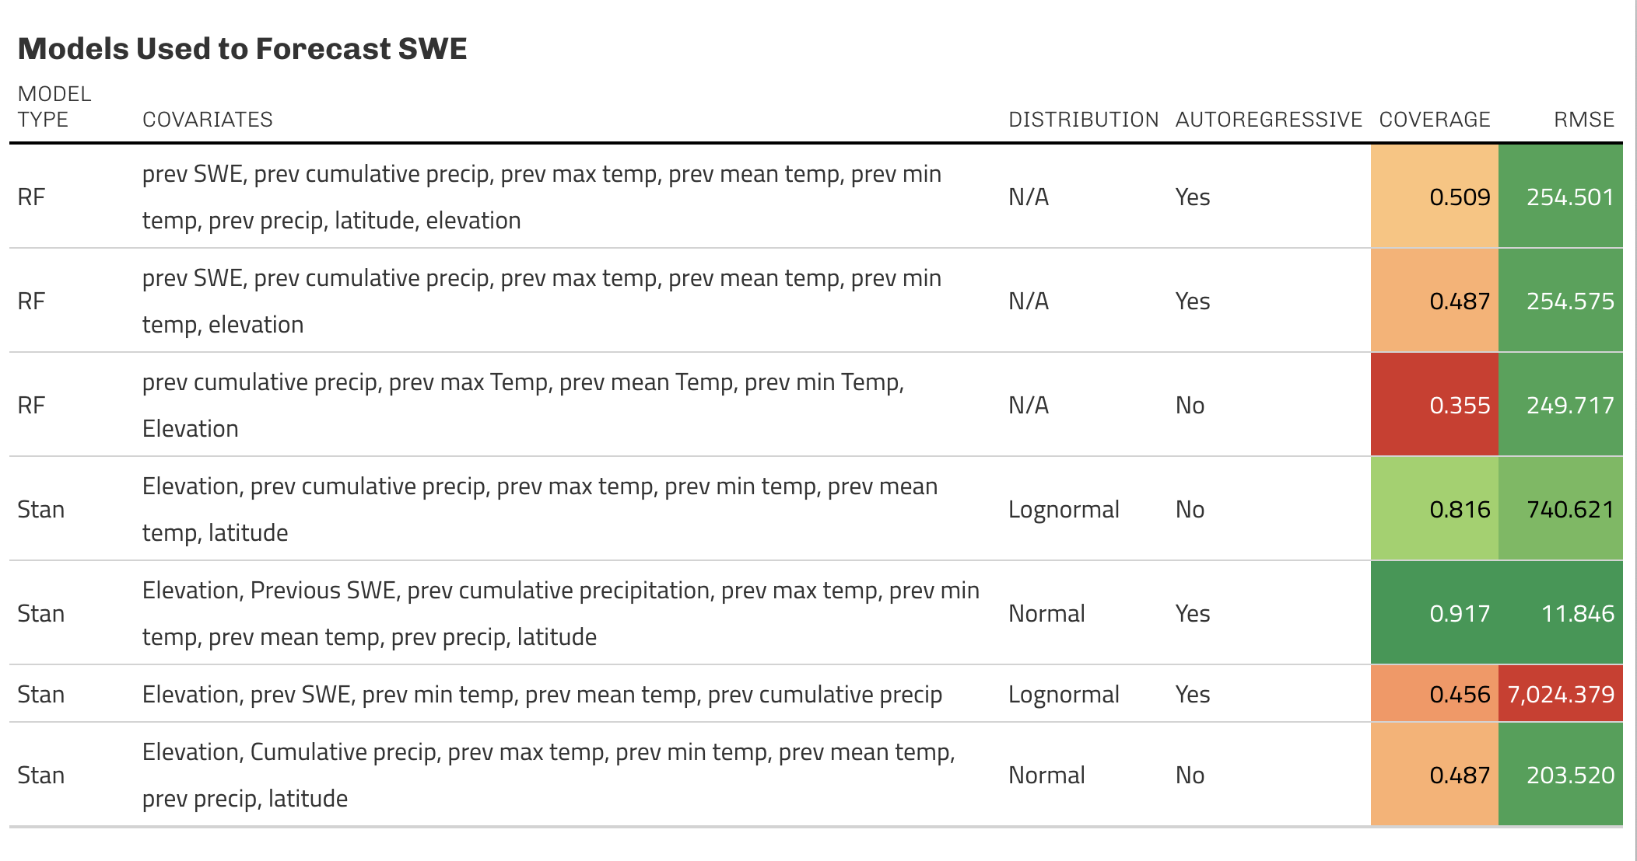
Model Comparison
AR models had lower RMSE, but not always higher coverage
Significant uncertainty with Lognormal

Slide 9
Problems to Solve/Future Ideas
Use more/wider variety of sites
Take log of AR term in lognormal models
Find better solution for missing data
Make model spatial
AR probably not possible

Slide 10
References
Hufkens, K. (2022). snotelr: a toolbox to facilitate easy SNOTEL data exploration and downloads in R. Zenodo. https://doi.org/10.5281/zenodo.7012728.
Thornton, M.M., R. Shrestha, Y. Wei, P.E. Thornton, and S-C. Kao. 2022. Daymet: Daily Surface Weather Data on a 1-km Grid for North America, Version 4 R1. ORNL DAAC, Oak Ridge, Tennessee, USA. https://doi.org/10.3334/ORNLDAAC/2129
Musselman, K. N., Molotch, N. P., & Margulis, S. A. (2017). Snowmelt response to simulated warming across a large elevation gradient, southern Sierra Nevada, California. The Cryosphere, 11(6), 2847–2866. https://doi.org/10.5194/tc-11-2847-2017
Hale, K. E., Jennings, K. S., Musselman, K. N., Livneh, B., & Molotch, N. P. (2023). Recent decreases in snow water storage in western North America. Communications Earth & Environment, 4(1), 170. https://doi.org/10.1038/s43247-023-00751-3
Qin, Y., Abatzoglou, J. T., Siebert, S., Huning, L. S., AghaKouchak, A., Mankin, J. S., Hong, C., Tong, D., Davis, S. J., & Mueller, N. D. (2020). Agricultural risks from changing snowmelt. Nature Climate Change, 10(5), 459–465. https://doi.org/10.1038/s41558-020-0746-8
Siirila-Woodburn, E. R., Rhoades, A. M., Hatchett, B. J., Huning, L. S., Szinai, J., Tague, C., Nico, P. S., Feldman, D. R., Jones, A. D., Collins, W. D., & Kaatz, L. (2021). A low-to-no snow future and its impacts on water resources in the western United States. Nature Reviews Earth & Environment, 2(11), 800–819. https://doi.org/10.1038/s43017-021-00219-y

