Slide 1

Investigating the Role of Snow Water Equivalent on Streamflow Predictability During Drought
Griffin Shelor

Slide 2
Why this paper
Snowpack is critical for water management in the west
Much uncertainty around snowpack
Recency

Slide 3
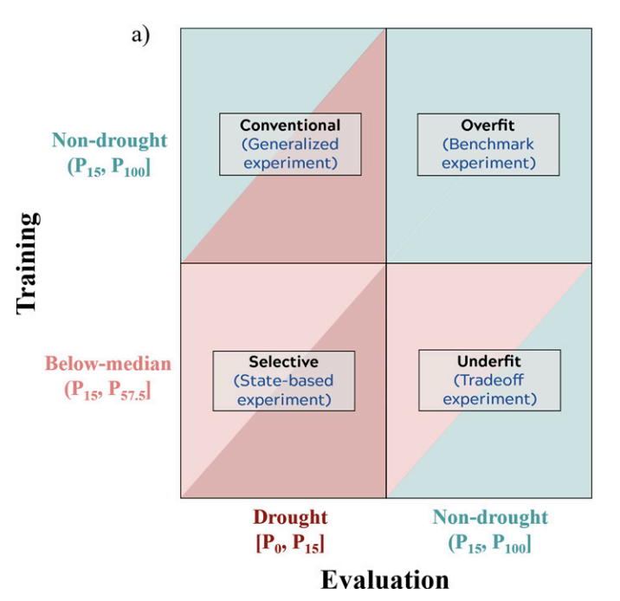
Broad Overview of Methods
Simple Linear Model
Using streamflow percentiles to create training subsets
Developing a set of forecast experiments and applying them to a case study
Adaptive sampling using prior SWE conditions
Model metrics and statistical testing

Slide 4
Brief Results
Both models trained on below-median years and on all non-drought years overestimated streamflow in drought years
Conventional shows larger residuals
Residual direction varied by experiment type
Conventional showed no obvious trend
Selective indicated consistent overprediction
Forecast skill
Similar trend compared to residual size
Drier training subsets performed best
Adaptive Sampling

Slide 5
Discussion Questions
What are some downsides of the adaptive sampling approach they tested as one of their experiments, and do you agree with its usage?
In this paper, they specifically set out to predict streamflow in years identified by some form of extreme (in this case, drought years) and achieved better forecasting skill when limiting model training to years with below-median streamflow. What are some examples in your field (or anywhere else you can think of) that would benefit from a similar approach?

