Slide 1


OpenShift Roadmap Update:
January 2014
Joe Fernandes – Sr. Manager Product Mgt.
Mike Barrett – Principal Product Manager
Nam Duong – Principal Product Manager

Slide 2



Red Hat’s PaaS Strategy
Open Source PaaS
Project
Public PaaS
Service
On-premise or Private PaaS
Software
Notes:
In Red Hat fashion, we are leveraging the best of community-powered innovation to drive the development of OpenShift Origin. OpenShift Origin then becomes the “Upstream” project for Red Hat’s PaaS offerings, OpenShift Online and OpenShift Enterprise. These two enterprise-class PaaS solutions leverage the combination of the innovation provided by the community and the enterprise support provided by Red Hat. Whether you want to utilize PaaS in the public cloud, or on-premise, the OpenShift technology is available to you.
<next slide>

Slide 3
What's New in
OpenShift Enterprise 2
Red Hat teaming with our Customers to drive Innovation:
Administration Console
Development Team Collaboration
New and Updated Languages
Web Routing Layer and HA Enhancements
Deployment Enhancements
Simplified Installation

Slide 4
What's New in OpenShift Enterprise 2.0
Web Routing Enhancements
New and Updated Cartridges
Deployment Enhancements
Administration Console
Collaboration
New Installer
OpenStack Heat templates

Slide 5
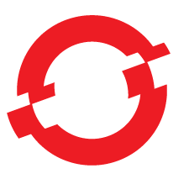
OpenShift CY2014 Release Roadmap
2.0
2.1
2.2
3.0
-Redundant Web Routing for HA
-Pluggable External Routers
-Updated Cartridges (Ruby, Python, Postgres)
-New Node.js Cartridge
-Binary Deployment, Rollback
-User-Defined Environment Variables
-PaaS Administrator Console (v1)
-Team Collaboration/Access Control (v1)
-Easier Installation/Config Scripts
-OpenStack Integration (Heat)
-Gear Placement
& Extensibility
-Log Management
& Metric Collection
-Groups & LDAP integration
-Python 3.3, PHP 5.4
& MySQL 5.5 cartridges
-iPaaS / Fuse cartridge
-VM Appliance
-Puppet Modules (?))
-TBD
-Docker Integration
-Routing Layer
-Scaling Enhancements
-User Notifications
-New cartridges - Mongo, MariaDB
-Updated cartridges - Ruby, Perl, other
-Other TBD
-Large Gears
-Silver Geo Expansion
-Python 3.3
-PHP 5.4
-MySQL 5.5
-iPaaS / Fuse Beta
-Bronze Plan
-SaaS ISV Marketplace
-Annual SKU
-Other TBD
OPENSHIFT
Enterprise
Online
Origin
Orign v3
Origin v4
Dec
Jan
Feb
Mar
Apr
May
Dec
Notes:
This slide shows a snapshot of the OpenShift roadmap, which includes all 3 offerings – Origin, Online and Enterprise.
OpenShift Origin is updating the most rapidly, with new features and functionality being added daily. The Origin community is also moving towards quarterly stable Origin milestone releases.
The OpenShift Online service is being updated on a monthly basis, after each development sprint. So our Online users can benefit from new features each and every month.
The OpenShift Enterprise software product is releasing about 3 – 4 times per year as we rapidly evolve the platform.
The following slides will provide details on all the new features listed here, as well as where we are going as we move into 2014.

Slide 6
Gear Placement & Extensibility
Ability to direct application deployments across selected groups of Nodes
  Administrators can tag & group Nodes into Zones
  Force application Gears to be deployed across multiple Zones by default
Ability to customize the Node placement algorithm when deploying OpenShift Gears
  Extensibility via a Ruby plugin mechanism
  Plugin will get passed User, Cartridge, App & available Nodes info and expected to return a Node selection
  Sample plugins will be provided

Slide 7
Log Management
Allow Cartridge, Gear & Node metrics and logs to be collected and sent to an external source
Standardized Node and Gear statistics (Memory/CPU/IO)
Customized Cartridge statistics can be specified by the Cartridges (as callable bin/script)
All data is collected at a Node level with options for enterprises to send data to a custom location
Logstash will be used as primary collection mechanism
Phase 2:
  Log storage in OpenShift itself
  GUI / Admin Console integration for Log Mgt.

Slide 8
Cartridge Updates
Updates to supported OpenShift Cartridge
  Leveraging RHEL Software Collections
MySQL 5.5
  Current supported version = 5.1
Python 3.3
  Current supported versions = 2.6 & 2.7
PHP 5.4
  Current supported version = PHP 5.3

Slide 9
User Groups
Admins can define teams and assign LDAP Users or a Group to that team
  REST API at a minimum; possibly script that runs automatically, etc.
  Background sync on specified interval with option to update immediately
  1 group per team (is this mapping stored in mongo or specified external per synchronization event)
  Ability to lazily create users via team membership API
  Teams are assigned to domains the same as users

Slide 10

Docker Integration
Kernel namespaces integrated OpenShift Gears
Docker images

Slide 11
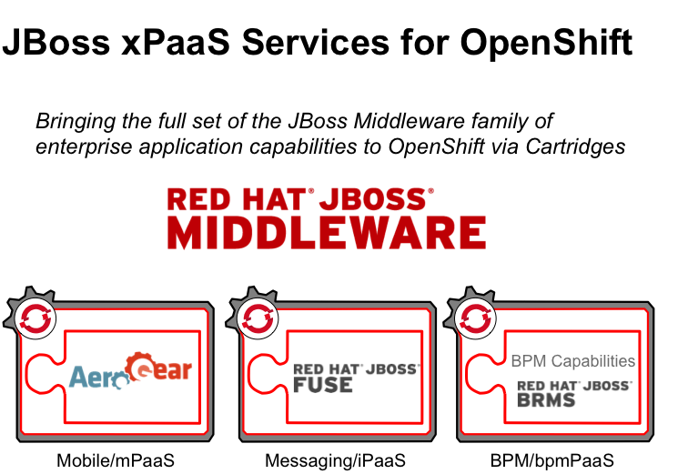
Expanded Middleware Services

Slide 12
Questions?
Thank You!

