Slide 1
Title: Regional Product Sentiment Analysis Using Clustering, Classification, Statistics and NLP
Team Group No : 11
Gangadhar Singh Shiva
Akshobhya BV
Himanshu Kumar

Slide 2
Project Description
Project Description
Investigates customer sentiment towards iPhone products across APAC, EMEA, and the United States.
Utilizes machine learning models, including traditional classifiers and LLMs like DistilBERT.
Applies clustering to uncover geographic preferences.
Key Objectives:
Regional sentiment variation.
Key factors influencing satisfaction.
Comparing traditional ML models and LLMs.
Temporal sentiment trends.

Slide 3
Methodology
Dataset Overview
Size: 3,062 reviews across 11 features.
Features: Country, date, rating score, review text, variant details.
Reviews span 2021–2024 across multiple regions.
Data Preprocessing
Cleaned missing values and duplicates.
Extracted features (e.g., size, color, temporal insights).

Slide 4
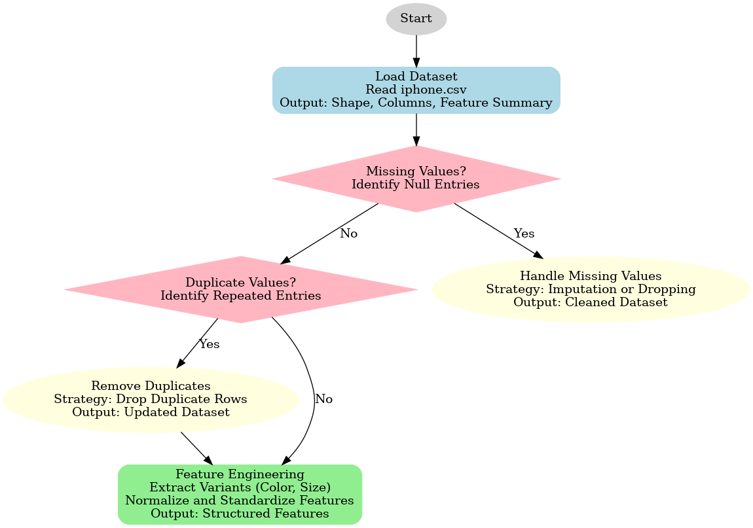
Work Flow

Slide 5
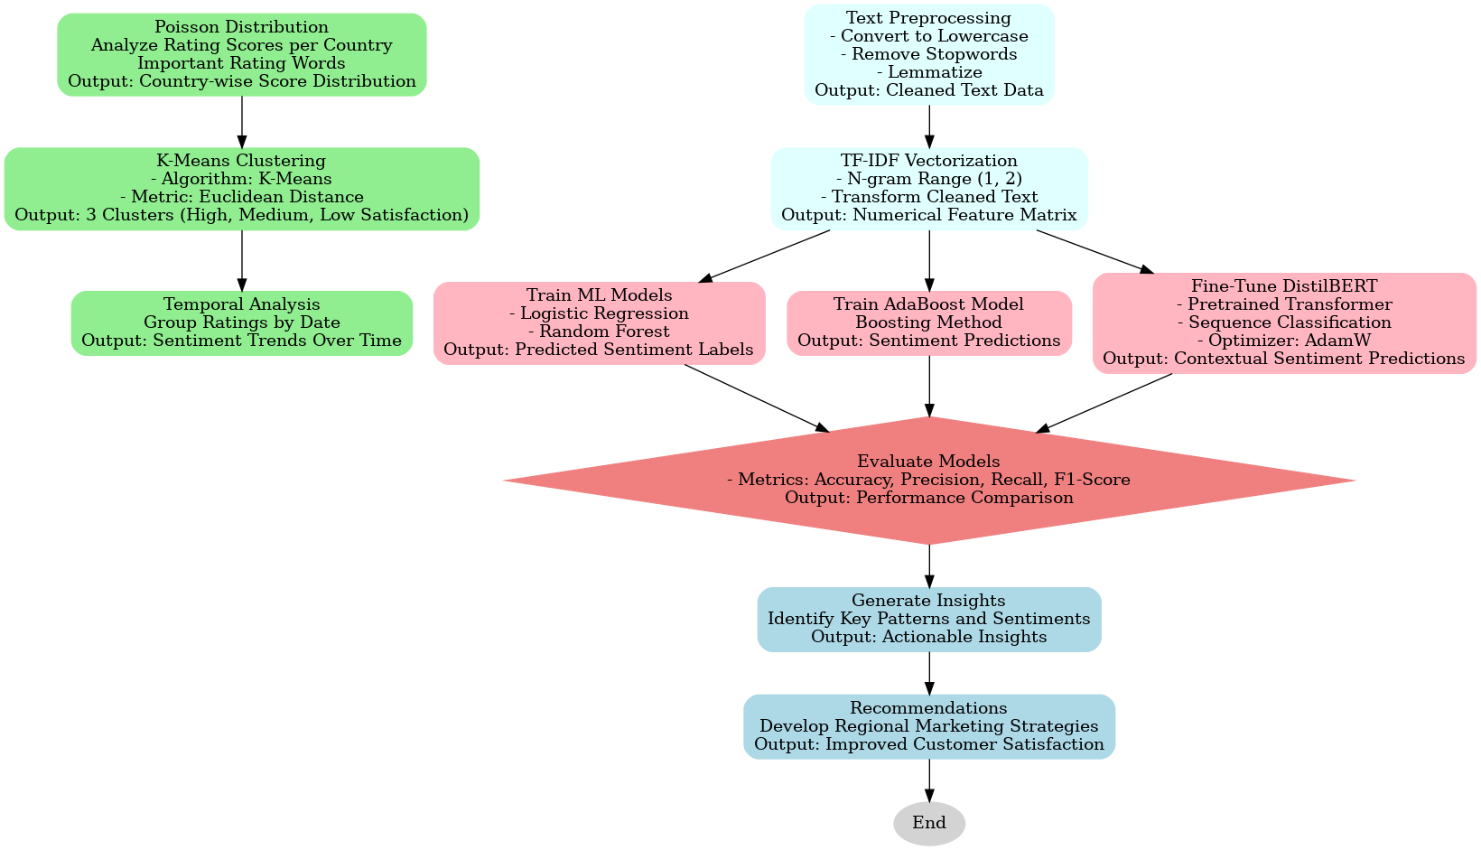
Work Flow

Slide 6
Key Insights
Clustering Analysis
K-Means algorithm used for geographic segmentation.
Clusters Identified:
Cluster 0: Japan, UAE, United States.
Cluster 1: India, Japan, UAE.
Cluster 2: UAE, Egypt, US, Mexico, Canada.

Slide 7
Key Insights
1. Sentiment Variation Across Regions
High Engagement: India, UAE, US with mixed feedback.
Sparse Data: Canada and Egypt, yet high ratings (4.5–5.0).
Key Concerns:
Cluster 0: Scratches, battery.
Cluster 2: Screen, condition.

Slide 8
Key Insights
2. Key Factors Influencing Ratings
Storage: 128GB dominates usage; limited engagement for 512GB.
Color Preferences: Blue, Midnight lead; data cleaning needed.
Product Condition: Common issues with scratches and screens.

Slide 9
Model Comparison
Performance Metrics
Random Forest:
Accuracy: 99.67%, Precision: 99.67%.
Outperformed DistilBERT and other ML models.
DistilBERT:
Accuracy: 90.7%.
Suitable for nuanced text analysis.
Logistic Regression & AdaBoost:
Accuracy: 83.5% and 85.59%, respectively.
Insights
Random Forest excels in handling structured data.
DistilBERT captures complex language relationships but needs tuning.
Notes:
Consider talking about:
Market action discounts everything
Prices move in trends
History tends to repeat itself

Slide 10
Key Findings
Key Findings
Regional clusters reveal diverse customer expectations.
Storage size and product condition significantly impact sentiment.
Temporal trends show a ~20% rating drop (2022–2023) with recovery in 2024.
Notes:
Consider talking about:
Software

Slide 11
Future Work
Future Work
Expand analysis with demographic data (age, gender).
Explore advanced LLMs like GPT-4 for better accuracy.
Use insights for targeted marketing and product development.
Notes:
Consider talking about:
Software

Slide 12
Thankyou
Notes:
Consider talking about:
Software

