Slide 1

Title: Scalable Multi-Agentic Sentiment Analysis with A2A, MCP, and ML Agents
Subtitle: A Cloud-Native Deployment for Twitter and iPhone Review Understanding Group: Project Team - 9
Team Members:
Gangadhar Singh Shiva,
Ananya Chandraker,
Mohd Sharik
Date: June 2025

Slide 2
Business Goals and Objectives
Goal: Classify user sentiment from Twitter posts and iPhone reviews.
Need: Organizations struggle with scattered ML pipelines and lack of intelligent routing.
Solution: Use Agentic AI solutions with MCP for coordination, A2A for agent communication, and ML and Transformer, Embedding models for analysis.

Slide 3
Project Dataset Summary
iPhone Review Dataset
Source: Amazon product reviews
Fields: reviewDescription, ratingScore
Label derivation: Rating 1–2 → Negative, 3 → Neutral, 4–5 → Positive
Neutral, Negative
Twitter Dataset
Source: Pre-labeled tweets with sentiment classification (Positive, Negative, Neutral).
Size: ~75,000 samples
Fields: Tweet ID, Entity, Sentiment, Tweet Content

Slide 4
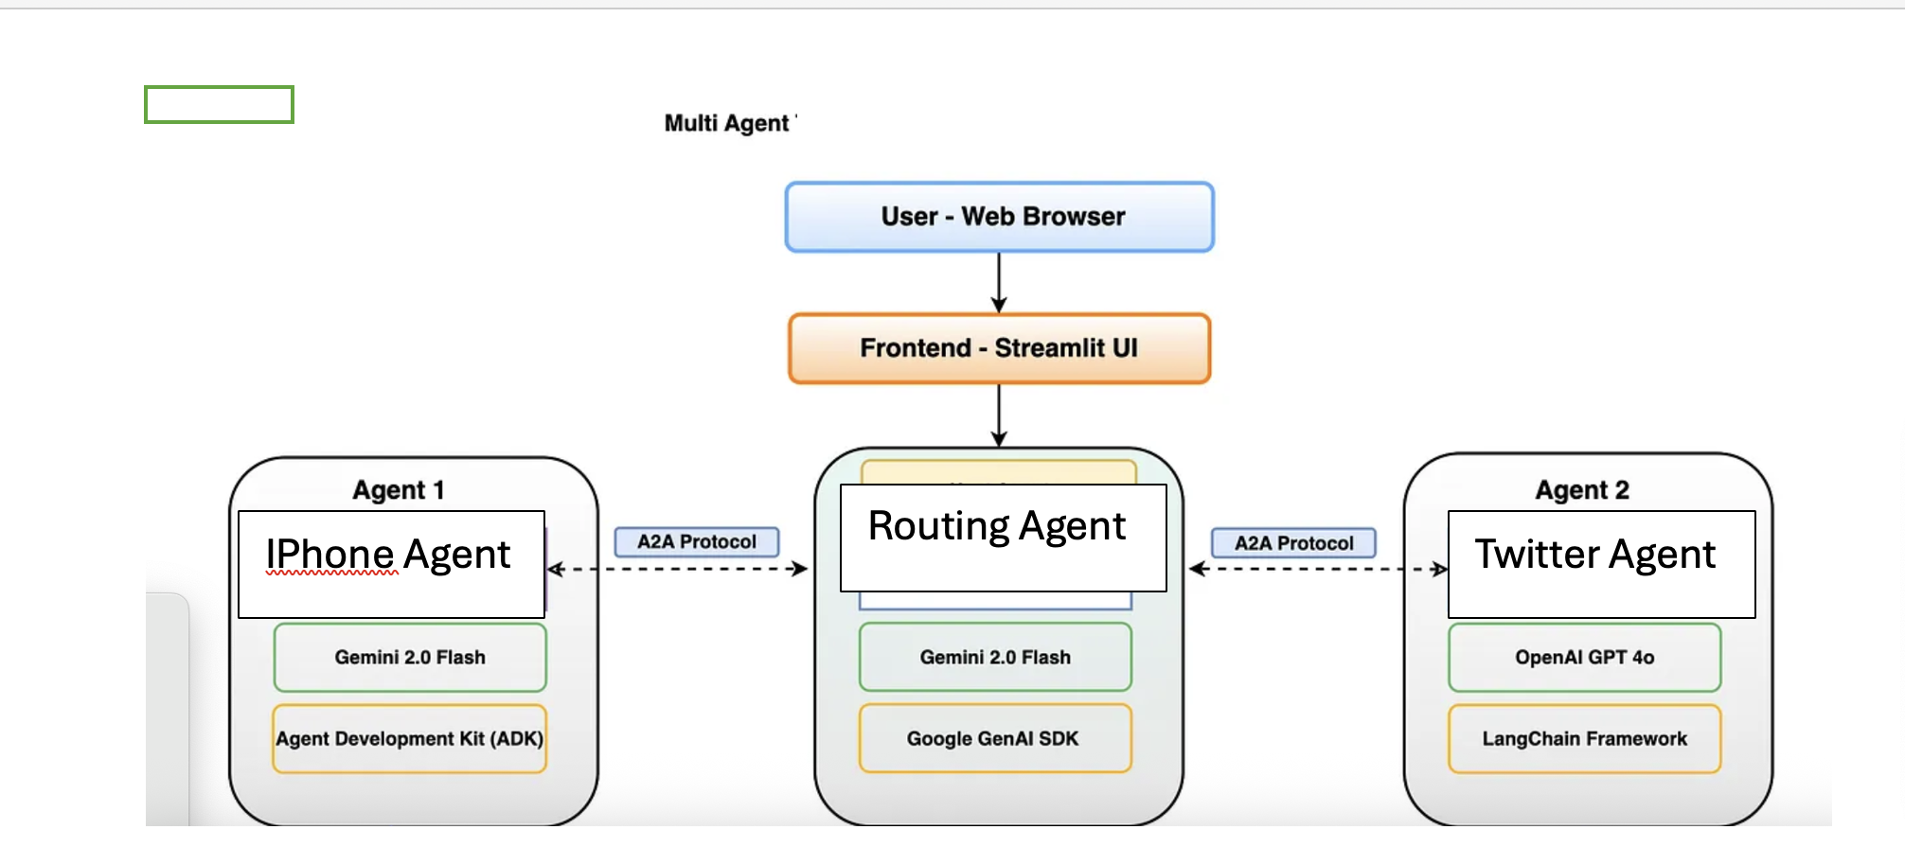
System Architecture

Slide 5

System Architecture
Agent Overview
Agent | Model | Input | Output
iPhone Agent | Random Forest / TextBlob | Review text | Sentiment
Twitter Agent | BERTweet | Tweet content | Sentiment
Router Agent | Keyword/Embedding | Query | Routes to Agent
MCP Server | FastMCP | Agent requests | Manages routing/Sentiments

Slide 6
System Architecture (A2A)
A2A Overview
A2A (Agent-to-Agent) is a lightweight coordination SDK that enables modular and autonomous agent tools to be invoked via message-based or callable interfaces. Each agent runs as an independent process or module, exposing callable functions through a shared routing framework. Agents do not depend on each other directly, making the architecture fault-tolerant and extensible.
Key Features:
Stateless communication over stdio, sockets, or HTTP
Lightweight and minimal overhead
Integrates seamlessly with MCP for routing and service discovery

Slide 7
System Architecture (MCP)
MCP Client and Server Integration
The system is structured such that the MCP server listens for function calls from agent clients. MCP clients act as wrappers for the agents and route communication using either standard input/output (for terminal-based tools) or HTTP. The client uses schema definitions and registered MCP decorators (@mcp.tool) to facilitate execution.
MCP Server: Hosts service registration, manages message routing, handles execution lifecycle.
MCP Client: Sends query via CLI or embedded API (e.g., FastMCP.run("tool_name", input))
Embedding Support: For routing, sentence transformers or keyword-based vector encoders are used to transform queries into semantic space and match the most appropriate agent.

Slide 8
System Architecture (ML Model)
ML Models
Twitter Agent: Fine-tuned BERTweet Transformer (HuggingFace)
a2a_twitter_sentiment_agent.py handles loading the model, tokenizing input, and returning prediction
Uses Hugging Face's AutoModelForSequenceClassification
Optimized for short-text sentiment classification
Example Query: "Twitter keeps crashing on my phone."
Output: Negative sentiment with ~88% classification confidence
iPhone Agent: Random Forest with TF-IDF vectorization and optional TextBlob sentiment analysis
a2a_iphone_sentiment_agent.py loads review CSVs, vectorizes reviews, applies RandomForestClassifier
Sentiment is derived from Amazon star ratings and review content
Alternative lightweight path uses TextBlob polarity scoring
Example Query: "The iPhone battery drains too fast."
Output: Negative sentiment (probability from RF classifier or polarity < -0.1 from TextBlob)
Routing Agent Uses keyword classification or sentence embeddings to identify target agent
a2a_main.py uses mcp.call(tool_name, input) to route user query
Routing Accuracy observed: 100% in test samples
Uses keyword classification or sentence embeddings to identify target agent
a2a_main.py uses mcp.call(tool_name, input) to route user query
Routing Accuracy observed: 100% in test samples

Slide 9
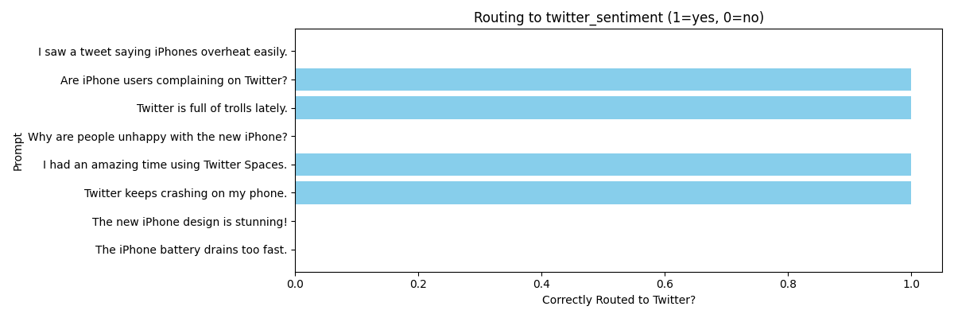
Performance Metrics

Slide 10
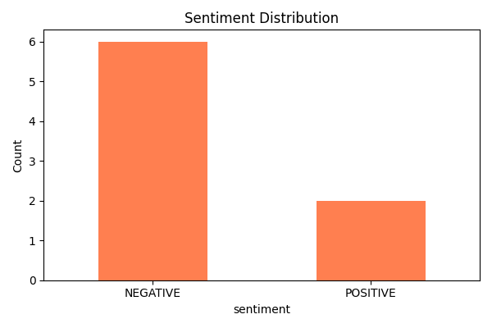
Performance Metrics

Slide 11
Performance Metric
Performance Metrics
Agent | Accuracy | Notes
iPhone ML Agent | ~86% | RF + TF-IDF
Twitter BERT Agent | ~88% | BERTweet fine-tuned
Routing Accuracy | 100% | On test queries

Slide 12
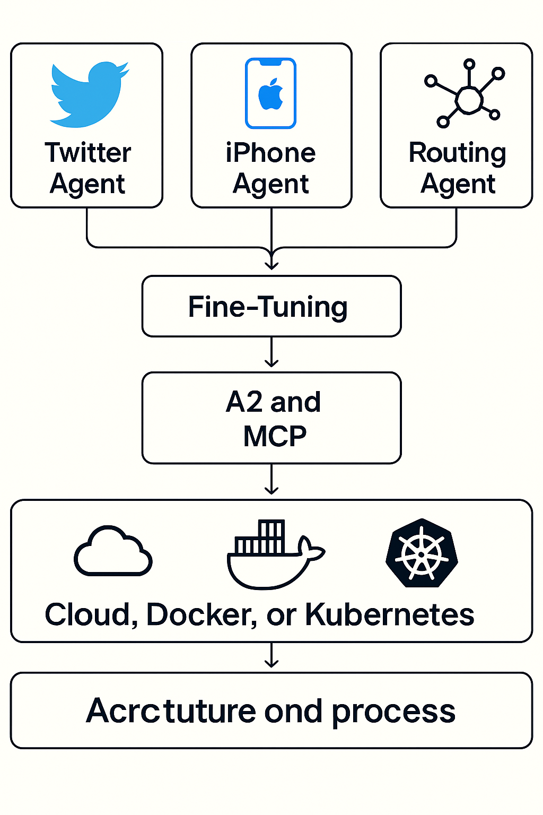
Deployment Strategy
Containerized with Docker
Microservices on Kubernetes
Option for FastAPI-based REST
Deployable via Helm or
Docker Compose

Slide 13
Thank You
\

