Slide 1
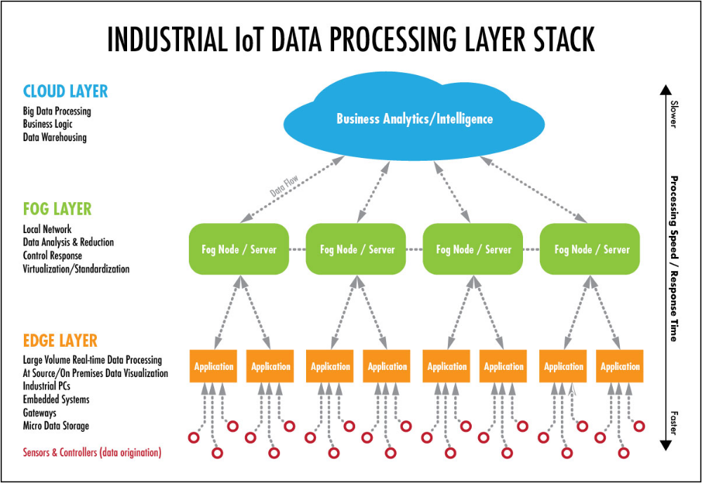
IOT System Design
Convergence of ML, Security in forecasting, anomaly detection
This Photo by Unknown Author is licensed under CC BY-SA-NC
This Photo by Unknown Author is licensed under CC BY-SA-NC

Slide 2
