Slide 1



Studio Shodwe
Ethical AI Recommender Systems
Leveraging SHAP, LIME, RAG, Groq LLM, and Fairness Techniques for Transparent and Fair Recommendations
Team Number
Team Members : Gangadhar Singh Shiva, Ananya Chandraker, Harish Kapettu Acharya
Team Number: AAI-531 Group 7
Team Members :
Gangadhar Singh Shiva,
Ananya Chandraker,
Harish Kapettu Acharya
01

Slide 2

Studio Shodwe
Project Objectives - AI Ethics Principles
Build a transparent, fair, and privacy-preserving recommender system
Ensure that recommendation outcomes are interpretable, unbiased, and protect user privacy
Accountability: Clearly defining responsibility for decisions and outcomes of the recommender system.
Utilize modern AI tools including RAG, transformers, and differential privacy
Leverage state-of-the-art methods to enhance recommendation quality while embedding ethical AI safeguards
Address bias and explain model predictions using SHAP and LIME
Use explainability tools to detect and mitigate potential sources of discrimination or unfairness in model behavior
02

Slide 3
Studio Shodwe
Unintended Stakeholders and Impacts
Potential unintended stakeholders: Marginalized or minority demographics, competitors, third-party developers, and international users.
Impacts:
Risk of unintentionally reinforcing existing biases leading to discriminatory or unfair recommendations.
Potential violation of user privacy through insufficiently secured data practices.
Unfair competitive dynamics resulting from biased or non-transparent algorithms.
Ethical Harms: Potential discrimination, compromised user privacy, loss of consumer trust, and reduced market fairness.
Team Number
Team Members : Gangadhar Singh Shiva, Ananya Chandraker, Harish Kapettu Acharya
01

Slide 4
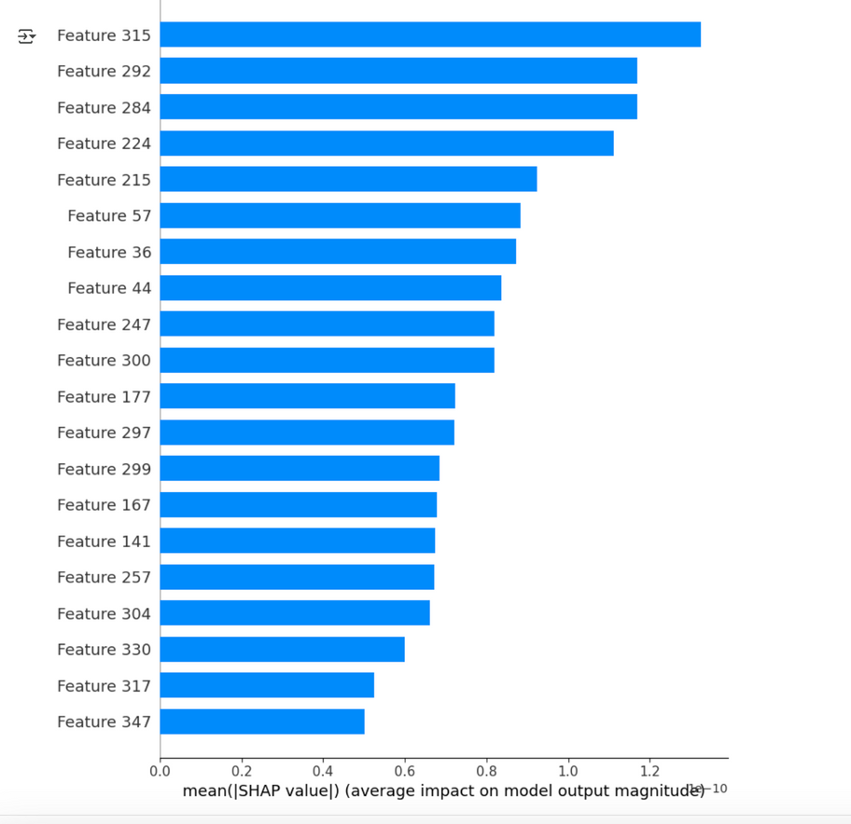
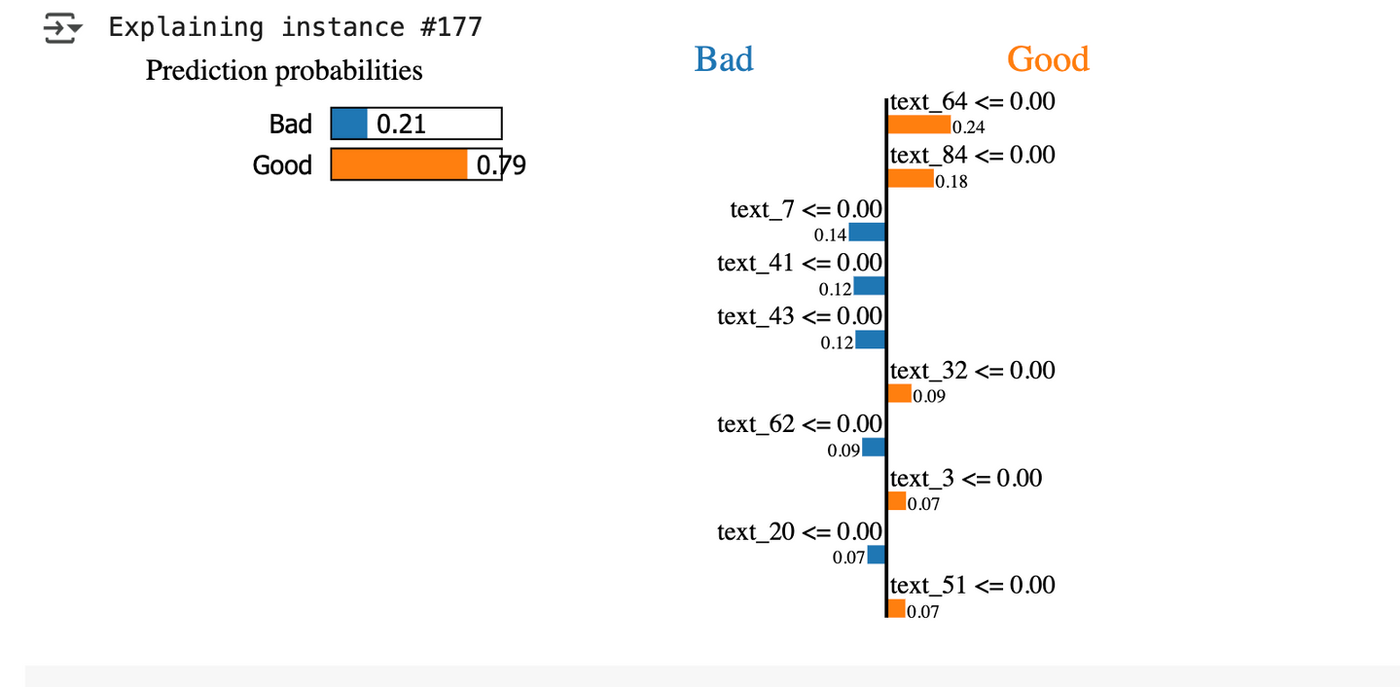
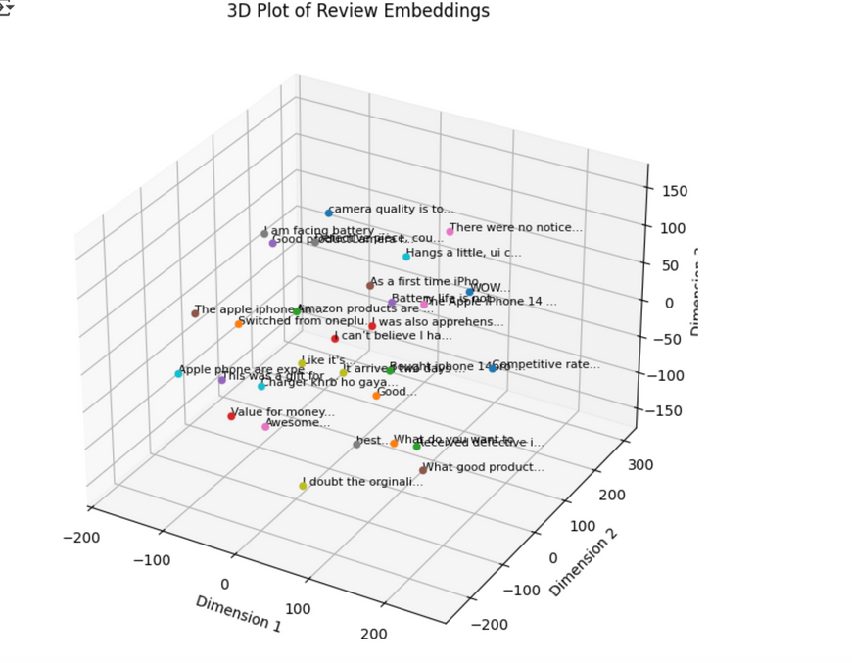
Studio Shodwe
ETHICAL EXPLAINABILITY AND TRANSPARENCY
Personal Perspective:
Advocates strongly for transparent and interpretable recommendations using SHAP and LIME.
Highlights fairness as a cornerstone to ensure unbiased outcomes.
Comparison to Team:
Shares transparency focus, with unique emphasis on interpretability tools.
Common Sense View:
Ethical recommender systems must prioritize transparency and fairness, rooted deeply in personal values of integrity and equality.
SHAP Result
feature embedding
Team Number:
LIME Result
01

Slide 5
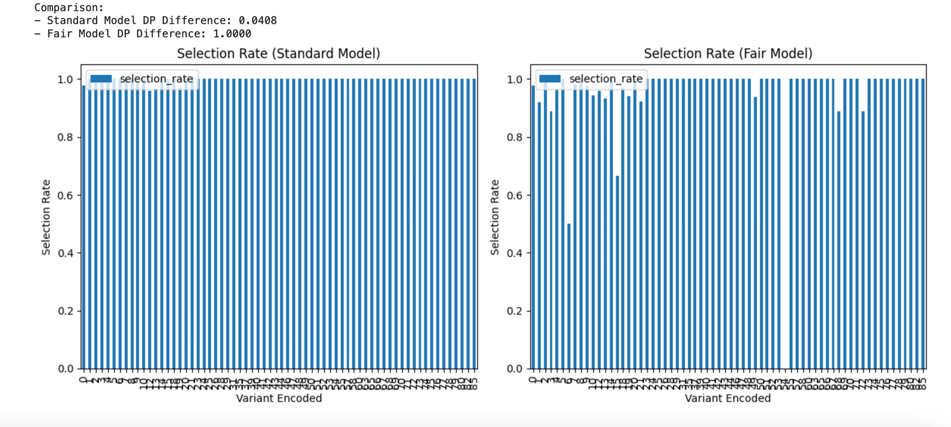
ETHICAL PRINCIPLES (FAIRNESS AND DIFFERENTIAL PRIVACY
Studio Shodwe
Personal Perspective:
Strong emphasis on data privacy, utilizing differential privacy and thorough data sanitization practices.
Views privacy protection as essential to preventing ethical harms.
Contrast to Team:
Agrees broadly on transparency but emphasizes rigorous privacy measures.
Common Sense View:
Protecting user privacy is paramount, aligning with personal values of autonomy, respect, and accountability.
Team Number:Team Members : Gangadhar Singh Shiva, Ananya Chandraker, Harish Kapettu Acharya
01

Slide 6
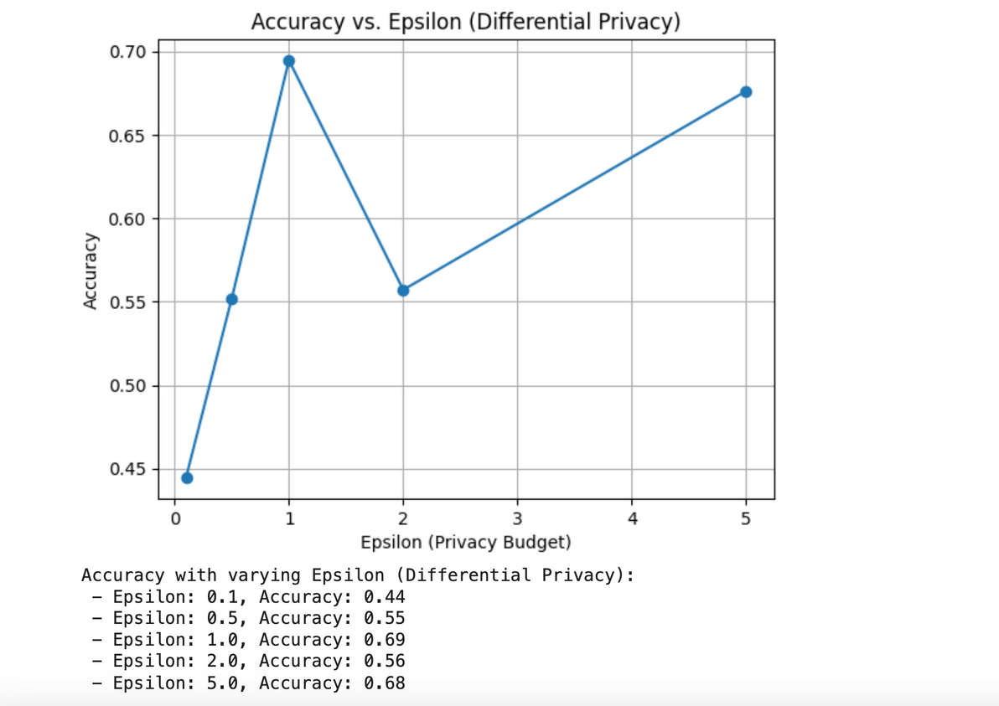
Studio Shodwe
ETHICAL - FAIRNESS AND PRIVACY ENHANCEMENTS
Personal Perspective:
Emphasizes fairness techniques, such as demographic parity, to prevent biased outcomes.
Advocates strongly for practical ethical implementations.
Relation to Team:
Strong agreement on fairness and privacy, with practical focus on ethical accountability.
Common Sense View:
Ethical AI recommendations must actively promote fairness and unbiased treatment, aligning with values of equality and ethical responsibility.
Team Number: Team Members : Gangadhar Singh Shiva, Ananya Chandraker, Harish Kapettu Acharya
01

Slide 7
Studio Shodwe
CONCLUSION
Reinforced importance of SHAP and LIME for transparency and interpretability.
Emphasized fairness and differential privacy as critical elements ensuring equitable and secure AI recommendations.
Team consensus highlights the necessity of fairness, transparency, privacy, and accountability.
Advocates continuous ethical review, responsible governance, user empowerment, and adherence to regulatory frameworks for maintaining user trust and ethical integrity.
Team Number:
Team Members : Gangadhar Singh Shiva, Ananya Chandraker, Harish Kapettu Acharya
THANK YOU
01

