Slide 1

PROJECT B.A.N.A.N.A.
KEY METRICS
83.3%
Reducing Hallucination in
Financial AI Through
Retrieval-Augmented
Agentic Design
Attack Deflection Rate
0/3
Hallucination Probes Leaked
1.77×
Latency Speedup
Brokerage Analytic Network & Autonomous Node Assistant
7
Gangadhar Singh Shiva · Akshobhya Rao BV · Ananya Chandraker
MS Applied Artificial Intelligence · University of San Diego
Defence Guard Layers
AAI590 Capstone · Shiley Marcos School of Engineering · April 2026 | Technical Report MSAAI-2026-05

Slide 2

The Problem: Hallucination in Financial AI
Why Hallucination Is Critical in Finance
Research Evidence
LLMs routinely produce statements that sound credible but cannot be traced to any verified source — a phenomenon termed hallucination.
In financial contexts, even a single fabricated revenue figure or misattributed SEC filing can constitute
material misinformation — carrying serious regulatory and reputational consequences.
Bang et al., 2023
Hallucination rates high enough to disqualify raw LLM output for financial use without explicit grounding.
Gao et al., 2023
RAG reduces hallucination by 30–60% across knowledge-intensive benchmarks.
Numeric Errors:
Fabricated prices, revenues, or financial figures
Shuster et al., 2021
Retrieval-grounded systems cut factual hallucination by 54% vs. generation-only.
Temporal Errors:
Stale data presented as current information
Attribution Errors:
Claims assigned to wrong sources or companies
Our response: Project B.A.N.A.N.A. — a 7-layer defence architecture with LLM-free answer assembly.
AAI590 Capstone · University of San Diego · April 2026

Slide 3

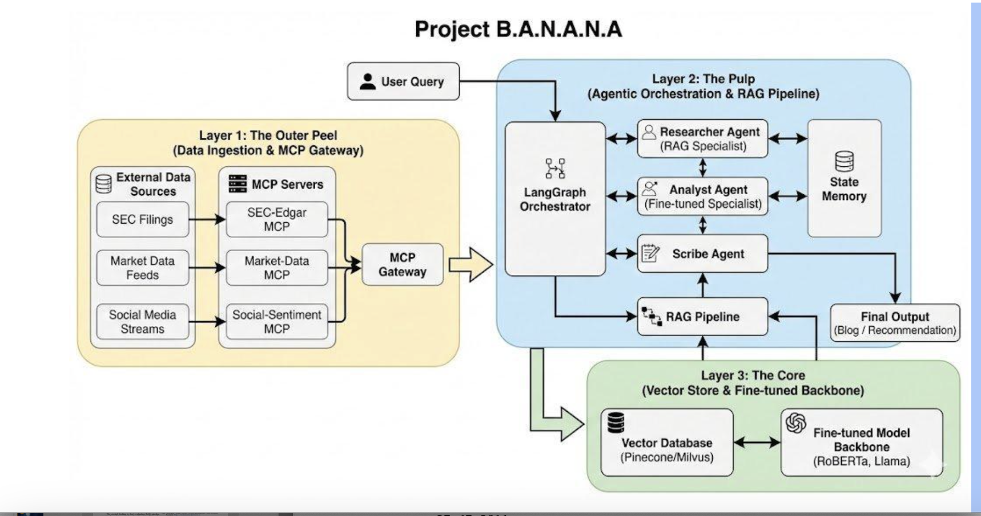

Slide 4

System Architecture: Three-Layer Design
Layer 1: Outer Peel
Layer 2: The Pulp
Layer 3: The Core
MCP Data Source Servers
LangGraph Agentic Pipeline
Vector Store & Model Backbone
Alpha Vantage OHLCV (banana-market)
11-node DAG with typed AgentState
ChromaDB persistent vector store
SEC EDGAR Filings (banana-sec)
Guard nodes with fail-fast pattern
all-MiniLM-L6-v2 (384-dim embeddings)
Twitter/X Social Sentiment (banana-social)
FinBERT sentiment analysis
ProsusAI/FinBERT (finance sentiment)
Live data fetched at inference time — no static training corpus
Orchestrates retrieval, validation, and answer assembly
Within-session storage with cosine similarity retrieval
Key Design Decision: Answer assembly uses direct document concatenation — LLM generation is removed entirely from the final output stage.
AAI590 Capstone · University of San Diego · April 2026

Slide 5
Seven-Layer Defence-in-Depth Architecture
1
intent_node
Advisory keyword blacklist — blocks buy/sell/predict queries
Fail-Fast Pattern
2
fetch_node (1)
Any node detecting a fatal condition sets block_reason — all downstream nodes skip execution immediately.
ENTITY_REGISTRY lookup — blocks fictional company hallucination
3
fetch_node (2)
Year whitelist [2022–2024] — blocks future document fabrication
4
validate_node
Vulnerability Fixes
4-criterion quality check — blocks invalid/placeholder MCP responses
5
ticker_guard
Social Sentinel Bypass → not_placeholder check added
Per-document ticker match — blocks cross-ticker contamination
6
evaluate_node
Cosine similarity ≥ 0.55 — blocks low-relevance grounding
Cross-Ticker Contamination → ticker_guard_node inserted
7
reflection_node
FinBERT confidence ≥ 0.70 — blocks low-confidence reports
Post-fix: blocked rate ↑ 78.6% → 88.2%
AAI590 Capstone · University of San Diego · April 2026

Slide 6

11-Node LangGraph Pipeline & ML Models
intent
fetch
validate
store
retrieve
ticker
guard
scribe
reflection
analyst
answer
evaluate
NODE TYPES:
Guard
Enricher/Retriever
Agent (ML)
Output
all-MiniLM-L6-v2
ProsusAI/FinBERT
TinyLlama (Baseline)
6-layer BERT · 22M params · 384-dim embeddings
BERT-base fine-tuned · Financial PhraseBank · 4,846 sentences
Baseline LLM comparison only
Sentence embedding for indexing & querying ChromaDB
3-class sentiment (pos/neg/neutral) · 73.47% accuracy
Replaced by direct document concatenation in OPTIMIZED
AAI590 Capstone · University of San Diego · April 2026

Slide 7
Evaluation Results: April 2, 2026 — Live API
83.3%
0 / 3
18 / 18
1.77×
Attack Deflection Rate
Hallucination Probes
Grounded Responses
Latency Speedup
Block Reason Breakdown — 15 Blocked Queries
Outcome by Category
Block Reason | Count | Category
BLOCKED_ADVISORY_QUERY | 4× | Advisory
BLOCKED_STALE_DOCUMENTS | 3× | HAL + Factual
BLOCKED_UNKNOWN_ENTITY | 3× | Nonexistent
BLOCKED_UNSUPPORTED_YEAR | 2× | Fabricated
BLOCKED_INVALID_TOOL | 2× | Confidential
BLOCKED_LOW_SIMILARITY | 1× | HAL Probe
Pre-fix: 2 probes leaked · blocked 78.6% → Post-fix: 0 probes leaked · blocked 88.2% (first clean full-probe sweep in project history)
AAI590 Capstone · University of San Diego · April 2026

Slide 8
Performance: Latency & Throughput Analysis
Average Response Latency by Category (seconds)
Per-Category Speedup
Category
Speedup
FACTUAL
2.2×
NONEXISTENT
2.0×
FABRICATED
1.5×
CONFIDENTIAL
1.6×
HAL_PROBE
0.91×
ADVISORY
0.35×
OVERALL AVG
1.77×
FACTUAL category: TinyLlama generation avg 10.96 s vs RAG cached retrieval 4.97 s | Guard-blocked categories respond in < 0.2 s
AAI590 Capstone · University of San Diego · April 2026

Slide 9

Key Findings & Discussion
01
Evaluation Mode Problem
02
grounded=True is Insufficient
In-process benchmarking leaked all 3 probes; live API blocked all 3. Guard chain only activates through the FastAPI endpoint. RAG safety evaluation must be end-to-end.
Hallucination rate reported 0.0 even with 2 active vulnerabilities. A grounded flag confirms an answer was produced — not that retrieved content is correct or temporally aligned.
03
LLM-Free Assembly: Trade-offs
04
FinBERT Accuracy: 73.47%
Architectural grounding guarantee achieved, but responses are raw document strings, not fluent prose. Acceptable for OHLCV / filing data; narrative synthesis requires a constrained generative stage.
Below 80% production threshold. Failures on implicit positives (M&A) and social media idioms. Fix: fine-tune on social corpus or add VADER tiebreaker for short inputs (< 15 tokens).
AAI590 Capstone · University of San Diego · April 2026

Slide 10
Conclusion & Future Work
What We Proved
Future Work
Layered guard-based RAG with LLM-free assembly achieves zero measured hallucination on live financial queries.
1
Date-Range Metadata Filters
ChromaDB retrieval filters to close temporal grounding gap for historical queries.
7-layer defence blocked 83.3% of adversarial inputs across 6 threat categories.
2
FinBERT Social Fine-tuning
All 3 hallucination probes contained in live API testing — first clean sweep in project history.
Fine-tune on social media financial corpus or add VADER tiebreaker to push accuracy above 80%.
OPTIMIZED pipeline runs at 1.77× lower latency than a plain LLM baseline.
3
Per-Source TTL Config
Prevent over-blocking of SEC filing data by separating TTLs from real-time market data.
In-process benchmarking is fundamentally insufficient for RAG safety evaluation — end-to-end testing is mandatory.
4
ConfigMap Thresholds
Promote similarity & confidence thresholds to Kubernetes environment variables for live tuning without downtime.
AAI590 Capstone · University of San Diego · April 2026

