Slide 1

AGENTIC AI AND MCP SERVER
DEMO’S(Investment Research Agent and Video Summarization)
GANGADHAR S SHIVA

Slide 2
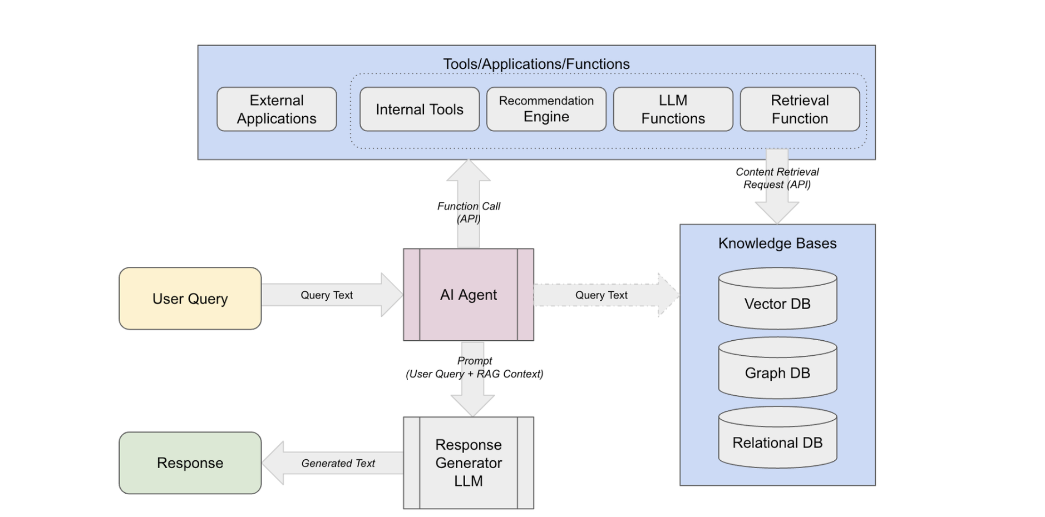
AGENTIC AI ARCHITECTURE ( HIGH LEVEL )

Slide 3
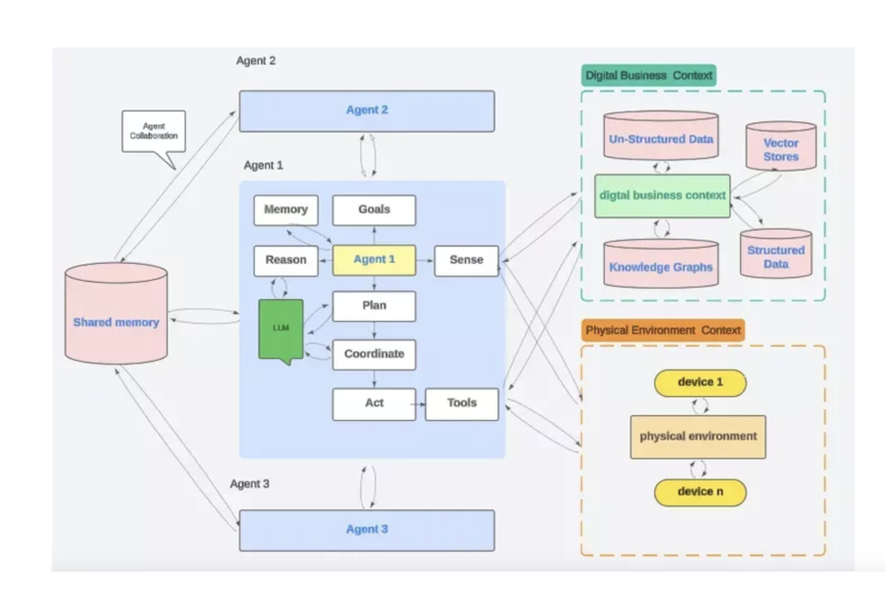
AGENTIC AI ARCHITECTURE ( DETAILED )
Works on a Goal
Uses LLM, Memory (Volatile/Persistent)
Plan, Reason, Act
Tools.
Talks to other Agents

Slide 4
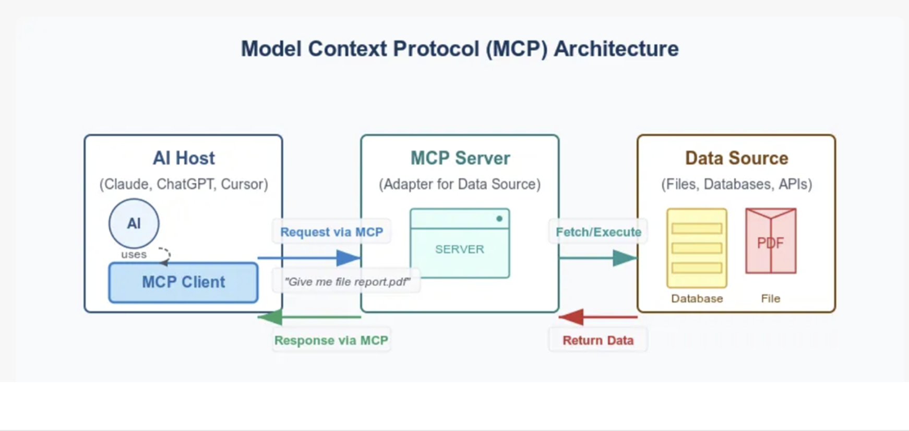
AGENTIC AI – MCP ARCHITECTURE

Slide 5
FEATURES OF TOOL
Uses Neural Networks (LLM/Transformer) – ( Text Generation/Sentimental Analysis)
Implement Agentic AI with LangGraph Frameworks. Complex use case can be done with Lang Graph
MCP Server
Incorporate this Agent in MCP Server
Use Claude UI/MCP Client for processing the prompts and response.
Recommendation Logic

Slide 6
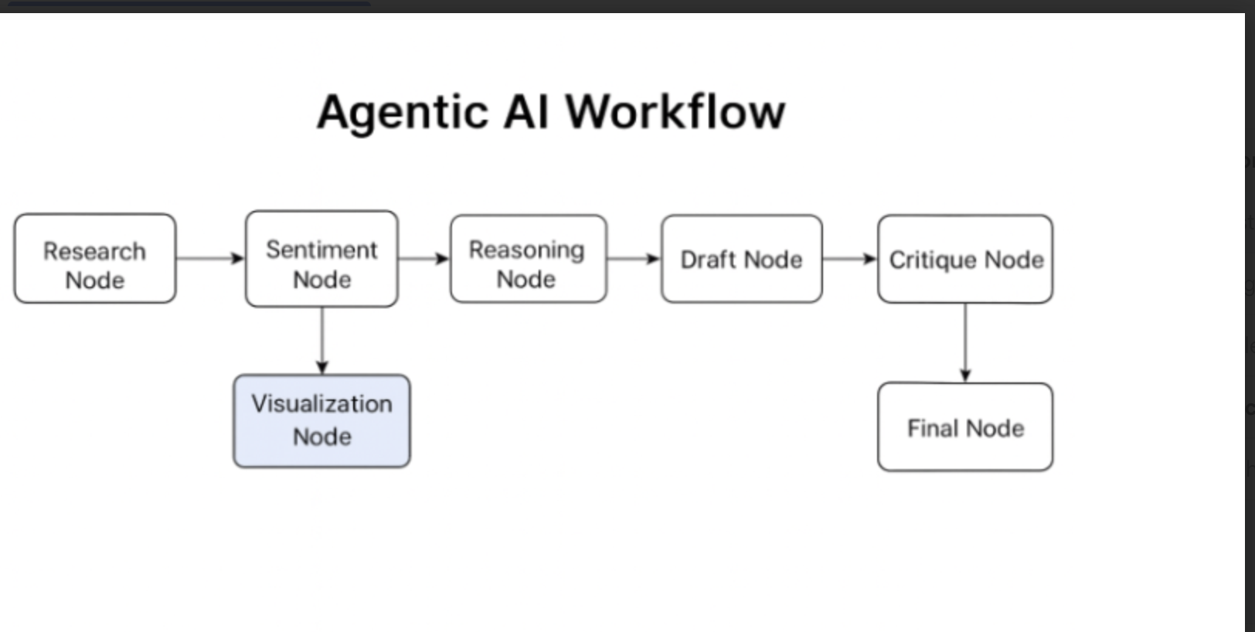
INVESTMENT AGENTIC AI WORKFLOW

Slide 7
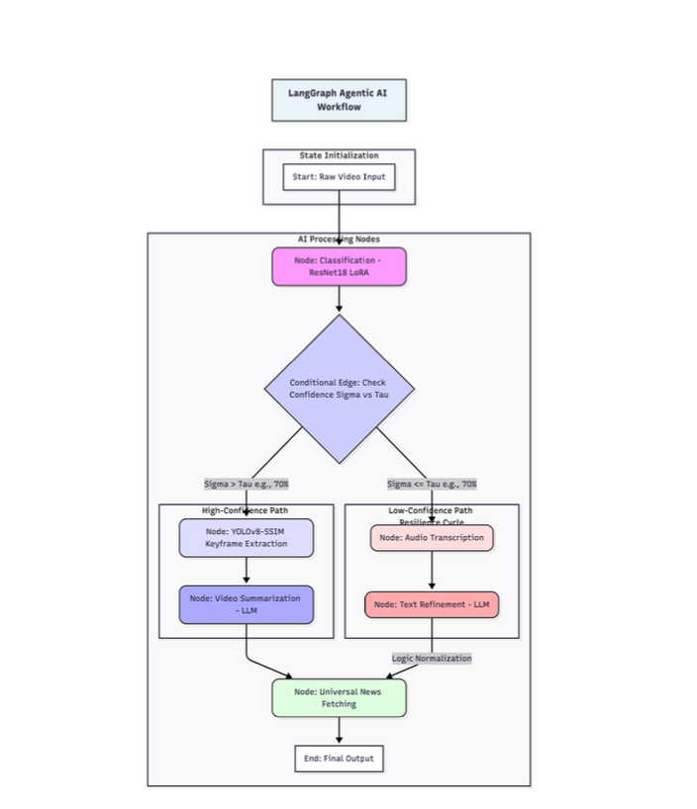
VIDEO ANALYSIS AGENTIC AI WORKFLOW

