Slide 1
CS5200 Introduction to Database Management System
Flight Reservation System
Team Members :
Joy Machado
Mounika Dantuluru
Shivani Gowrishankar

Slide 2
Problem statement
To create a Flight Reservation System, where a User can login to the system, and find flights between various airports in the country on a given departure date and arrival date.
The user can buy a ticket on the system, and their booking details will be stored in the system, as a Booking History and they can view all their Booking on their User Profile Page
The User can also cancel his/her booking
The User can also rate and give comments on the various airlines which he/she has travelled on .

Slide 3
Proposed Solution
We plan to use an external API Service, to give us the real time/test data available to implement the system.
The API returns the data in either in the JSON/XML Format. Using this data, we can display to the user, the various Flights available according to their search.
The user can then book the flight they wish to book, this data will be then stored in our System, and the user will gain points for every purchase made by them
The user can then use these points assigned to them to book tickets in the future.

Slide 4
Architecture
We have used the Sabre Dev Studio to fetch data in the JSON Format
We parsed the data, using a Server Side Web Service Client
The data was then displayed to the User, and when the user chooses to book a flight, the data was persisted into the Database using JPA
We also have a User Admin who produces data in the JSON format and use the JWS technology to Create a User, Delete a User, Update User Details and Read All the Users in the Database

Slide 5
Architecture Diagram
API
DAO
Database
JPA

Slide 6
Use Cases
Use Case: User Login[userLogin]
Description: User wants to login
Actors: Customer
Preconditions: User name should exist and password should match
Steps:
Actor Actions: User submits login details
System Responses: User authentication passed
Post Condition: User directed to his profile page
Alternate paths: User authentication fails
Error Message: The username or password you entered is incorrect

Slide 7
Use Cases
. Use Case: Search for Flights[flightSearch]
Description: User wants to search for flights
Actors: Customer
Preconditions: Flights for the requested dates should have seats available
Steps:
Actor Actions: User selects arrival, departure dates and boarding,destination locations
System Responses: Flight details displayed
Post Condition: User should give the dates of travel and location of departure and arrival
Alternate Paths: No flights available for the user entered details
Error Message: Flights not available

Slide 8
Use Cases
Use Case: Cancel a Booking[cancelBooking]
Description: User selects a travel id of upcoming journey and selects the cancel button for that passenger or the complete travel
Actors: Customer
Preconditions: The journey should be upcoming
Steps:
Actor Actions: User selects either a particular passenger or the whole travel
System Responses: Cancels order
Post Condition: The journey details are still visible but the order is canceled for a selected passenger or the whole travel
Alternate Paths: If the travel id is of past journey
Error Message: Order cannot be canceled as it is a past journey

Slide 9
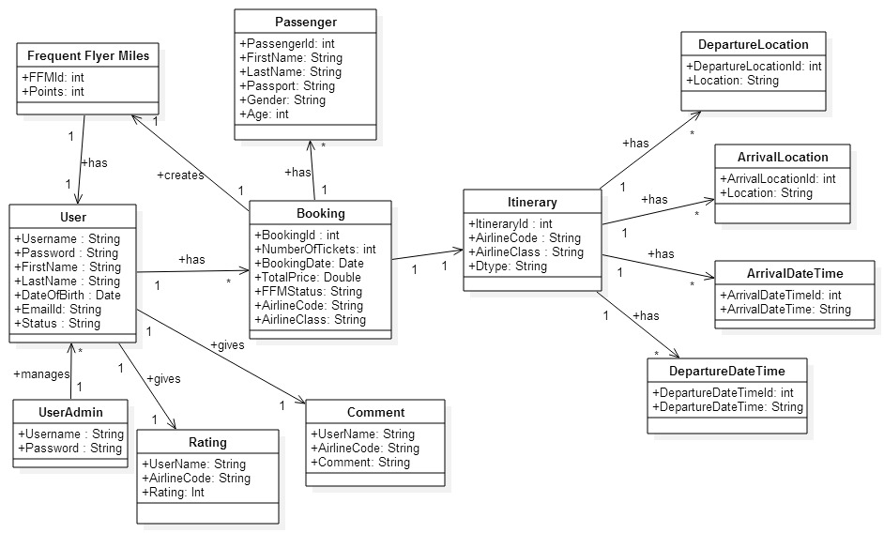
CLASS DIAGRAM

Slide 10
Statistics
Classes: 17
DAOs: 12
No. of Data Tables: 12
No. of Fields: 50
Foreign Keys: 8

Slide 11
THANK YOU

