Slide 1
FILE VERSIONING AND
RECOVERY SYSTEM
Project Presentation

Slide 2
PROBLEM STATEMENT
Users frequently lose earlier versions of important files when a document is overwritten or accidentally modified.
Manual backup practices (copy-pasting files, renaming with dates) are tedious, inconsistent and error-prone.
Most systems provide no built-in way to track, compare, or restore previous versions of a file.
There is no centralized record of who changed a file, when it changed, or what changed.
Recovering an older version after data loss or a mistaken edit is often difficult or impossible.

Slide 3
EXISTING SYSTEM
Files are stored and edited directly, with each save overwriting the previous copy.
Backups, when taken, are manual and stored as separate duplicate files or folders.
General-purpose cloud sync tools offer limited, coarse-grained version history.
No structured metadata (timestamps, version numbers, change notes) is maintained for versions.
Restoring an earlier version requires manually locating and replacing the current file, with no comparison support.
Storage grows uncontrolled since old, unused backups are never automatically cleaned up.

Slide 4
PROPOSED SYSTEM
A web-based File Versioning and Recovery System that automatically manages file history for the user.
Every upload or modification through the web interface is saved as a new, timestamped version.
A Java backend handles the versioning logic, while MySQL stores version metadata and local storage holds the actual file contents.
Users can view version history, compare versions, and restore any earlier version with one action.
A configurable version limit automatically removes the oldest version once the limit is reached, keeping storage in check.

Slide 5
OBJECTIVES
Automatically create a new version whenever a file is uploaded or modified.
Maintain a complete, chronological version history for every file.
Allow users to compare different versions of the same file.
Provide quick, reliable restoration of any previous version.
Enforce a version limit per file, removing the oldest version when the limit is exceeded.
Deliver a simple, intuitive web interface for all versioning operations.

Slide 6
SCOPE
In scope: web-based upload, modification, versioning, comparison and restoration of files for individual users.
In scope: storage of file version data in MySQL and actual file versions in local file storage.
In scope: automatic enforcement of a maximum number of retained versions per file.
Out of scope: real-time multi-user collaborative editing of the same file.
Out of scope: distributed or cloud-based storage infrastructure (planned as future enhancement).
Out of scope: native mobile application (current delivery is web-only).

Slide 7
TECHNOLOGY IDENTIFICATION
Frontend (Web Interface): HTML, CSS and JavaScript for file upload, modification and version operations.
Backend (Business Logic): Java, responsible for handling requests, versioning rules and coordinating storage.
Database: MySQL, used to store file information and version metadata (name, timestamp, size, version number).
File Storage: Local file storage system, used to save and retrieve the actual content of each file version.
Communication: The frontend sends requests to the backend and receives responses over standard web protocols.

Slide 8
BASIC ARCHITECTURE
File Versioning and Recovery System
User: uploads, modifies files and performs version operations through the web interface.
Frontend (HTML / CSS / JavaScript): presents the web interface and sends requests to the backend.
Backend (Java): contains the business logic and the Version Management module.
Version Management: creates new versions, maintains version history, compares versions, restores earlier versions, and enforces the version limit by removing the oldest version.
MySQL Database: stores file information and version details.
Local File Storage: stores the actual file versions.

Slide 9
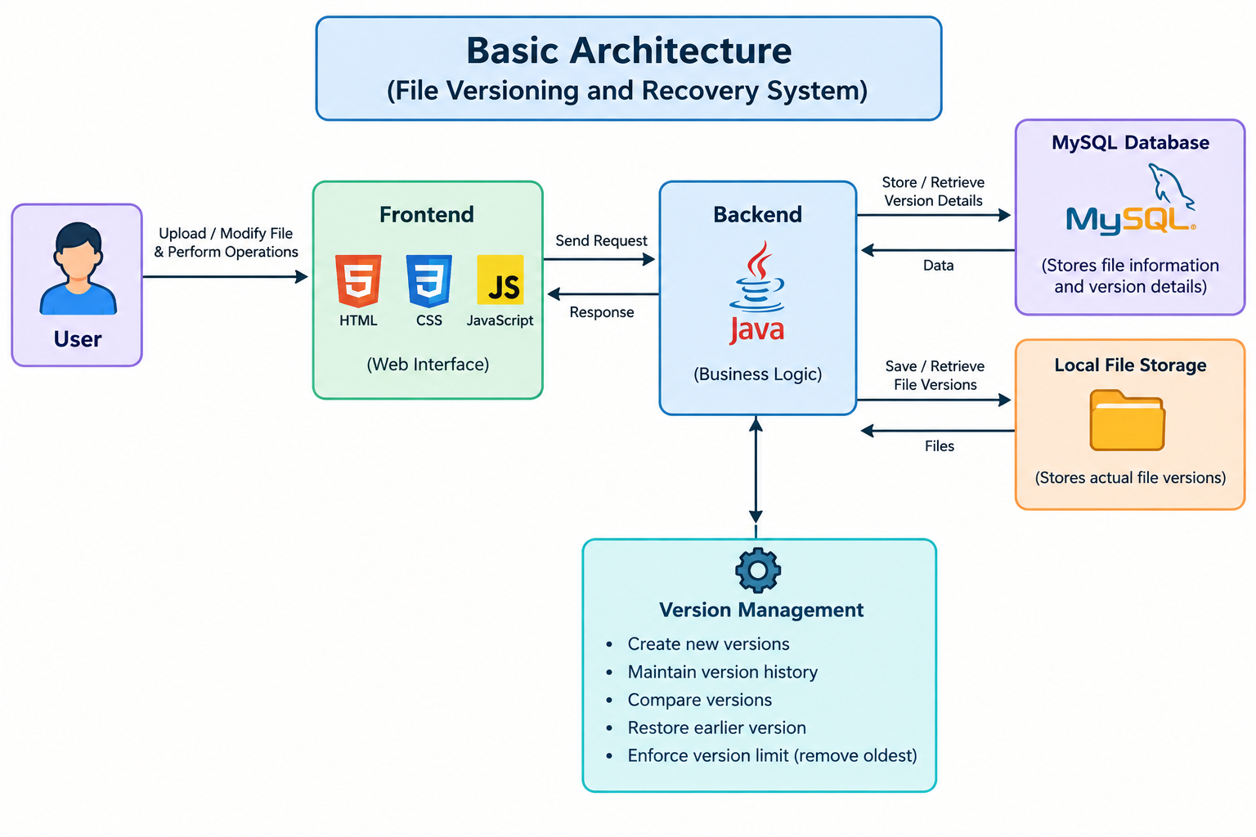

Slide 10
THANK YOU

