Slide 1
Time Travelers
By
Manasa Thipparthi
Sai Jyothi Gudibandi
Sujitha Puthana
Sri Harsha Kumar Raja Golla

Slide 2
Overview
Aim: To develop a conversation app that offers the clients to interact with it regarding the health issues they face. This application finds the suitable doctor and books an appointment for the client.
Approach: We have implemented a conversation model using the api.ai platform and integrated our web page with the same. Thus the operations are linked with the conversation between our app and the client.

Slide 3
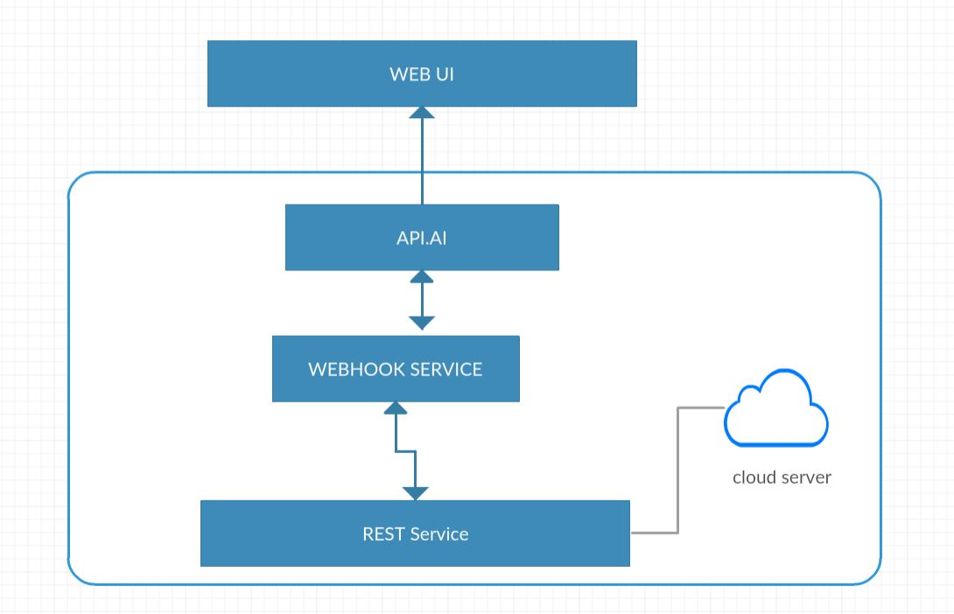
Architecture

Slide 4





Technologies used

Slide 5
Flow of the application
Patient(client) starts interaction with the app with a Hello! , Hi!, etc.
Convo App greets the client and asks for any help.
Patient responds with the problem like I have a bad stomach or heart pain etc.
Now Convo App searches for the concerned doctor and replies back.
Patient asks the Convo app to check for the doctor’s availability
Once the availabilities are popped up by the Convo App patient asks the app to book an appointment
Convo App books an appointment and blocks the doctors calendar for that time.
Patient quits the conversation.

Slide 6
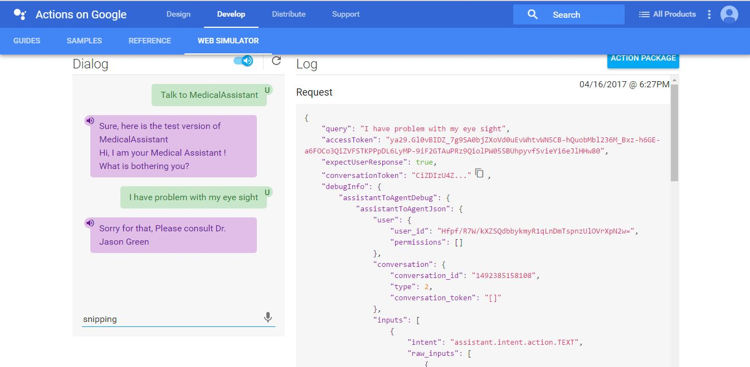
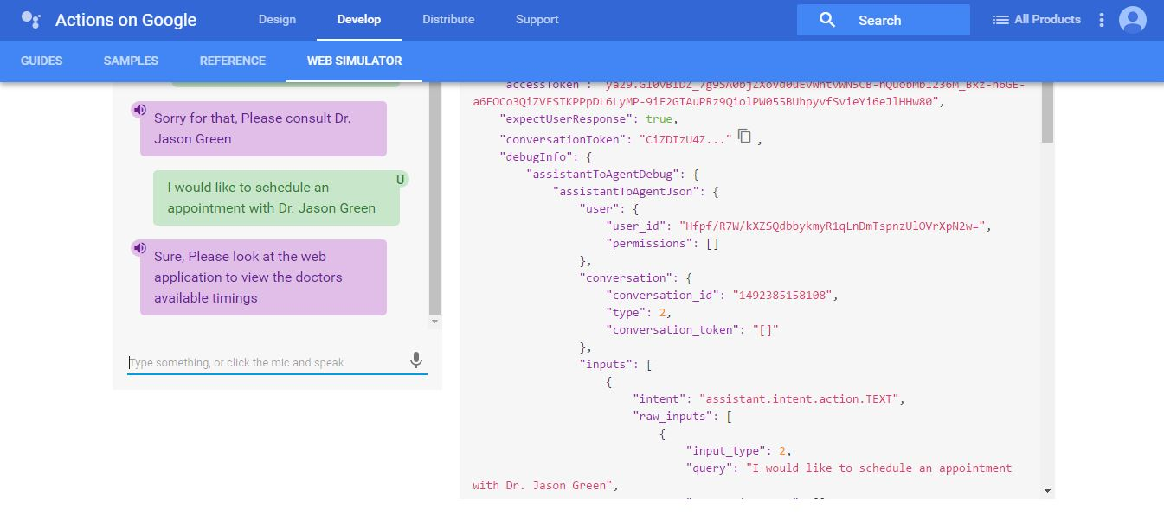
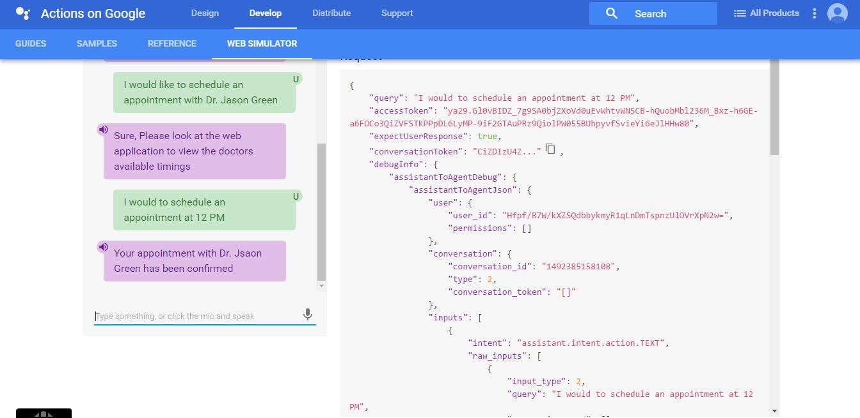
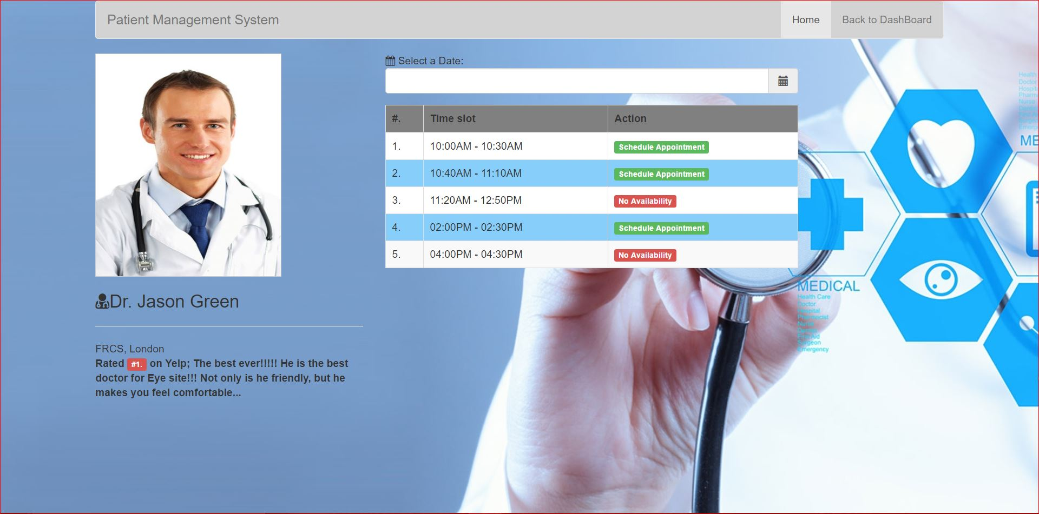

Screenshots of our application

Slide 7
Thank you

