Slide 1
Title of the project
Names of people in the project

Slide 2
Instruction Summary
Have a set of slides for each meeting
The slides of each meeting should include:
The roadmap slide
Your presentation slides
Meeting note slides
Actionable items slide
We only need one set of slides for one project
Multiple people can contribute and co-edit the same document
Prepared before the meeting
Completed during or after the meeting

Slide 3
Meeting date: 2021/01/02

Slide 4
Project Roadmap
At the beginning of each meeting, have a reminder slide:
The end goal
The roadmap toward the end goal
Where we are on the map
The current hypotheses/ideas/steps for advancing

Slide 5
Your Presentation Slide (1)
After the roadmap slide, prepare some slides to help you present
Use the slides to tell us:
What you have done
The results
Bring to our attention what you want to discuss
You should be on the driving seat
Leads the presentation and discussion
Have an agenda for the meeting

Slide 6
Your Presentation Slide (2)
Use figures and graphs as many as possible
Draw the process diagram for your idea or processing pipeline
Put the old and new results side by side for easier comparison
Don’t just show the quantitative numbers of new results
If you want to compare with the old results, put them side by side

Slide 7
Meeting Note (1)
Alice suggested …
Bob hypothesized that …
We should have done … instead

Slide 8
Meeting Note (2)
Continue the meeting note here

Slide 9
Actionable items
Write down the list of actionable items and who are responsible for them
Task | Who? | Status
Replace VGG16 by ResNet | Alice | Done
Use pose detection to guide the tracker | Alice | Done
Collect and annotate 20 more videos | Bob | 10%. Take too much time.
Forward the ArXiv paper to everyone | Alice | Note done
Read the ArXiv paper on … | Minh | Done

Slide 10
Meeting date: 2021/01/10
(Suppose this is an upcoming meeting)

Slide 11
Project Roadmap
End goal: develop a method for tracking multiple hands in video
Roadmap:
Data has been collected and annotated
Baseline methods have been run
Developing new method
Write paper
Current step: method development
Problem: our method still has lower accuracy than the baseline
Hypothesis: we can improve hand tracker with a pose detector

Slide 12
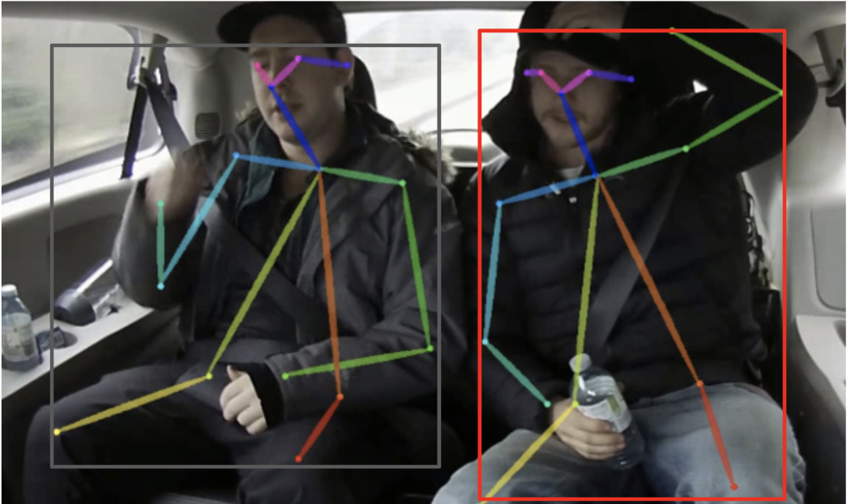
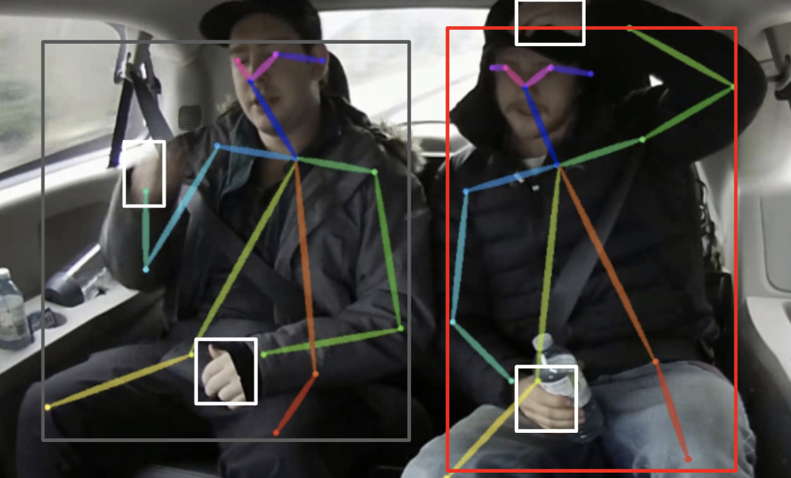
Hand tracking with detected pose
image
open-pose
Output contains keypoint and generated human bbox
Read detection from hand-cnn
Assign hands ID based on the distance between hand bbox center and wrist keypoints

Slide 13
Processing Pipeline
dets
dets
image in frame t
re-ID network
dets
re-ID features
re-ID features
track
track
track
dists
Frame t
Frame t-1

Slide 14
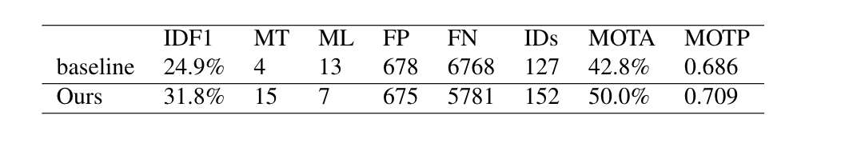
Results

