Slide 1
SMITH MSIS ALUMNI DATABASE
PROJECT 0504-05
Divya Chhabra
Gauri Yewale
Mohini Saxena
Priya Ashok
Shruti Gupta
12/02/2018

Slide 2
BACKGROUND:
USERS:
Our users are locally based small to medium size businesses/organization. They would be using the Smith MSIS Alumni database to provide customized solutions to Smith MSIS students.
DATA/SOURCE:
The data/source that is available to the user is the Smith MSIS Alumni database created by us. They can put this data to use in order to give solutions to student.

Slide 3
INTRODUCTION
MISSION STATEMENT
To deliver to the client, the required Smith School Alumni Contacts Database, enabling them to improve the effectiveness of their business potential, by using this database as an input for providing customized solutions to students and deliver value to their customers.

Slide 4
INTRODUCTION
MISSION OBJECTIVES
To satisfy the need to offer a full-time consulting product for small to medium size businesses
To provide an umbrella to develop and grow the client base and requiring a team effort to satisfy client requirements
To develop and maintain a broad Smith MS in Information Systems Alumni Contacts Database
To provide Alumni’s personal contact information such as address, contact details, Visa status etc.
To provide Alumni’s job information, both for internships and jobs (whichever is applicable), along with the Company and its location
To provide Alumni’s Smith School related information such as course Period, courses taken, GPA etc.
To maintain an environment which is conducive to innovative thinking and solutions.
To work towards excellence and achievement.

Slide 5
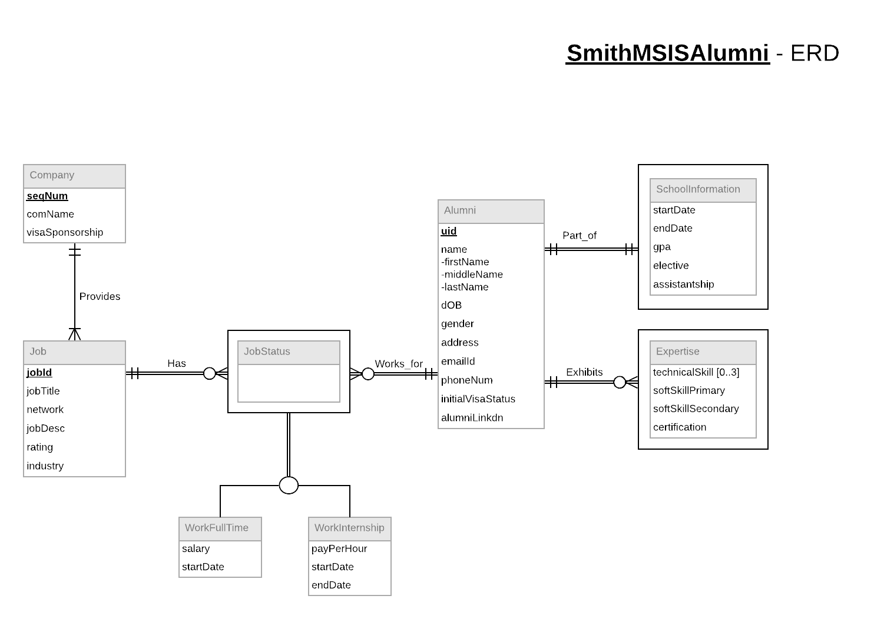
CONCEPTUAL DATABASE DESIGN
NOTE: The tables ‘JobStatus’ , ‘SchoolInformation’,’Expertise’ don’t have any primary keys as they are weak entities and are taking their dependent table’s primary key as the foreign key.
The tables ‘WorkFullTime’ and ‘WorkInternship’ don’t have any primary keys either because they are a part of disjoint and using their parent’s tables data.

Slide 6
LOGICAL DATABASE DESIGN
Relational Schema:
Alumni (uid, firstName, middleName, lastName, dOB, gender, address, emailId, phoneNum, initialVisaStatus, alumniLinkdn)
Company (seqNum, comName, visaSponsorship)
Expertise (uid, technicalSkill{0..3}, softSkillPrimary, softSkillSecondary, certification)
SchoolInformation (uid, startDate, endDate, gpa, elective, assistantship)
Job (jobId, seqNum, jobTitle, network, jobDesc, rating, industry)
JobStatus (jobId, uid)
WorkFullTime (salary, startDate)
WorkIternship (payPerHour, startDate, endDate)

Slide 7
PHYSICAL DATABASE DESIGN
SQL CREATE TABLE containing Foreign Key:
CREATE TABLE [Smith.Job] (
uid Numeric(9) not null,
seqNum int not null,
jobId int identity(5001,1) not null,
jobTitle VARCHAR(50),
network VARCHAR(100),
jobDesc VARCHAR(200),
rating Numeric(10,2),
industry VARCHAR(50),
CONSTRAINT pk_Smith_Job_jobId PRIMARY KEY (jobId),
Constraint fk_Smith_Job_uid FOREIGN KEY(uid) REFERENCES [Smith.Alumni] (uid) ON DELETE CASCADE ON UPDATE CASCADE,
Constraint fk_Smith_Job_seqNum FOREIGN KEY(seqNum) REFERENCES [Smith.Company] (seqNum) ON DELETE NO ACTION ON UPDATE NO ACTION
);

Slide 8
USE CASES
USE CASE 1: Display Alumni details employed by given company
SELECT companyName,position,firstName,lastName,phoneNo FROM SMITH_US WHERE companyName=‘ZS’;
VIEW DEFINITION:
CREATE VIEW SMITH_UC AS
SELECTA.ALMFNAME,A.ALMLNAME,A.PHONE,A.INITIALVISASTATUS,J.JOBTITLE,J.NETWORK,J.INDUSTRY,C.COMNAME
FROM
ALUMNI A
INNER JOIN JOB J ON A.UID=J.UID
LEFT JOIN COMPANY C ON J.SEQNUM=C.SEQNUM
LEFT JOIN EXPERTISE E ON A.UID=E.UID
LEFT JOIN WORKFULLTIME F ON J.JOBID=F.JOBID
LEFT JOIN WORKINTERNSHIP I ON J.JOBID=I.JOBID;

Slide 9
USE CASES
USE CASE 2: Display relevant alumni and company details for all citizens.
SELECT * FROM SMITH_UC WHERE initialVisaStatus=‘Citizen’;
VIEW DEFINITION:
CREATE VIEW SMITH_UC AS
SELECTA.ALMFNAME,A.ALMLNAME,A.PHONE,A.INITIALVISASTATUS,J.JOBTITLE,J.NETWORK,J.INDUSTRY,C.COMNAME
FROM
ALUMNI A
INNER JOIN JOB J ON A.UID=J.UID
LEFT JOIN COMPANY C ON J.SEQNUM=C.SEQNUM
LEFT JOIN EXPERTISE E ON A.UID=E.UID
LEFT JOIN WORKFULLTIME F ON J.JOBID=F.JOBID
LEFT JOIN WORKINTERNSHIP I ON J.JOBID=I.JOBID;

Slide 10
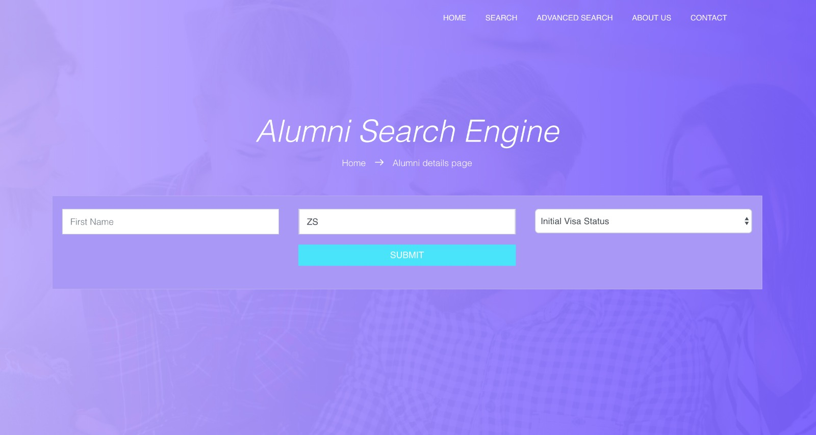
SCREENSHOTS: USE CASE 1
USE CASE 1: Display Alumni details employed by given company.

Slide 11
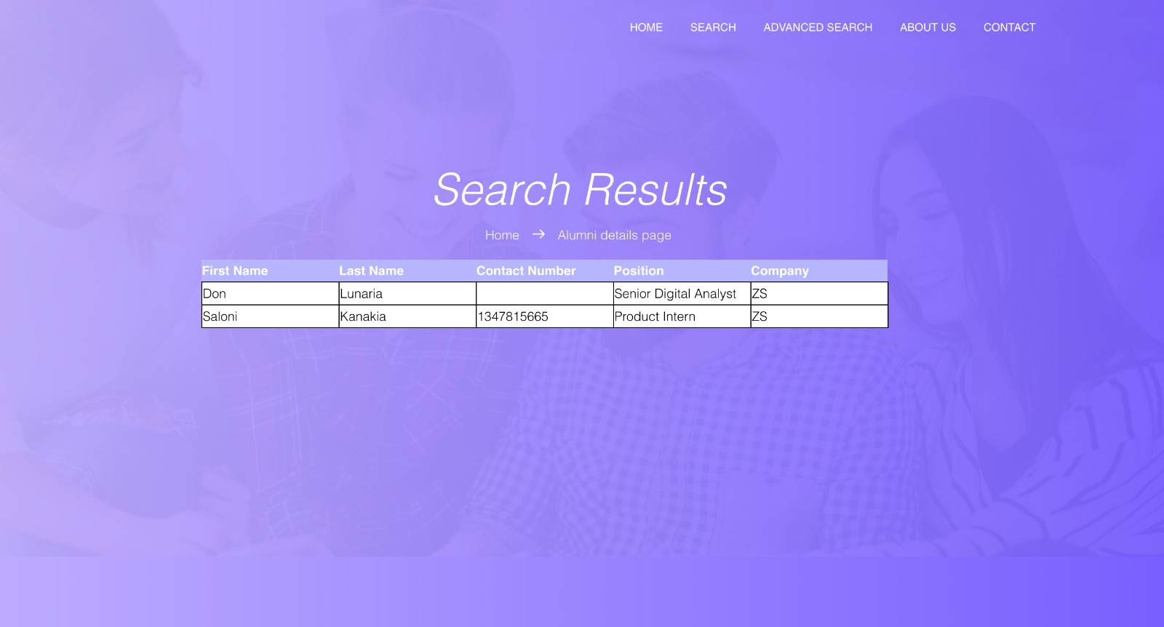
SCREENSHOTS: USE CASE 1

Slide 12
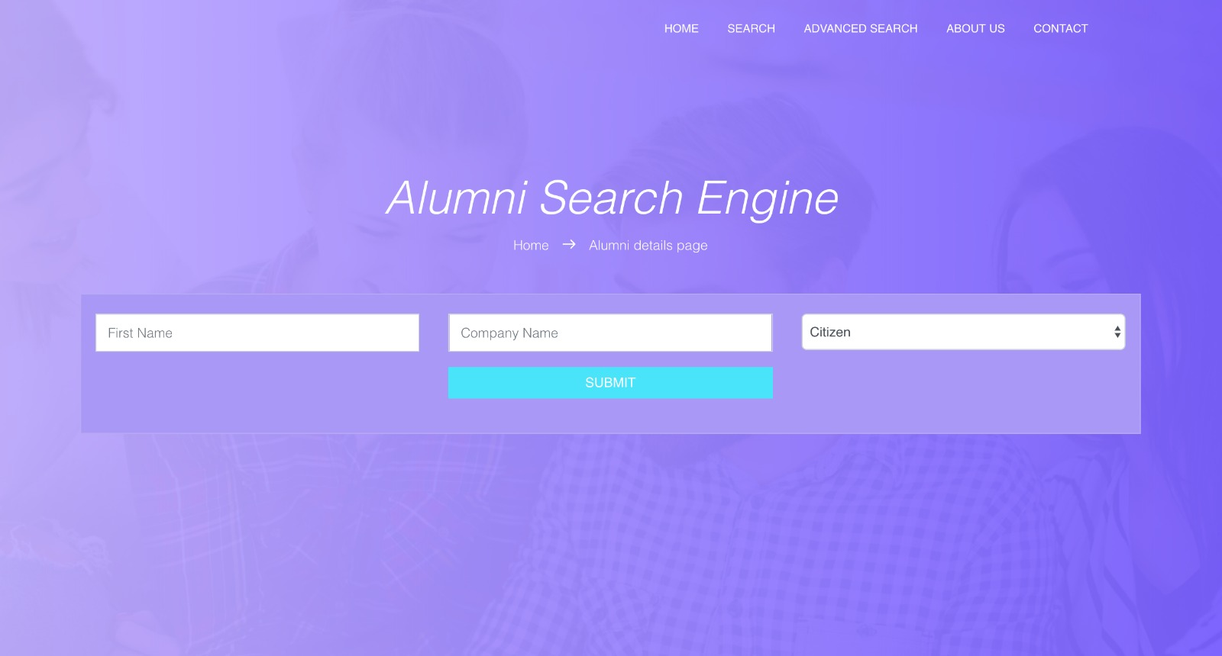
SCREENSHOTS: USE CASE 2
USE CASE 2: Display relevant alumni and company details for all citizens.

Slide 13
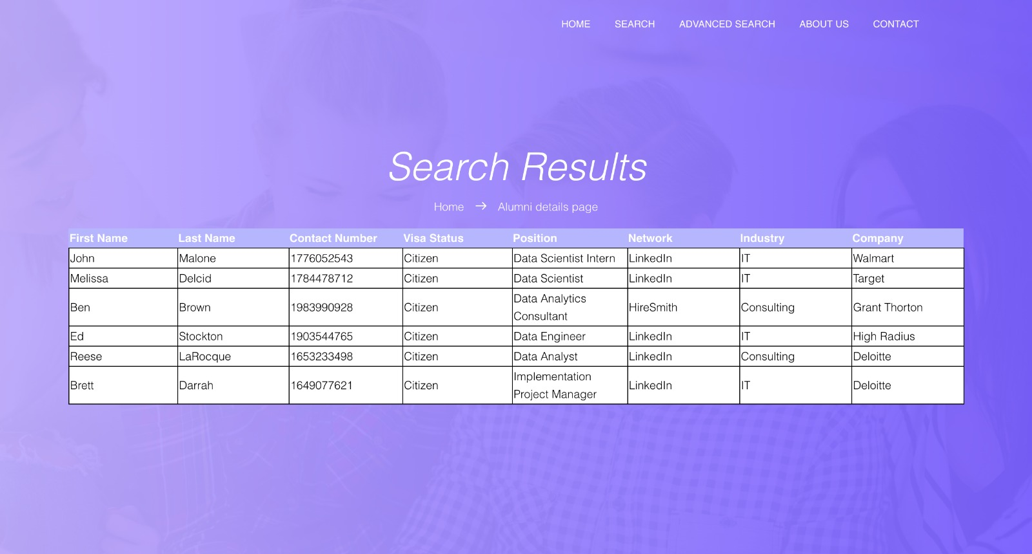
SCREENSHOTS: USE CASE 2

Slide 14
REFERENCES:
https://www.tutorialspoint.com/
https://www.w3schools.com/
https://www.safaribooksonline.com/library/view/fundamentals-of-database/9781118213575/15_chap07.html?orpq
http://ewebarchitecture.com/web-databases/physical-database-design
https://www.quora.com/What-is-the-conceptual-design-of-a-database

