Slide 1
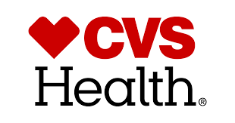
Firm Analysis
Team 3:
Ameya Kulkarni Mohit Ghodake
Brenton Petty Shruti Gupta
Divya Chhabra Yanfang Huo
Michael Ibironke Zachary Broderick

Slide 2
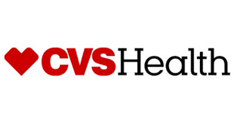
CVS Health: Overview
Founded in 1964 as a beauty- and health-aid company, ‘Consumer Value Stores’
Renamed ‘CVS Health’ in 2014
Fortune 500: #7, Fortune Global 500: #17 (2018, annual revenue $184 bn)
Today: 9800+ stores across US, Puerto Rico, Brazil
Notes:
Most of us are international students, and we must have heard of CVS in the first few days of coming to US. CVS Health is an American retail pharmacy and health care company. It was founded in 1964 as ‘Consumer Value Stores’. It was originally started as a beauty and health-aid company but very soon, pharmacy was included in its services. Since its inception, the company went through mergers and completed acquisitions as it continued to grow. In 2014, it was renamed to ‘CVS Health’, and that’s how we know it now.

Slide 3
Underlying Business Domain
Retail Pharmacy
Health profession that links health sciences with chemical sciences and aims to ensure the safe and effective use of pharmaceutical drugs
Pharmacy Benefit Management
A third-party administrator (TPA) of prescription drug programs for commercial health plans, self-insured employer plans
Health Services
Notes:
RP- located in 27 states, includes around 4000 retail drugstores. Sells prescription drugs and wide range of general merchandize like, photo finishing services, greeting cards, convenience food.
PBM- provides prescription benefit management services to various organizations. Services include plan design and administration, claim processing, mail order pharmacy services, etc.

Slide 4
Business Model
Retail Pharmacy
responsible for more than 67% of its revenue
includes dispensing prescriptions, administering flu shots and all the convenience sales
Pharmacy Benefit Management
ranked one of the top ten full service Pharmacy Benefit Managements in the US
part of CVS’s business that processes prescription claims
Notes:
RP- located in 27 states, includes around 4000 retail drugstores. Sells prescription drugs and wide range of general merchandize like, photo finishing services, greeting cards, convenience food.
PBM- provides prescription benefit management services to various organizations. Services include plan design and administration, claim processing, mail order pharmacy services, etc.

Slide 5
Business Model
The retail drugstore competes mainly on the basis of:
Store location and convenience
Customer service and satisfaction
Product selection and product variety
Price

Slide 6
Business Model
Digital Offerings of CVS - value creation and not “widget” sales
Apple Watch app
Prescription scanning
Insurance card scanning
MedRemind
In-store messages
Company rebranding to CVS Health - simultaneous timed with tobacco pull-out from stores
Acquisition of Aetna - strategic move to maintain itself as a leader in the pharmaceutical market.

Slide 7
Strategic Drivers of Performance in Industry
Personalization of Customer Experience
Use of big data to improve their marketing schemes
Pharmacists to Customer Relationship
Investment into customer oriented training to enhance return rate
Implementation of Technology
Use of technology to streamline prescription filling,and track medication adherence.
More Than Just a Drugstore
Offer in store health services, screenings, immunizations, checkups, and other health services.
Notes:
Kmart’s pharmacists, for example, are trained in medication therapy management and offer ongoing individualized consultations.

Slide 8
Strategic Drivers of Performance in Industry
CVS Advantage
Merger with Caremark in 2007, a prescription based company
CVS determined best customer were those that visited pharmacy frequently
Started sending automated texts, emails, and phone calls to individuals that missed refill.
Notes:
To imporive perofmrance

Slide 9
Strategic Drivers of Performance in Industry
2011 awarded supply chain distinction award
warehouse management system, routing optimizer
labor management system is integrated with this warehouse management system
SyncScript app combines prescription notification with special in store deals
Partnership with IBM Watson's artificial intelligence system
Determine customers who need interventions to avoid health crises
Increased visits to CVS
CVS have seen a 2.5% boost in overall sales and a 7% increase in food purchases

Slide 10

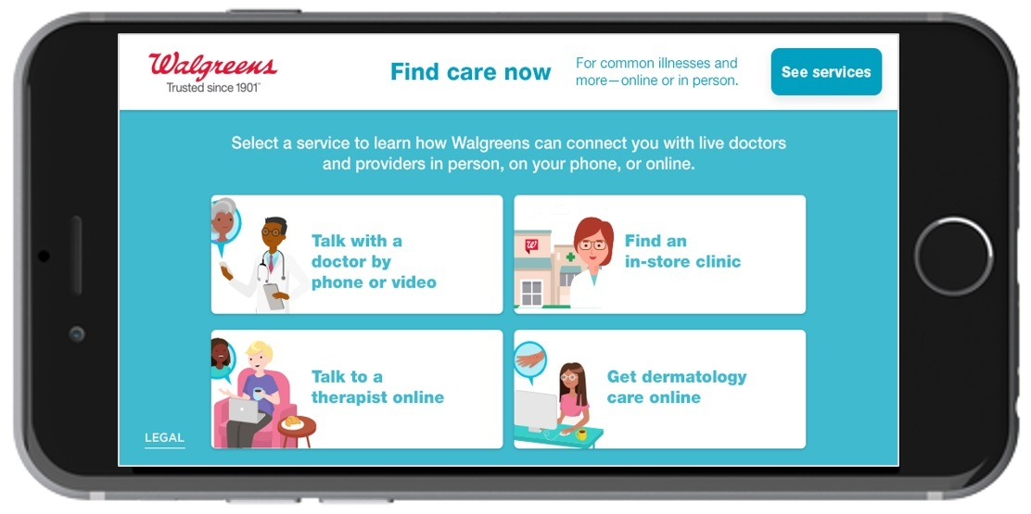
Competitors
Retail Competitors - Walgreens, Kroger, Costco and Safeway
Walgreens is the main digital competitor for CVS
FindCareNow helps customers connect with health care services at Walgreens stores.
ePass- Patient assessment tool; uses analytics to offer unique healthcare plans.

Slide 11
Would We Invest in the Firm?
The Verdict
CVS is a good option to invest and the stock is not expensive (78.91 USD)
Aetna acquisition and government policies regarding PBM business make it too risky to recommend buying stocks currently

Slide 12
Recommendations to Enhance Firm’s Strategic Edge
Continue investing in their data analytics programs
Customer loyalty program, interventional health analysis, and consumer spending patterns
Expand MinuteClinic services
Cover more locations
Include virtual care services
Continue emphasis on health-based rebranding initiative
Continue investing in the digital shopping experience
MyCVS, SmartScript app

Slide 13
Conclusion
CVS has evolved to become the second largest pharmaceutical company in the United States through its successful use of IT
CVS rebranded themselves multiple times, successfully taking advantage of the technological revolution while doing so
Future is uncertain for CVS due to recent alteration to business model
Shifting from retail pharmacy to health services provider

