Slide 1
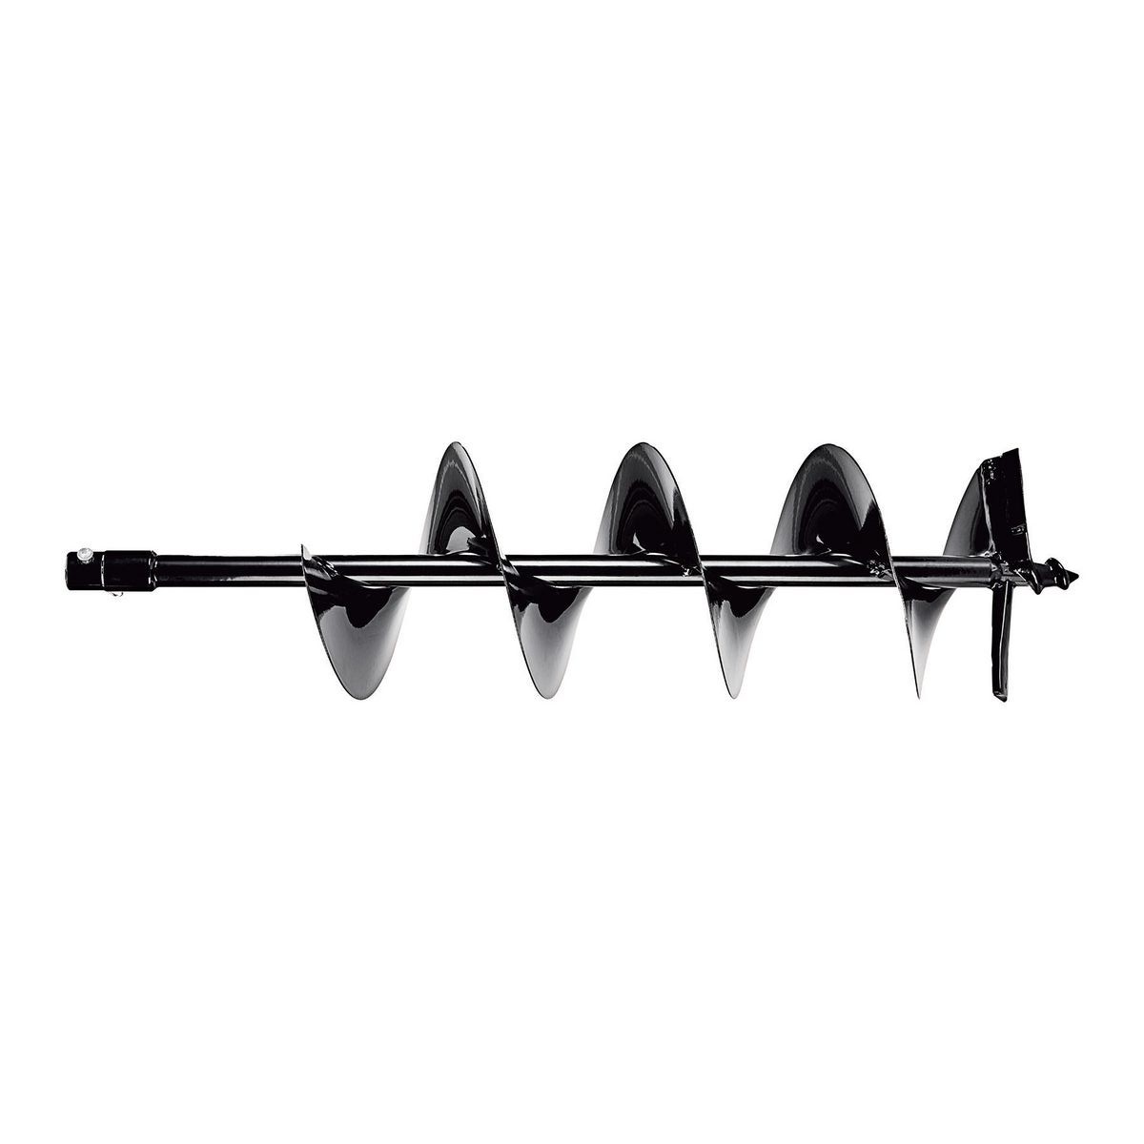


Developing self-adjusting robotic welding systems for manufacturing of augers.
Ghanashyam R K P
Manipal Institute of Technology, Manipal, Karnataka, India.

Slide 2
Under the Guidance of
Dr. Matt Khoshdarregi
Assistant Professor
Intelligent Digital Manufacturing Lab,
University of Manitoba, Winnipeg, Canada.
July - September 2021

Slide 3
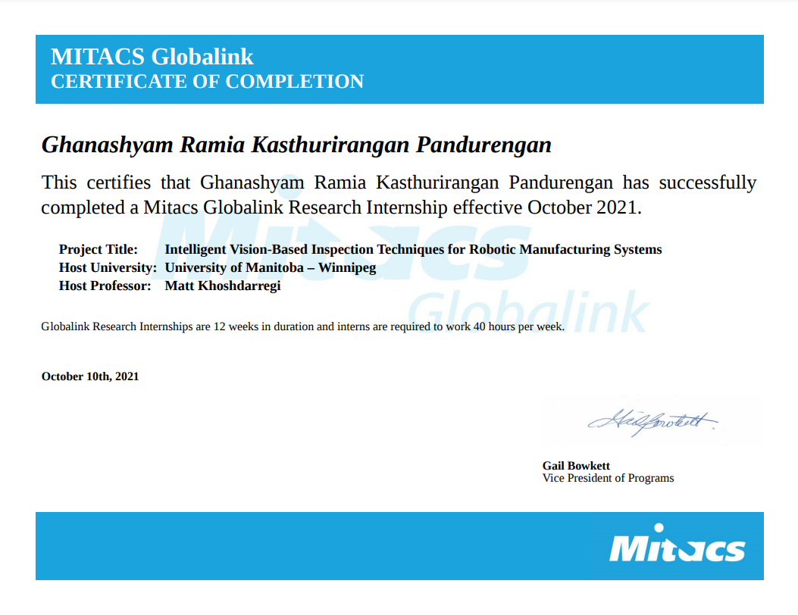
Certificate of Completion

Slide 4
Robot Operating System
ROS is an open source Middleware
A set of software libraries and tools that help you build robot applications that work across a wide variety of robotic platforms
ROS Nodes
Single-purposed executable programs
E.g. Sensor driver(s), actuator driver(s), map building, planner, UI, etc.
Individually compiled, executed, and managed
Nodes are written using a ROS client library
roscpp - C++ client library
rospy - python client library
Nodes can publish or subscribe to a Topic

Slide 5
Libraries used for processing point clouds
Open3D: Open3D is an open-source library that supports rapid development of software that deals with 3D data.
Point Cloud Library: The Point Cloud Library (PCL) is a standalone, large scale, open project for 2D/3D image and point cloud processing

Slide 6
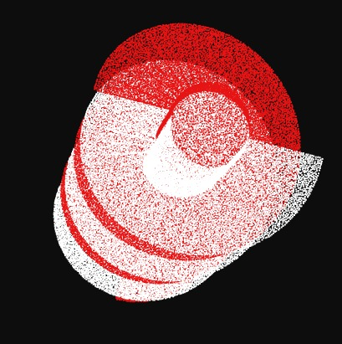
Rotation of Point Cloud
Created C++ Library for Rotation
ROS Node
subscribes to a topic which publishes
Point Cloud of type
sensor_msgs::PointCloud2
ROTATES
Publishes to a topic which subscribes
Point Cloud of type
sensor_msgs::PointCloud2

Slide 7
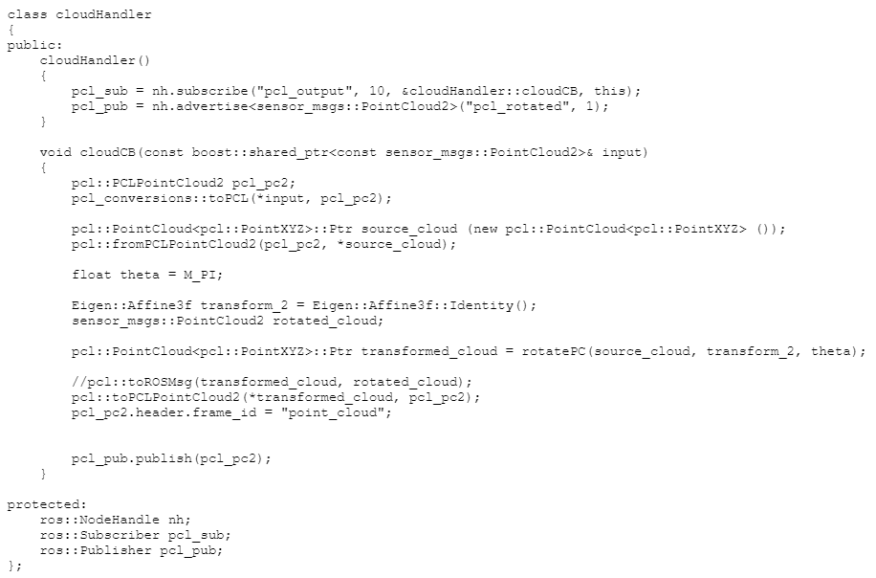
Class for Rotation of Point Cloud Data

Slide 8
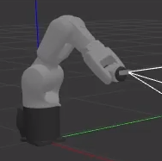
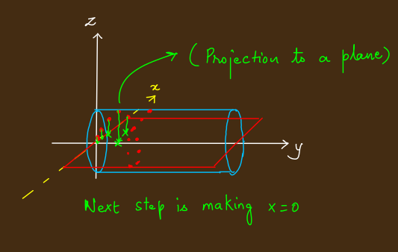
First Method and Projection of Points

Slide 9
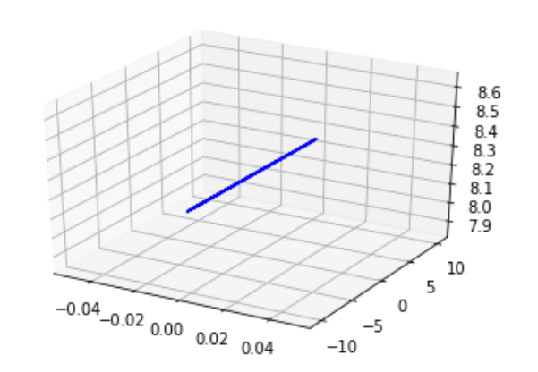
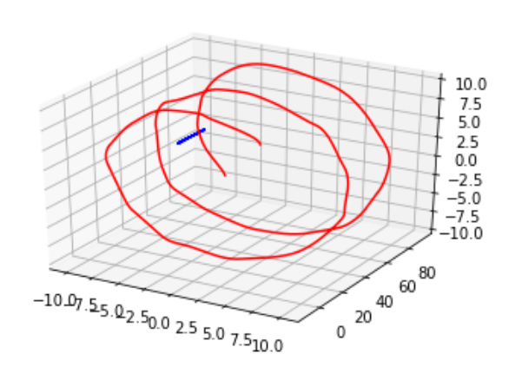
First Method - Results

Slide 10
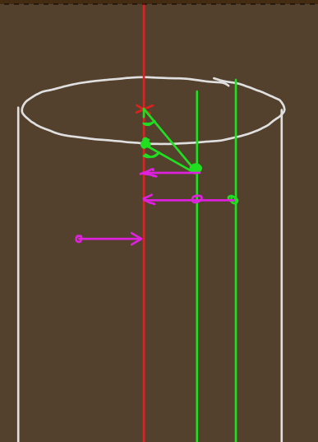
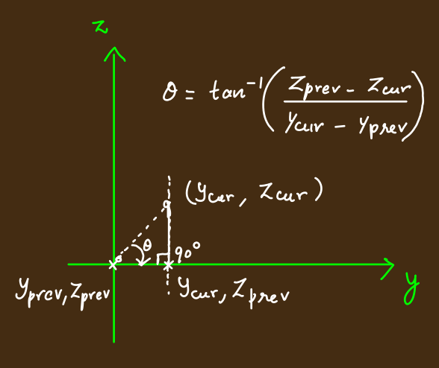
Rotation - Why this method won’t work

Slide 11

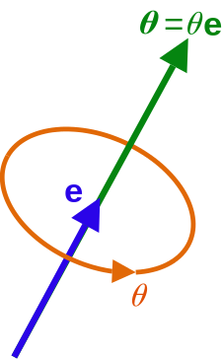
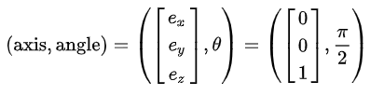
Axis Angle Concept
Axis–angle representation parameterizes a rotation in a three-dimensional Euclidean space by two
quantities: a unit vector e indicating the direction of an axis of rotation, and an angle θ describing the magnitude
of the rotation about the axis.
So the rotation vector will be a vector with a magnitude of π/2 pointing in the Z direction,

Slide 12
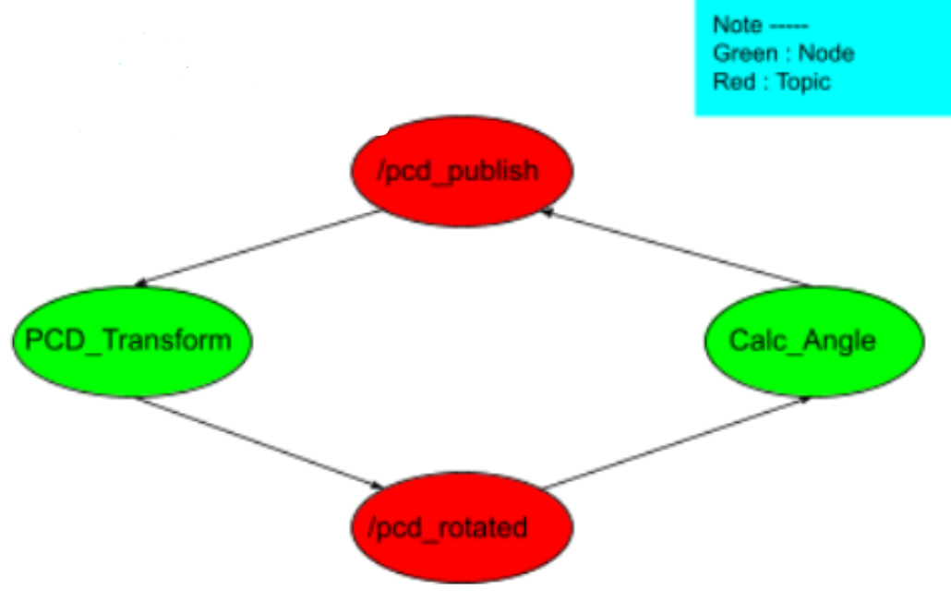
Node structure for generation of angles

Slide 13
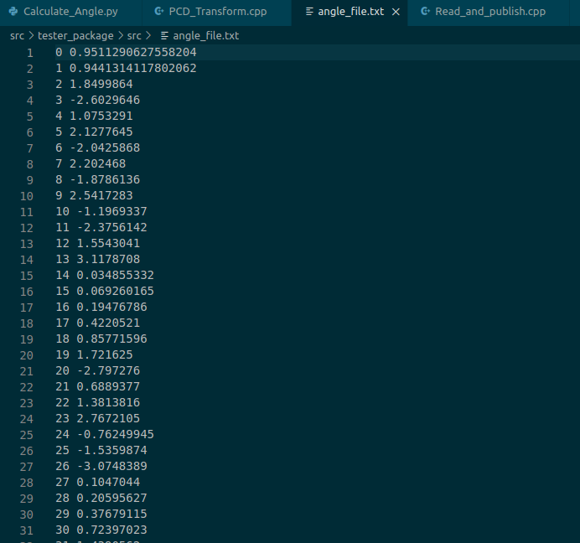
Angle File - Why this didn’t work?

Slide 14
Corrections in Angle Calculation
#Final Rotation Code
angles = []
red_pcd = o3d.io.read_point_cloud("/content/traj.pcd")
for i in range(83):
red_arr1 = PCDToNumpy(red_pcd)
angle = np.arctan2(red_arr1[i][0], red_arr1[i][2])
angles.append(angle)
red_pcd_rotmat = copy.deepcopy(red_pcd)
R = red_pcd_rotmat.get_rotation_matrix_from_axis_angle(np.array([0, -angle, 0]))
red_pcd.rotate(R)
This code was run after making the radius of all points same by taking the help of abhijay’s code.

Slide 15
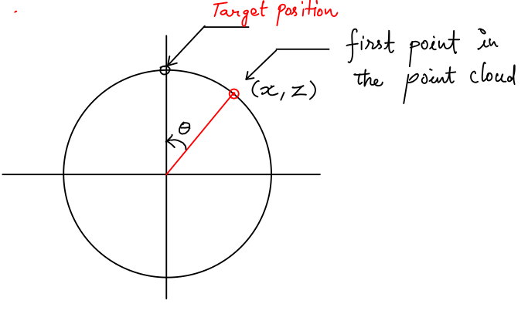
Why it works
For Every Point in the point cloud ------>
arctan2(x,z) gives the angle “theta”
Now in order to rotate the point cloud towards the target point, the rotation vector needs to have the angle as
- (theta)
So this process is repeated again and again and we see that the points one-by-one in every iteration going to the target position.

Slide 16
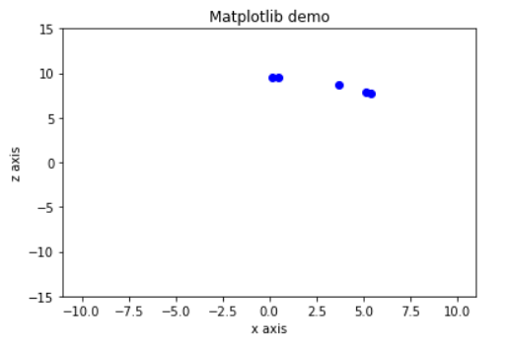
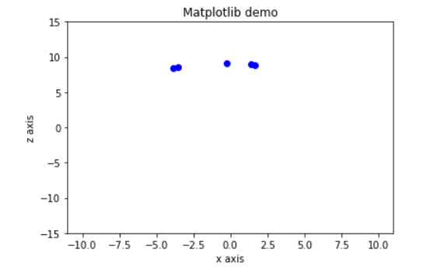
Sample points plotted
Snapshot of 2nd iteration Snapshot of 3rd iteration

Slide 17
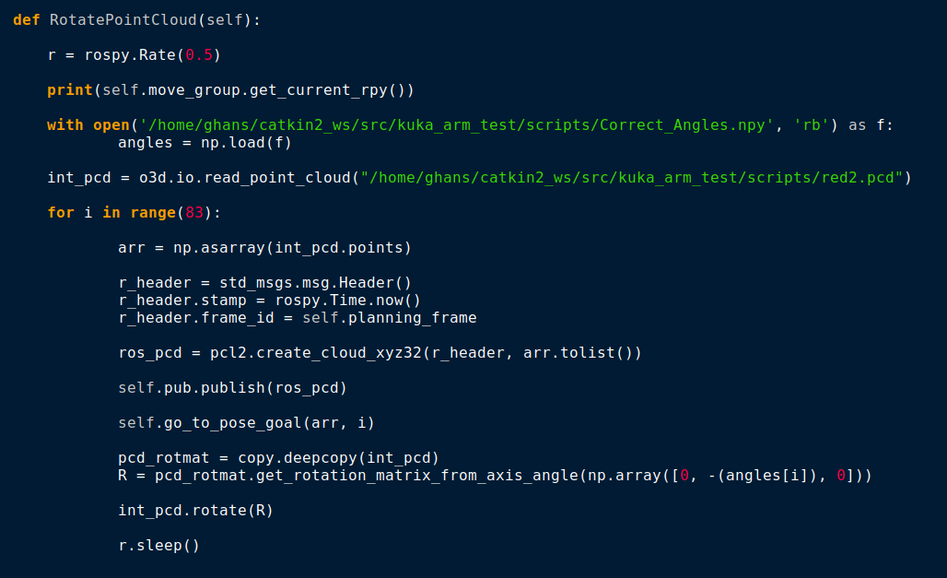
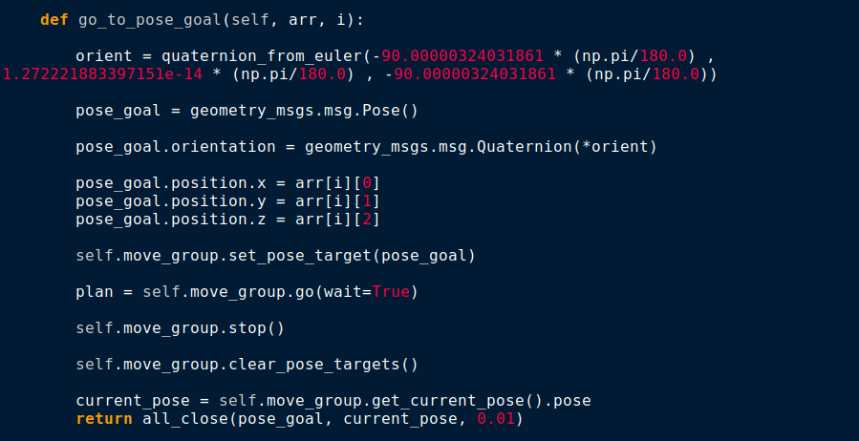
Rotation Node for simulation in Rviz and Gazebo

Slide 18
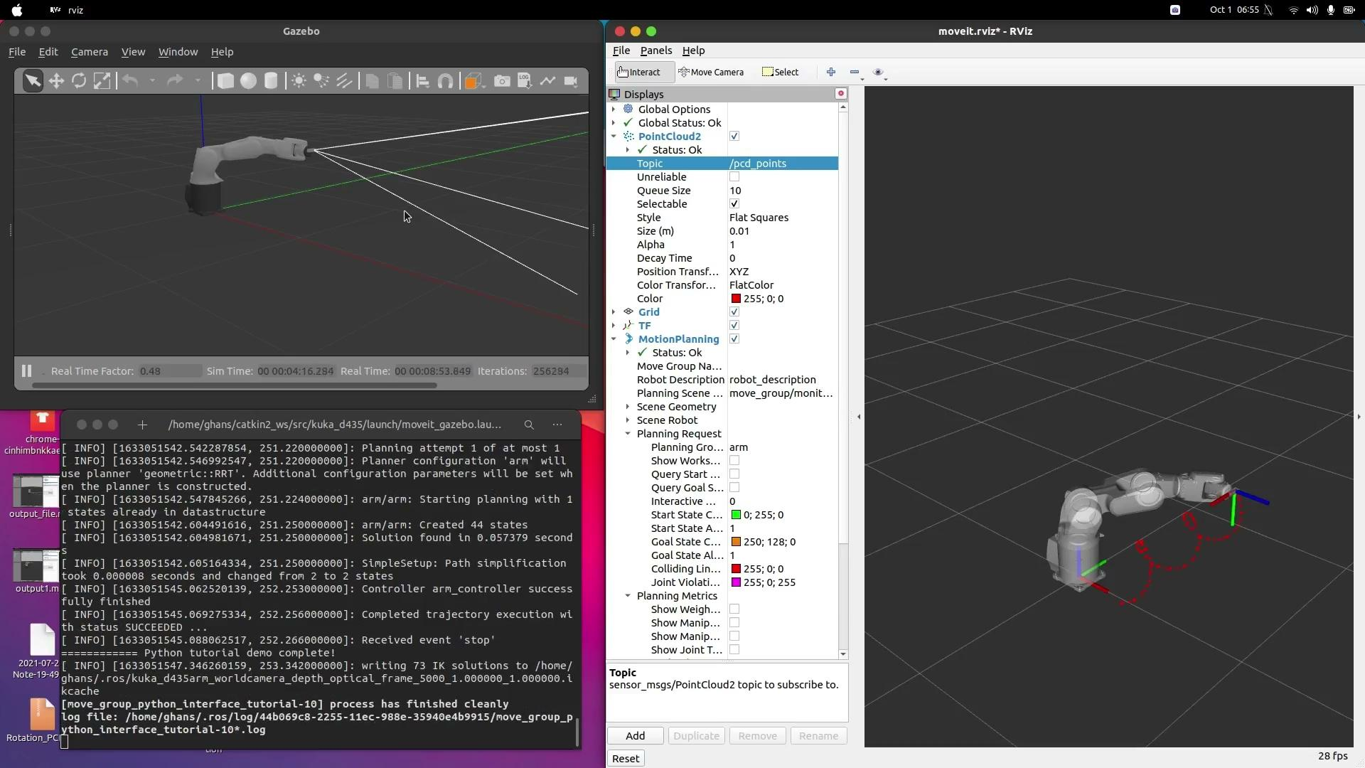
Result

Slide 19
Thank You !

