Slide 1
In Silico Comparison of Photons versus Carbon Ions in Single Fraction Therapy of Lung Cancer
Kristjan Anderle

Slide 2
Outline
Introduction
Materials & Methods
Results
Conclusion & Outlook

Slide 3
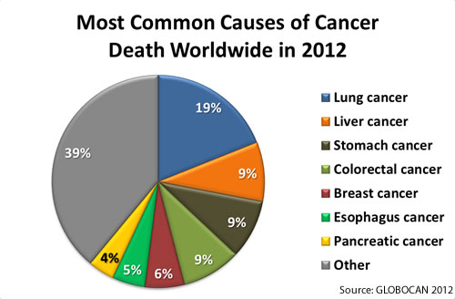
Introduction

Slide 4
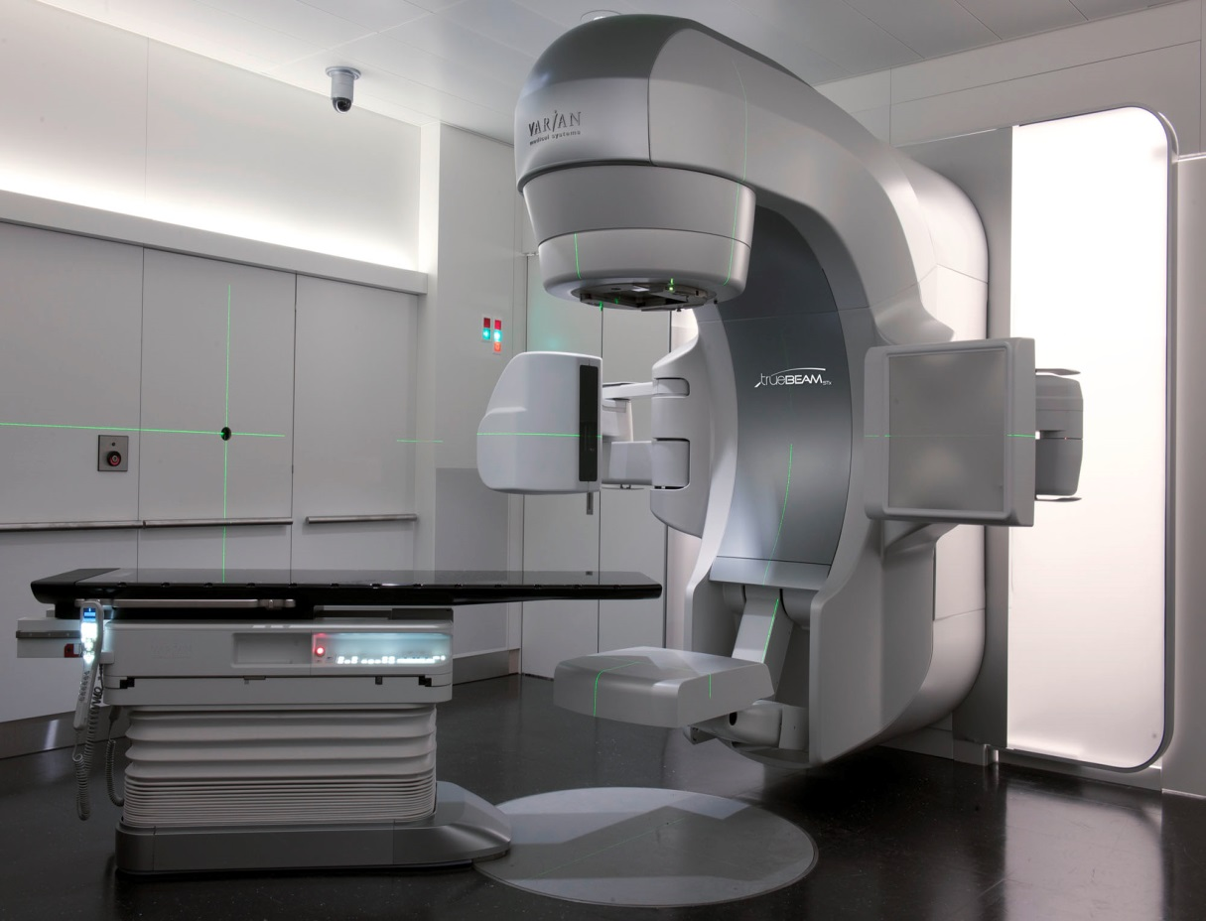
Introduction

Slide 5
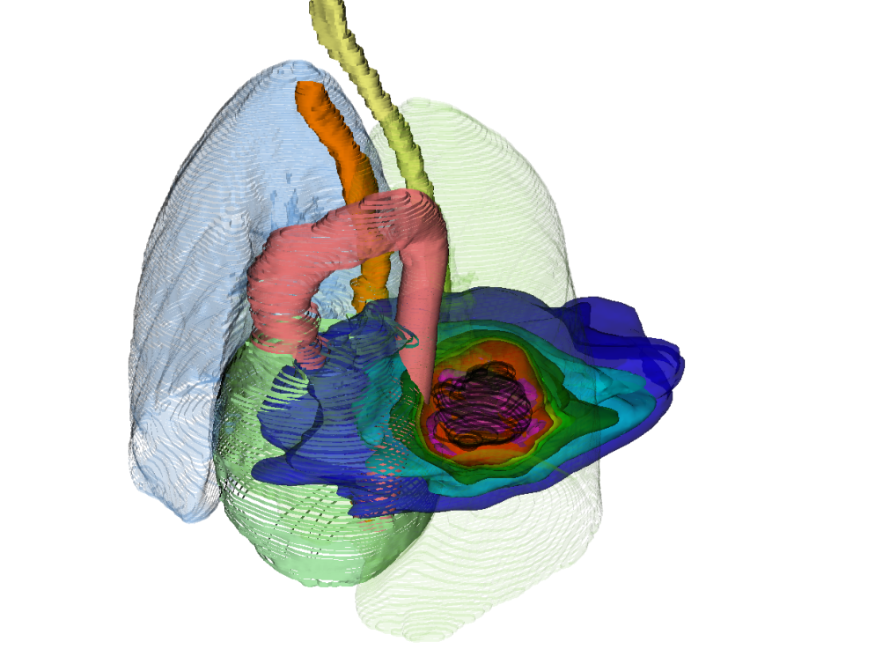
Introduction
photons

Slide 6
Introduction
photons
12C
photons
p+

Slide 7
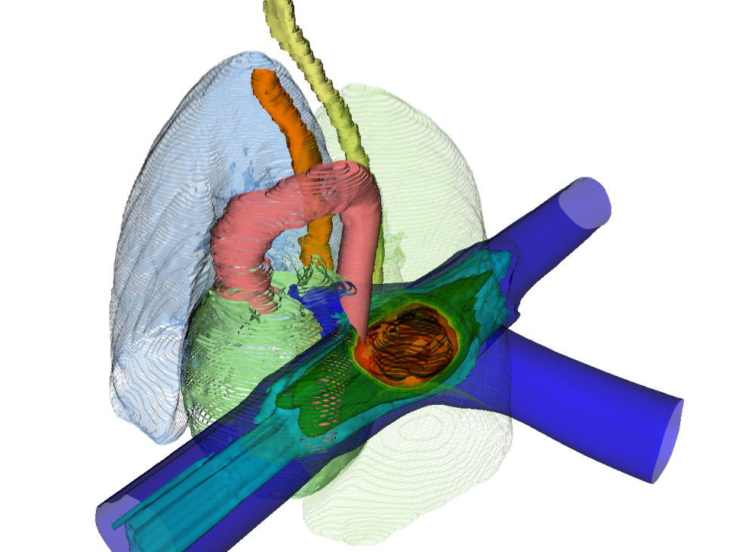
Introduction
photons
LEGENDA!
¹²C
12C
photons
p+

Slide 8
Introduction
PT Raster scanning
PT Bragg peak
PT range changes & interplay

Slide 9
Introduction
PT Raster scanning
PT Bragg peak
PT range changes & interplay
Courtesy M. Söhn, LMU

Slide 10
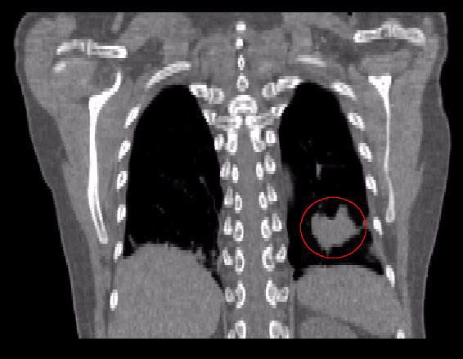
Deformable Image Registration

Slide 11
Patient Data
19 patients, 26 tumors
Average tumor volume:
Average tumor motion:
8 patients, 23 tumors

Slide 12

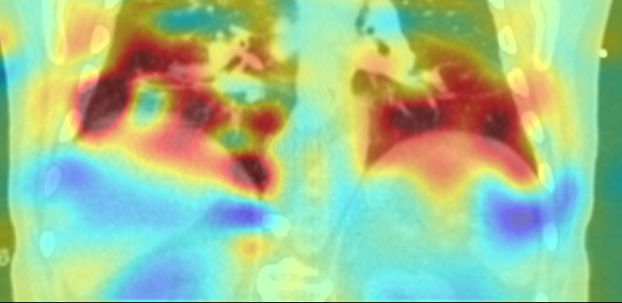
Deformable Image Registration Quality Assurance
Quality assurance with qualitative and quantitative test
Extensive verification
(1000 deformable image registrations)

