Slide 2
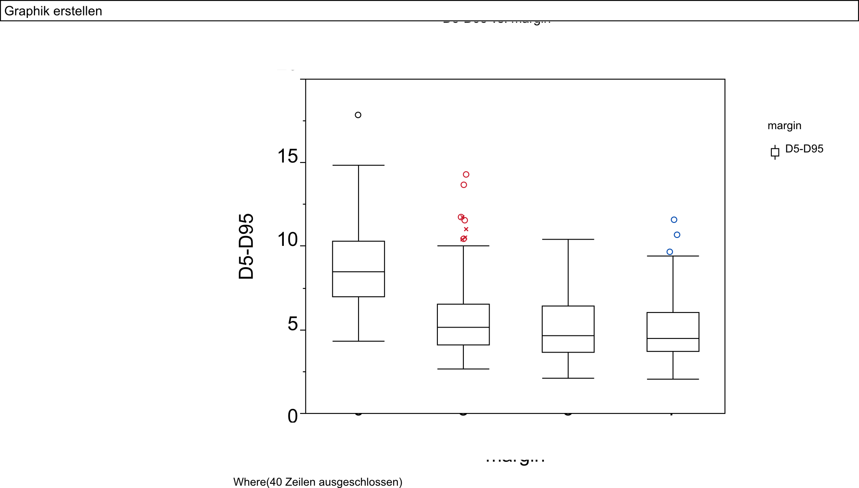
0
3
5
7
Margin [mm]

Slide 3
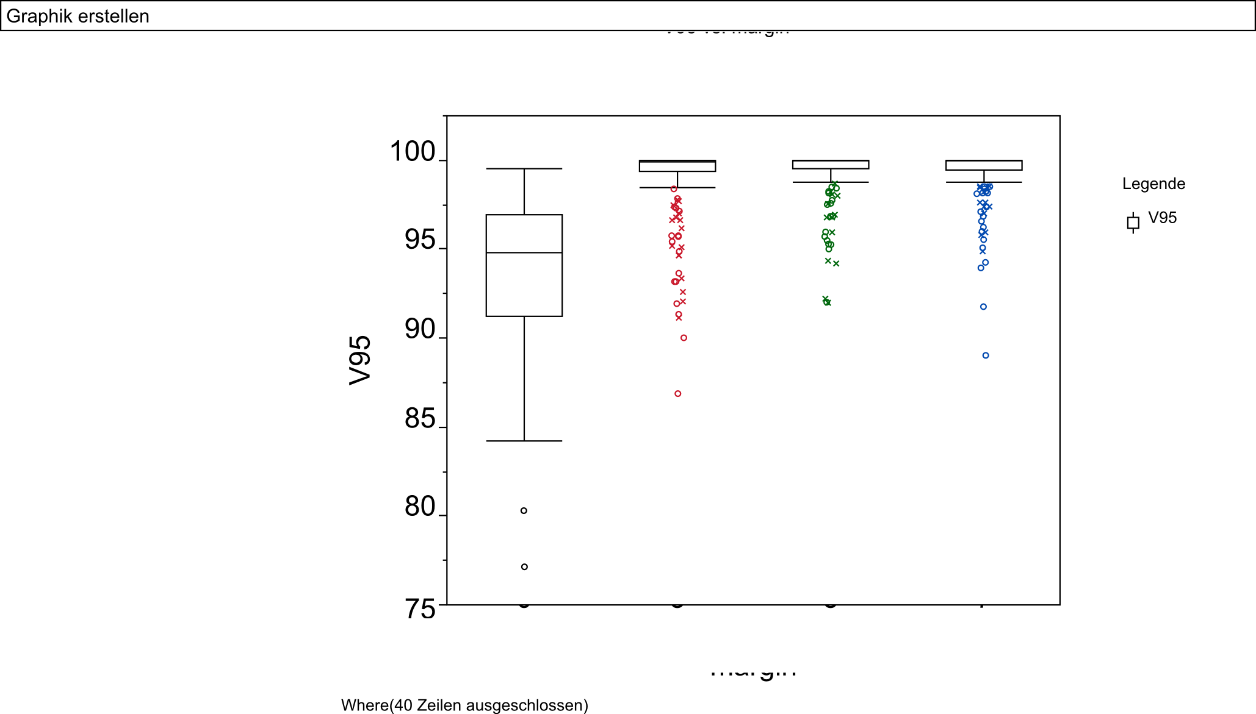
0
3
5
7
Margin [mm]

Slide 4
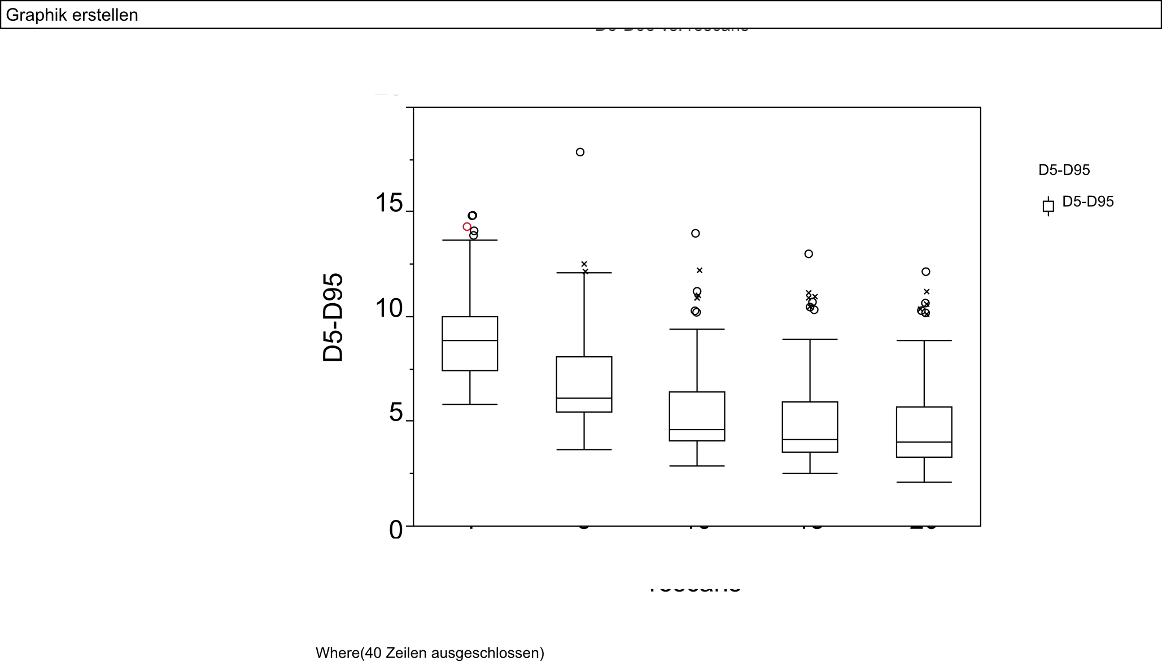
1
5
10
15
20
No. rescans

Slide 5
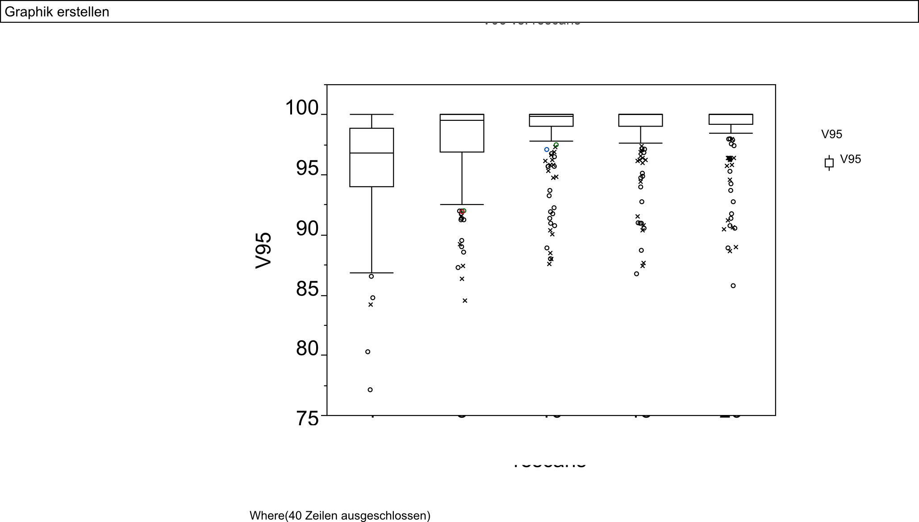
1
5
10
15
20
No. rescans

