Slide 2
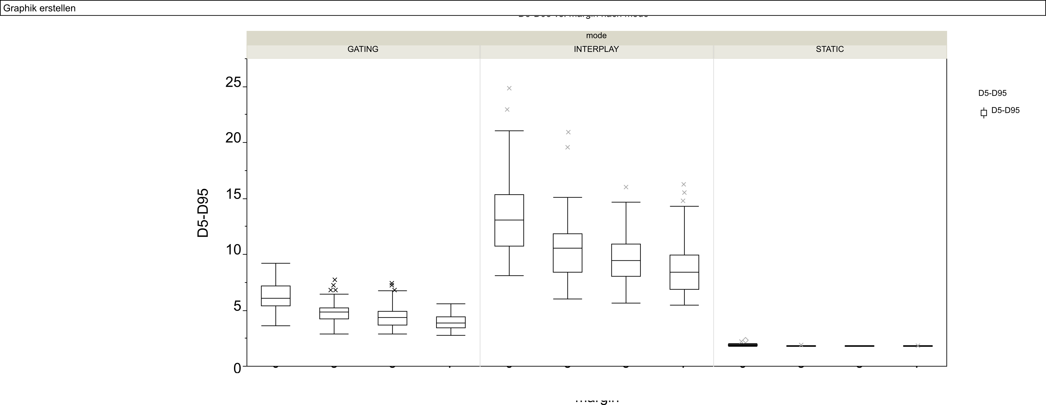
25

Slide 3
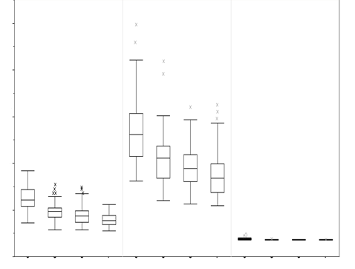
gating
interplay
static
25
20
D5-D95
15
10
5
0
3
5
7
0
3
5
7
0
3
5
7
Margin [mm]

Slide 4
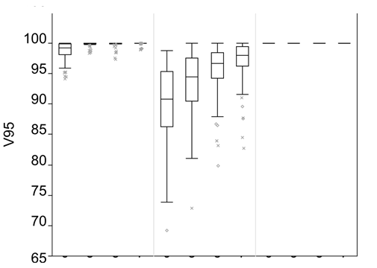
gating
interplay
static
0
3
5
7
0
3
5
7
0
3
5
7
Margin [mm]

Slide 5
