Slide 1
MOSKopt — simulation-based stochastic black-box optimization under uncertainty Ph.D. Resul Al Supervisors: Assoc. Prof. Gürkan Sin, Dr. Alexandr Zubov, Prof. Krist V. Gernaey, Process and Systems Engineering Centre (PROSYS), DTU, Denmark From PhD Defence – June 29, 2020

Slide 2



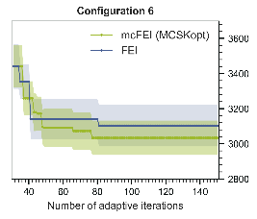
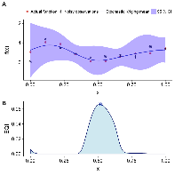
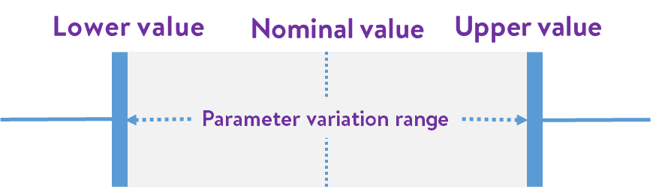
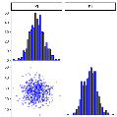



A simulation-based stochastic black-box optimizer A new generic black-box solver:
MOSKopt
Uncertainty definition
Stochastic
black-box
optimizer
SK modelling Optimization
introducing
Stochastic black-box optimizer for optimization under uncertainty of complex systems, e.g. digital twins.
available on
Download
Available from a repository, documentation in preparation.
A generic stochastic black-box optimizer, implements the workflow.
Embedded Monte Carlo simulations for uncertainty quantification.
Allows for multiple uncertainty hedging strategies.
Implements SK modelling, infill optimization, and provides the popular as well as the newly proposed infill (mcFEI) criteria.
Object-oriented programming → user-extendable infills.
Applications to other processes (e.g., fermentation) underway.
MOSKopt
Expensive blackbox simulator
MOSKopt
Stochastic black-box optimizer for optimization under uncertainty
MOSKopt

Slide 3
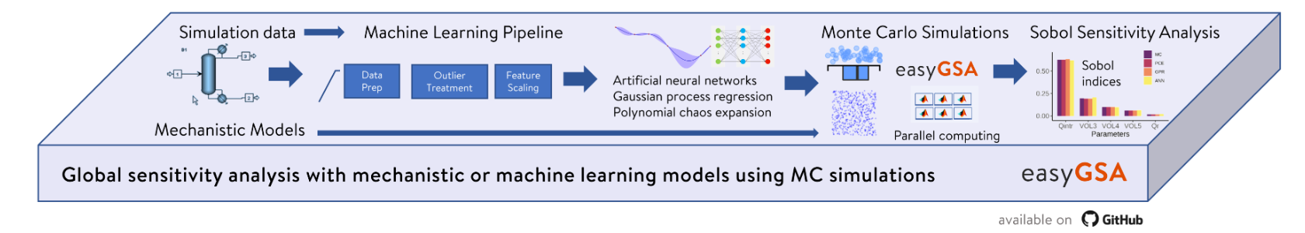


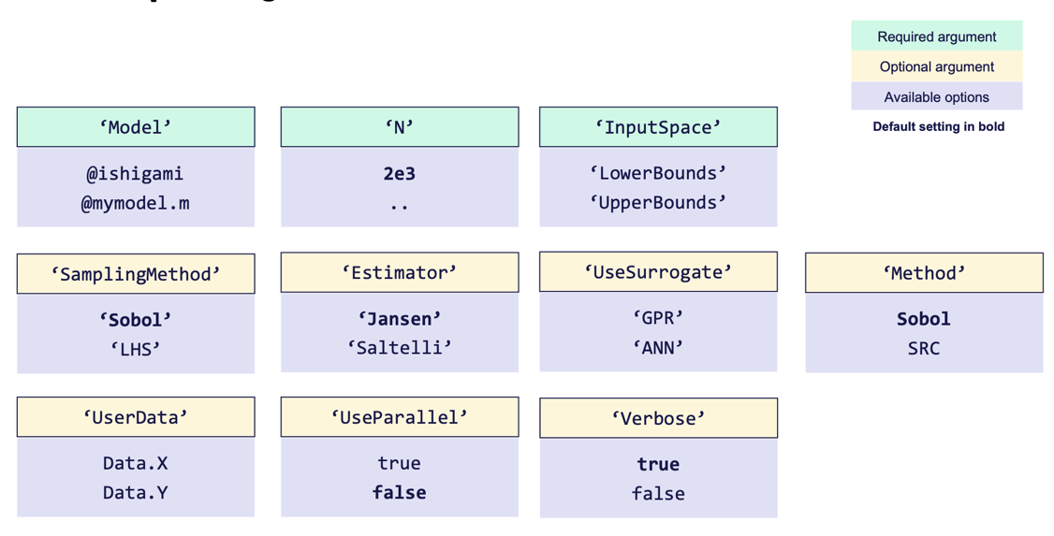
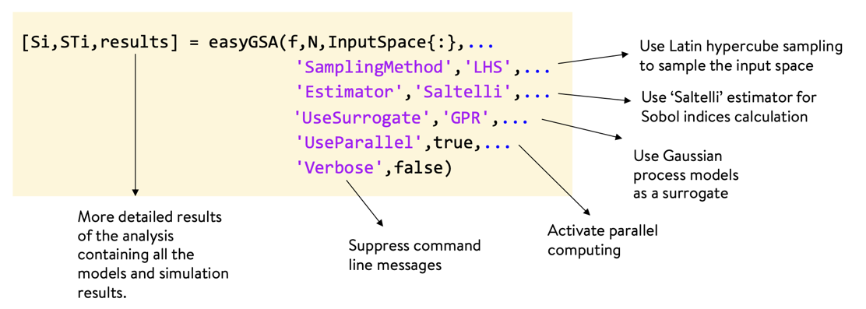



Chapter 5 > Outcomes easyGSA
introducing
easyGSA
Global sensitivity analysis framework using mechanistic or machine learning algorithms
available on
Download
Input arguments overview
Easy-to-work syntax → plug in any model.
GSA methods: the Sobol method and the SRC method.
Sampling schemes: Sobol sequences, LHS.
Statistical inference for distributions in user data.
Support for multiple outputs → expensive simulations.
Hyperparameter optimization → GPR models.
Gridsearch optimization algorithm → ANN models.
Allowing user provided data to fit surrogates and perform Sobol GSA.
ML pipeline for automatic data treatment.
Efficient use of available parallelization architecture.
Inc. in course materials, already used by MSc and PhDs.
Syntax
Summer School on Uncertainty and Sensitivity Analysis

Slide 4
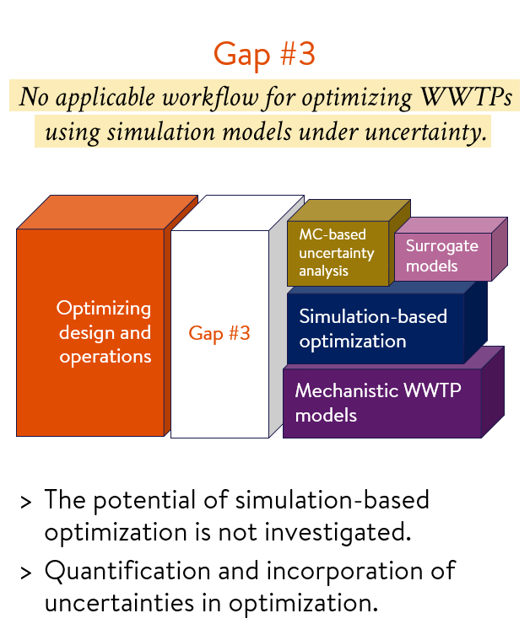
Chapter 6 > Introduction Optimization of WWTP networks under uncertainty
Chapter motivations
WWTP design is subject to high uncertainty.
Use the community’s well-matured first principles simulation models to do design optimization (e.g., ADM1).
Address Gap#3 identified in literature review.
Further optimize WWTP layouts that are identified as promising in Chapter 4.
Quantify and integrate the impacts of uncertainties (e.g., influent composition).
Primary goals:
Develop/demonstrate an applicable simulation-based workflow for WWTP design optimization under uncertainty (OUU).
Automate the workflow in a generic tool.

Slide 5
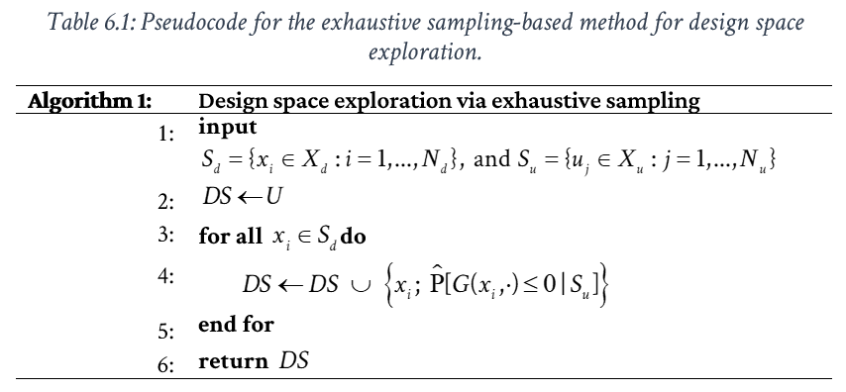
Chapter 6 > Methods Exhaustive sampling-based optimization
Used as a benchmark method.
Discretizes both the design and the uncertainty spaces using sampling.
Allows for an exhaustive search for an optimum under uncertainty.
Effective yet heavily suffers from the curse of dimensionality.
simulations needed.
Hedging strategies against the uncertainties
Tune the level of conservativeness.
Name | Explanation
Mean | The mean of constraint observations acquired from the Monte Carlo simulations is less than the constraint limit.
UCI95 | The upper confidence interval for the mean of constraint observations acquired from the Monte Carlo simulations is less than the constraint limit.
PF80 | The probability of the feasibility calculated from the Monte Carlo simulations is higher than 80 %.
MeanPlusSigma | The mean plus one standard deviation of constraint observations acquired from the Monte Carlo simulations is less than the constraint limit.

Slide 6
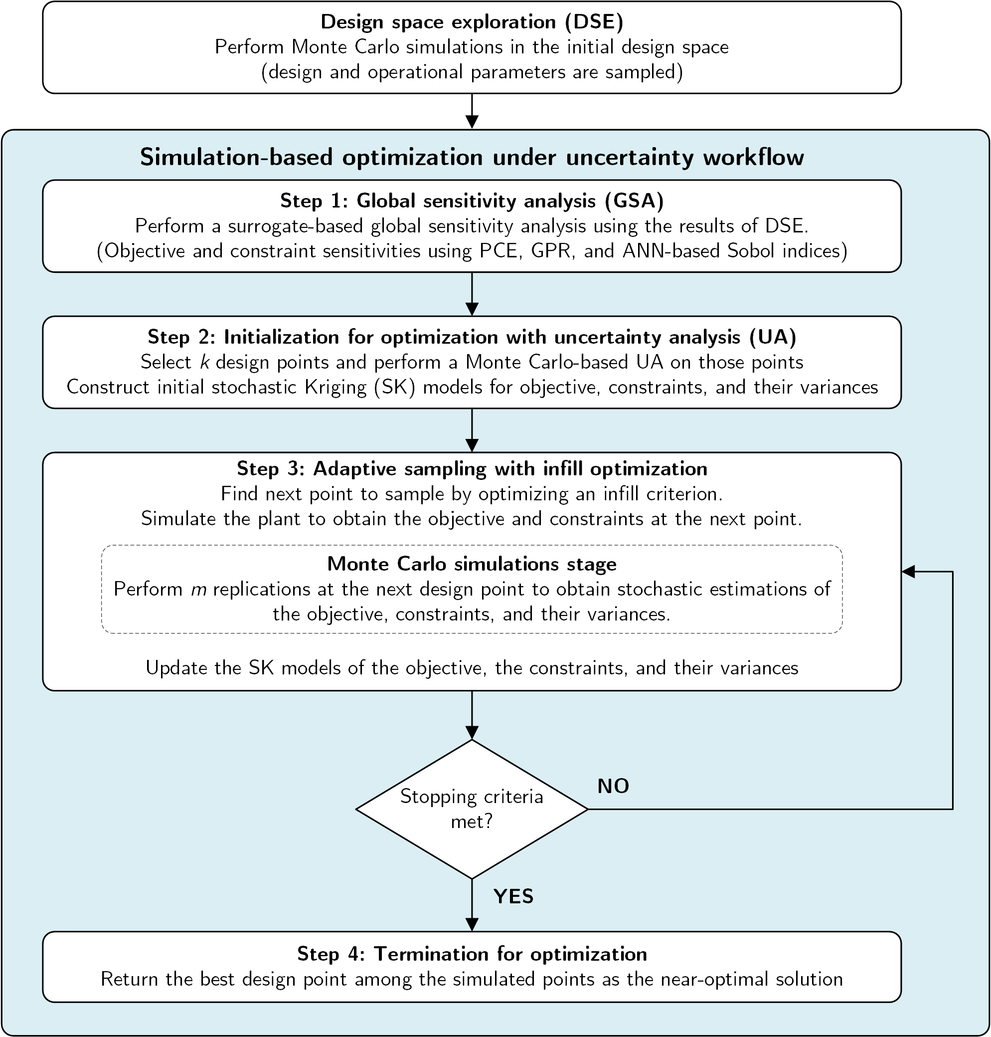
Chapter 6 > Methods Simulation-based optimization under uncertainty
Employs surrogate models for a better-informed exploration in the design space.
Generic workflows have 3 stages: initialization, adaptive sampling, and termination.
We integrate 2 more stages: global sensitivity (prior to initialization) and uncertainty analysis ( both in initialization and in adaptive sampling stages).
Key to its success is the infill criterion,—an internal optimization of an expected improvement measure using surrogates.

Slide 7

Chapter 6 > Methods Stochastic Kriging modeling
An extension of Kriging,—an interpolation-based meta-model.
Introduced by Ankenman et al. as a meta-modeling technique for stochastic simulations.
Found promising uses in simulation optimization.
Extrinsic uncertainty
The lack of certainty of the meta-model about the simulation model’s behavior at regions where no observations are obtained.
Intrinsic uncertainty
The lack of certainty in the original simulation model’s responses.
Stochastic Kriging model structure
SK model
input vector
Wang and Ierapetritou, 2018. Comput Chem Eng 118.
Picheny et al., 2013. Technometrics 55.
a constant surface trend, i.e. mean
extrinsic uncertainty
intrinsic uncertainty
Ankenman et al., 2010. Oper Res 58.
stochastic replications
heteroscedastic noise std.
Monte Carlo simulations for UQ
uncertainty information

Slide 8
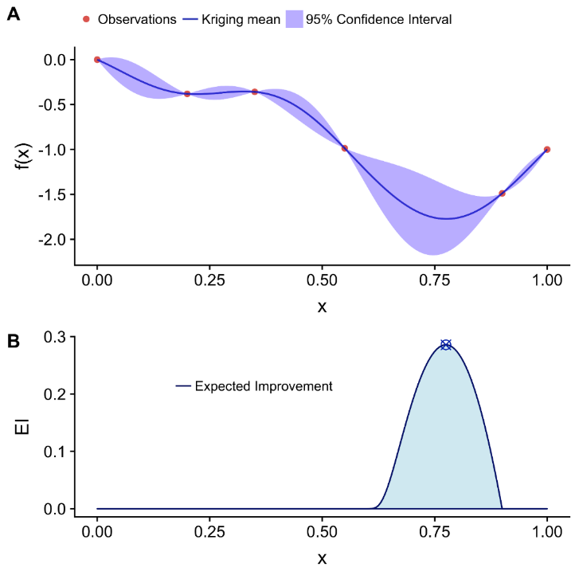
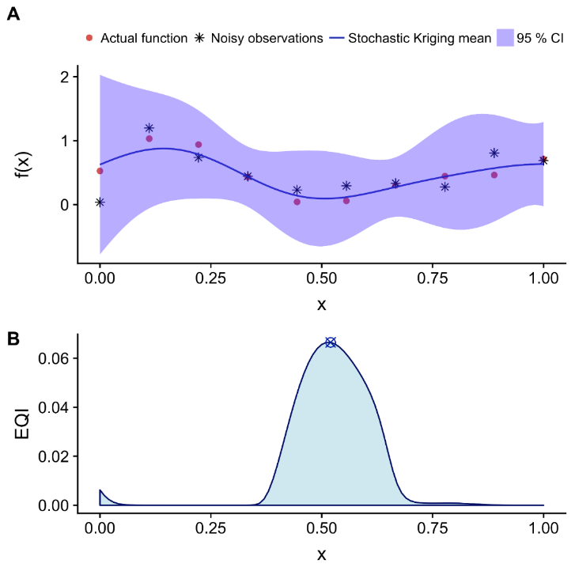
Chapter 6 > Methods Infill criteria for optimization
Understanding infill optimization
Expected Improvement Mockus, J., 1975. Opt Techniques → Jones et al., 1998. J Glob Optim 13.
Expected Quantile Improvement Picheny et al., 2013. Technometrics 55.
Constrained Expected Improvement Wang and Ierapetritou, 2018. Comput Chem Eng 118.
Feasibility Enhanced Expected Imp. (FEI) Wang and Ierapetritou, 2018. Comput Chem Eng 118.
Multiple-constrained FEI (mcFEI) Al et al., 2020. Comput Chem Eng (under review).
Expected improvement
Unconstrained deterministic
Unconstrained stochastic
improve objective
prioritize feasible regions
balance between explore & exploit
Expected quantile improvement
focus on areas where f is small
handle stochasticity in the constraint
handle stochasticity in multiple constraints

Slide 9
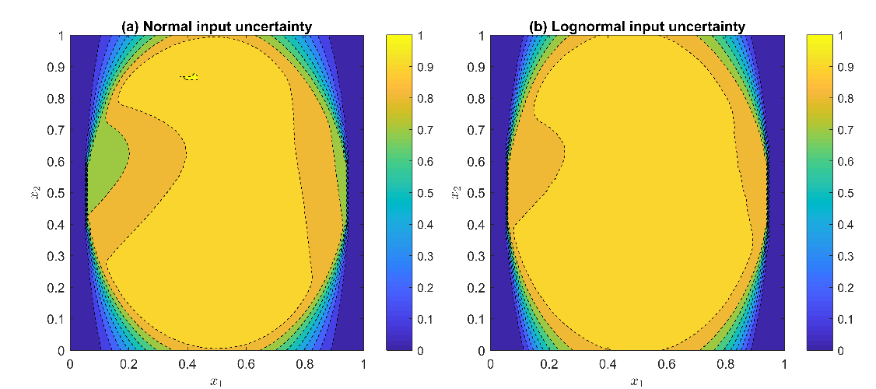
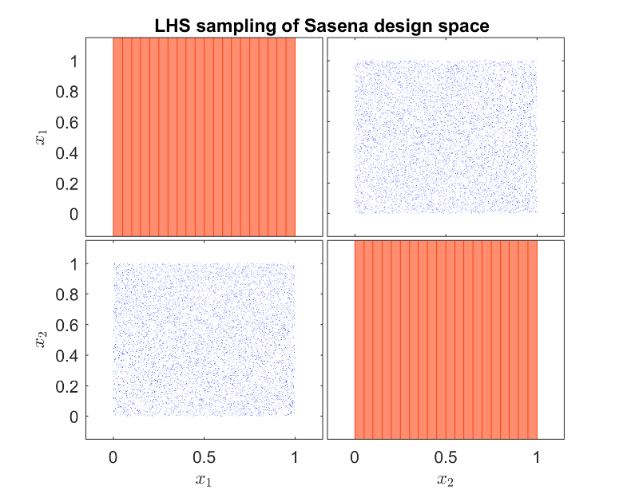
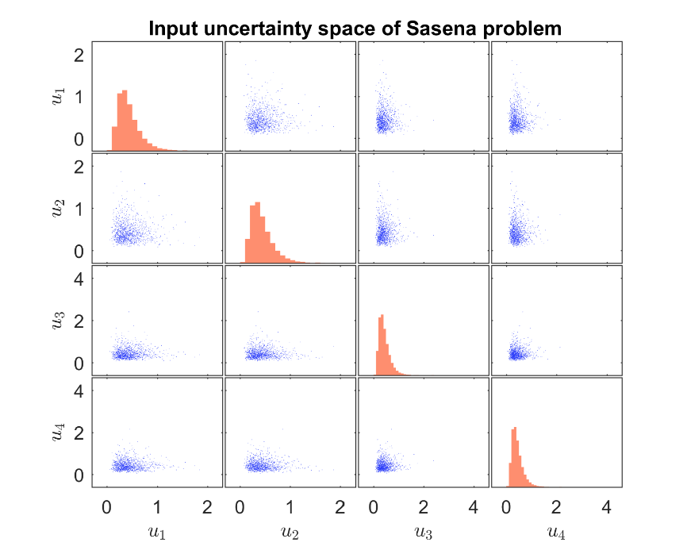
Chapter 6 > Results > Case study 1 Sasena: An illustrative example
Probabilistic design spaces
Sasena test problem
Mathematical formulation (modified).
2 decision variables,—visualize the design space.
4 uncertain parameters,—following normal and lognormal distributions.
Solution via Exhaustive sampling
From 10 to 10⁵ LHS design samples x 10³ LHS uncertainty samples.
Vectorized Monte Carlo simulations → simultaneous exploration in both spaces.
Design space
Uncertainty space

Slide 10
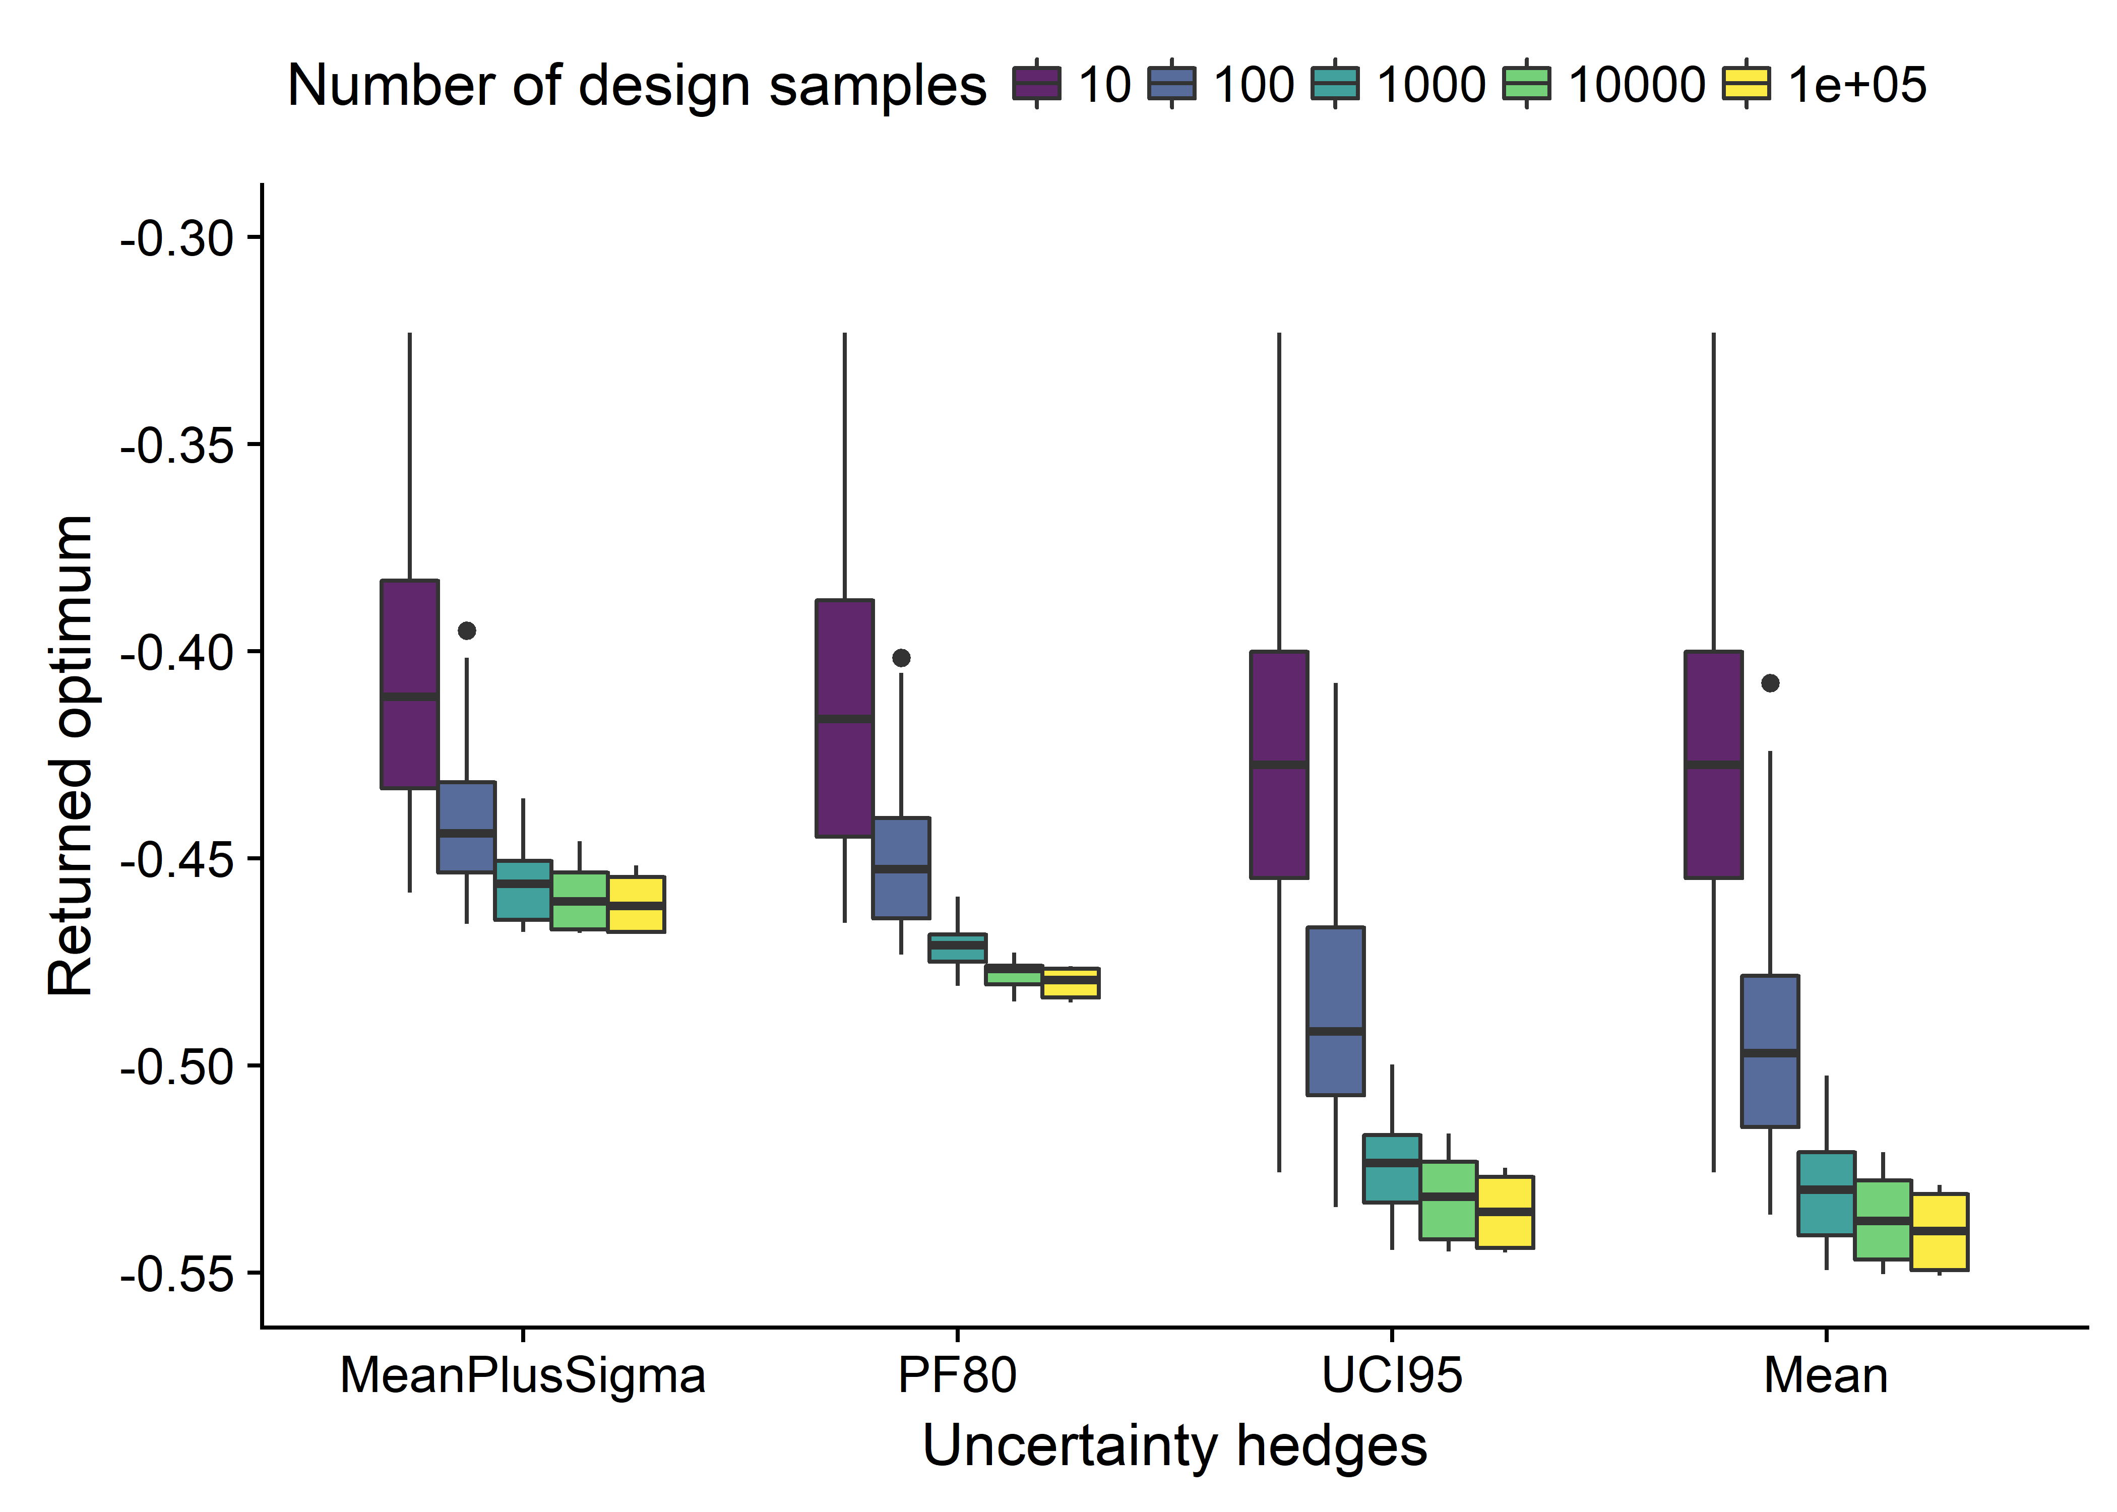
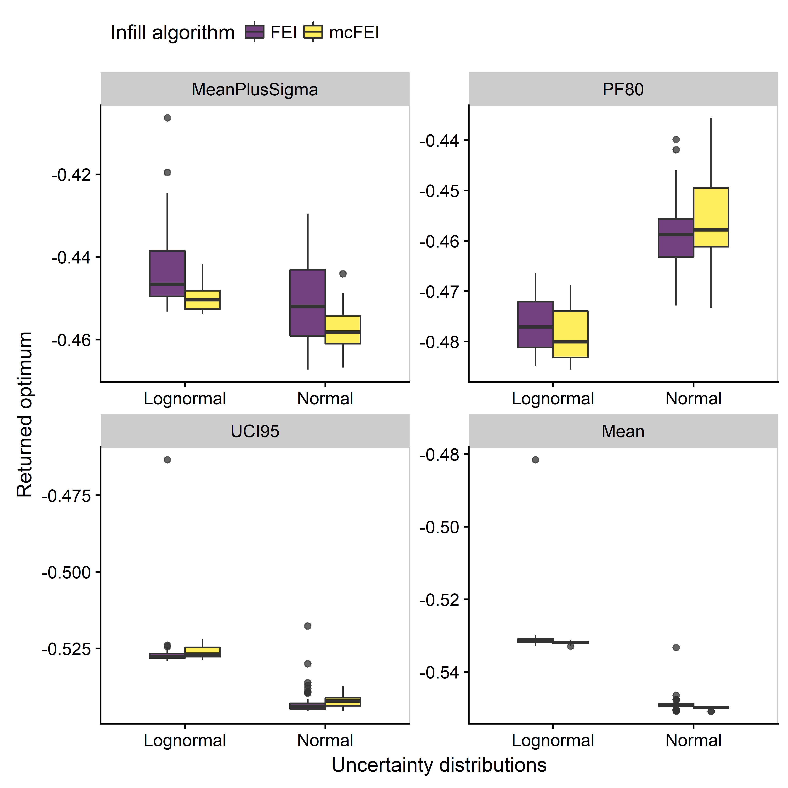
Chapter 6 > Results > Case study 1 Sasena results
Solutions via Exhaustive sampling
Competitive solutions already at 10³ samples.
Solutions via simulation-based optimization
100 design samples, 50 independent repetitions.

Slide 11
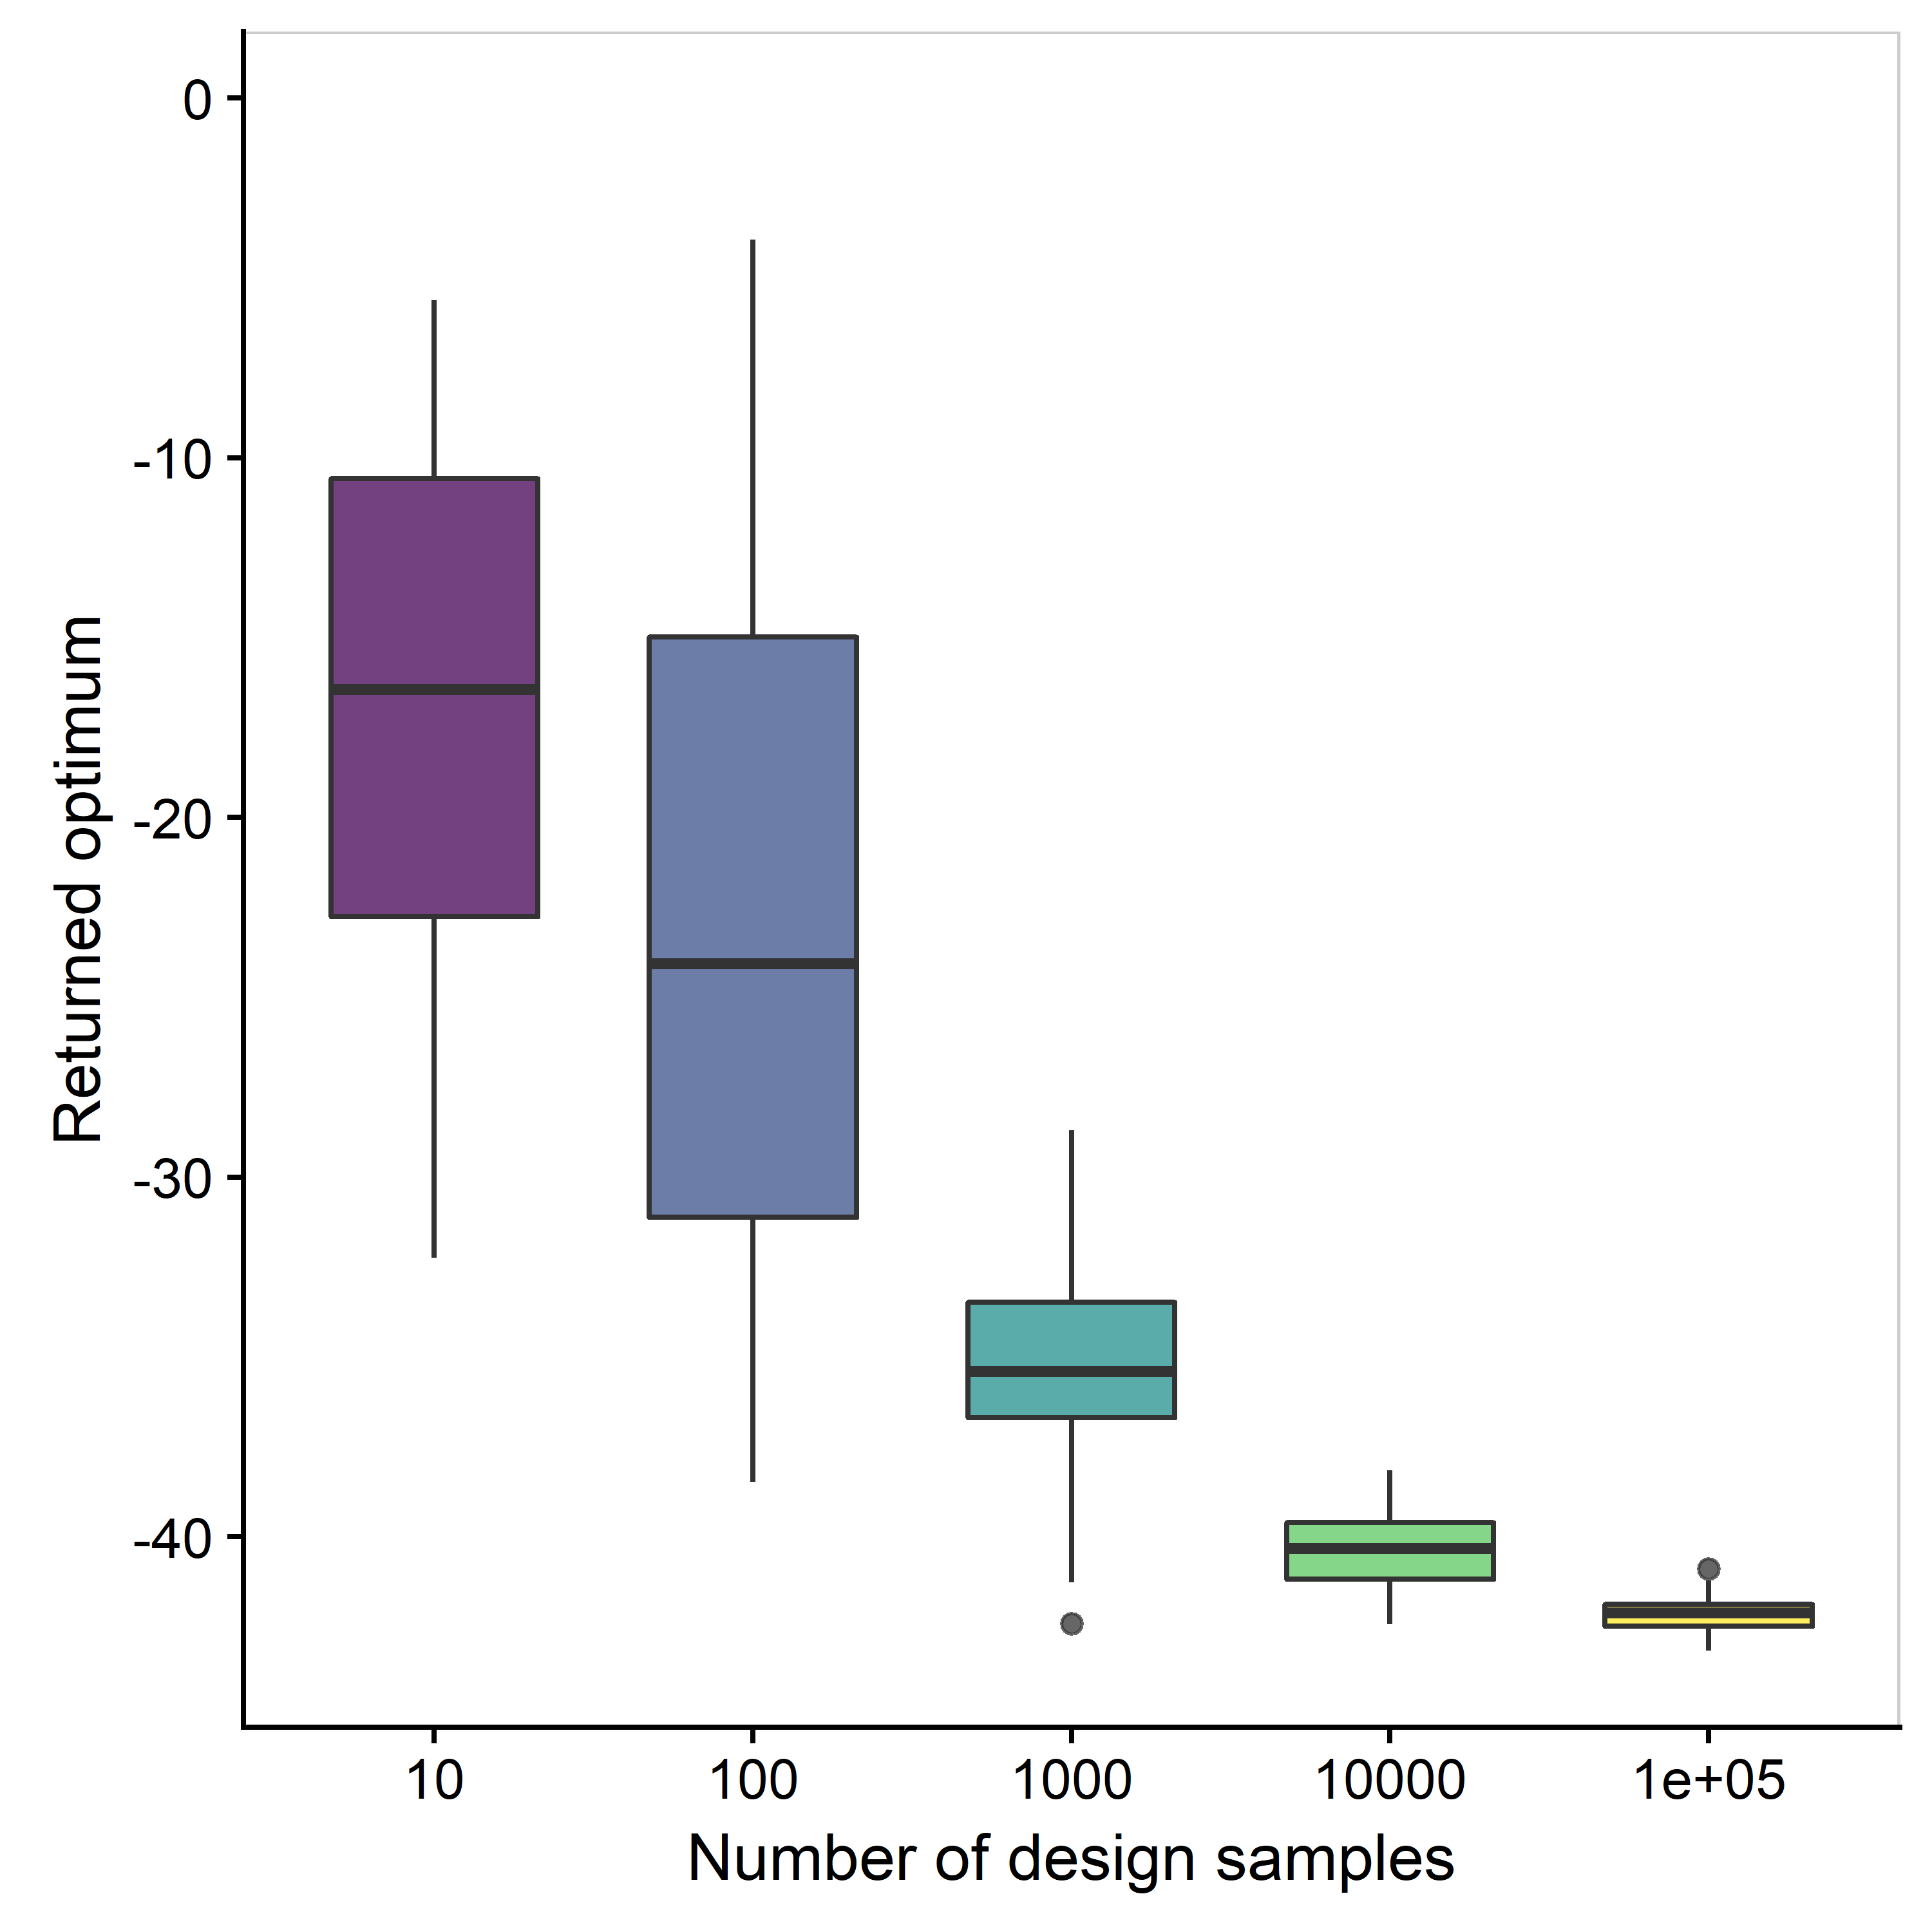
Chapter 6 > Results > Case study 2 Rosen Suzuki: A higher dimensional example
Rosen Suzuki test problem
Mathematical formulation (modified).
4 decision variables.
4 uncertain parameters,—following normal distributions.
Solutions via
Exhaustive sampling
#5dbcd2
Benchmark solution
Number of LHS design samples | Total number of calls to the model | Optimum value of the objective | Location of the optimum (x)
10⁵ | 10⁸ | -42.152 | [-0.026, 0.841, 1.951, -0.914]

Slide 12
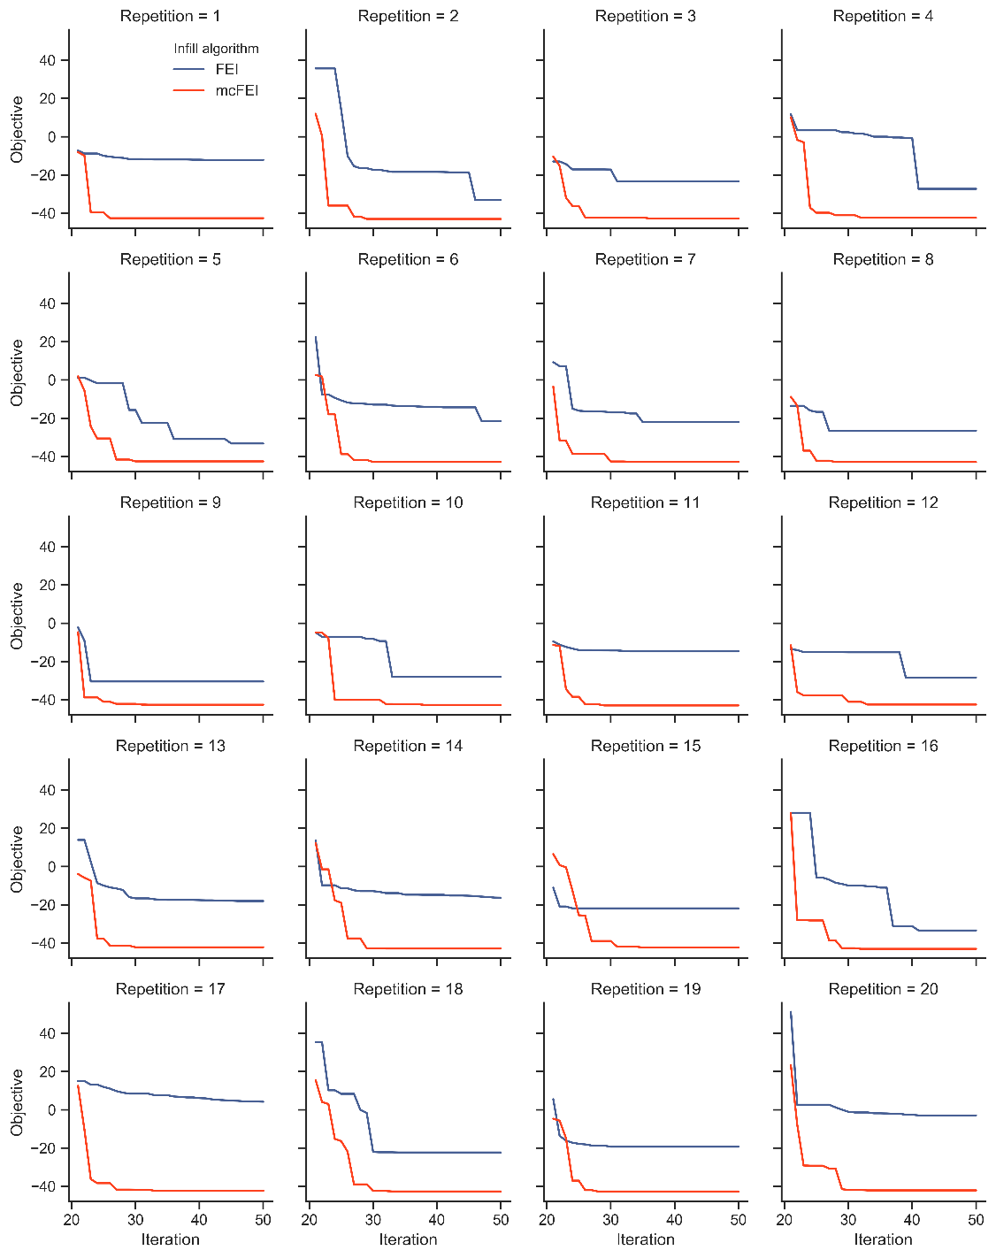
Chapter 6 > Results > Case study 2 Rosen Suzuki
Optimization progress: FEI (blue) vs mcFEI (orange)
Solution via simulation-based optimization
MCSKopt is called with two infills: FEI and mcFEI.
50 design samples with 50 independent runs.
The mcFEI visibly outperforms FEI.
The mcFEI solution (cost=50) is even better than the benchmark solution (cost=10⁵). Why? → the curse of dimensionality.
SK-based approach → a better-informed exploration.
Infill algorithm | Number of LHS design samples | Total # of calls to the model | Optimum value of the objective | Location of the optimum (x)
FEI | 50 | 50x10³ | -24.915 | [-0.368, 0.607, 1.468, 0.128]
mcFEI | 50 | 50x10³ | -42.701 | [0.028, 0.608, 1.996, -0.996]
Exhaustive | 10⁵ | 10⁸ | -42.152 | [-0.026, 0.841, 1.951, -0.914]

Slide 13
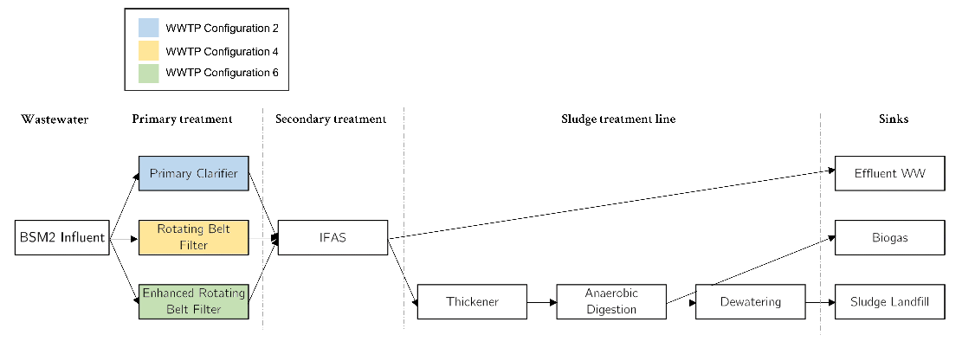
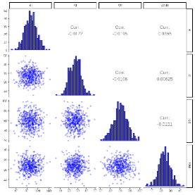
Chapter 6 > Results > Case study 3 WWTP design optimization
The 3 promising layouts from Chapter 4
Simulation-based optimization of the 3 layouts.
Decision variables
Aeration energy
Sludge production
External carbon
Mixing energy
Objective KPI
Methane production
Influent uncertainty
BSM2 influent states | Nominal value (µ) g COD/m³ | Variation (σ)
SI_{inf} | 27.22 | 25 %
SS_{inf} | 58.17 | 25 %
XI_{inf} | 92.49 | 25 %
XBH_{inf} | 50.68 | 25 %
Heating energy
Plant-wide simulation-based objective function
Envelope for optimization
plant
#5dbcd2
Quality limits
influent
effluent
Uncertain influent fractions
Effluent quality KPIs
The impact of uncertainties

Slide 14
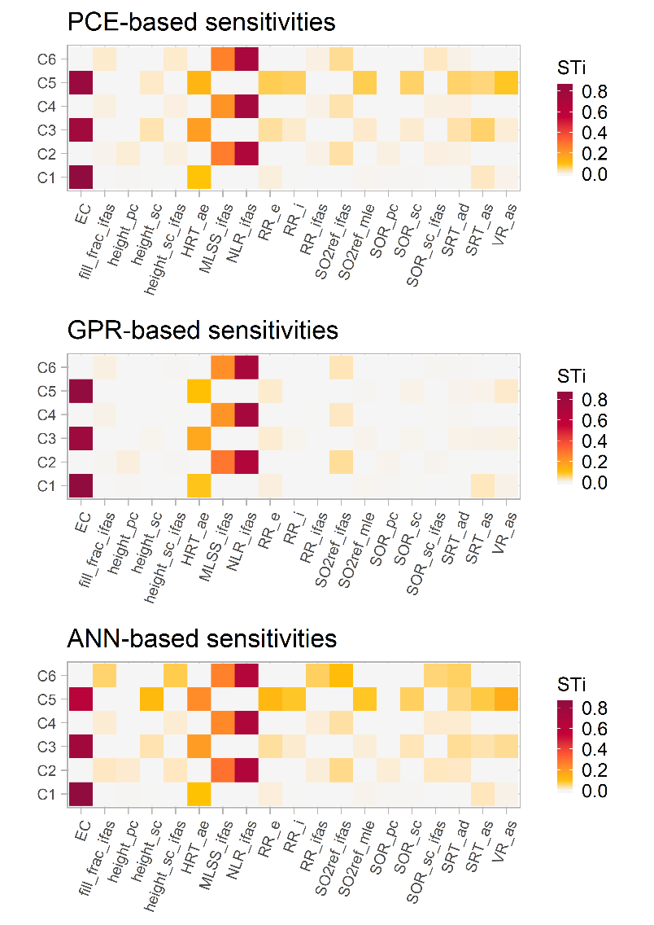
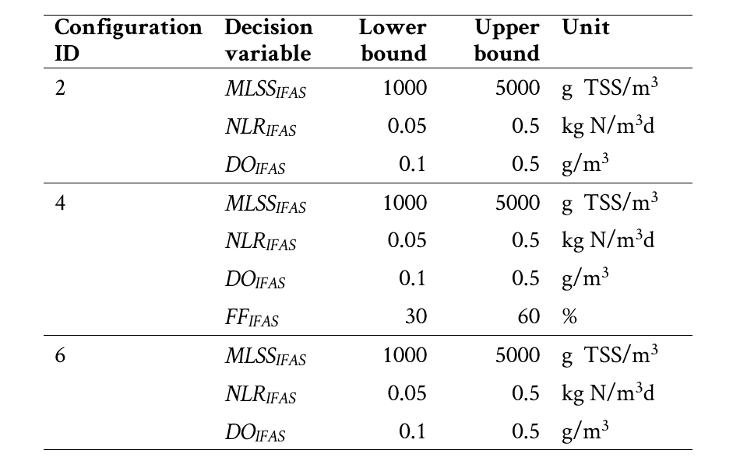
Chapter 6 > Results > Case study 3 WWTP design optimization
Global sensitivity analysis from MCS results
The results of MCS (from Chapter 4) → GSA with surrogates → further refined design spaces in C2, C4, and C6.
Total impacts (as quantified by STi) of design/operational decisions quantified using 3 surrogates → ensemble approach.
Refined design spaces in C2, C4, and C6
#5dbcd2

Slide 15
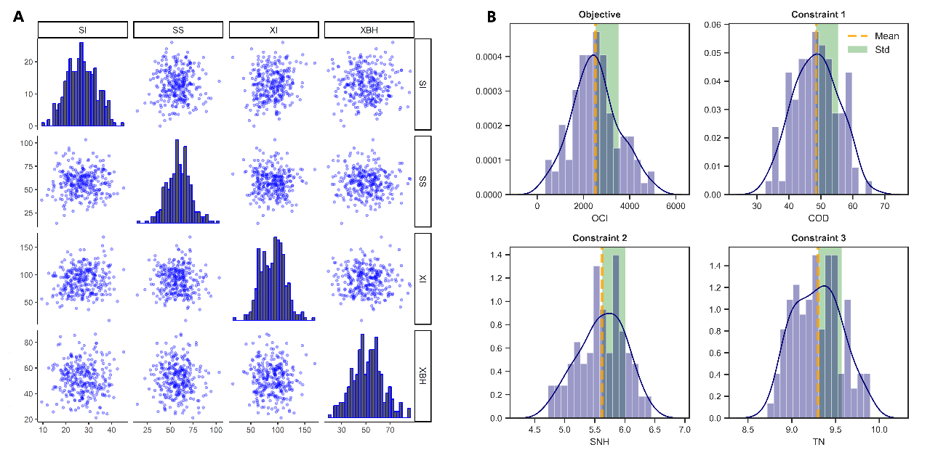
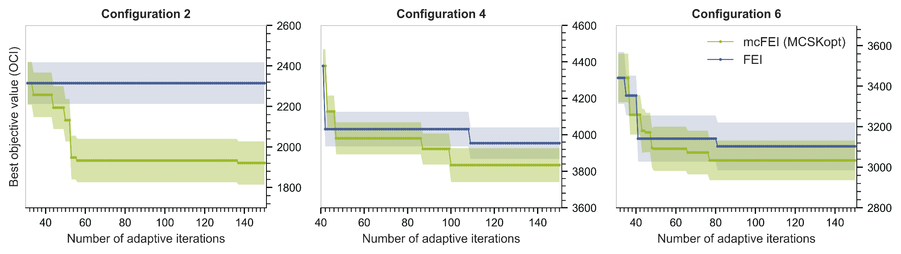
Chapter 6 > Results > Case study 3 WWTP design optimization
Uncertainty quantification using embedded MCS
Continued from where Chapter 4 left off.
150 design samples in total (10d initial + adaptive).
Parallelized MCS for uncertainty quantification.
Hedging strategy for satisfying effluent quality constraints: MeanPlusSigma.
Comparison of two infills: mcFEI outperforms FEI.
Optimization progress: FEI (blue) vs mcFEI (green)

Slide 16
Chapter 6 > Optimization of WWTP networks under uncertainty Summary and conclusions
The developed workflow enables using plant-wide WWTP models for effectively formulating/solving rigorous design optimization problems under uncertainty.
GSA using surrogates can help identify decision variables worth optimizing.
Monte Carlo based uncertainty management can be effectively and non-intrusively integrated into simulation-based optimization workflows.
Stochastic Kriging model provides a means to model output uncertainties in optimization objectives and constraints, hence making it suitable for simulation-based optimization under uncertainty problems.
Maintaining feasibility while improving objective poses a significant challenge in systems subject to multiple stochastic constraints. The proposed mcFEI infill criterion outperforms the FEI criterion in returning near-optimal solutions for such systems.
MCSKopt: an initial step towards making the developed workflow applicable to design under uncertainty problems arising in other domains.
Related publications
R. Al, C.R. Behera, K. V. Gernaey, G. Sin, Stochastic simulation-based superstructure optimization framework for process synthesis and design under uncertainty, Comput. Chem. Eng. (Under review).

