Slide 1
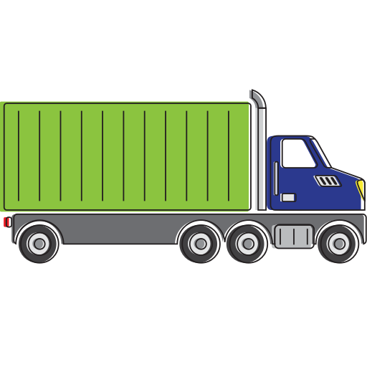
BIG DATA Project team - 6
Team Members:
Siddharth Govindarajan
Neelima Naladimmu
Prathyusha Samala
Ranadeep Varma Mantena
Adityan Rajendran
Gift Chima

Slide 2
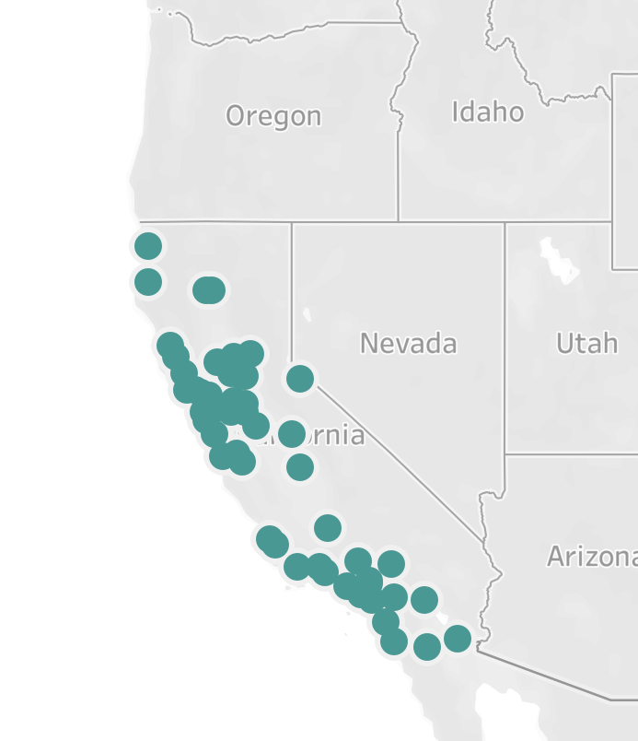
PROBLEM STATEMENT
Given GeoLocation excel file having truck driver incidents in California state.
Import excel file to Hadoop and load it to tableau to determine risk factors.
Visualize the same by bar graph.
OBJECTIVE
Import data in excel file to Hadoop
Load the hive database table with the excel file from Hadoop
Connect tableau to this hive to get the data in this vmware
Calculate risk factor by dividing (Events / Total miles) * 10 ^ 6
Normalize step 4 to get values between 0 and 10
Find the driver who have normalized risk factor >= 7
Plot the same to have a visualize and understand better.

Slide 3
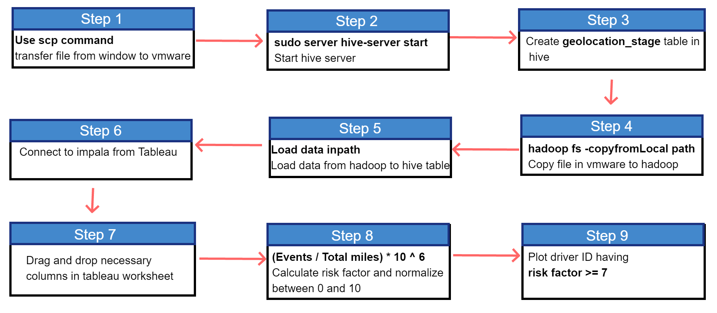

Slide 4
