Slide 1

CDP-Based Prediction of Emissions and Disclosure in Indian Cities
Siddhi Gupta
Dataset: CDP 2023 – Indian Cities Emissions and Disclosure

Slide 2


Research Gap
Research is mostly on national-level emissions
Indian cities’ climate disclosure behavior is underexplored
Most ML models only predict emissions, not transparency
CDP’s Indian city dataset is rarely used in ML-based research
No studies combine forecasting + explainability + policy impact

Slide 3
How my project fills
the gap
Uses real CDP 2023 data from Indian cities
Models both CO₂ emissions and disclosure quality
Applies XGBoost for accurate ML prediction
Uses SHAP to make results explainable
Clusters cities for peer benchmarking
Provides insights for policy action

Slide 4
Project Objectives
Forecast city-level CO₂ emissions
Predict disclosure transparency (e.g., number of scopes, years reported)
Use SHAP to explain what drives performance
Cluster cities with similar disclosure/emission behavior
Offer actionable insights for climate governance

Slide 5
Novel Contributions
Focus on Indian cities — rarely modeled in CDP-based ML
Predicts transparency behavior, not just emissions
Uses explainable ML (SHAP) to support policy-making
Enables peer learning through clustering
Aligns with SDG, ESG, and CDP goals
Bridges data science with climate governance

Slide 6
Sample Model
Goal of the Sample Model
To validate the feasibility of predicting CO₂ emissions and disclosure quality using machine learning models trained on CDP India city data.
Features Used:
Population
Reporting frequency
Protocol used
Inventory tool

Slide 7
Models & Methods
XGBoost Regressor for emissions and disclosure
Custom Disclosure Score (0–3 scale)
SHAP for model interpretability
KMeans & Hierarchical Clustering for city grouping

Slide 8
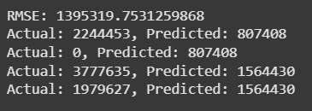
Result
Predicting CO2 emission

Slide 9
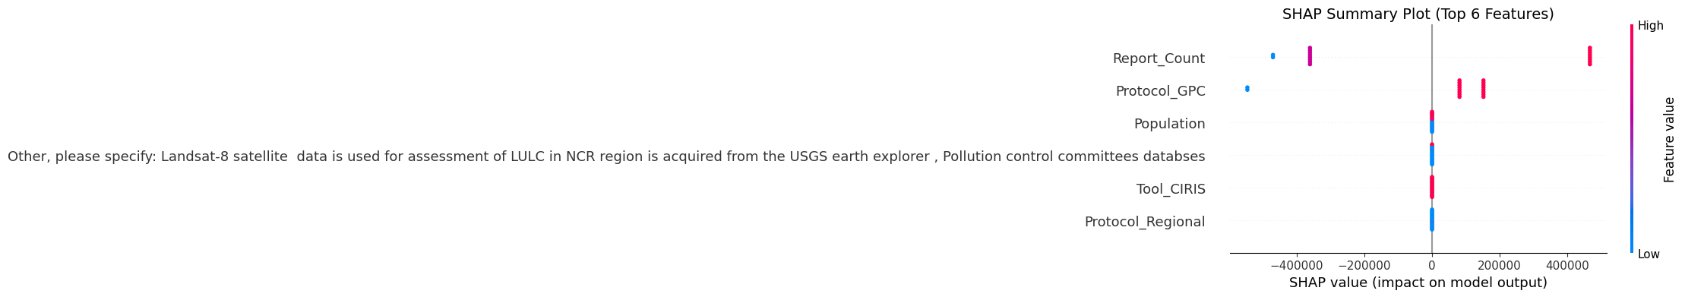
SHAP Summary

Slide 10

Model Evaluation

Slide 11
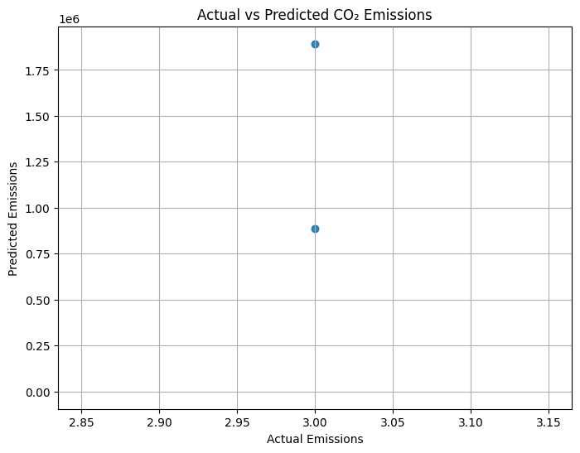
Actual V/S Predicted

Slide 12
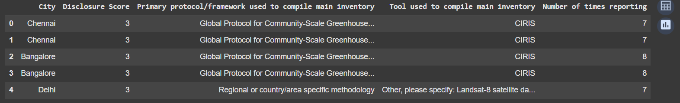
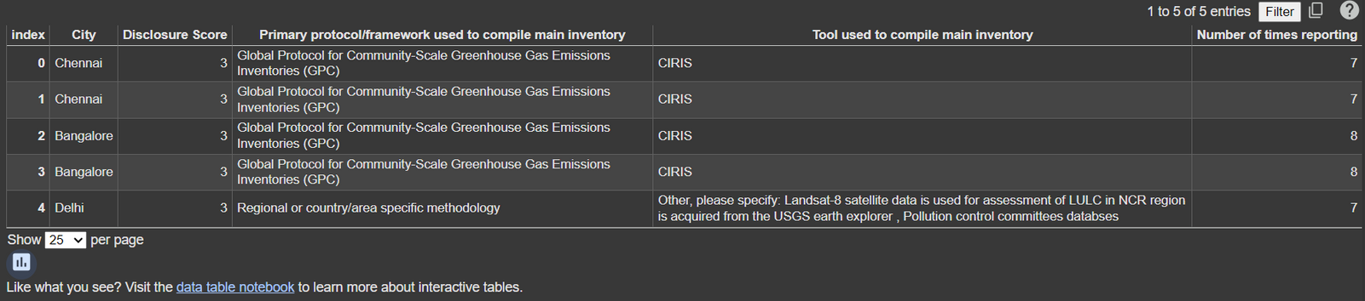
Disclosure Score Calculation

Slide 13
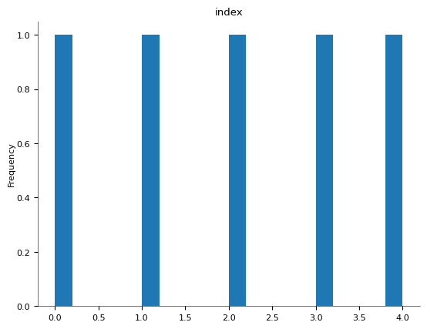
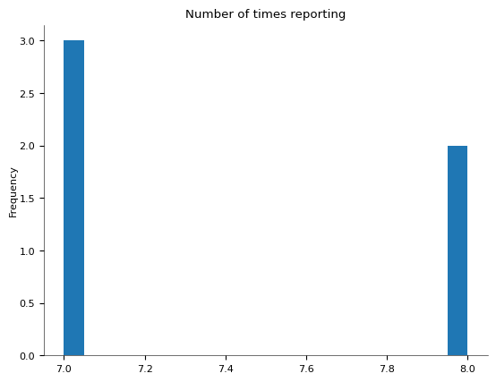
Disclosure Score Calculation
Distributions

Slide 14
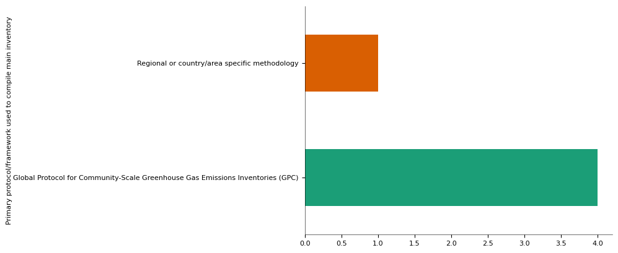
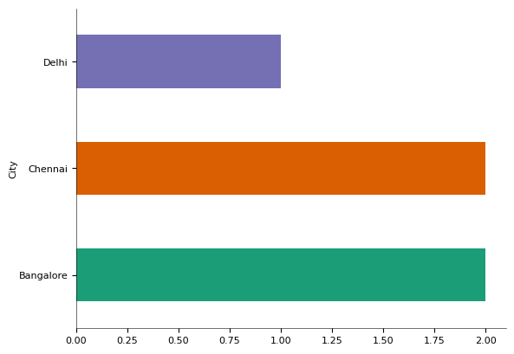
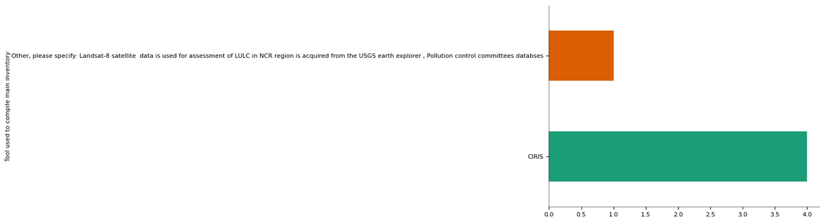
Disclosure Score Calculation
Categorial Distributions

Slide 15
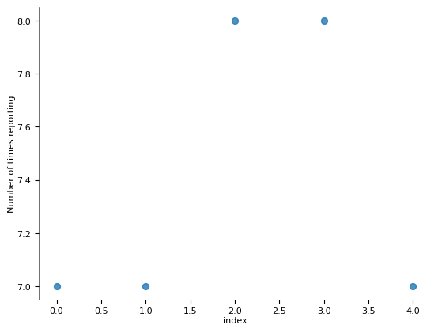
Disclosure Score Calculation
2D-Distributions

Slide 16
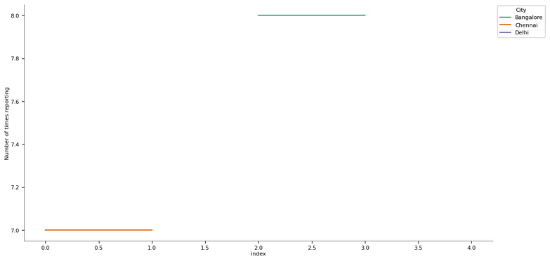
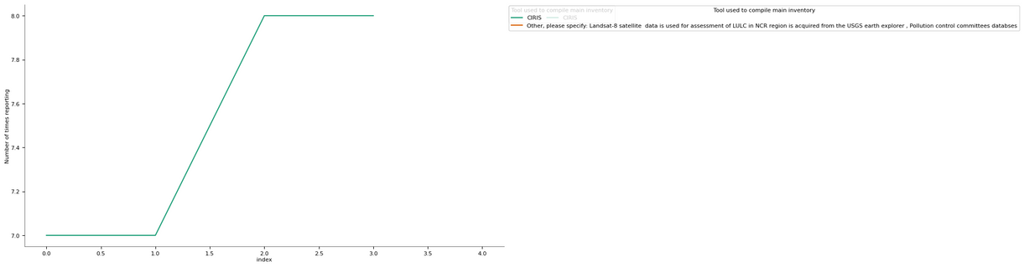
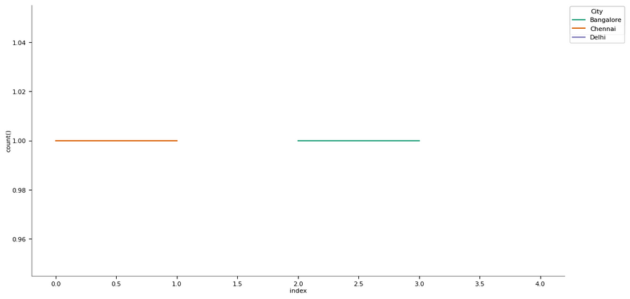
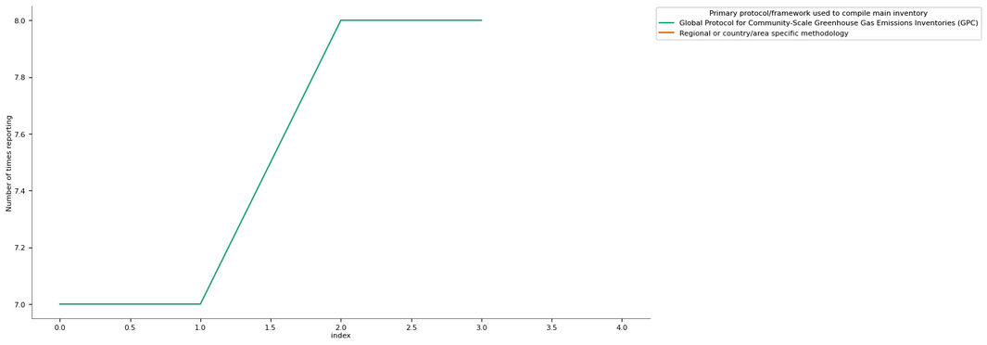
Disclosure Score Calculation
Time Series

Slide 17
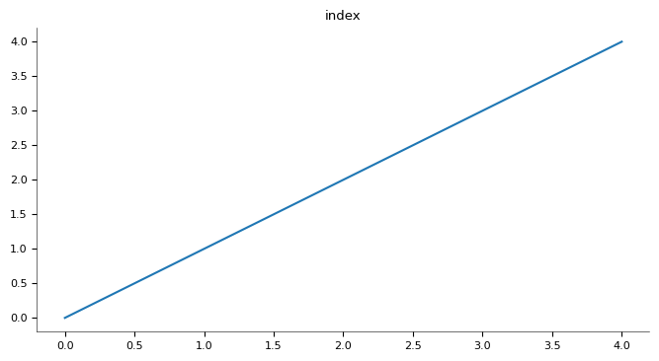
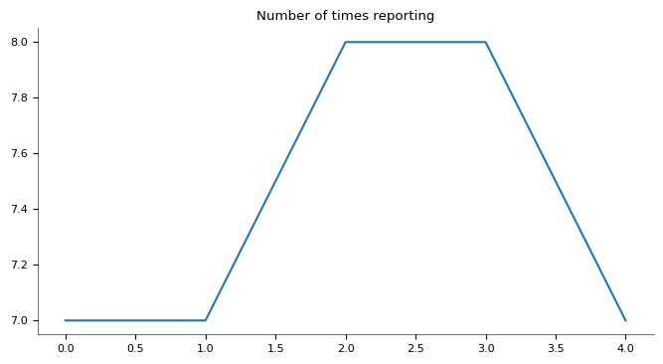
Disclosure Score Calculation
Values

Slide 18
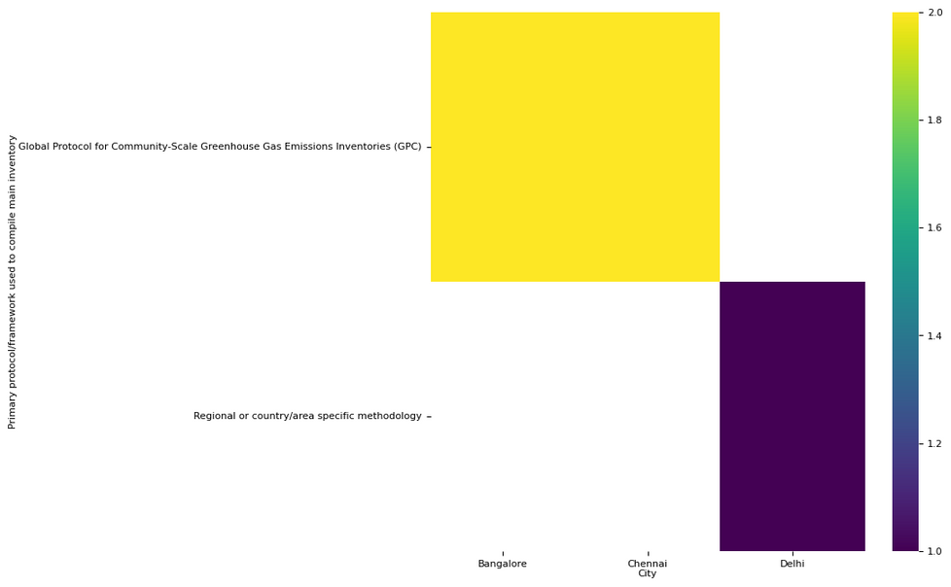
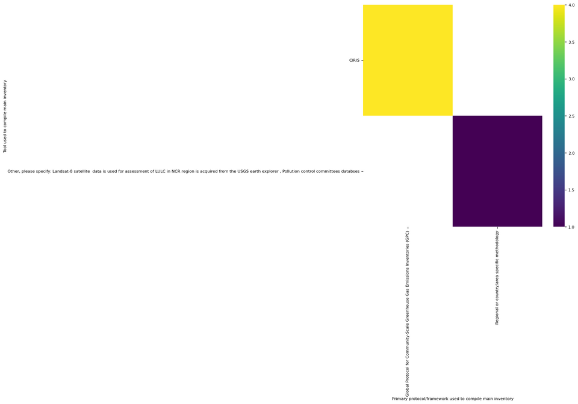
Disclosure Score Calculation
2D-Categorial Distributions

Slide 19
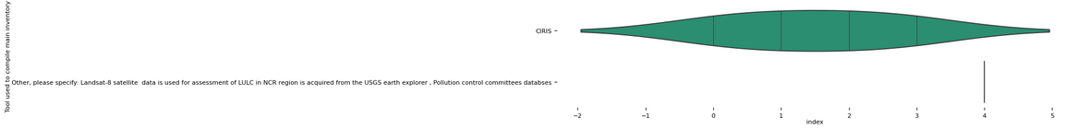
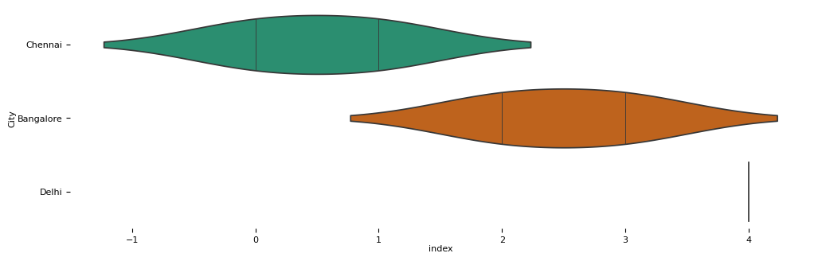
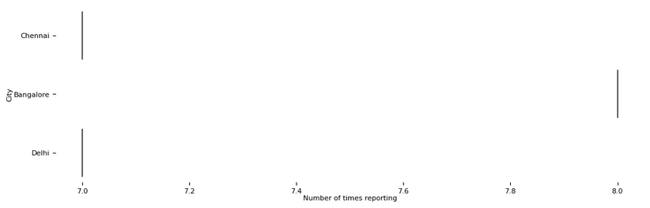
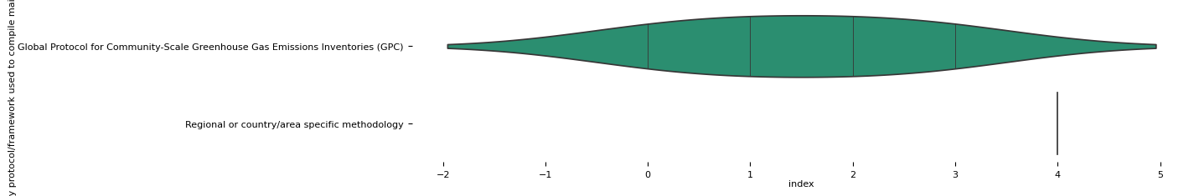
Disclosure Score Calculation
Faceted Distributions

Slide 20
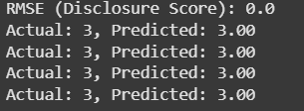
Disclosure Score Calculation

Slide 21
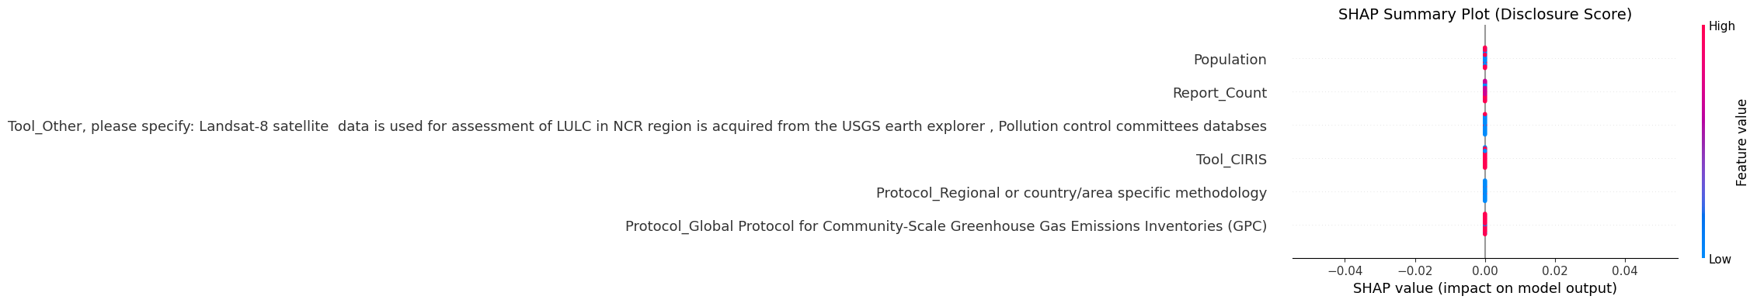
SHAP Summary

Slide 22
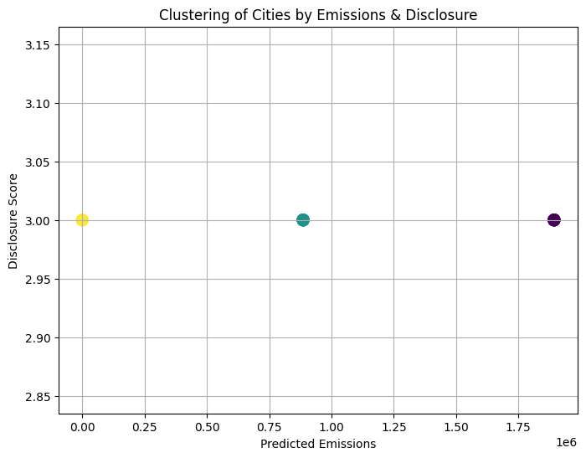
Clustering of Cities

Slide 23
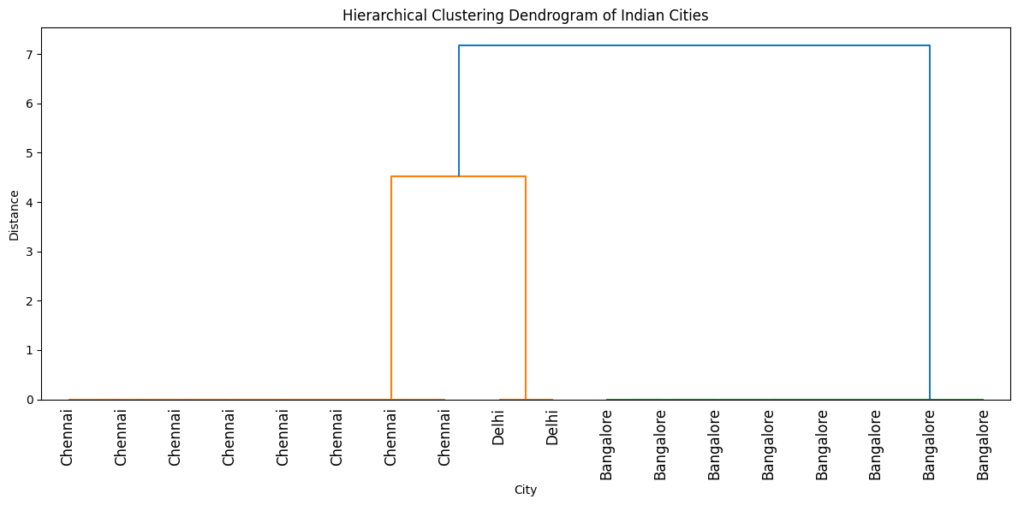
Dendrogram(Hierarchical Clustering)

Slide 24

Conclusions
1.
Model proves feasibility, interpretability, and scalability in predicting city-level emissions and disclosure behavior using real-world data.
2.
Establishes a solid foundation for full-scale research on urban climate transparency across Indian cities using advanced ML techniques.

Slide 25
Thank
You

