Slide 1
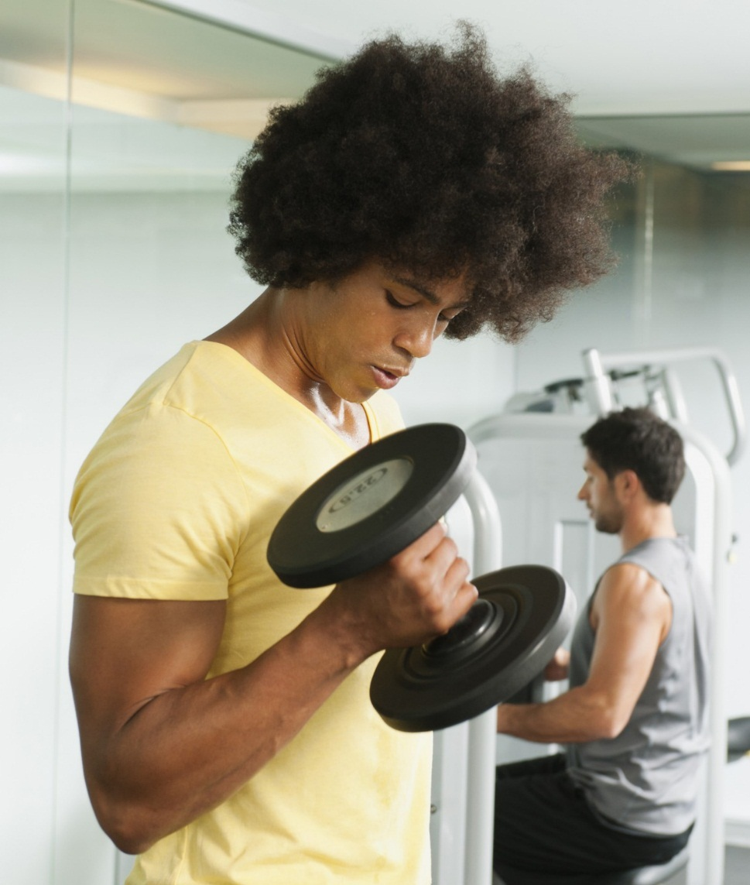
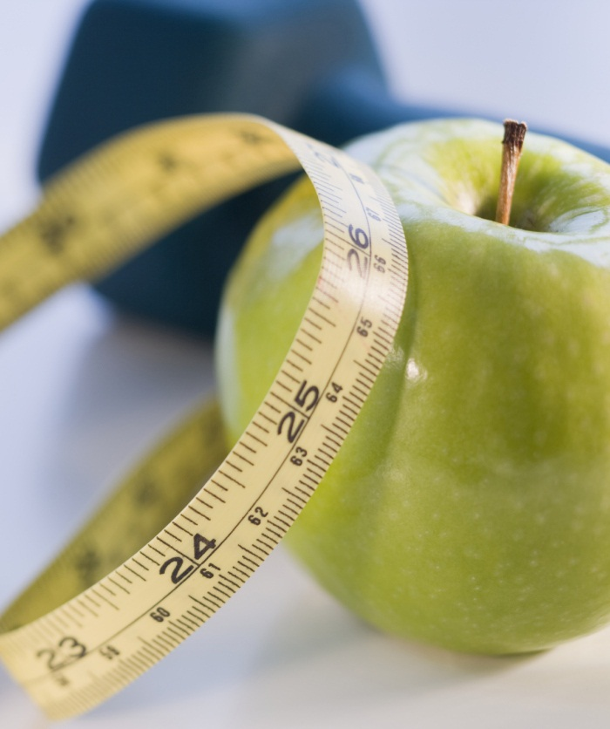
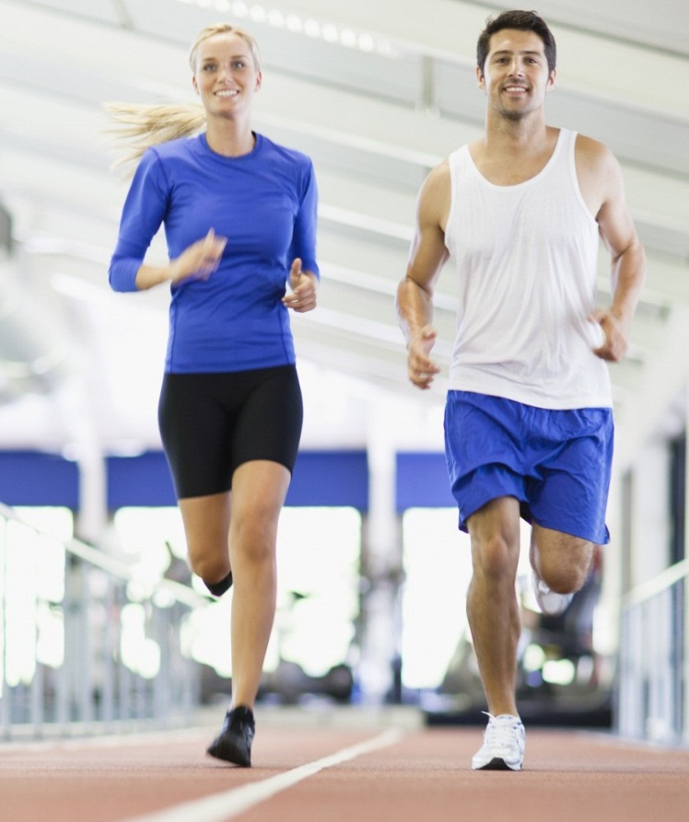
FirstHackathonEver
Presented by: Giedrius silys, airidas svobunas, Lea Lippuner, yevheniya nosyk

Slide 2
Working process
Identify current situation and problems
Thing about the whole user experience
Focus on one problem
Start „Hacking“

Slide 3
Identified Problems
2 different websites
hard to find specific information
missing definitions
not detailed information
not personalized information
no feedback

Slide 4
Whole user experience - Goals
Before dining: Users know how to use the SmartMeal
During dining: Fast serving process, real-time energy calculator and easy handling
After dining: Webpage provides specialized information about nutrition etc.
After dining
During dine
Before dining

Slide 5
Main Goals
Having only one website
All the information in one place
Information is presented in an improved way
Increase user‘s value
Provide more personalized information
Get information about customer satisfaction and preferences

Slide 6
Areas of improvement
Suggested physical activities
Connection between the website and apps, gadgets etc.

