Slide 1
Active Learning Exercise
Giora Simchoni
https://github.com/gsimchoni/ActiveLearningExercise

Slide 2
General Approach
Wikipedia →
Burr Settles Review →
Skimming more advanced articles →
Searching for existing implementations →
Getting MNIST →
Implementing myself in R →
Experiments and additions until time ran out

Slide 3
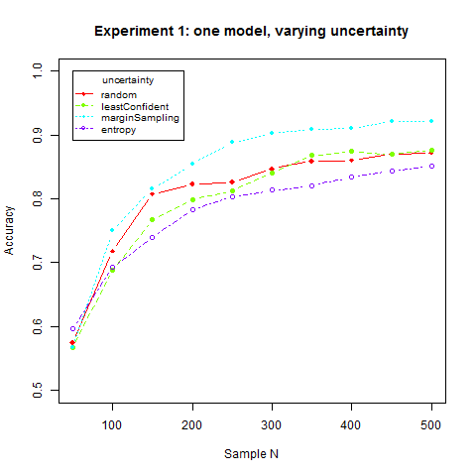
Experiment 1: one model, varying uncertainty
Model = Random Forests, initSampleSize = 50, querySize = 10

Slide 4
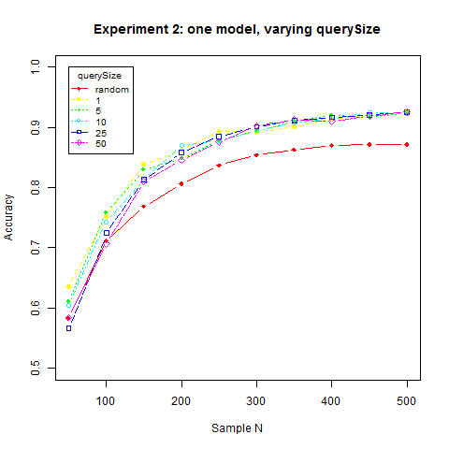
Experiment 2: one model, varying querySize
Model = Random Forests, initSampleSize = 50, uncertainty = marginSampling

Slide 5
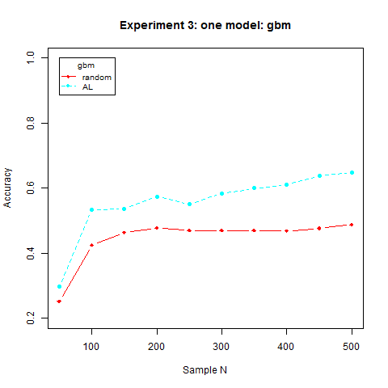
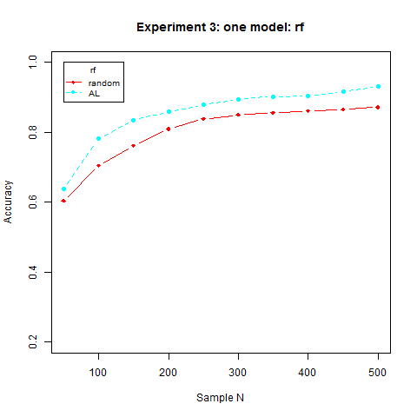
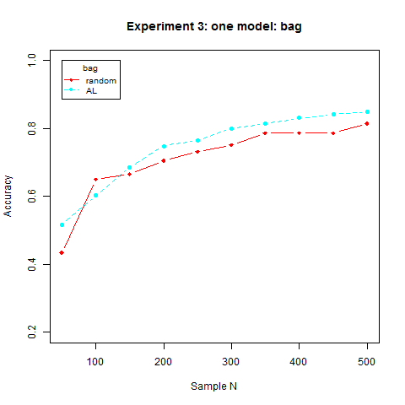
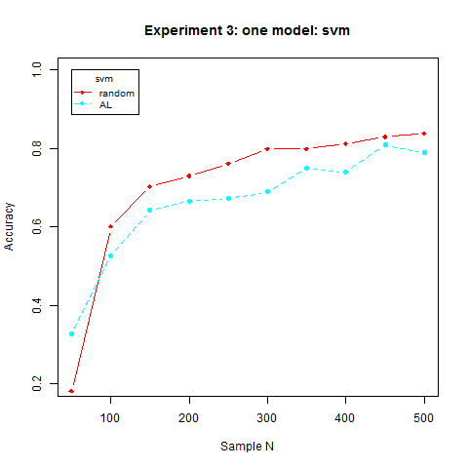
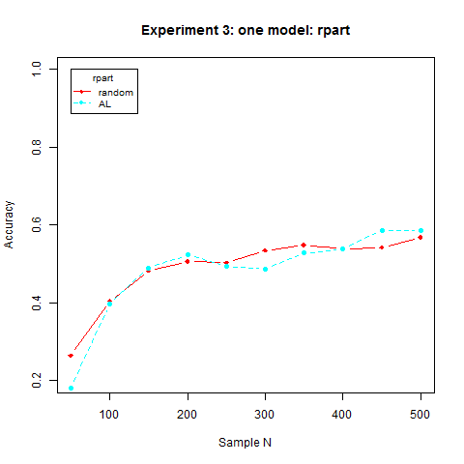
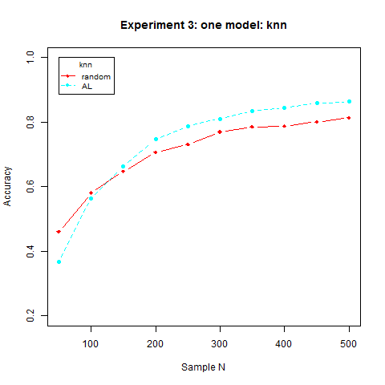
Experiment 3: one model, varying type

Slide 6
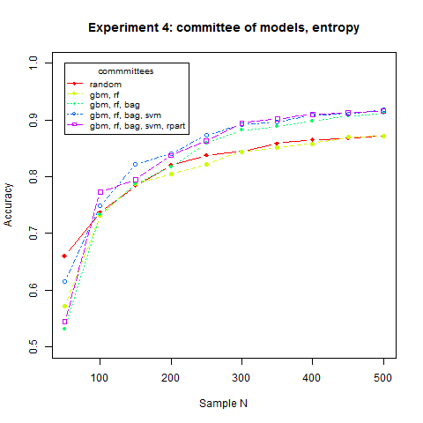
Experiment 4: committee of models, entropy
initSampleSize = 50, querySize = 10, uncertainty = voteEntropy, finalModel = Random Forests

Slide 7
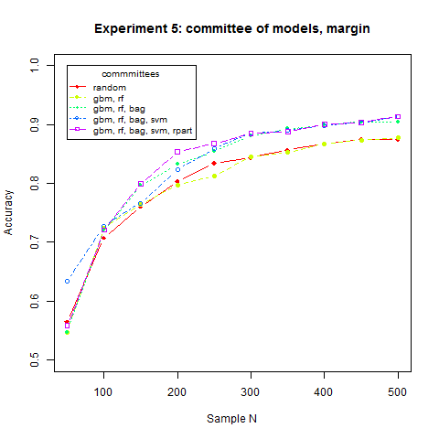
Experiment 5: committee of models, margin
initSampleSize = 50, querySize = 10, uncertainty = voteMargin, finalModel = Random Forests

Slide 8
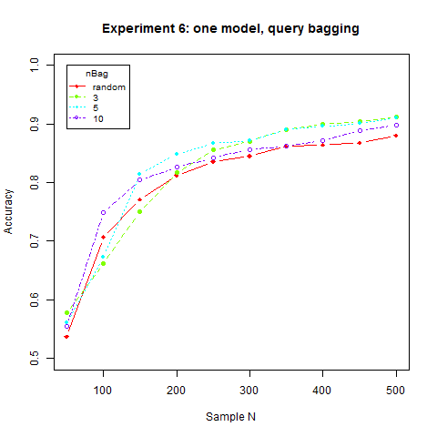
Experiment 6: one model, query bagging
Model = Random Forests, initSampleSize = 100, querySize = 10, uncertainty = voteEntropy

Slide 9
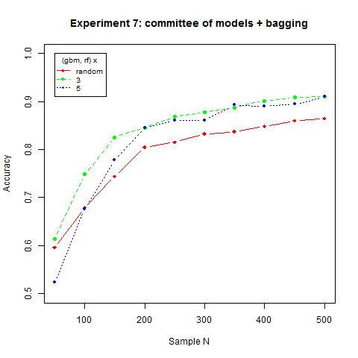
Experiment 7: committee of models + bagging
initSampleSize = 100, querySize = 10, uncertainty = voteEntropy, finalModel = Random Forests

Slide 10
Conclusions
Margin Sampling worked best for a single model
For a committee of models, voteMargin (new method) performed as good as voteEntropy
It seems like the more committee members – the higher the accuracy, however this reaches a “ceiling effect” – and it might depend on the models themselves (e.g. adding the weak rpart to the stack does nothing)
Random Forests worked best, AL didn’t improve rpart and degraded SVM. Highest relative improvement to gbm, whose baseline was weak
Committee of RF-GBM + Bagging x 3 (total 6 members) did not do as good as simple Random Forests with AL (91.1% vs. 92.1%)

Slide 11
TODOs
Make it a linux/cmd runnable RScript
Add logger
Parallelize
Fancier plotting
Add uncertainty methods: Kullback–Leibler, ...
Add models
Cache 10 digit training data the initial sample would only add to
Make it a package
Send some tedious code to functions
Add datasets
Add experiments on binary classification (2 digits from MNIST)

