Slide 1

Presales training

Slide 2

Workshop session

Slide 3
Useful resources
Questions ? http://ask.sigfox.com
Github http://github.com/sigfox/makers-tour-resources
Github http://github.com/nicolsc
Smarteverything : http://www.smarteverything.it/
Telit LE51-868s guides : http://www.telit.com/sr-rf/le51-868-s/
User guides -> Software user guide

Slide 4
Payload examples
GPS coordinates (lat x lng) : 6 bytes
Temperature: 2 bytes
State reporting : 1 byte
Heartbeat, update request : 0 byte
And … who needs full bytes when 5 bits are enough ?

Slide 5
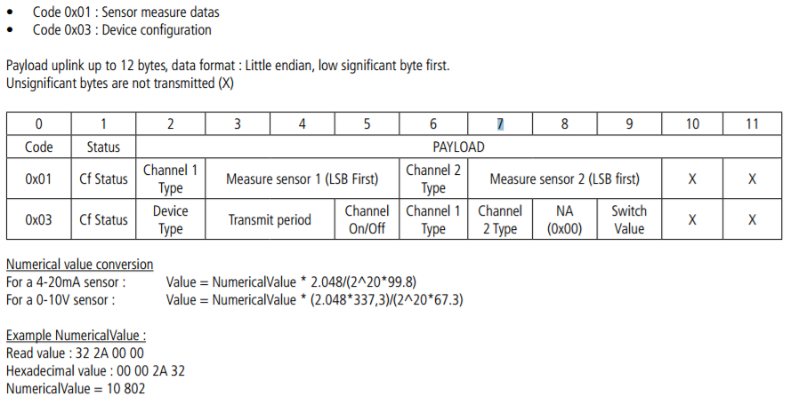
Real life example
http://www.adeunis-rf.com/media/downloads/181/trad_file/fre/arf8047xx_sigfox_sensors_user_guide_v2.0.1-fr-gb.pdf

Slide 6
Arduino 101
2 main functions : setup(), infinite loop()
Librairies to be #include first:
arduino.h
wire.h
SerialUSB.begin -> initiate serial
SerialUSB.print / prinln -> print to serial monitor

Slide 7
ACTIVATE DEVICE
For dev kits : https://backend.sigfox.com/activate
Enter type : Smarteverything
Country : France
Device ID : (sticker on the back)
PAC –> Unique activation code (ask me)
Create an account.
(For non dev kits :
Create a new device type
Create a new device with ID and PAC and put it in the device type. )

Slide 8

HELLO WORLD CAFE

Slide 9
SmartEverything test
Open the Arduino IDE
Select the Board type : Smart Everything Fox (USB)
Select the com port
Create a new (empty) file, compile and upload to the board. Works ?
Now add Serial + Sigfox initialization, put the Telit module in command mode and use SigFox.print to send AT command to Telit module (lookup software guide for AT command references). Don’t forget to SigFox.print(« \r") after.

Slide 10
Message received ?
https://backend.sigfox.com
Navigate to the devices menu in the top bar
Click on the ID of your device
Enter the messages menu from the left navigation column

Slide 11

First callback

Slide 12
Callback setup #1
Device Type menu
Click on your device type name
Enter the Callbacks menu
Select new default callback

Slide 13
Callback setup #2
TYPE : DATA UPLINK
Choose a CHANNEL : URL (EMAIL for a quick test)
Url pattern: URL of your own server
Use HTTP method: GET/POST/PUT

Slide 14
Callback status
In the Devices > Messages panel, you have a indicator of the callback status (an arrow)
Black : in progress
Green : Callback OK
Red : Callback KO (at least one of the callbacks failed)
Click the arrow to display details.

Slide 15
Run it !
Reset your board for another run, you should see the callback coming out. Check on the backend for status.

Slide 16

Downlink

Slide 17
How does it work ?
Send a message, with a downlink flag
Once message is sent, the module gets back to sleep
After 20s, it will wake up automatically, in Rx mode
It will wait 20s for a downlink message
Afterwards it will get back to sleep

Slide 18
Downlink test setup
To setup an automatic callback :
Device Type > click on the device type chosen > Edit
In the Downlink data settings, set the following :
Downlink Mode : DIRECT
Set the value

Slide 19
How to request a downlink
Same AT command, with additional parameters
AT$SF=[hex byte]*, 1
In the main loop, read the input from SigFox and display to Serial.
RSSI value : http://www.binaryhexconverter.com/decimal-to-hex-converter

Slide 20
Real data

Slide 21
Read data from Temperature sensor
Look at example file !
#include HTS221.h
Wire.begin();
smeHumidity.begin();
Then temperature = smeHumidity.readTemperature();

