Slide 1
Dense Retrieval with Entity Views
By Hei Dang Tran & Andrew Yates
Seminar: Modern Information Retrieval
Presented by Johannes Gabriel Sindlinger

Slide 2
Outline
What‘s the issue? – Motivation
What has been already there? – Related Work
What‘s new? – Methodology
What‘s the outcome? – Evaluation & Results

Slide 3




Query
Documents / Passages
Favourite food bert sesame street
Pretrained Language Model
Similarity Scores [0..1]
Ranked Results
Notes:
- Cannot distinguish
Cannot provide any information if data was not present during training

Slide 4
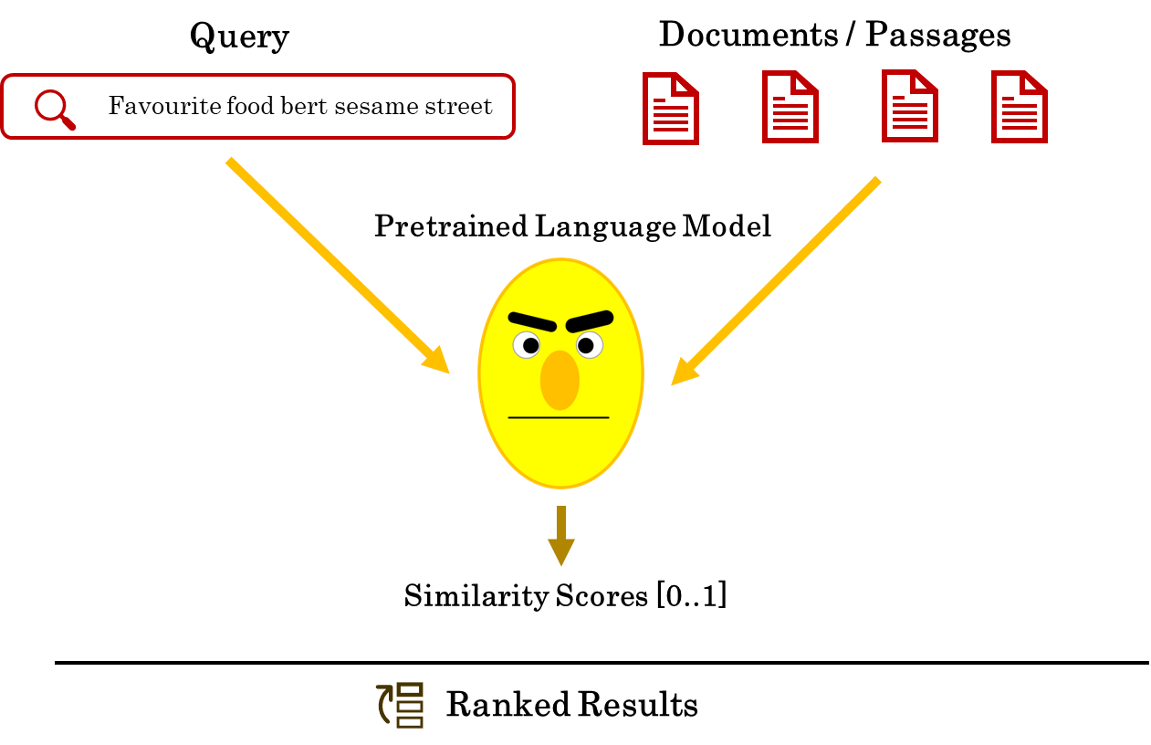

Slide 5
Query
Documents / Passages
Favourite food bert sesame street
Pretrained Language Model
i.e. Distilled TAS BERT (Sanh et al. [2020])
Query Embedding
Document Embeddings
indexing
FAISS (Johnson et al. [2019])
Approximate Nearest Search
Ranked Results

Slide 6
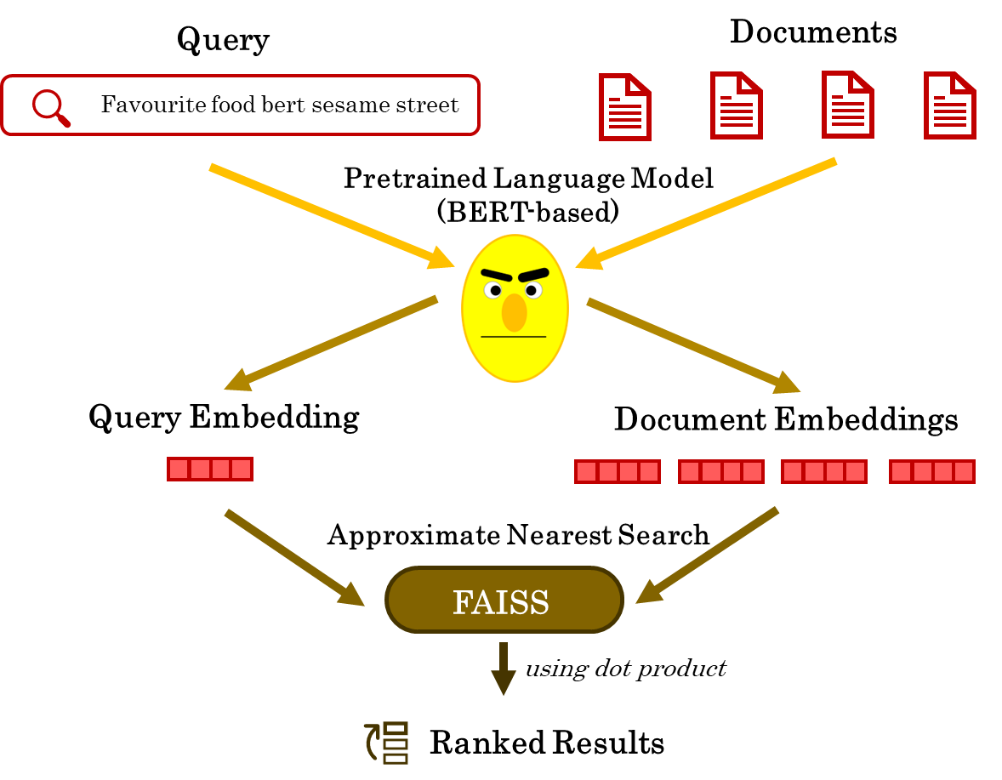
Notes:
- Cannot distinguish
Cannot provide any information if data was not present during training

Slide 7
Motivation
Paris is the Capital of [MASK].
France
Bert is a character on [MASK].
???
BERT
→ Language models do not fully capture information about real-world entities, especially for uncommon entities (see Heinzerling and Inui, 2021).
Notes:
- Cannot distinguish
Cannot provide any information if data was not present during training

Slide 8
Related Work
Paris is the Capital of [MASK].
France
Bert is a character on [MASK].
???
BERT
→ Language models do not fully capture information about real-world entities, especially for uncommon entities.

Slide 9







Query q
Document d
Dim = 768
Dim = 100
Dim = 768
Dim = 100
TAS BERT embedding of q
Embedding of entities in q
TAS BERT embedding of d
Embedding of entities in d
Note: Entity embeddings are transformed using learned matrix to ensure joint embedding space
T
T
T
T
Optional: Kernel pooling score of entities of q & p
$$⊗$$
$$+$$
$$⊗$$
$$+$$
dot product
T
T
T
T
Final ranking result
Choose document with highest overall score

Slide 10
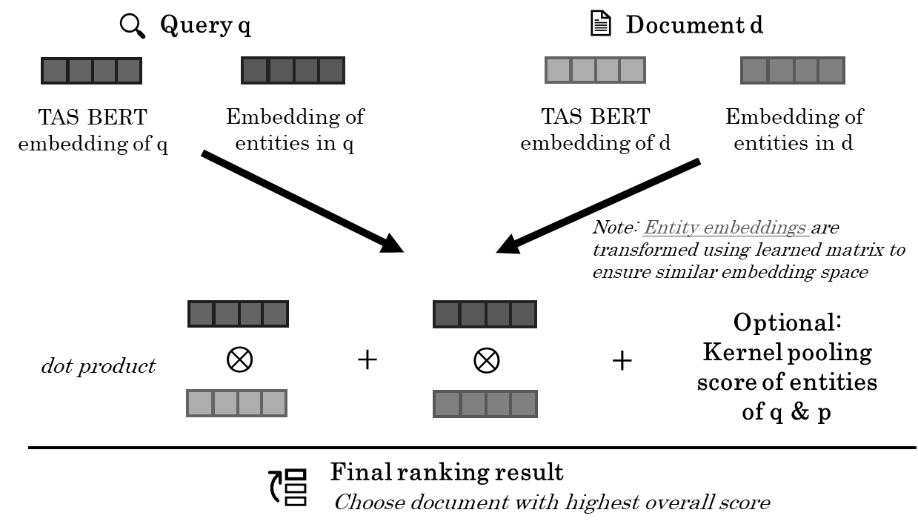
Embedding of entities in q

Slide 11
Embedding of entities in d

Slide 12
Bert / BERT
Sesame Street
Boring Stories
Query q
Favourite book bert sesame street
Document d
Bert is a beloved character from the children's television show Sesame Street. […] Bert is known for his love for dull and uneventful narratives, which yields to funny moments within the show. Therefore, he also likes to read a lot on the book Boring Stories.

Slide 13
Query q
Favourite book bert sesame street
Entity Linker
i.e. Dexter
Bert / BERT
Sesame Street
Knowledge base
i.e. Wikipedia2Vec
Dim = 100
Embedding 1
Embedding 2

Slide 14
Query q
Entity Linker
i.e. Dexter
Knowledge base
i.e. Wikipedia2Vec
Bert / BERT
Favourite book bert sesame street
Embedding 1
Dim = 100
Sesame Street
Dim = 100
Embedding 2

Slide 15
Input q
Output embedding
Favourite book bert sesame street
Ø
Ø
Ø
Ø
Generate each single entity embedding
Build average embedding

Slide 16
Input d
Output embedding
Bert is a character from Sesame Street. […]
He also likes to read […] Boring Stories.
Ø
Ø
Ø
Ø
Generate each single entity embedding
Build average embedding

Slide 17

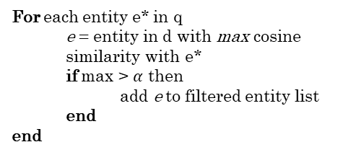
All entity embeddings of d
Filtered embeddings of d
Output embedding
Ø
For each entity e* in q
e = entity in d with max cosine similarity with e*
if max > $α$ then
add e to filtered entity list
end
end
Ø
Ø
Ø
Build average embedding

Slide 18
All entity embeddings of d
Filtered embeddings of d
Output embedding
Ø
Ø
Ø
Algorithm 1
Ø
Build average embedding

Slide 19
Input document
Cluster sets
Average embedding per cluster
Bert is a character from Sesame Street. […]
{ Bert / BERT }
Ø
Ø
Ø
Ø
{ Sesame Street }
Ø
Ø
Ø
Ø
{ Boring Stories }
Ø
Ø
Ø
Ø
Multiple document representations
He also likes to read […] Boring Stories.
{ Bert, Sesame Street }
Ø
Ø
Ø
Ø
{ Bert, Boring Stories }
Ø
Ø
Ø
Ø
{ Sesame Street, Boring Stories }
Ø
Ø
Ø
Ø

Slide 20
EVA Multi-KNRM
→ 0.743
EVA Single
→ 0.672
ERNIE Multi
→ 0.669
EVA Multi
→ 0.733
BM25
→ 0.506
TAS BERT
→ 0.693
ANCE
→ 0.621
Best Reported
→ 0.765
nDCG@10 / TREC DL 19
0.75
0.70
0.65
0.60
0.55
0.50
EVA Single-QA
→ 0.737
= Reference models
= Low-latency EVA models
EVA Single-QA-KNRM
→ 0.747
= High-latency EVA models

Slide 21
EVA Multi-KNRM
→ 0.743
EVA Single
→ 0.672
ERNIE Multi
→ 0.669
EVA Multi
→ 0.733
BM25
→ 0.506
TAS BERT
→ 0.693
ANCE
→ 0.621
Best Reported
→ 0.765
nDCG@10 / TREC DL 19
0.75
0.70
0.65
0.60
0.55
0.50
EVA Single-QA
→ 0.737
= Reference models
= Low-latency EVA models
EVA Single-QA-KNRM
→ 0.747
= High-latency EVA models

Slide 22
EVA Multi-KNRM
→ 0.743
EVA Single
→ 0.672
ERNIE
→ 0.574
ERNIE Multi
→ 0.669
BM25
→ 0.506
EVA Multi
→ 0.733
ANCE
→ 0.621
TAS BERT
→ 0.693
Best Reported
→ 0.765
nDCG@10 / TREC DL 19
0.50
0.55
0.60
0.65
0.70
0.75
= Reference models
EVA Single-QA
→ 0.737
= Low-latency EVA models
EVA Single-QA-KNRM
→ 0.747
= High-latency EVA models

Slide 23
EVA Multi-KNRM
→ 0.743
EVA Single
→ 0.672
ERNIE
→ 0.574
ERNIE Multi
→ 0.669
BM25
→ 0.506
EVA Multi
→ 0.733
ANCE
→ 0.621
TAS BERT
→ 0.693
Best Reported⁸
→ 0.765
nDCG@10 / TREC DL 19
0.50
0.55
0.60
0.65
0.70
0.75
= Reference models
EVA Single-QA
→ 0.737
= Low-latency EVA models
EVA Single-QA-KNRM
→ 0.747
= High-latency EVA models

Slide 24
EVA Multi outperforms
Baseline TAS BERT
EVA Multi-KNRM
→ 0.743
EVA Single
→ 0.672
ERNIE
→ 0.574
ERNIE Multi
→ 0.669
BM25
→ 0.506
EVA Multi
→ 0.733
ANCE
→ 0.621
TAS BERT
→ 0.693
Best Reported
→ 0.765
nDCG@10 / TREC DL 19
0.50
0.55
0.60
0.65
0.70
0.75
= Reference models
EVA Single-QA
→ 0.737
= Low-latency EVA models
EVA Single-QA-KNRM
→ 0.747
= High-latency EVA models

Slide 25
EVA Multi-KNRM
→ 0.743
EVA Single
→ 0.672
Kernel pooling provides slight improvement
ERNIE
→ 0.574
ERNIE Multi
→ 0.669
BM25
→ 0.506
EVA Multi
→ 0.733
ANCE
→ 0.621
TAS BERT
→ 0.693
Best Reported
→ 0.765
nDCG@10 / TREC DL 19
0.50
0.55
0.60
0.65
0.70
0.75
= Reference models
EVA Single-QA
→ 0.737
= Low-latency EVA models
EVA Single-QA-KNRM
→ 0.747
= High-latency EVA models

Slide 26
EVA Multi-KNRM
→ 0.743
EVA Single
→ 0.672
ERNIE
→ 0.574
ERNIE Multi
→ 0.669
BM25
→ 0.506
EVA Multi
→ 0.733
Multi entity views increase performance compared to single view
ANCE
→ 0.621
TAS BERT
→ 0.693
Best Reported
→ 0.765
nDCG@10 / TREC DL 19
0.50
0.55
0.60
0.65
0.70
0.75
= Reference models
EVA Single-QA
→ 0.737
= Low-latency EVA models
EVA Single-QA-KNRM
→ 0.747
= High-latency EVA models

Slide 27
EVA Multi-KNRM
→ 0.743
EVA Single
→ 0.672
ERNIE
→ 0.574
ERNIE Multi
→ 0.669
EVA Multi is an efficient alternative to EVA Single-QA
→ Note: EVA Single-QA has enormous latency due to BERT inference during computation time
EVA Multi
→ 0.733
BM25
→ 0.506
ANCE
→ 0.621
TAS BERT
→ 0.693
Best Reported
→ 0.765
nDCG@10 / TREC DL 19
0.50
0.55
0.60
0.65
0.70
0.75
= Reference models
EVA Single-QA
→ 0.737
= Low-latency EVA models
EVA Single-QA-KNRM
→ 0.747
= High-latency EVA models

Slide 28
EVA Multi-KNRM
→ 0.743
EVA Single
→ 0.672
EVA Multi outperforms Baseline TAS BERT
ERNIE Multi
→ 0.669
EVA Multi
→ 0.733
BM25
→ 0.506
TAS BERT
→ 0.693
ANCE
→ 0.621
Best Reported
→ 0.765
nDCG@10 / TREC DL 19
0.75
0.70
0.65
0.60
0.55
0.50
EVA Single-QA
→ 0.737
EVA Single-QA-KNRM
→ 0.747

Slide 29
EVA Multi-KNRM
→ 0.743
EVA Single
→ 0.672
Kernel pooling gives mostly slight improvement
ERNIE Multi
→ 0.669
EVA Multi
→ 0.733
BM25
→ 0.506
TAS BERT
→ 0.693
ANCE
→ 0.621
Best Reported
→ 0.765
nDCG@10 / TREC DL 19
0.75
0.70
0.65
0.60
0.55
0.50
EVA Single-QA
→ 0.737
EVA Single-QA-KNRM
→ 0.747

Slide 30
EVA Multi-KNRM
→ 0.743
Multi entity views increase performance compared to single view
EVA Single
→ 0.672
ERNIE Multi
→ 0.669
EVA Multi
→ 0.733
BM25
→ 0.506
TAS BERT
→ 0.693
ANCE
→ 0.621
Best Reported
→ 0.765
nDCG@10 / TREC DL 19
0.75
0.70
0.65
0.60
0.55
0.50
EVA Single-QA
→ 0.737
EVA Single-QA-KNRM
→ 0.747

Slide 31
EVA Multi-KNRM
→ 0.743
EVA Single
→ 0.672
ERNIE Multi
→ 0.669
EVA Multi is an efficient alternative to EVA Single-QA
→ Note: EVA Single-QA has enormous latency due to BERT inference during computation time
EVA Multi
→ 0.733
BM25
→ 0.506
TAS BERT
→ 0.693
ANCE
→ 0.621
Best Reported
→ 0.765
nDCG@10 / TREC DL 19
0.75
0.70
0.65
0.60
0.55
0.50
EVA Single-QA
→ 0.737
EVA Single-QA-KNRM
→ 0.747

Slide 32
