Slide 1

Firmware Update
Summary
ICub 2.7 architecture
The tool - FirmwareUpdater
The repo – icub-firmware-build
Practical example
Which Firmware to flash?

Slide 2
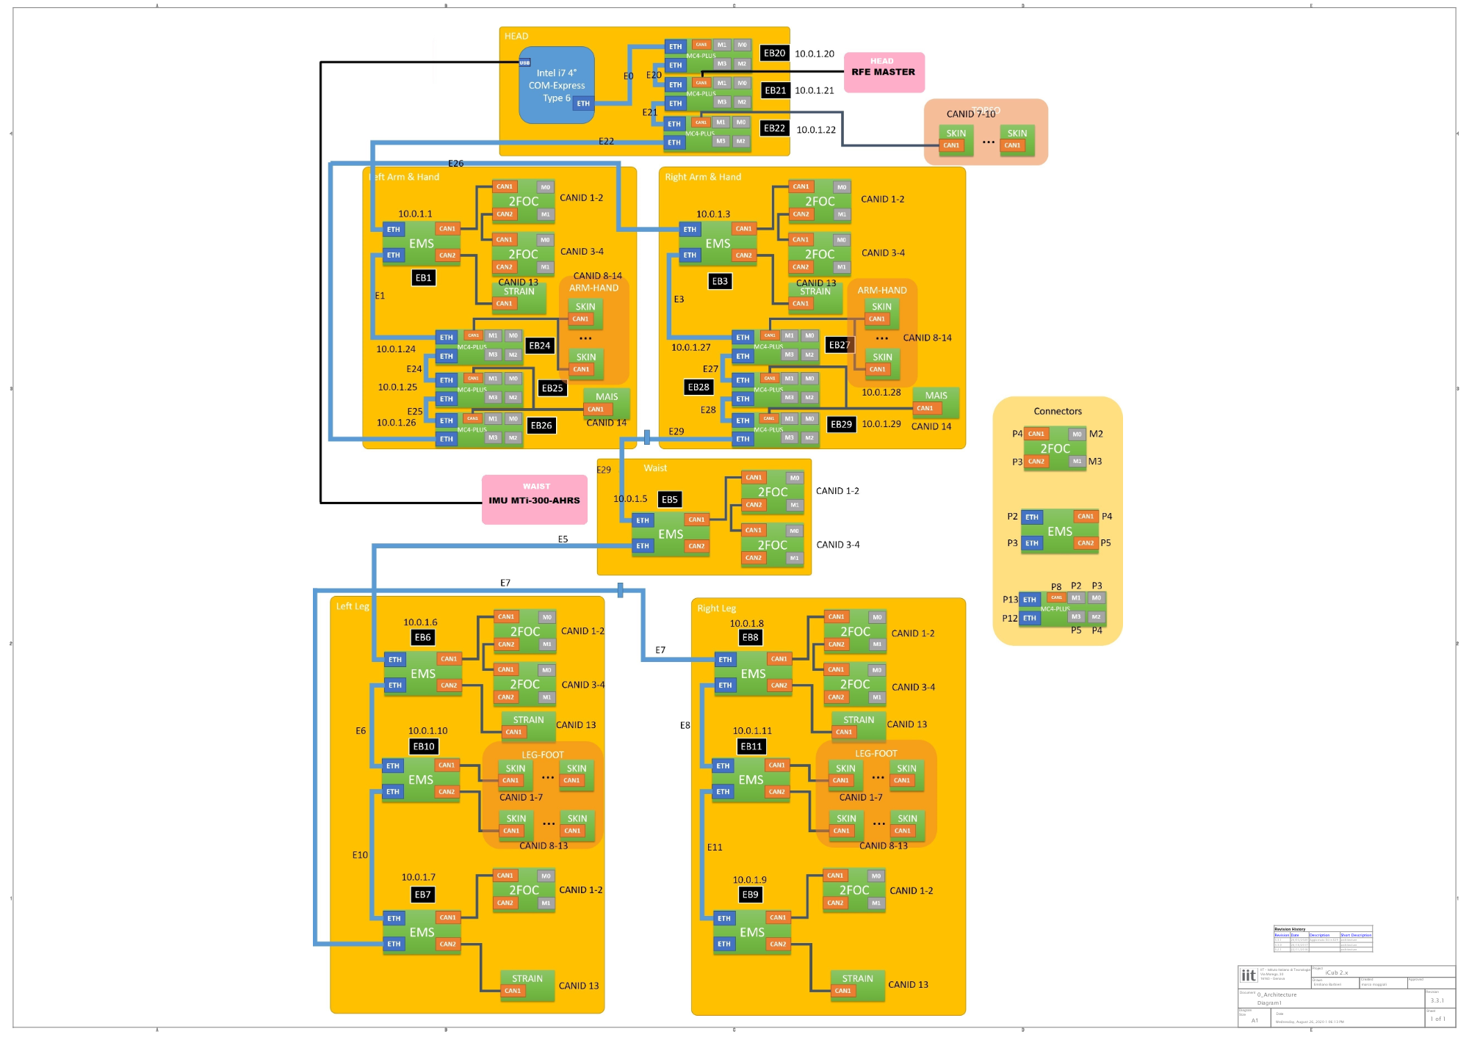
ICub 2.7 architecture
ICub electronics boards
Your iCub is equipped mainly with this kind of boards:
- mc4plus : it controls small DC motors (up to 4) and has 2 SPI ports to read AEA encoders; it also can manage mtb4 boards for skin management
- ems4 : It manage 2foc CAN boards for brushless motors and reads AEA encoders
- 2foc : it drives up to 2 brushless motors and read their optical encoders
- mtb4 : it's dedicaded to the skin sensors readings
- strain2 : is the board inside the FT sensors
- rfe : it's placed on the top of the head, it has an IMU on it and manages also the face expressions
For detailed info, refer to the official documentation

Slide 3
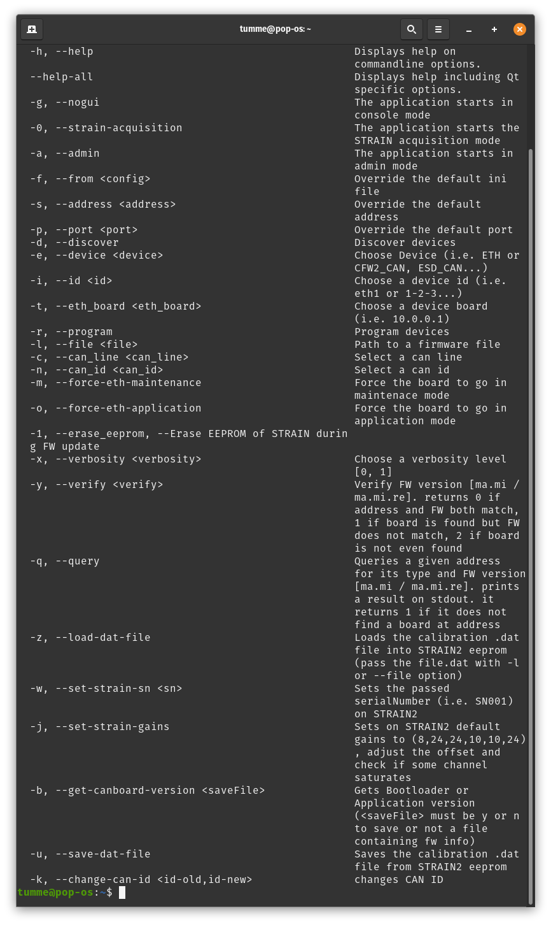
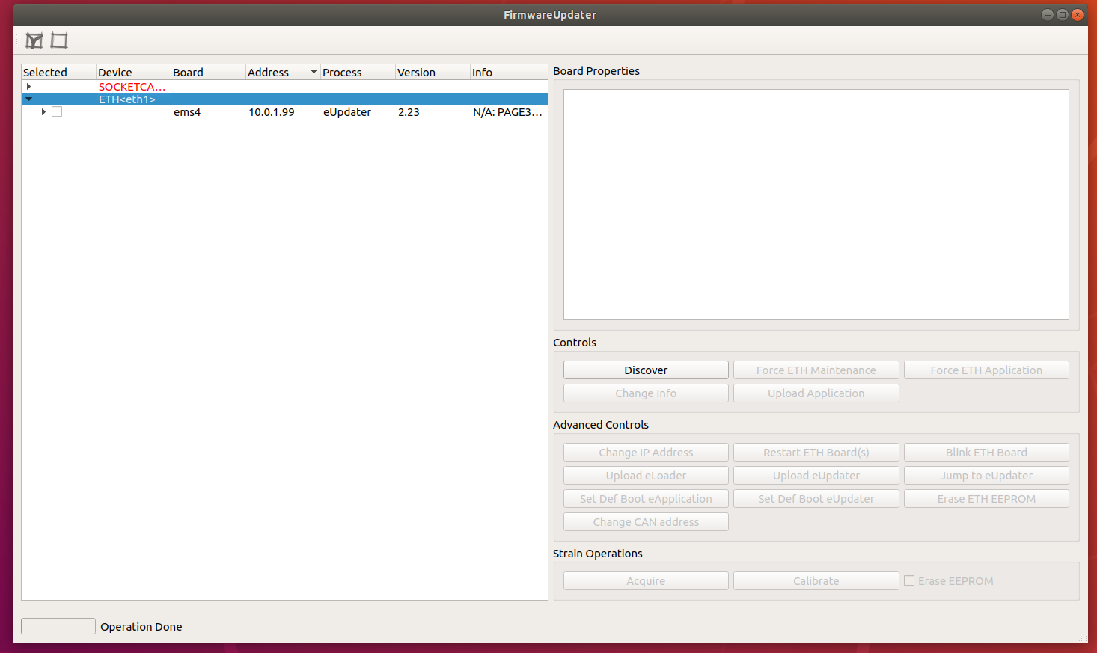
The tool - FirmwareUpdater
The tool used to update the Firmware on the electronics boards is FirmwareUpdater
FirmwareUpdater is a GUI based tool that lets you to update firmware on the boards.
It has also a bunch of CLI options that let you do same operations of the GUI via terminal, the documentation will be updated soon
i.e. :
- https://github.com/robotology/icub-main/pull/776
- https://github.com/robotology/icub-main/pull/679
- https://github.com/robotology/icub-main/pull/682
- https://github.com/robotology/icub-main/pull/683

Slide 4
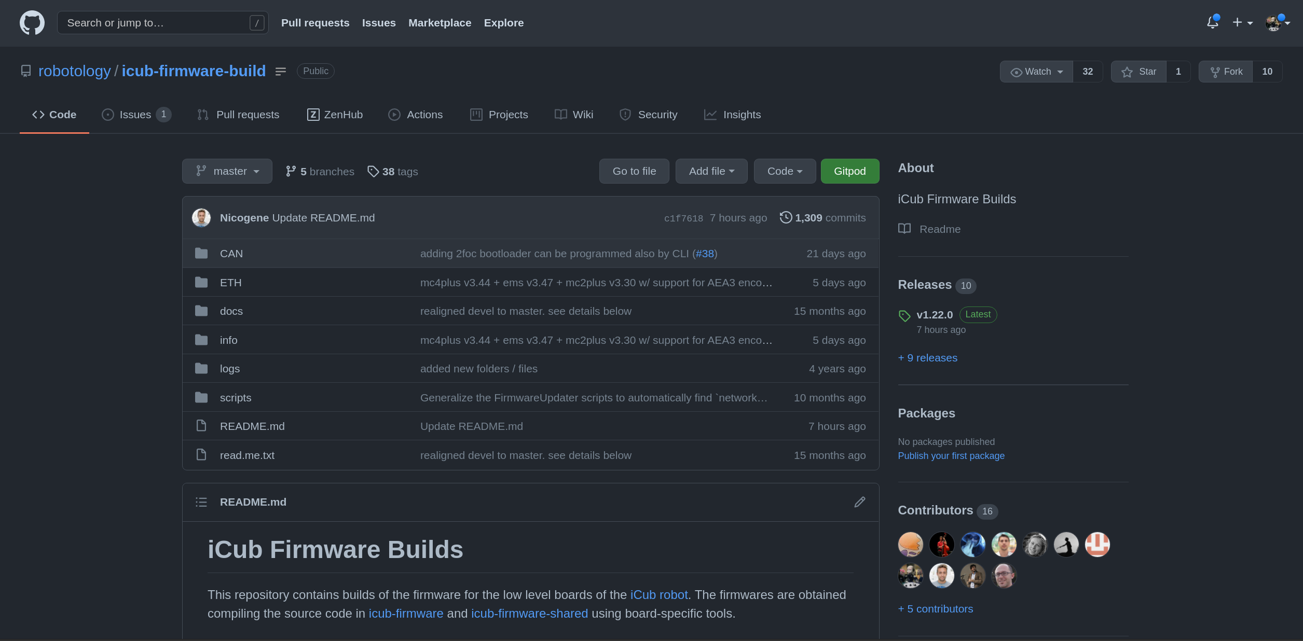
The repo – icub-firmware-build
The repository that contains all binaries of the firmware is icub-firmware-build
The sources of the firmware are hosted on icub-firmware repo.
In order to update the firmware on your boards, you'll need to clone the repo on the icub-head (usually under $ROBOT_CODE)

Slide 5
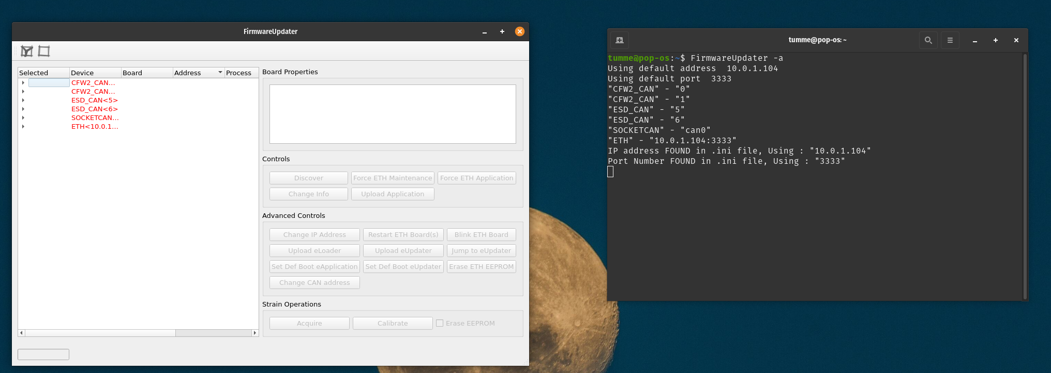
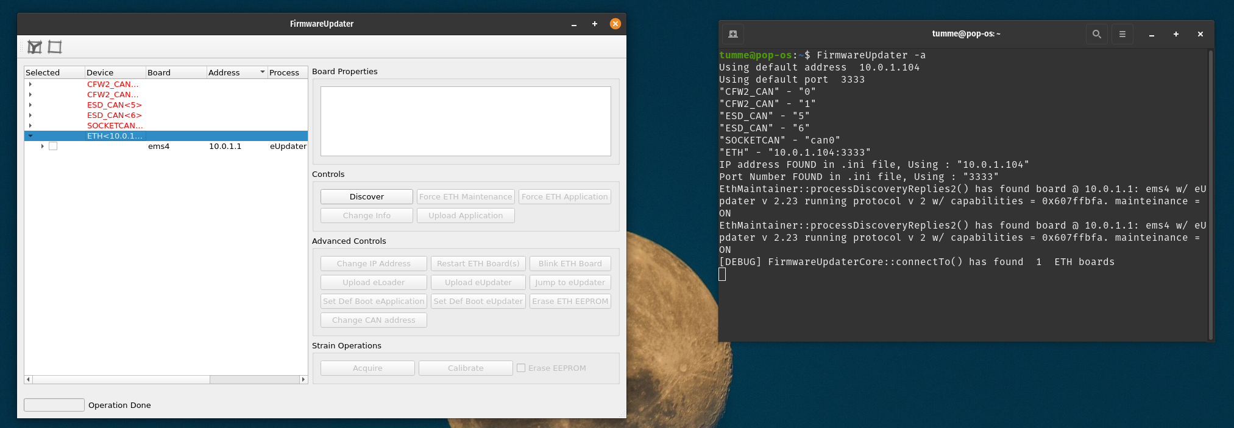
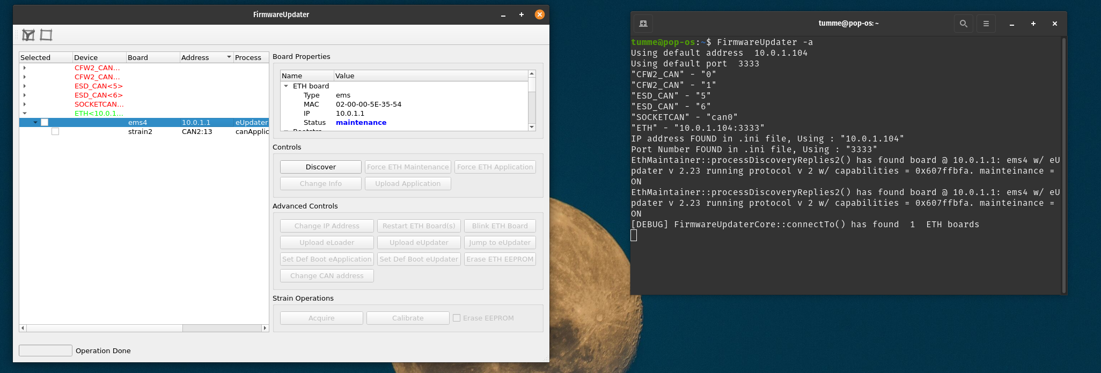
Practical example
In the images beside you can see a discovery of an ETH board (ems4) and then the discover to the CAN boards attached to it.
- Select ETH device and click on Discover
- Select the ETH board and click on Force ETH Maintenance
- Select the board and click on Discover

Slide 6
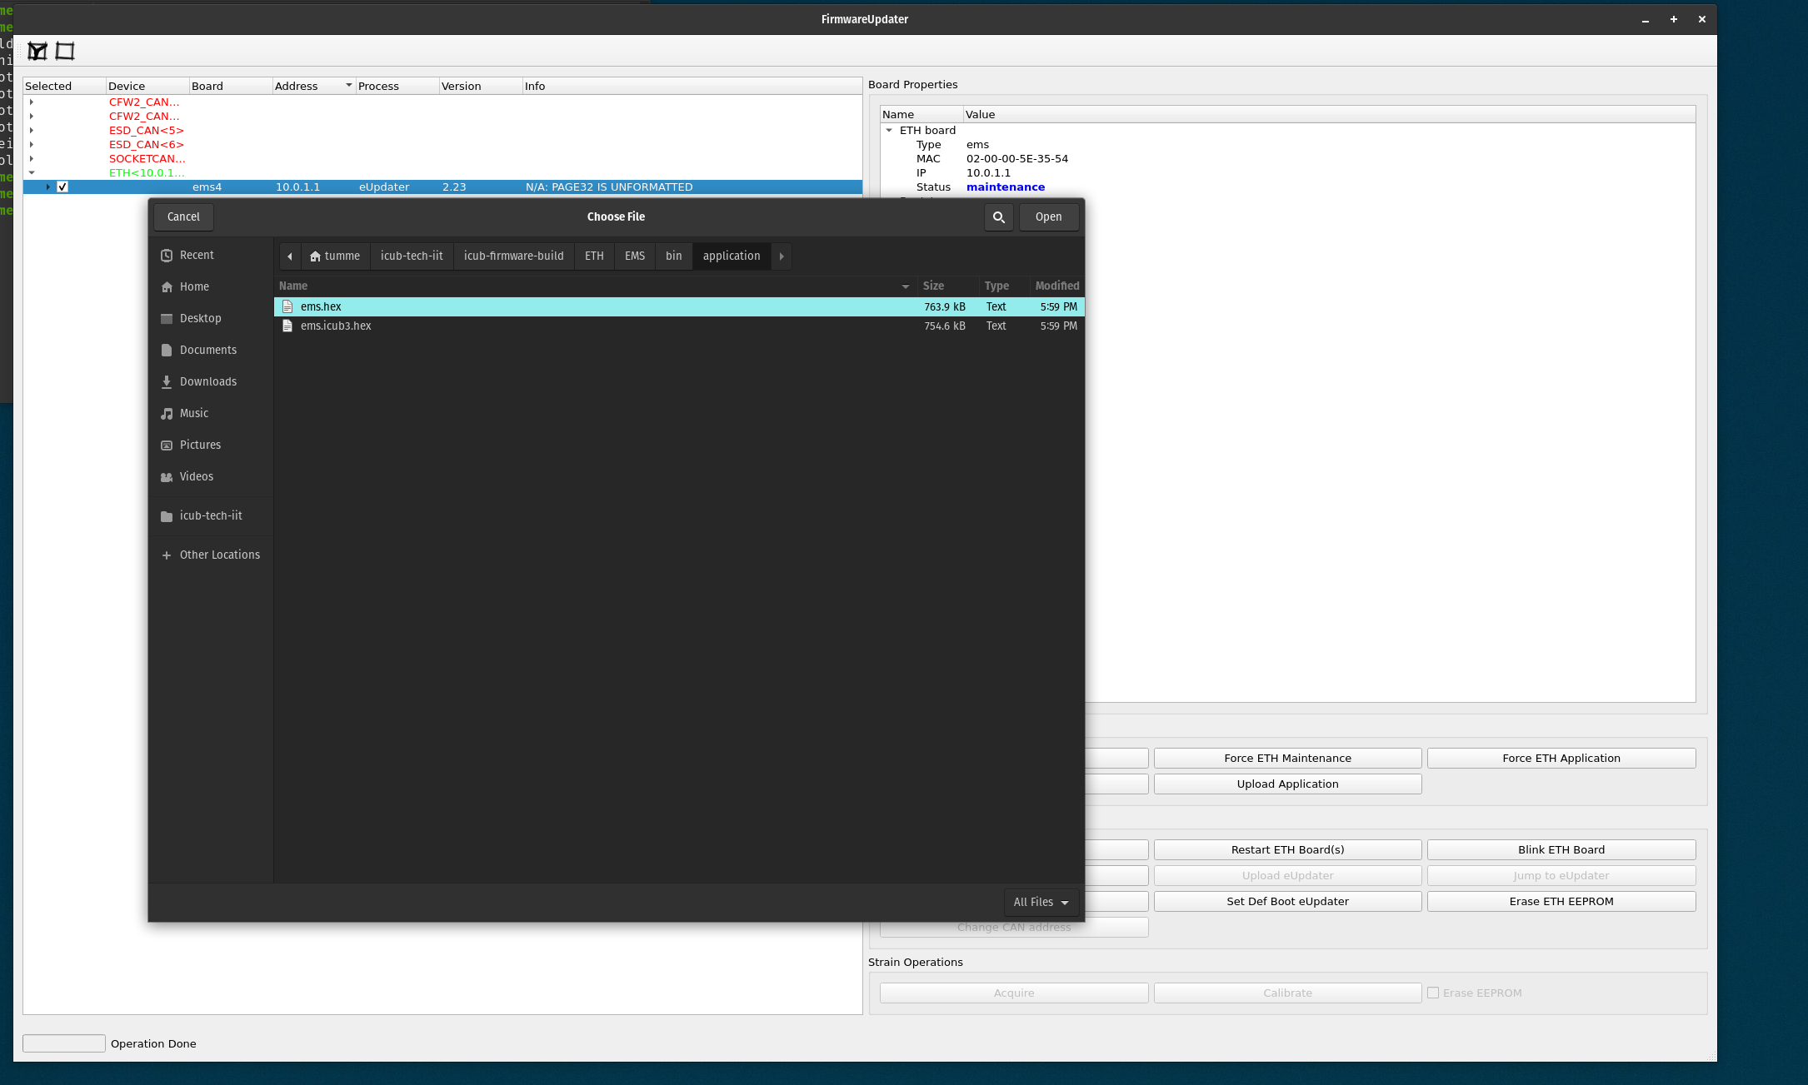
Upload the Firmware
Follow the procedure described in the previuos slide, then select the board and click on Upload application

Slide 7
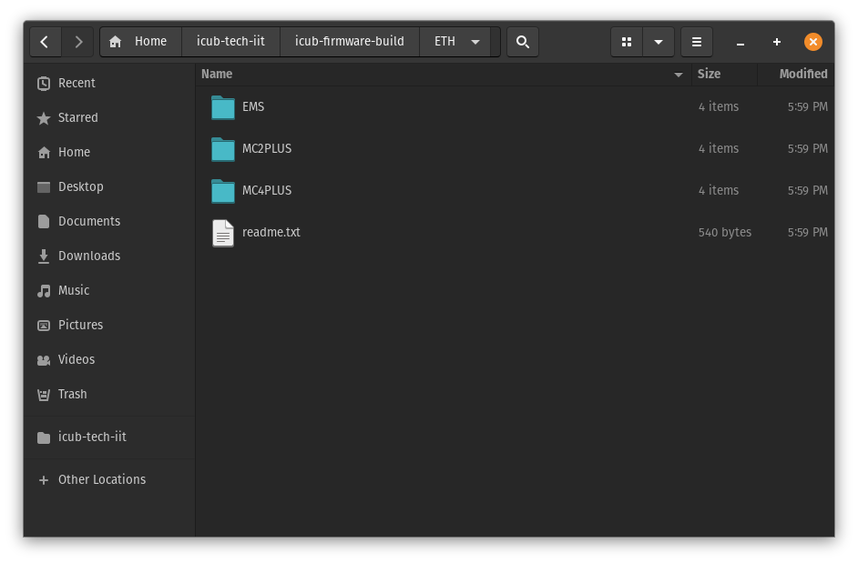
Which Firmware to flash?
On ETH robots, the firmware to be flashed is the same for all kind of boards, then they will be configured via .xml configuration files
Resources:
- FirmwareUpdater
- Firmware binaries repository
- Firmware sources repository

