Slide 1

IcUB Skin – GUI and High level software
Nicolò Genesio

Slide 2
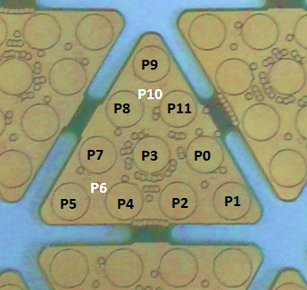
Introduction
The iCub skin is divided in patches, that identifies the robot’s parts like forearm, upperarm, hand etc.
The data of the skin is streamed at 50Hz, each patch:
Has its own microcontroller
Can read at most 192 values(16 triangles)
Is organized in triangular modules, each triangle contains 12 taxels.

Slide 3
skin output
The taxel output can be read raw or compensated. The output raw is expressed by a byte, 240 (i.e. 0xF0) is the value when there is no pressure. When a pressure is applied, the value is decreased until 0.
The skin raw output is streamed by the ports /icub/skin/<part_name> and it is published by the firmware of mtb boards.
The compensated one is expressed by a double(between 0.0 and 255.0) and when a pressure is applied the output increases. This kind of compensation si performed by the skinManager that streams this data throught the ports /icub/skin/<part_name>_comp

Slide 4
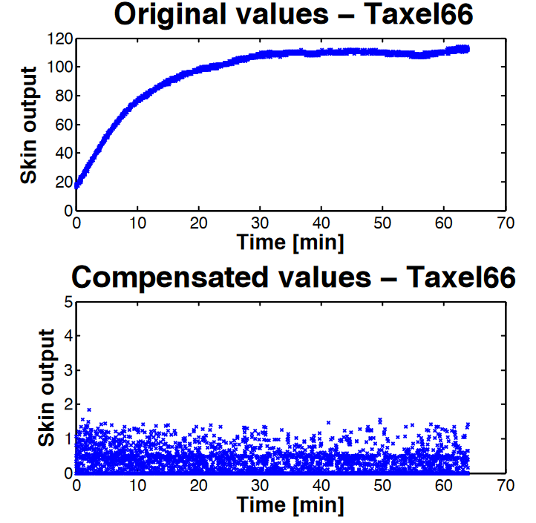
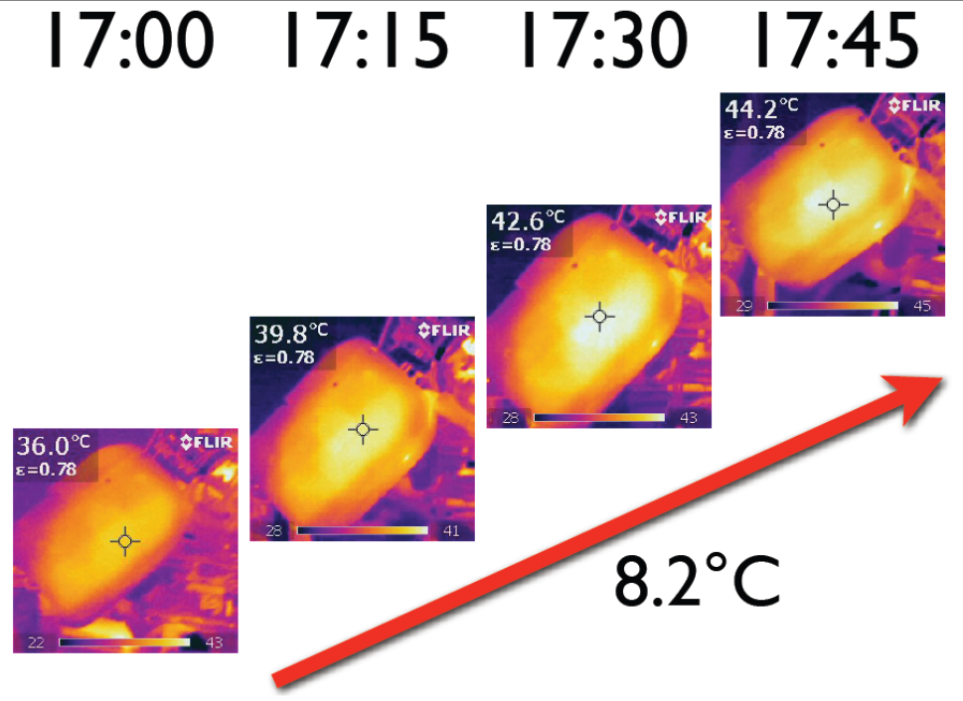
Thermal drift
The taxels measures are affected by thermal drift, and it is compensated both by skinManager and by the calibration done on the mtb board

Slide 5
SKINmanager
The skinManager is an executable included in the icub-main repository.
Can handles multiple skin patches, it is used for handle and refine the data coming from the firmware.
It allows to:
Set a low pass filter to the data
Compute touch threshold for the taxels used by the binarization
Define skinContacts

Slide 6
SkinManager - Touch threshold
Each skin taxel is subject to a different noise hence the touch threshold should be different for each taxel. The skinManager module computes the touch thresholds (the 95% percentile) during its calibralibration phase. The touch thresholds may be retrieved sending a message ‘get percentile’ to the rpc port of the skinManager module

Slide 7
SkinManagerGui
Also this module is included in the icub-main repository, it is an handy interface for interacting with the skinManager module.
In this sense it allows to request to the skinManager to filter/compensate data and it shows errors and warning coming from the skin.

Slide 8
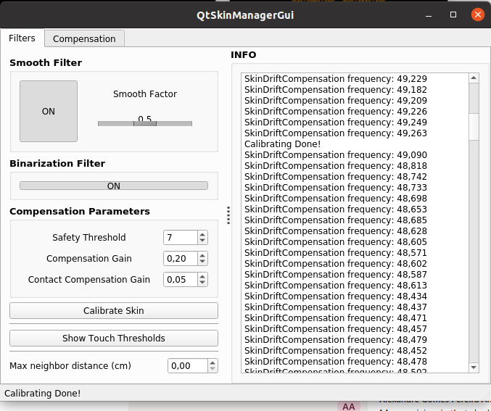
SkinManagerGui
Low pass filter, the smooth
factor goes from 0.0 to 1.0.
Greater it is, more noise is removed
but also more artifacts are added
Log messages coming from skinManager
If set to ON, the output of the *comp ports is binarized, 0.0 if there is no touch, 100.0 if there is touch.

Slide 9
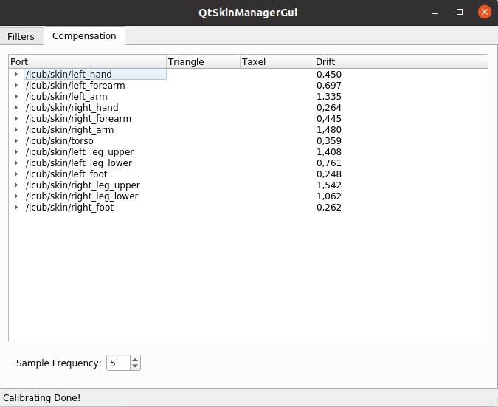
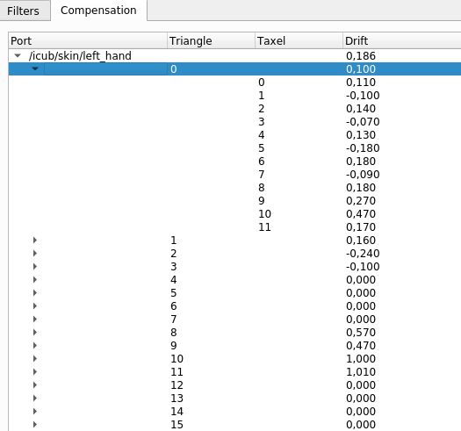
SkinManagerGui
On the Compensation tab is display the thermal drift for each skin patch.
It is possible to open the tree and check it for each triangle and each taxel.

Slide 10
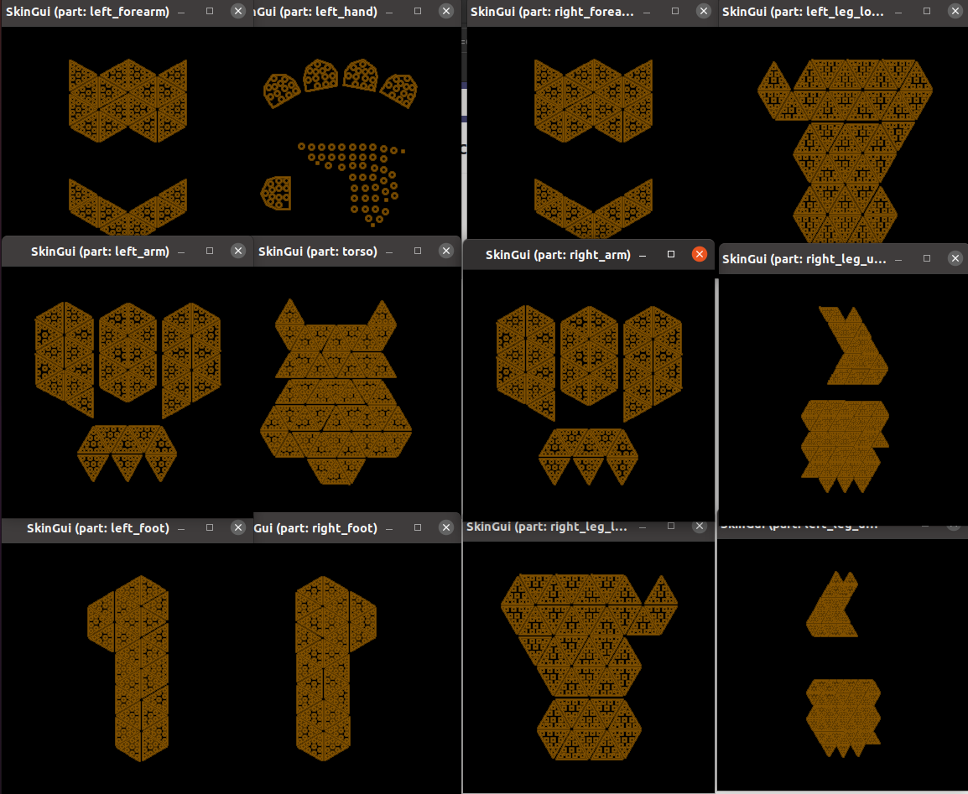
icubskingui
iCubSkinGui is a GUI to display the output of fingertips/skin tactile sensors.
It is defined by the configuration files located in
icub-main/apps/skinGui/conf/skinGui.

Slide 11
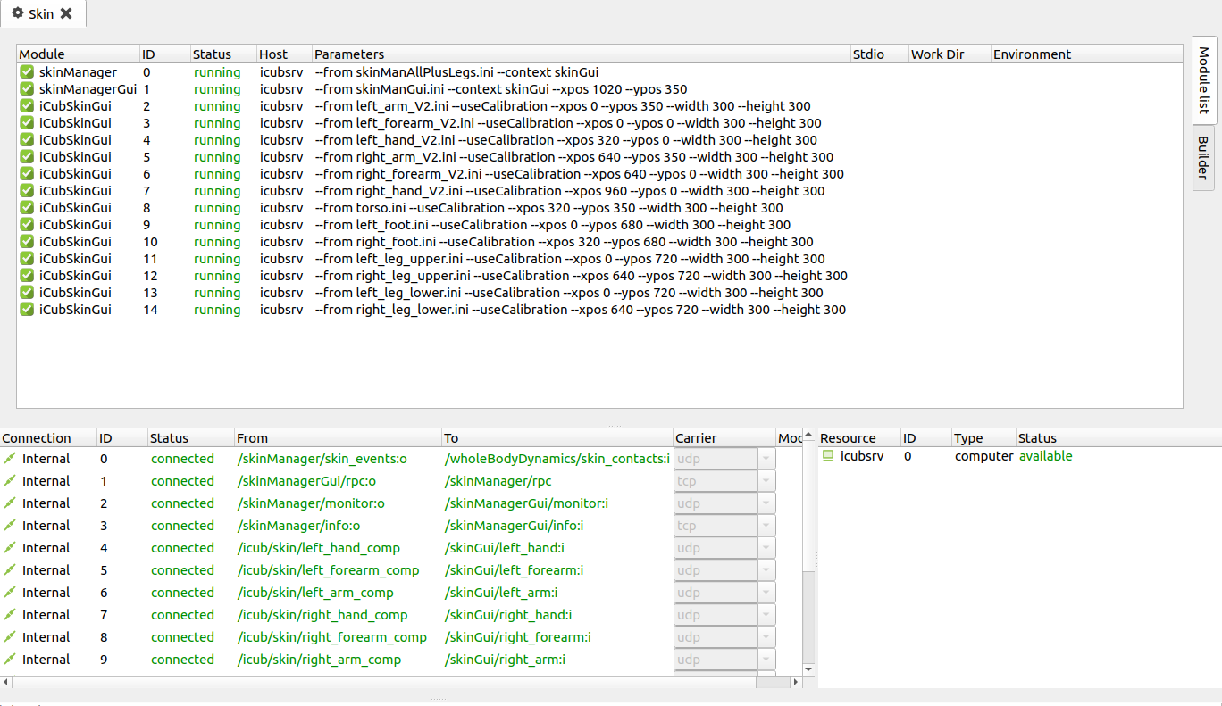
Run skin on the robot
In order to have the skin working on the robot, the relative devices has to be launched through yarprobotinterface. Once done that, running the “Skin” application in yarpmanager, it launch SkinManager, SkinManagerGui and all the iCubSkinGuis.

