Slide 1

IcUB Skin – From Hardware to High level software
Simeone Dussoni & Nicolò Genesio

Slide 2
Introduction
The iCub skin has a modular approach, we can distinguish:
Patches, that identifies the robot’s parts like forearm, upperarm, hand etc.
Triangles: each triangle has its unique ID allowing to reconstruct the data packets and thus the touches
Taxels: a taxel (TActile piXEL) is the basic unit of touch detection. It exploits capacitive measurement of applied force.
The capacitive sensing is implemented thanks to a deformable textile skin on top of the electronics
Different parts have different textile structure
Each block of uniquely identified triangles is connected to a microcontroller board (MTB) performing basic signal conditioning

Slide 3
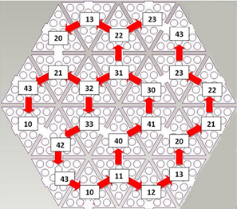
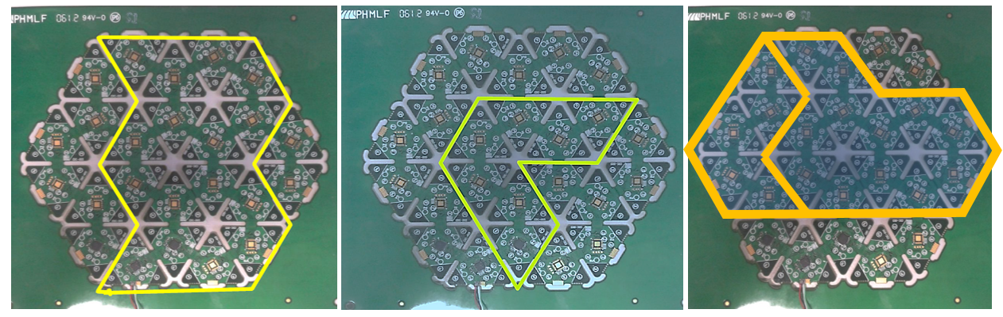
PATCHES
Patches are cut out of a dedicated PCB
The PCB ("hexagone") contains 24 triangles, engineered in a way to allow different shapes to be cut and used on different robot covers
On this board we have some not-unique IDs
When the shape is cut, only unique IDs remain on connected data lines
The information of the geometry is used in the SkinGUI to show the touch zones

Slide 4
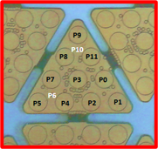
TRIANGLES and taxels
Each triangle contains 12 pads or taxels
10 pads: form the lattice of taxels and are exposed to feel the capacitance variations
2 pads: are buried within the PCB and are used to compensate for thermal drift (see later): these are P6 and P10 in the picture
All 12 taxels are read out by a capacitance to digital converter with 16 bits resolution. Conversion time is ~10 ms, hardware limited.
Data are then trasnferred to the MTB board that prepare the packets

Slide 5
The MTB and data stream
The MTB performs a few operations:
Adjust the CDC operating range by means of the CDC Offset parameter (take care of different textile skin layers)
Compute the no-touch capacitance and subtracts from the measurement
Performs, if activated, temperature compensation based on the readings of one of the two buried taxels
trim each 16-bit measurement to 8-bit words for all taxels
Key parameter: BitShift
Prepare the CAN packets to be sent: for each triangle we have two 8-byte CAN messages
Header1 + 7 taxels data
Header2 + 5 taxels data + 2 bytes diagnostic
Sends the can packets with the user-defined time intervals (default: 20 ms or 50 Hz)
The CAN data are received and decoded in the YARP flow that performs higher-level conditioning

Slide 6
...On the yarp side...
The YARP framework encompasses ports to send and receive data, with the possibility of doing intermediate processing
The data are simply streamed as a set of messages in incremental order
ID: contains the info about the CAN device, message and triangle id, in HEX format
d1 is the header
d2 -- d8 is the data string
YARP strips the taxel datas and streams them in a row through a data port
The last two bytes are streamed in a diagnostic port and contain info about touches, saturation etc.
Additional processing can be performed in yarp when passing contents from an input port to an output one (i.e. visualization)
The CAN messages

Slide 7
skin output
The taxel output can be read raw or compensated. The output raw is expressed by a byte, 240 (i.e. 0xF0) is the value when there is no pressure. When a pressure is applied, the value is decreased until 0.
The skin raw output is streamed by the ports /icub/skin/<part_name> and it is published by the firmware of mtb boards.
The compensated one is expressed by a double(between 0.0 and 255.0) and when a pressure is applied the output increases. This kind of compensation si performed by the skinManager that streams this data throught the ports /icub/skin/<part_name>_comp

Slide 8
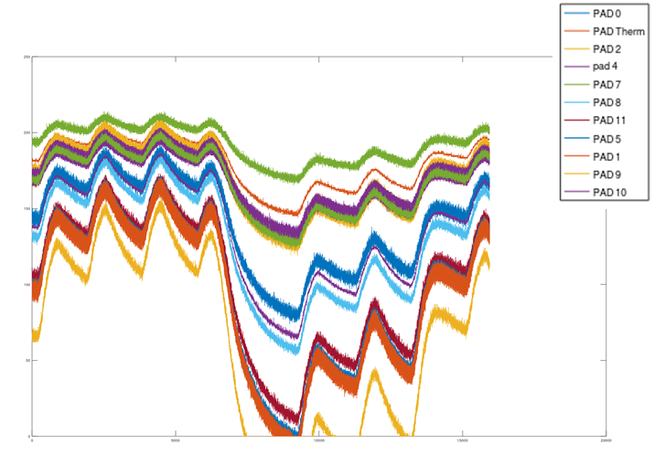
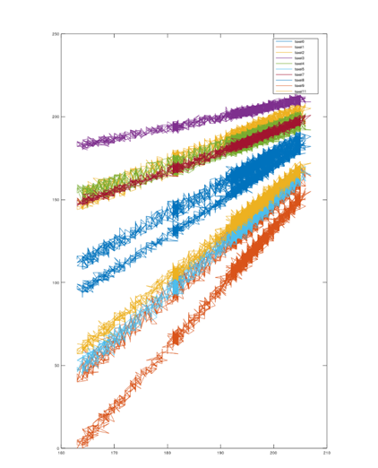
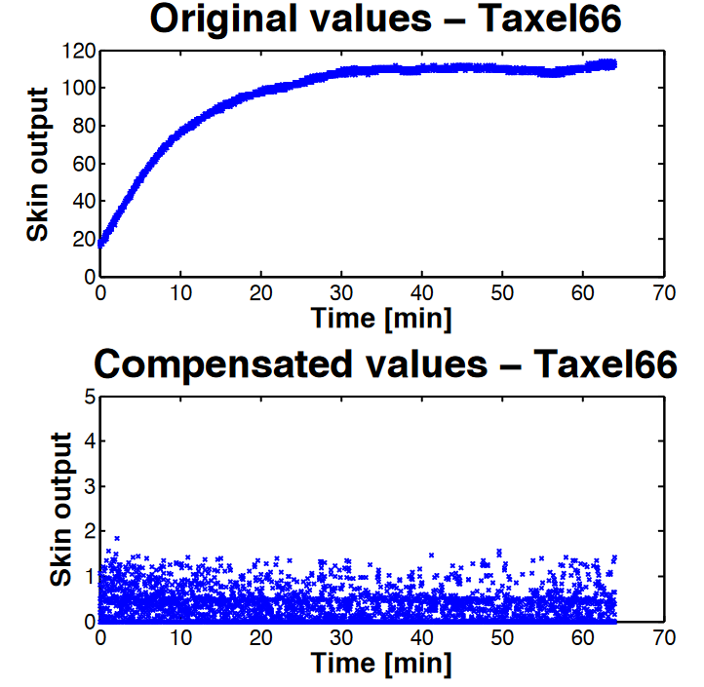
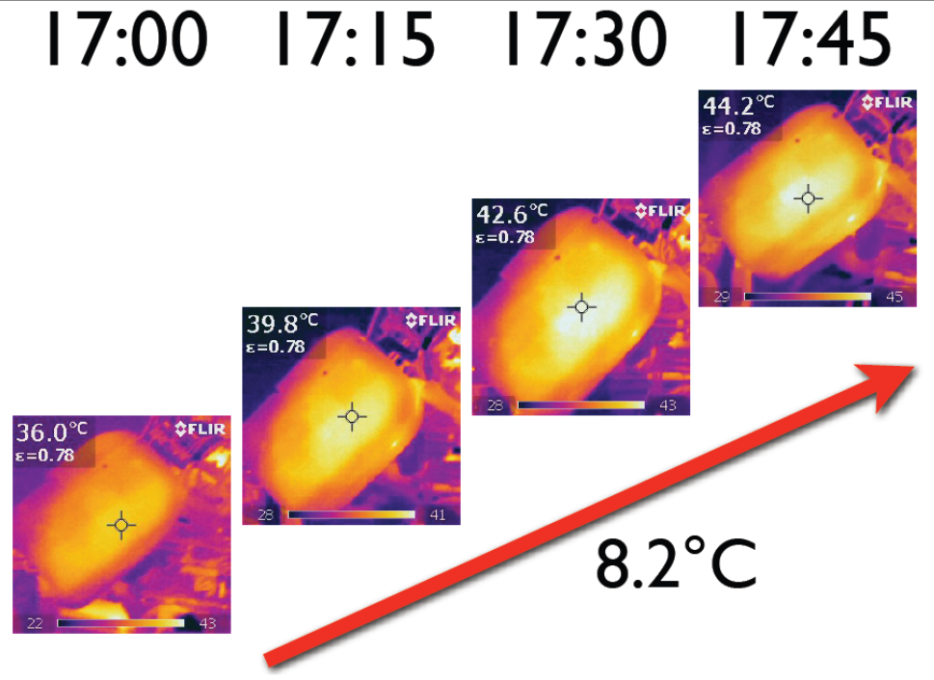
Thermal drift
The taxels measures in case a power electronics is near the skin, are affected by thermal drift, this can be compensated both by skinManager or onboard the MTB
Typical thermal drift
Calibration in climatic chamber of the temperature coefficients
Compensation works!

Slide 9
SKINmanager
The skinManager is an executable included in the icub-main repository.
Can handles multiple skin patches, it is used for handle and refine the data coming from the firmware.
It allows to:
Set a low pass filter to the data
Compute touch threshold for the taxels used by the binarization
Define skinContacts

Slide 10
SkinManager - Touch threshold
Each skin taxel is subject to a different noise hence the touch threshold should be different for each taxel. The skinManager module computes the touch thresholds (the 95% percentile) during its calibralibration phase. The touch thresholds may be retrieved sending a message ‘get percentile’ to the rpc port of the skinManager module

Slide 11
SkinManagerGui
Also this module is included in the icub-main repository, it is an handy interface for interacting with the skinManager module.
In this sense it allows to request to the skinManager to filter/compensate data and it shows errors and warning coming from the skin.

Slide 12
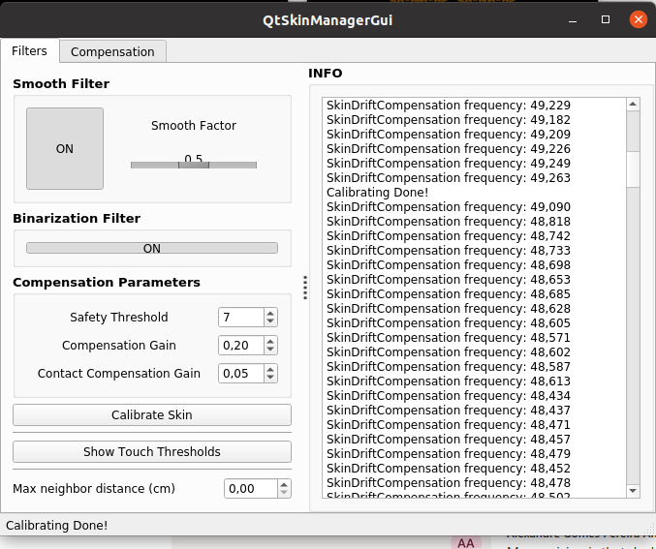
SkinManagerGui
Low pass filter, the smooth
factor goes from 0.0 to 1.0.
Greater it is, more noise is removed
but also more artifacts are added
If set to ON, the output of the *comp ports is binarized, 0.0 if there is no touch, 100.0 if there is touch.
Log messages coming from skinManager
Reset the baseline

Slide 13
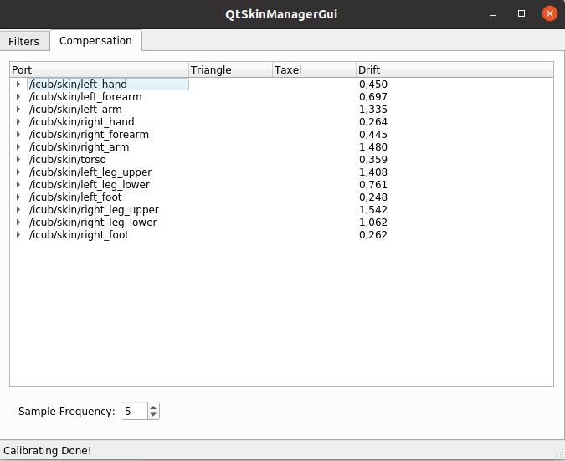
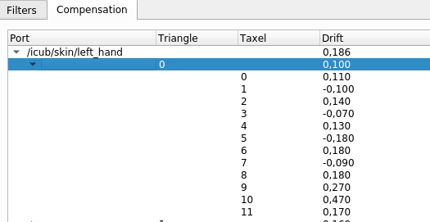
SkinManagerGui
On the Compensation tab is display the thermal drift for each skin patch.
It is possible to open the tree and check it for each triangle and each taxel.

Slide 14
Icub SKIN API
SkinContact is a C++ class part of the skinDynLib library, it represent a contact on the tactile sensor system of iCub.
It contains info such as:
Body part
Link number
Center of pressure
Normal direction
Indexes of the taxels
These SkinContact objects are streamed by the SkinManager on the port /skinManager/skin_event:o in the form of SkinContactList.

Slide 15
Icub SKIN API – Example
std::string local_name {"test"};
yarp::os::BufferedPort<iCub::skinDynLib::SkinContactList> portSc;
portSc.open(string("/"+local_name+"/skin_contacts:i").c_str());
Network::connect(portSc.getName().c_str(), "/skinManager/skin_events:o","udp");
iCub::skinDynLib::SkinContactList *scl = portSc.read(false);
if(scl != nullptr)
{
map<iCub::skinDynLib::BodyPart, SkinContactList> contactsPerBp = scl->splitPerBodyPart();
for(auto& contacts : contactsPerBp)
{
doSomethingWithSkinContact(contacts);
}
}

Slide 16
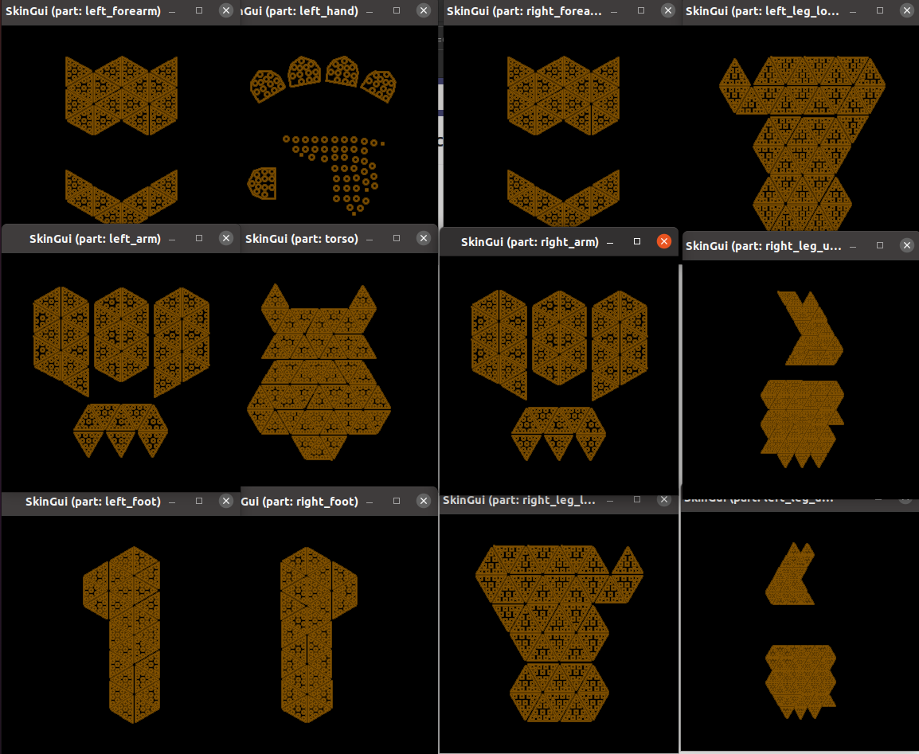
icubskingui
iCubSkinGui is a GUI to display the output of fingertips/skin tactile sensors.
It is defined by the configuration files located in
icub-main/apps/skinGui/conf/skinGui.

Slide 17
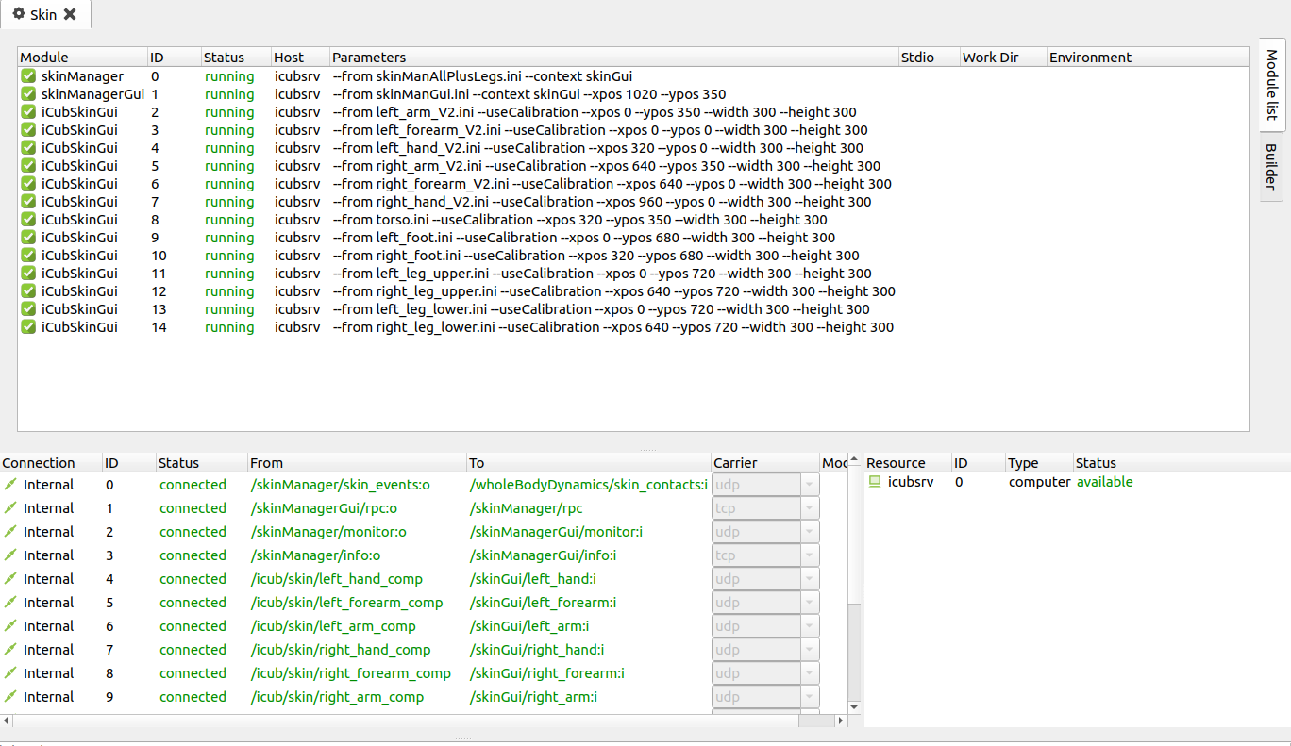
Run skin on the robot
In order to have the skin working on the robot, the relative devices has to be launched through yarprobotinterface. Once done that, running the “Skin” application in yarpmanager, it launch SkinManager, SkinManagerGui and all the iCubSkinGuis.

