Slide 1
UI Development
BUILD AN AWESOME WEBISTES

Slide 2
agenda
1) Internet
2) Websites
3) Web servers
4) Websites Development
5) Technologies involved
6) UI Technologies

Slide 3
Agenda
7) Project Development Life Cycle
8) Roles of UI Designer
9) Roles of UI Developer
10) Core Technologies of Websites
11) Tools for Web Development
12) Introduction to HTML

Slide 4

Internet

Slide 5

Web sites

Slide 6
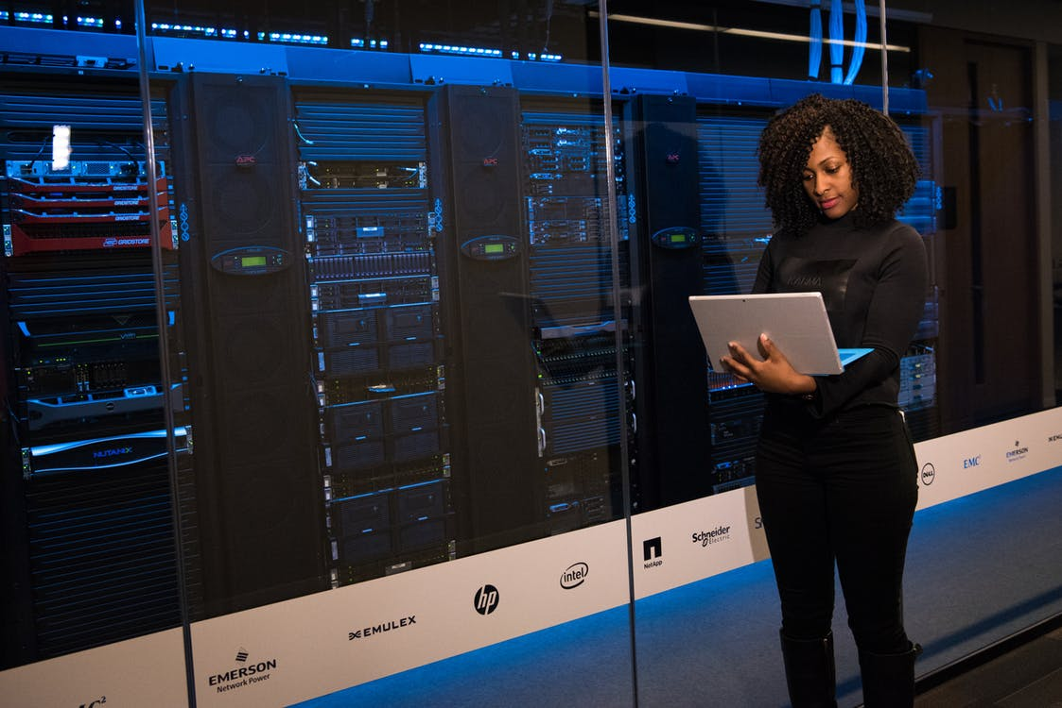
Web Servers

Slide 7

Websites Development

Slide 8









Technologies involved

Slide 9








UI Technologies

