Slide 1

GIT ASSIGNMENT
:GROUP 12

Slide 2
GROUP 12
-Piyush Agrawal
-Arun Singh
-Nitin Saxena
-Sanjay Rathore
-Gargi Sandhya
Repository Link:- https://github.com/PiyushAgrawal1243/Knoldus_KIP_Group_12.git

Slide 3
GROUP 12 PROBLEM STATEMENT
-Create and collaborate on a new empty repository on GitHub.
-Each member should make one commit each.
-This group needs to learn and discuss on the following topic - add
-You need to push the slides or the doc you create to this repository.
-Share it with the other class members.

Slide 4
Explained “GIT ADD”
The git add command adds a change in the working directory to the staging area. It tells Git that you want to include updates to a particular file in the next commit. However, git add doesn't really affect the repository in any significant way—changes are not actually recorded until you run git commit .
Syntax :-
Git add [ ]
Source : Internet

Slide 5
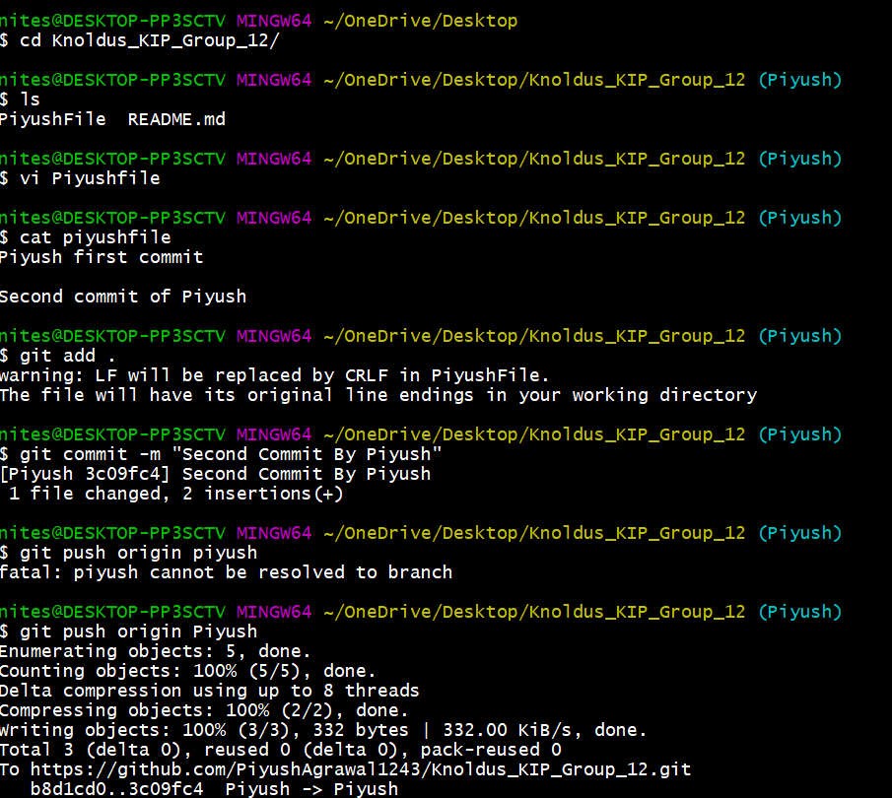
Piyush

Slide 6
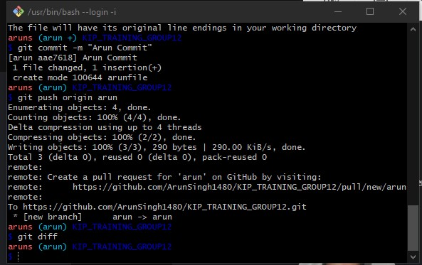
Arun Singh

Slide 7
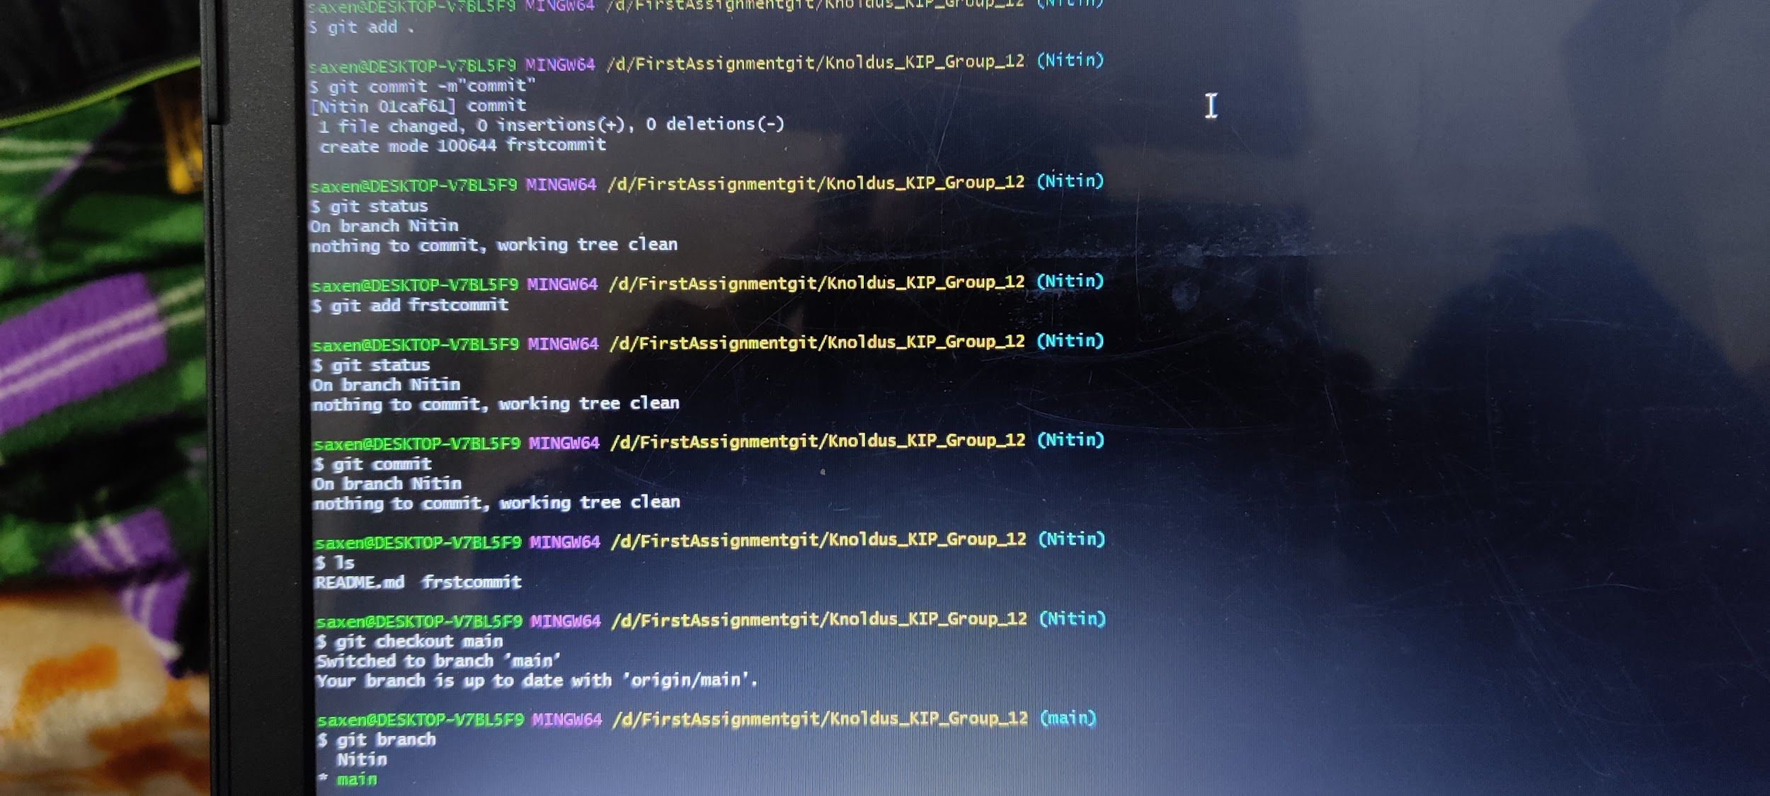
Nitin Saxena

Slide 8
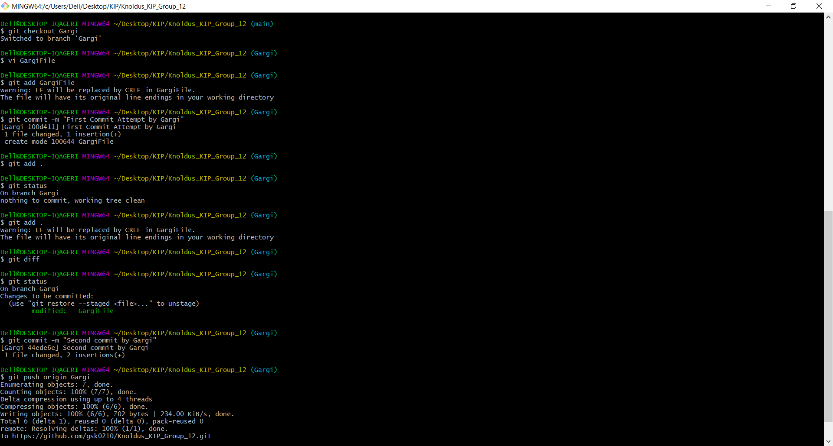
Gargi

Slide 9
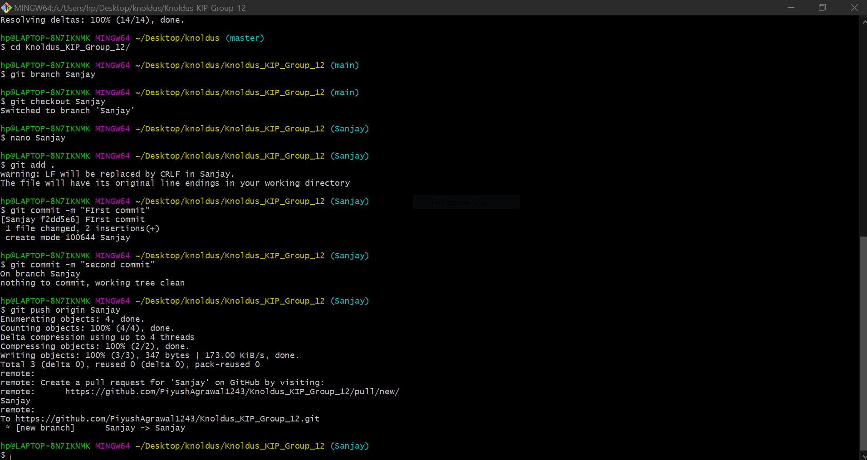
Sanjay

