Slide 1
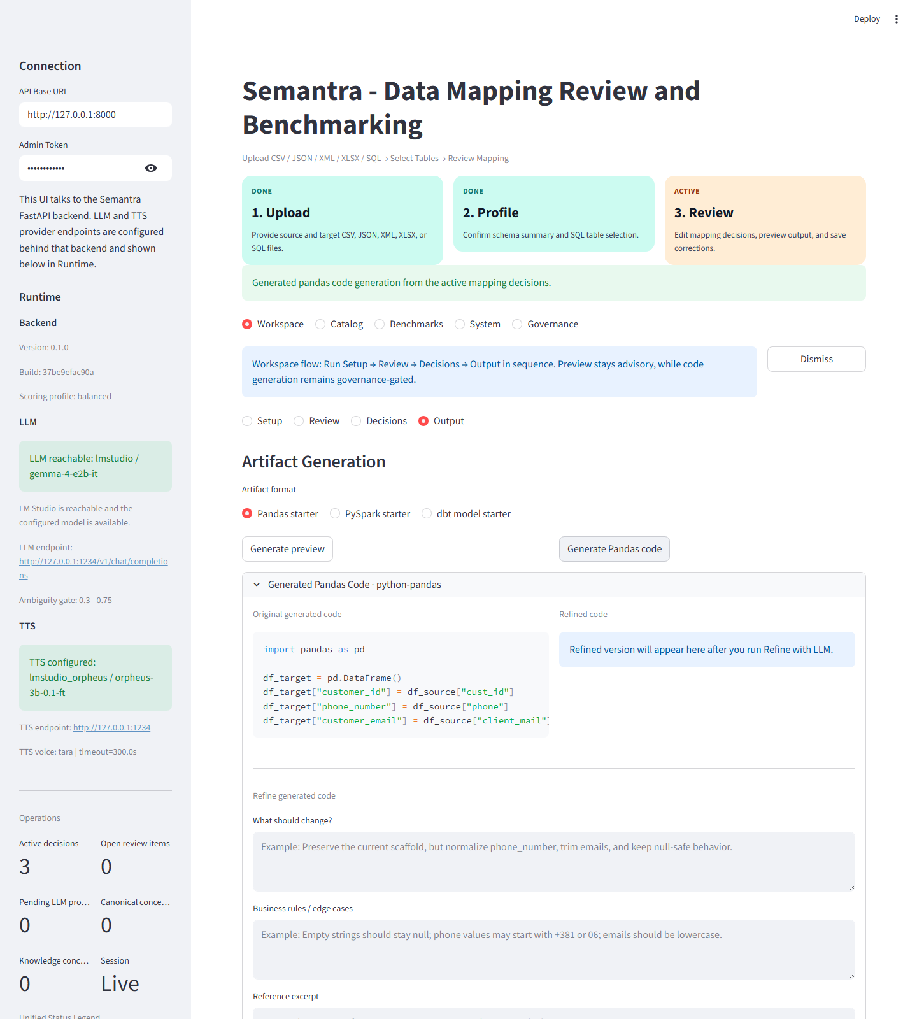
Semantra
Full menu presentation
Semantra povezuje analyst rad, quality evidence i governance odluke u jedinstven data-integration tok.
Why This Slide Matters
Radni tok: Workspace -> Catalog -> Benchmarks -> System -> Governance
Pokazuje ingestion, review, decisions, output, reuse, observability i stewardship
1/18
Notes:
Speaker note: Semantra nije samo mapper. To je kompletan radni i governance sistem za data integration, od pripreme i review-a do benchmark merenja, runtime kontrole i stewardship odluka.

Slide 2
Navigation Map
Top-level product structure
Pet glavnih zona razdvajaju analyst rad, reuse, quality telemetry, runtime kontrolu i steward odgovornosti.
Why This Slide Matters
Workspace: setup, review, decisions, output
Catalog: discovery, detail, diff, reuse, handoff
Benchmarks, System i Governance pokrivaju kvalitet, operacije i stewarding
2/18
Notes:
Speaker note: Na vrhu aplikacije postoji pet glavnih zona: Workspace, Catalog, Benchmarks, System i Governance. Time publika odmah dobija mentalni model cele aplikacije.

Slide 3
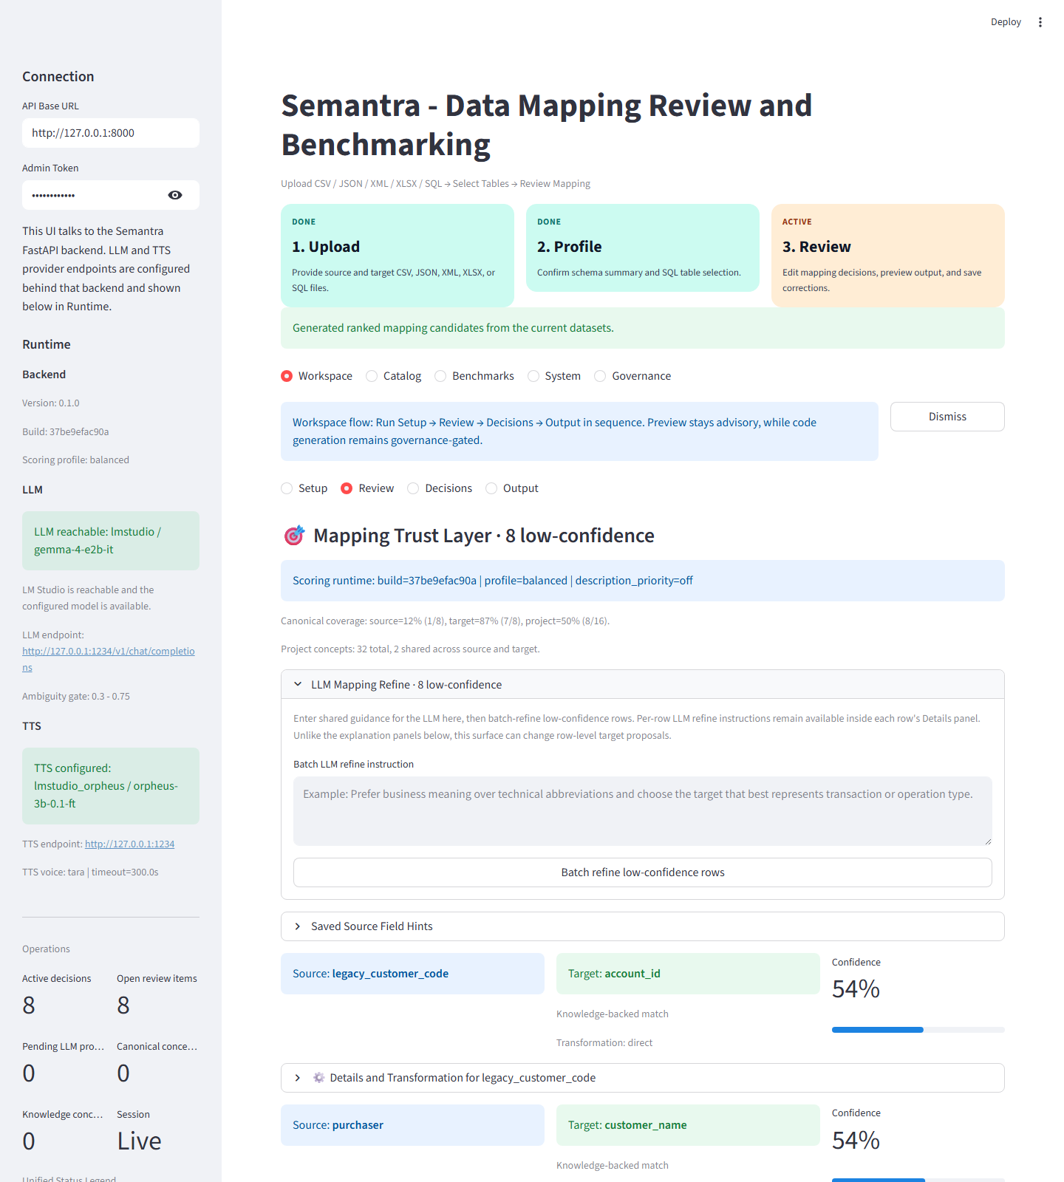
Workspace / Setup
Upload and interpret source inputs
Setup pokriva standardni two-file mapping i canonical-only tok, uz razlikovanje row-data i schema-spec inputa.
Why This Slide Matters
Mapping mode: Standard ili Canonical
Source/Target upload i profiling
Source mode i Target mode za data vs. schema spec
3/18
Notes:
Speaker note: Setup je mesto gde pocinje rad sa podacima. Ovde korisnik bira da li radi standardni two-file mapping ili canonical-only tok, i ovde sistem tumaci da li je fajl row data ili schema spec.

Slide 4
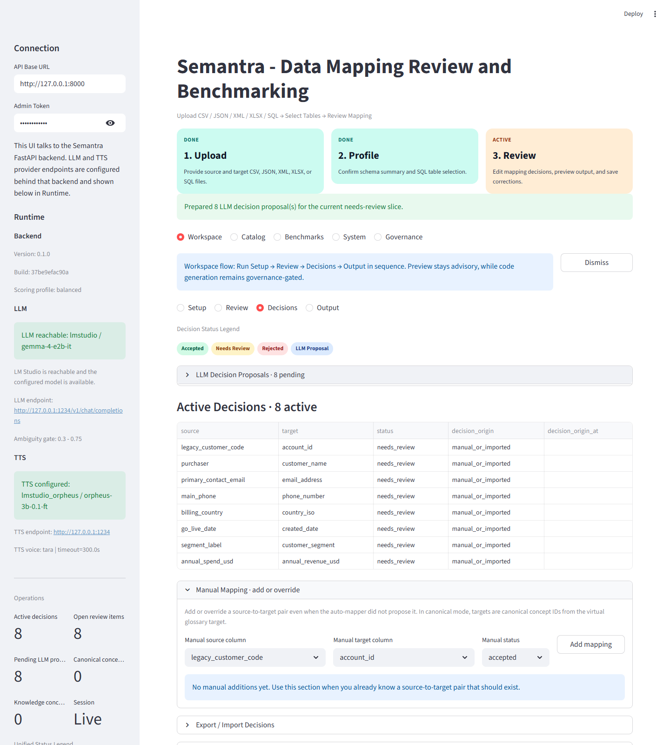
Workspace / Review
Trust-layer analyst review
Review prikazuje kandidate, coverage, knowledge i LLM signale, ali zadrzava bounded analyst-centered tok odluka.
Why This Slide Matters
Mapping Trust Layer i review prioritizacija
Review Queue Plan za fokus rada
LLM Decision Proposals kao bounded pomocni sloj
4/18
Notes:
Speaker note: Review je analyst-centered trust layer. Tu se vide kandidati, coverage, knowledge i LLM signali, kao i review prioritizacija kroz queue plan.

Slide 5
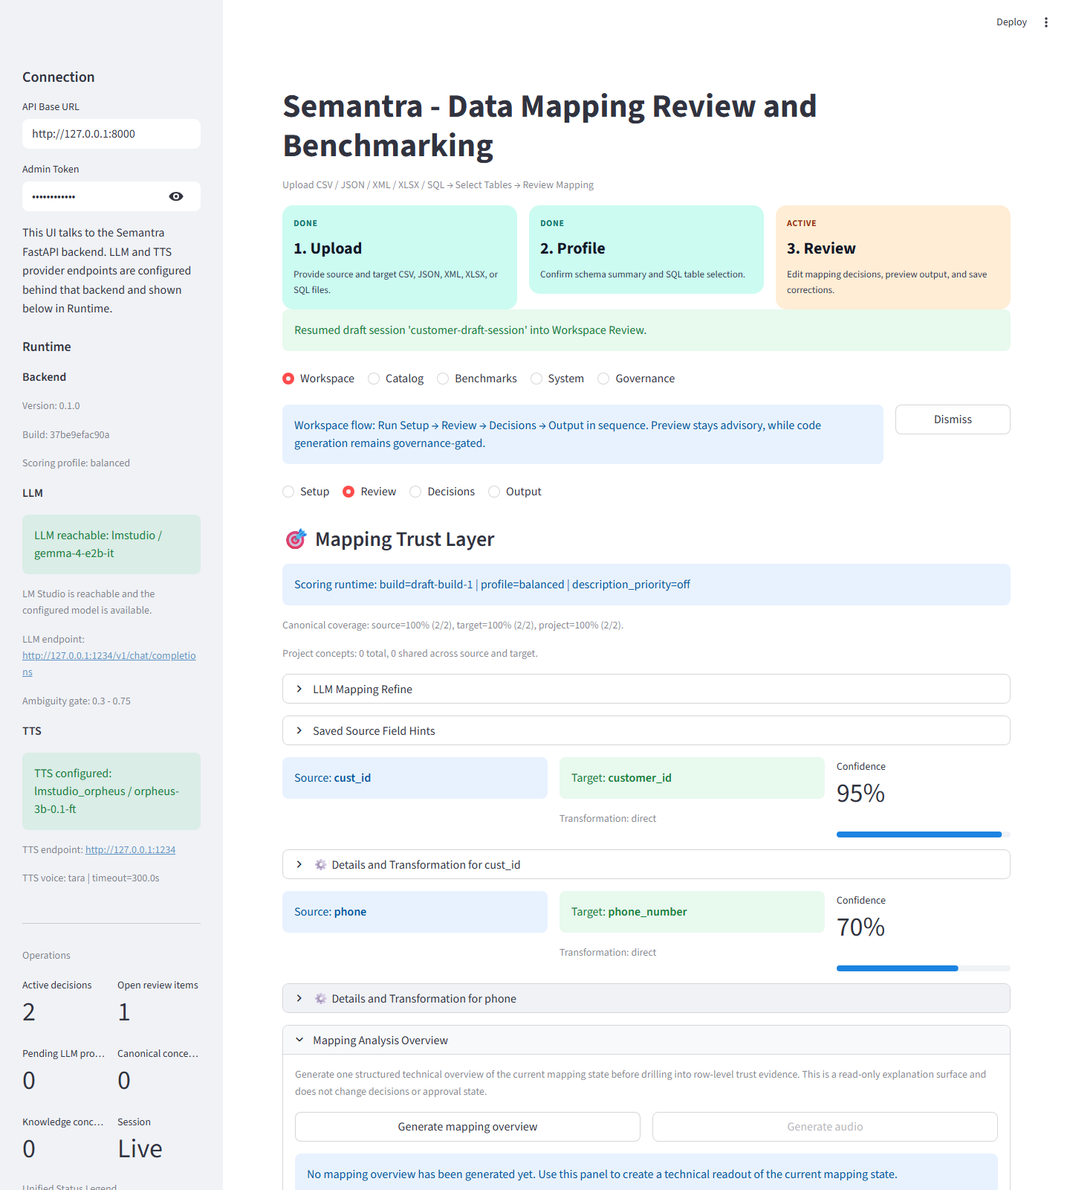
Workspace / Decisions
Persist and resume analyst decisions
Decisions pretvara review state u trajne ili polutrajne odluke kroz overrides, imports, versions i draft sessions.
Why This Slide Matters
Manual overrides i import/export povrsine
Mapping Set Versions i draft-session restore
Continuity rada bez gubitka konteksta
5/18
Notes:
Speaker note: Decisions je prelaz iz review-a u trajne ili polutrajne odluke. Tu se cuvaju manual overrides, import/export stanja, mapping set verzije, draft sessions i correction tokovi.

Slide 6
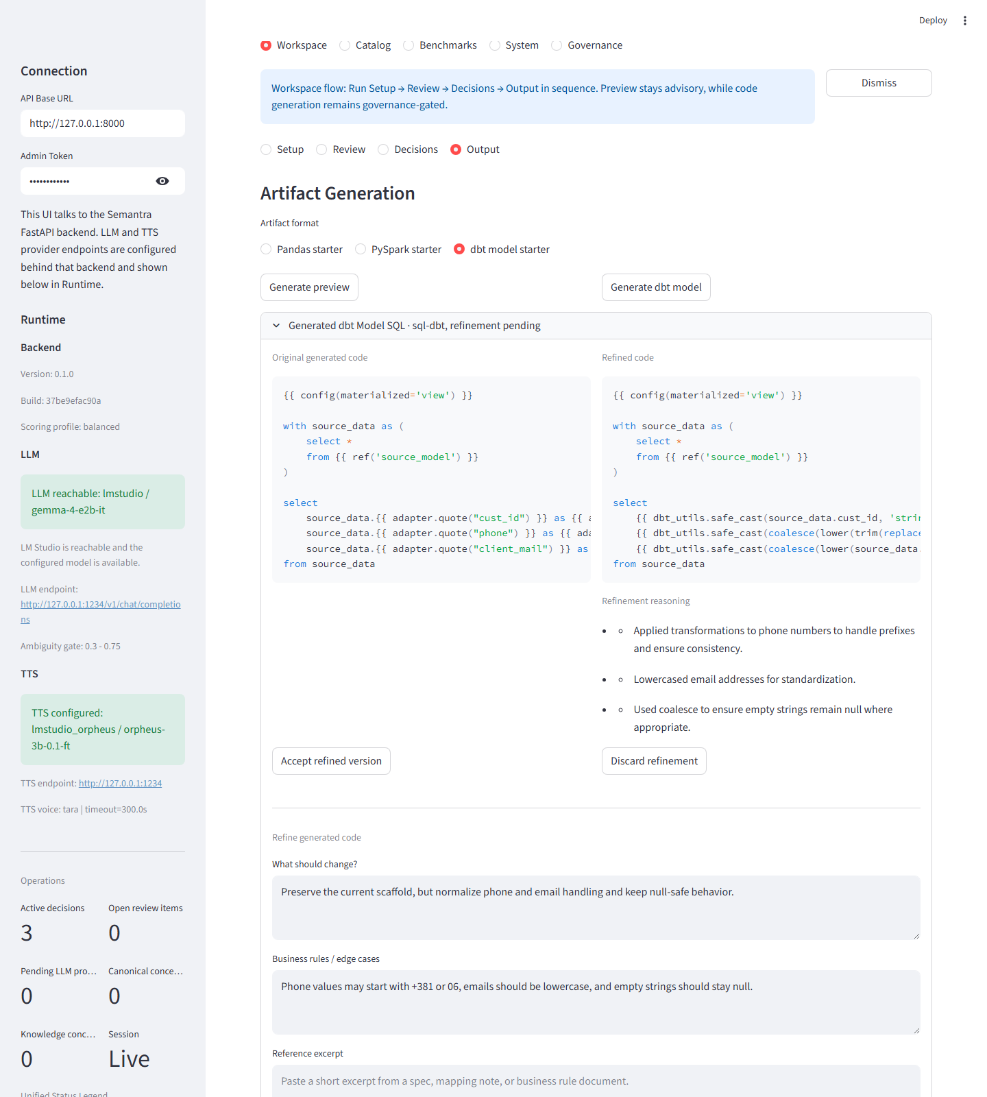
Workspace / Output
From mapping state to dev artifacts
Output zatvara analyst tok kroz preview, Pandas, PySpark, dbt i LLM refinement artefakte.
Why This Slide Matters
Preview za standardni mapping
Artifact format za Pandas, PySpark i dbt
Refinement kao dodatni polish korak
6/18
Notes:
Speaker note: Output pretvara aktivni mapping state u razvojne artefakte. Iz istog radnog stanja mogu da nastanu preview, Pandas, PySpark ili dbt izlazi, plus refinement kada je potreban.

Slide 7
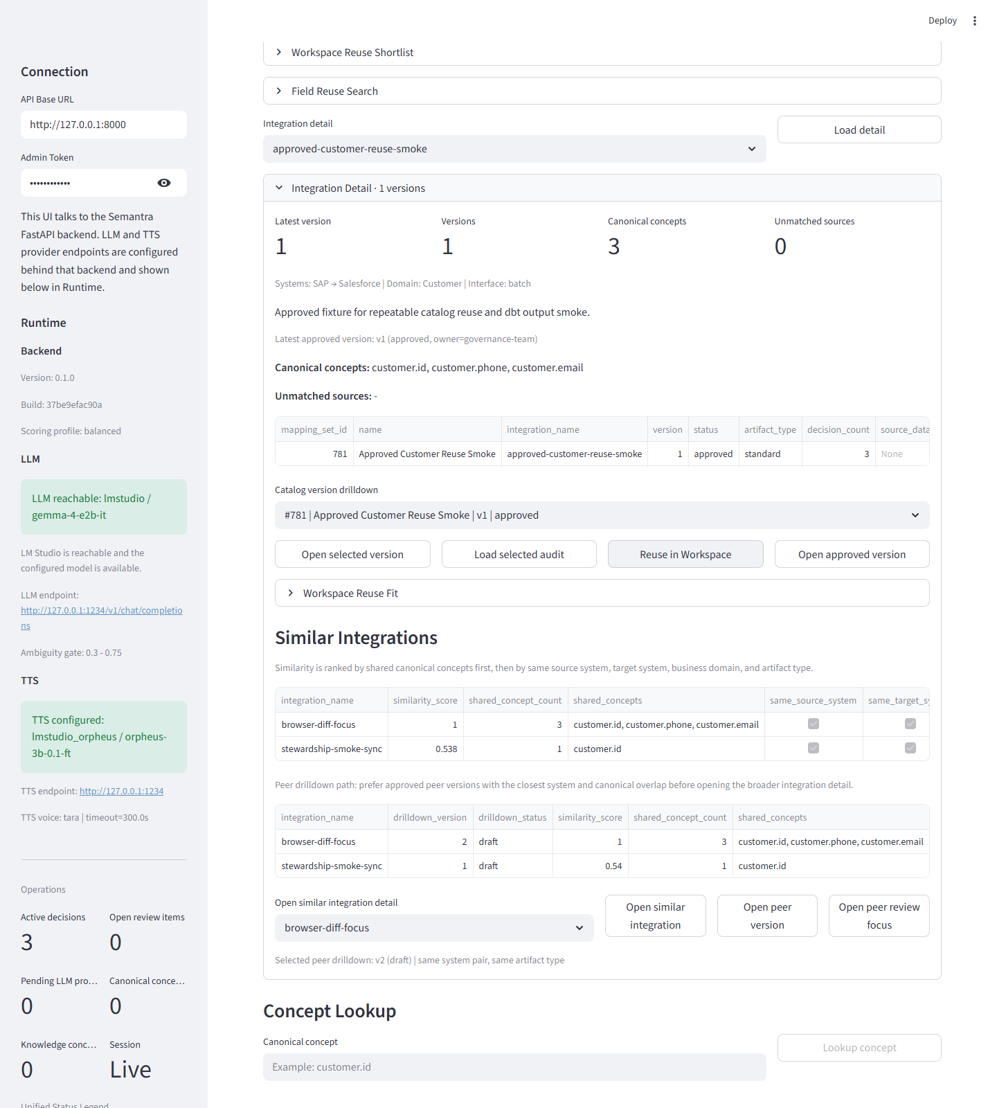
Catalog / Search and Discovery
Reusable integration knowledge
Catalog omogucava discovery reusable integracija po sistemima, domenu, statusu i canonical kontekstu.
Why This Slide Matters
Search and Filters za system/domain/owner/status
Discovery Overview i Integration Results
Reuse shortlist i system-pair pregled
7/18
Notes:
Speaker note: Catalog je reuse i discovery biblioteka integracionog znanja. Pretraga radi po sistemima, domenu, statusu, owner-u i canonical signalima, pa korisnik ne mora da krece od nule.

Slide 8
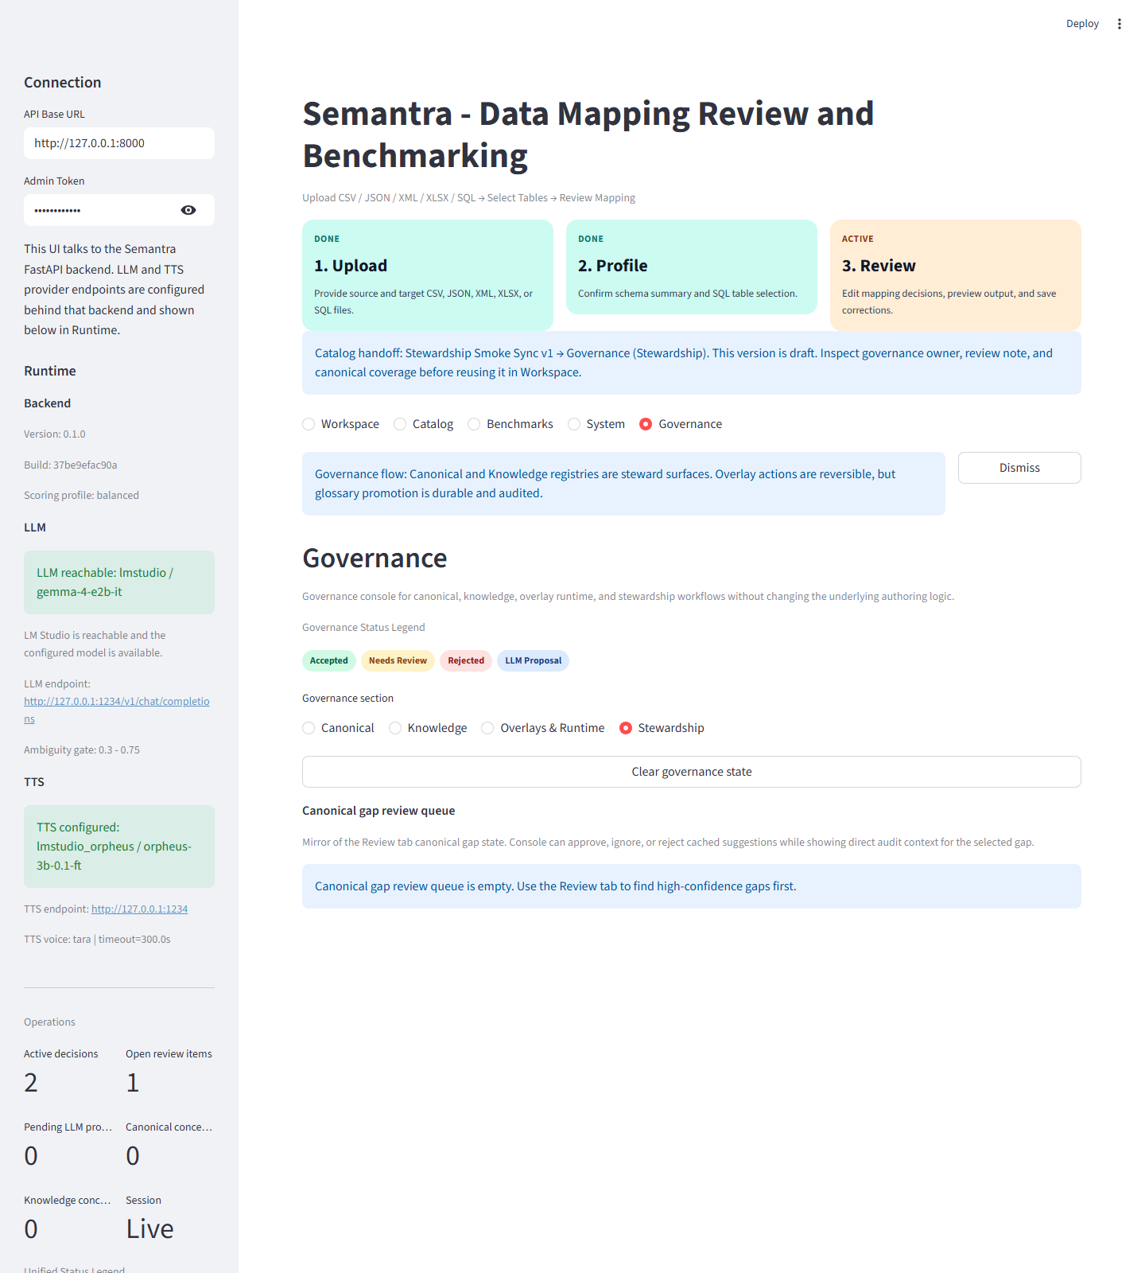
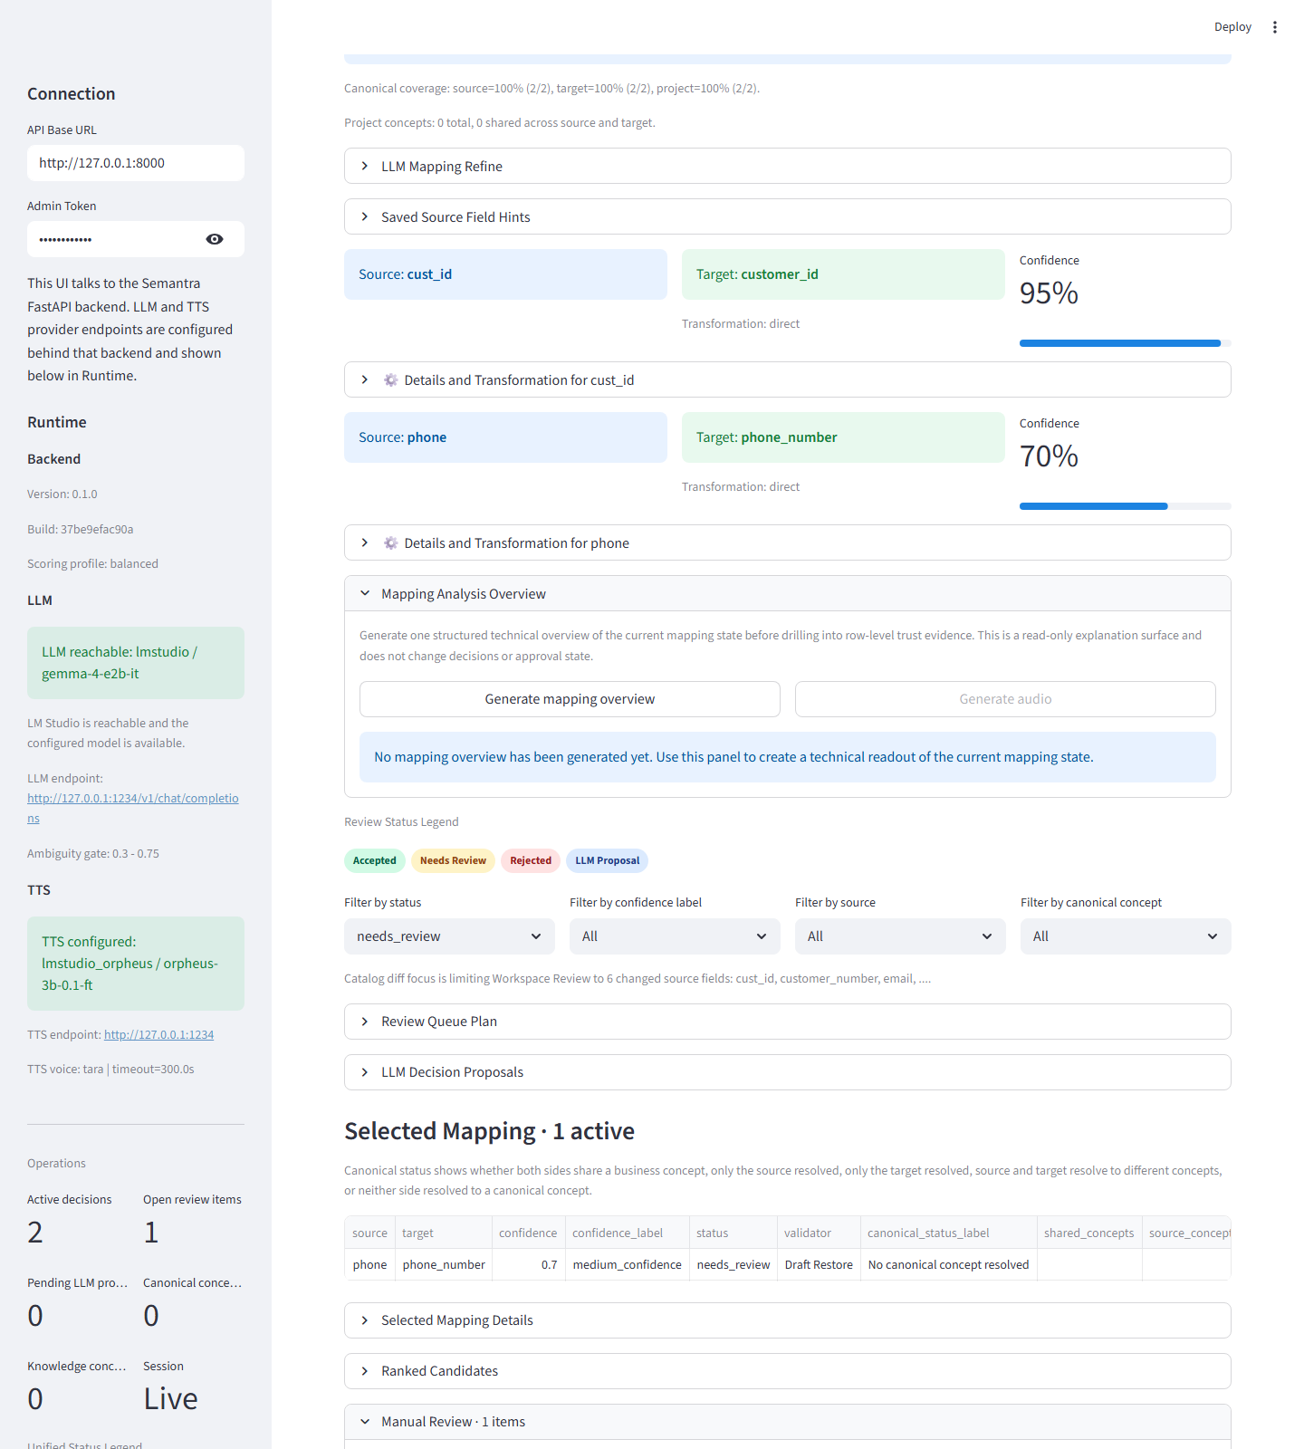
Catalog / Detail, Diff and Handoff
Move from stored assets into live work
Catalog nije pasivan: iz njega se ulazi u Workspace reuse, diff review i governance handoff tokove.
Why This Slide Matters
Approved reuse u Workspace
Version diff i Workspace Review handoff
Stewardship handoff u Governance
8/18
Notes:
Speaker note: Kada otvorimo konkretan asset, Catalog postaje ulaz u sledeci korak rada. Iz njega mozemo da uradimo reuse u Workspace, diff handoff u Workspace Review ili governance handoff u Stewardship.

Slide 9
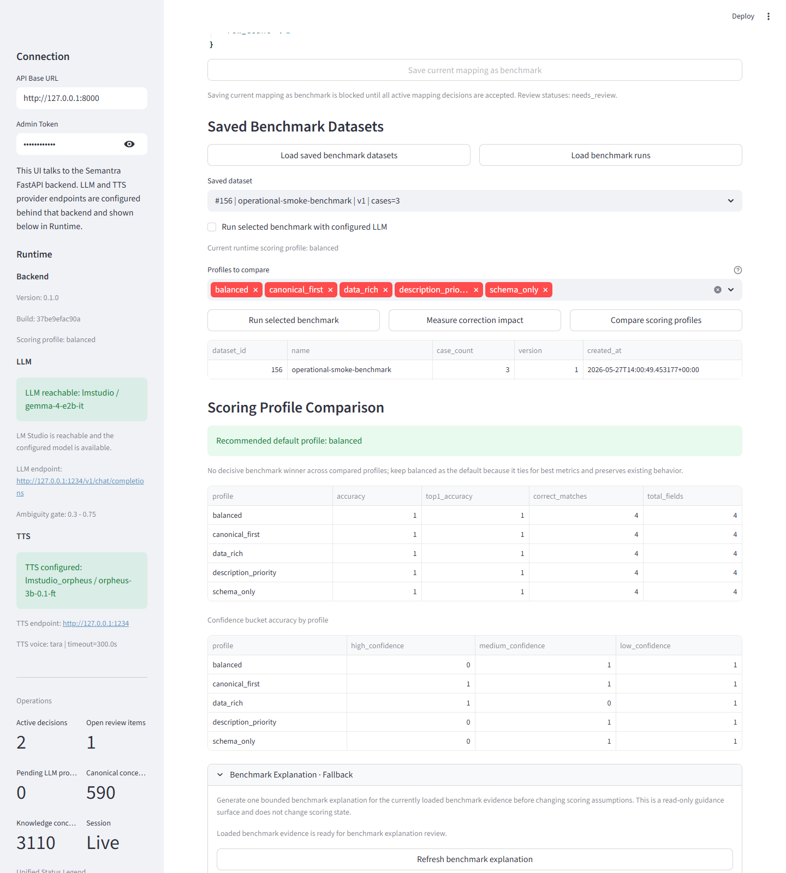
Benchmarks / Datasets and Runs
Persistent quality evidence
Benchmarking pocinje od cuvanja mapping stanja kao evaluation dataset-a i vracanja istorije run-ova.
Why This Slide Matters
Save current mapping as benchmark
Load saved benchmark datasets
Load benchmark run history
9/18
Notes:
Speaker note: Benchmarks pocinju od cuvanja mapping stanja kao benchmark dataset-a i od ucitavanja prethodnih run-ova. To znaci da evaluacija nije jednokratna demonstracija, vec trajni kvalitetni signal.

Slide 10
Benchmarks / Profile Comparison
Explainable scoring recommendations
Benchmarks ne daju samo metriku, vec i preporuceni scoring profil sa objasnjenjem, rizicima i sledecim koracima.
Why This Slide Matters
Scoring Profile Comparison
Recommended default profile
Benchmark Explanation sa findings i risks
10/18
Notes:
Speaker note: Kada benchmark dataset postoji, mozemo da uporedimo vise scoring profila i da dobijemo preporuceni default. Posle toga explanation prevodi metrike u razumljiv poslovni razlog.

Slide 11
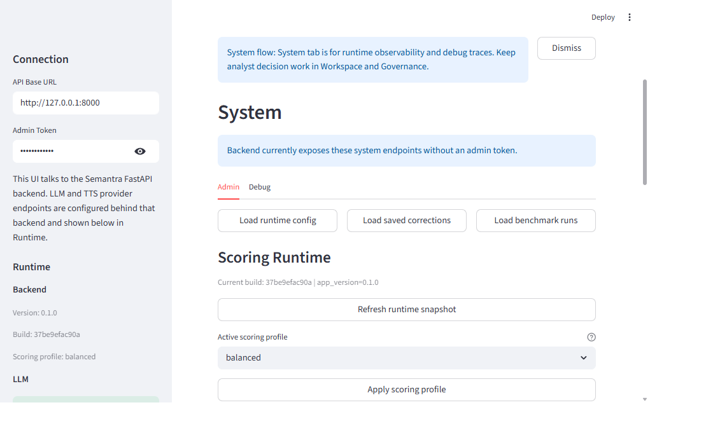
System / Admin
Runtime operations and control
System Admin je kontrolna tabla za runtime config, scoring profil, corrections i benchmark-run administraciju.
Why This Slide Matters
Load runtime config, saved corrections i benchmark runs
Scoring Runtime sa aktivnim profilom
Apply scoring profile za nove mapping prolaze
11/18
Notes:
Speaker note: System Admin je runtime administracija. Tu se ucitava runtime config, vide saved corrections i benchmark runs, i menja aktivni scoring profil za nove mapping prolaze.

Slide 12
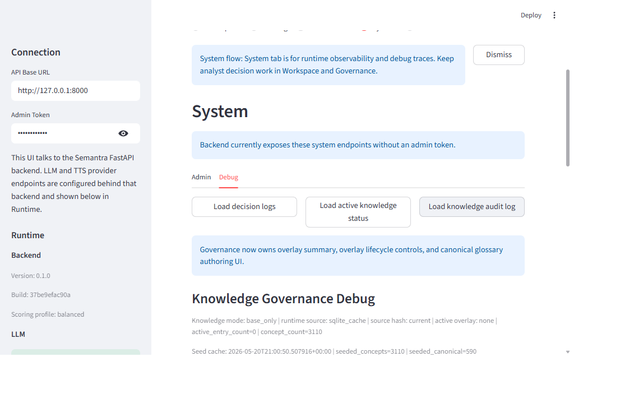
System / Debug
Structured observability
System Debug objedinjuje decision logs, knowledge runtime status, audit log i coverage debug pogled nad aktivnim mapping stanjem.
Why This Slide Matters
Decision logs i knowledge runtime status
Knowledge audit log
Coverage and match insights za troubleshooting
12/18
Notes:
Speaker note: System Debug je observability povrsina. Tu se vide decision logs, aktivni knowledge runtime, audit log i canonical coverage/debug insighte nad trenutnim mapping stanjem.

Slide 13
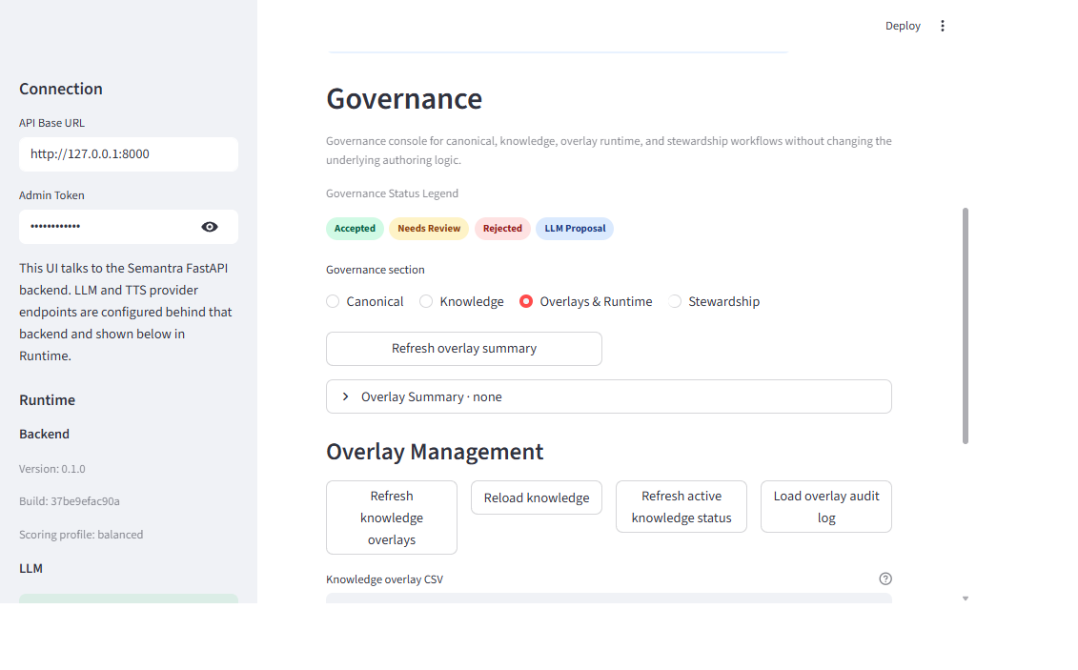
Governance Overview
Steward console structure
Governance razdvaja cetiri odgovornosti: Canonical, Knowledge, Overlays & Runtime i Stewardship.
Why This Slide Matters
Canonical za stabilni glossary
Knowledge za radni registry pojmova
Overlays & Runtime i Stewardship za operativno upravljanje promenama
13/18
Notes:
Speaker note: Governance je steward konzola sa cetiri sekcije: Canonical, Knowledge, Overlays & Runtime i Stewardship. Ovaj slajd sluzi da publika shvati da governance nije jedan ekran.

Slide 14
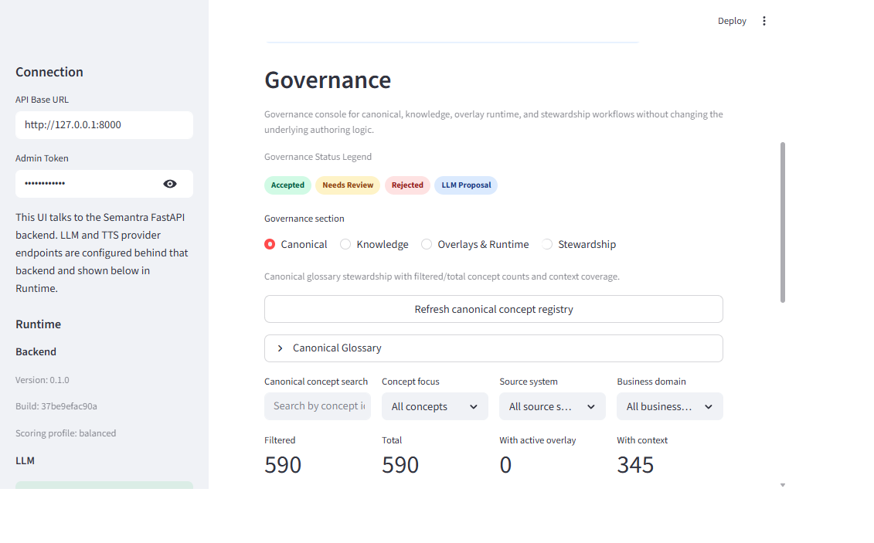
Governance / Canonical
Stable glossary stewardship
Canonical sekcija upravlja stabilnim konceptima, aliasima i promotion-ready signalima koji imaju dugorocan efekat.
Why This Slide Matters
Canonical Glossary
Concept details, aliases i context coverage
Promotion-oriented governance tokovi
14/18
Notes:
Speaker note: Canonical je stabilni glossary sloj. Tu se upravlja canonical konceptima, aliasima, coverage kontekstom i promotion-ready signalima.

Slide 15
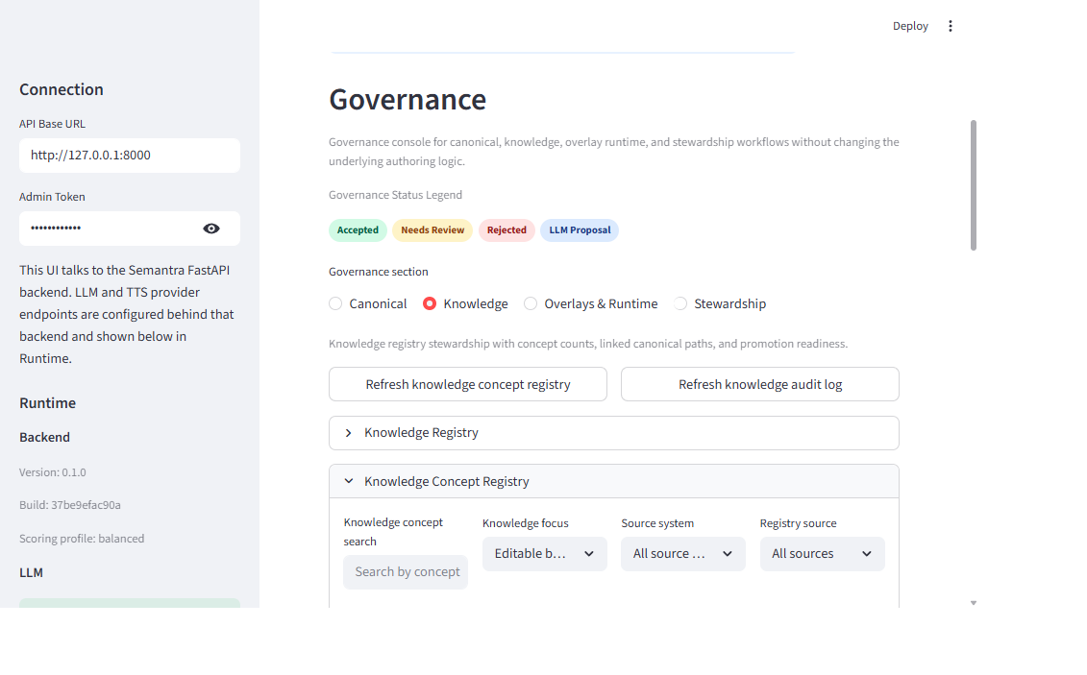
Governance / Knowledge
Operational knowledge registry
Knowledge sekcija povezuje realne integracione izraze sa canonical slojem i omogucava postepenu steward normalizaciju.
Why This Slide Matters
Knowledge Registry i Knowledge Concept Registry
Linked canonical paths
Promotion readiness i review detalji
15/18
Notes:
Speaker note: Knowledge cuva radni registry pojmova blizih stvarnim integracionim izrazima. On povezuje operativno znanje sa canonical slojem.

Slide 16
Governance / Overlays & Runtime
Reversible runtime knowledge changes
Overlays & Runtime obezbedjuje brz, reverzibilan i auditabilan sloj za runtime promene bez direktnog menjanja stabilnog glossarya.
Why This Slide Matters
Overlay Summary i active overlay status
Overlay lifecycle: refresh, reload, audit
Runtime-aware knowledge management
16/18
Notes:
Speaker note: Overlays & Runtime sluzi za kontrolisane i reverzibilne promene znanja koje uticu na runtime bez direktnog menjanja stabilnog glossarya.

Slide 17
Governance / Stewardship
Queue-based follow-up and decisioning
Stewardship pretvara operativne signale i gapove u auditabilne approve/reject/ignore odluke.
Why This Slide Matters
Queue status i selected item detail
Review note i proposal-state signal
Approve/reject/ignore tokovi za governance follow-up
17/18
Notes:
Speaker note: Stewardship je radna lista governance follow-up stavki. Tu steward vidi gapove, review note, queue statuse i odluke za promotion, reject ili ignore.

Slide 18
Closing
One integrated operating model
Semantra povezuje ingestion, review, decisions, output, reuse, benchmark evidence, runtime kontrolu i governance upravljanje u jedan tok.
Why This Slide Matters
Catalog vraca korisnika u Workspace
Benchmarks objasnjavaju kvalitet odluka
Governance pretvara operativne signale u trajno upravljano znanje
18/18
Notes:
Speaker note: Zakljucak prezentacije je da Semantra pokriva ceo zivotni ciklus: ingestion, review, decisions, output, reuse, benchmark evidence, runtime kontrolu i governance upravljanje znanjem.

